Slide 1
Tableau APIs and Use Cases
DC/ MD/ VA Regional TUG
June 3rd 2020

Slide 2

Hi! I am Viraj Deshpande
My ikigai (Japanese word for ‘reason for being’) is learning to create and creating to learn.
Moved to USA
Started writing a blog – documenting my escapades with data
www.datavizardry.org
Started working at
Blend360
Dec
2018
Dec 2019
June 2020
Aug 2018
Feb
2019
Feb 2020
Introduced to Tableau!
Graduated!!
Master of Science
Information Systems
TUG - 2020
My first TUG event!

Slide 3
Tableau APIs
Why?
Programmatically control Tableau Server components/ resources
More granular control over the users interaction with server
Automating tasks
Create custom apps
REST
WebHooks
Extract
Hyper
Managing users
Creating/ updating Groups
Updating workbooks/ data sources
Read/ write/ update .hyper files
Stay informed of the updates to your Tableau Online via SMS/ Email notifications

Slide 4








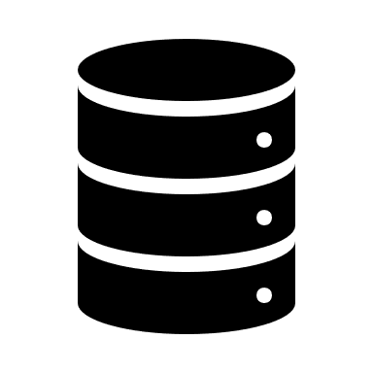



tableauserverclient
tableauhyperapi
pantab
pandas
tableau_api_lib
smtplib
A complete data prep, querying, updating & publishing solution
Python
Workflow
Publish the .hyper data sources using relevant project-id
Filter views/dashboard & export pdf
Sign into Tableau Server using TSC
Locate the .csv file
Read the file into pandas data-frame
Refresh the workbook
Email the report(s) to stakeholder
Query Tableau Online for project-id/ workbook-id/ view-id

Slide 5












Workflow
Create .hyper file
Use hyper API in Python
Locate .hyper file
Update/Append/Aggregate Data
Publish Data-source
Locate data file (csv)
Update/Append Data
Save the file
Open Tableau and connect to the data file
Create Tableau Data Extract
Wait for extract to complete
Publish Online

Slide 6
Demo!

Slide 7




Closing Notes
This workflow was born out of an in-progress reporting automation effort for a client looking to automate their Business Intelligence pipeline
Requirement – Schedule delivery of comprehensive and tailored Tableau reports for sales representatives spread across USA
Solution – Workflow automation at the intersection of ETL and BI tools like Alteryx, Tableau; Facilitated by environments like Python, Command Line, Bash scripts
Connect - blend360.com/contact-us
Questions?
Let’s get in touch!
bit.ly/viztableau
@viraj155
facebook.com/viraj.deshpande155/
bit.ly/viraj_linkedin
github.com/viraj1596

