Slide 1
Analysis of queuing services in a distributed architecture
Under the guidance of Prof. Gokay Saldamli
Team Members:
Sanjay Nag Bangalore Ravishankar
Atish Maitreya
Viraj Upadhyay
Daniel Sampreeth Reddy Eadara

Slide 2
Message queues
Distributed systems.
Mode of asynchronous communication between distributed systems.
Pull and Push type message queues.
Offer storage, processing depth, reliability and Scalability.
Ex: Kafka, RabbitMQ, Amazon SQS.

Slide 3
Project overview
Analyze and test Amazon SQS and Kafka messaging queues in a distributed system.
Create an application to benchmark.
Document the process and results.
Detailed research paper involving performance results and analysis.

Slide 4
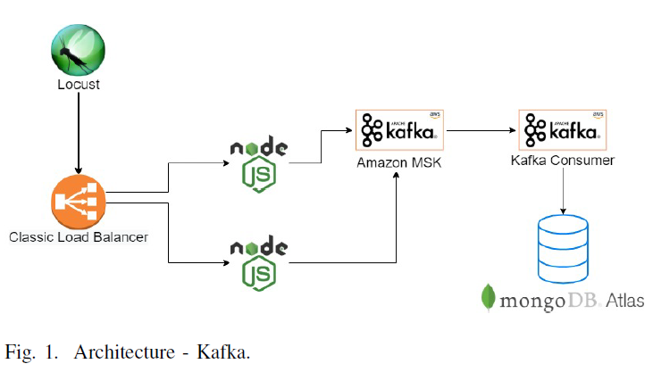
Project Architecture - Kafka

Slide 5
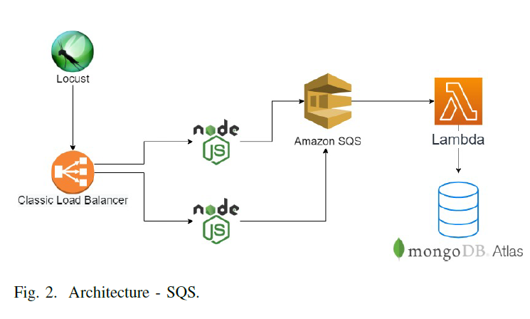
Project Architecture - Amazon SQS

Slide 6
Evaluation methodology
Deployment on Amazon web services
Benchmarking
Database used - MongoDB
Automated load testing using the service Locust

Slide 7
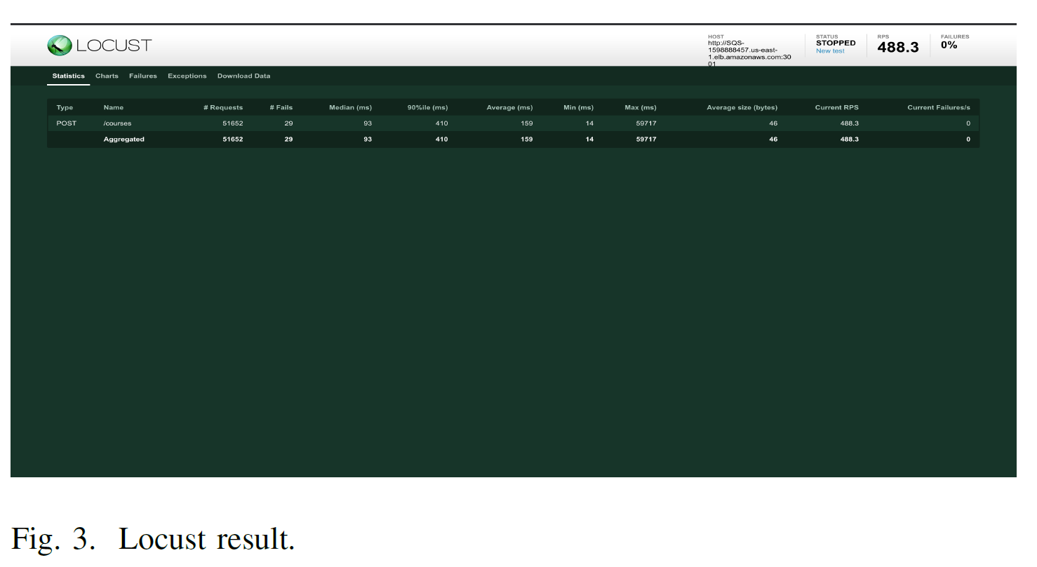
Amazon SQS

Slide 8
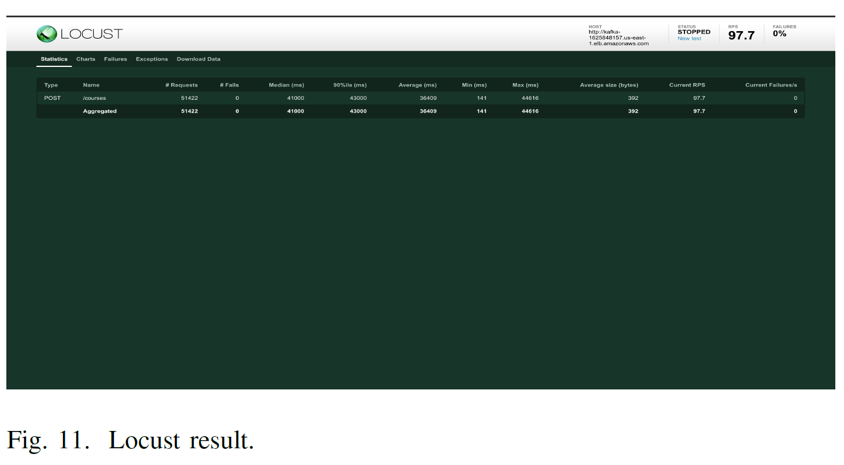
Kafka

Slide 9
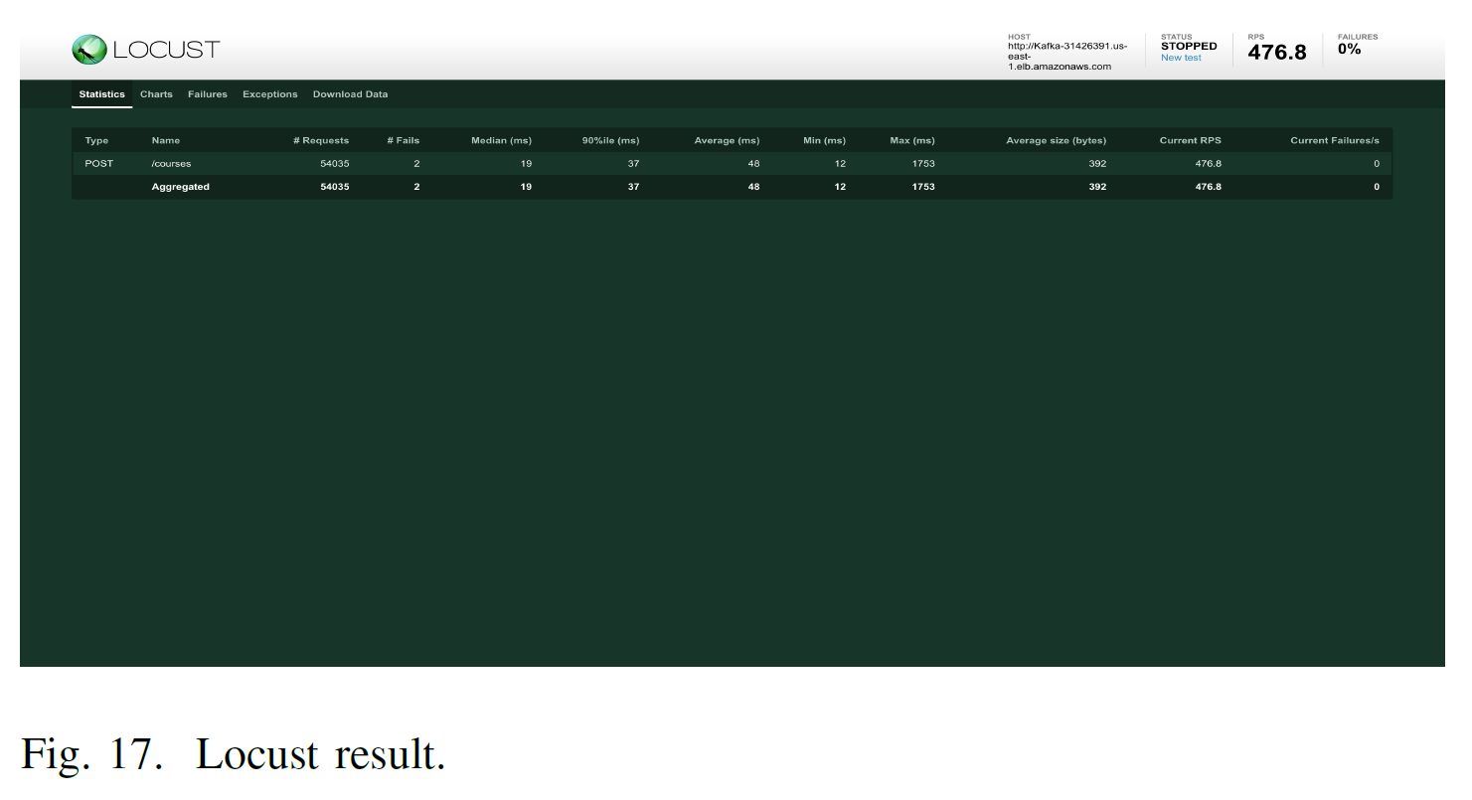
Kafka Optimized

Slide 10
Comparison
Response time of Kafka is better.
SQS failed on 29 requests while Kafka failed 2.
Kafka throughput is better
Kafka is heavier on the database connections due to throughput
SQS is much easier to implement
Kafka’s price depends on the instance of usage and storage

Slide 11
Conclusion
Kafka: Performs better if overall response time, failure rate and throughput is taken into consideration.
SQS: Performs better if the database doesn’t support huge number of connections.
Kafka is more cost efficient if the traffic is more

Slide 12
Thank you

