Slide 1
Utopia, an Alexa Skill
Project Team 12
Kevin Chuang
Viraj Upadhyay
Rohit Sharma
Varun Khatri

Slide 2

“According to the World Health Organization, 350 million people worldwide suffer from depression. Depression is the leading cause of disability.”

Slide 3
Introduction
Utopia is the name of the Alexa skill that is designed to help people cope with depression.
Disclaimer: Utopia is not meant to be a substitute for professional medical advice, treatment or diagnosis. It is more of a supplemental and informational helper to mitigate depression. The people who programmed this are not experts in mental illnesses such as depression, and this is a product of our subjectivity and couple months of basic research on depression.

Slide 4
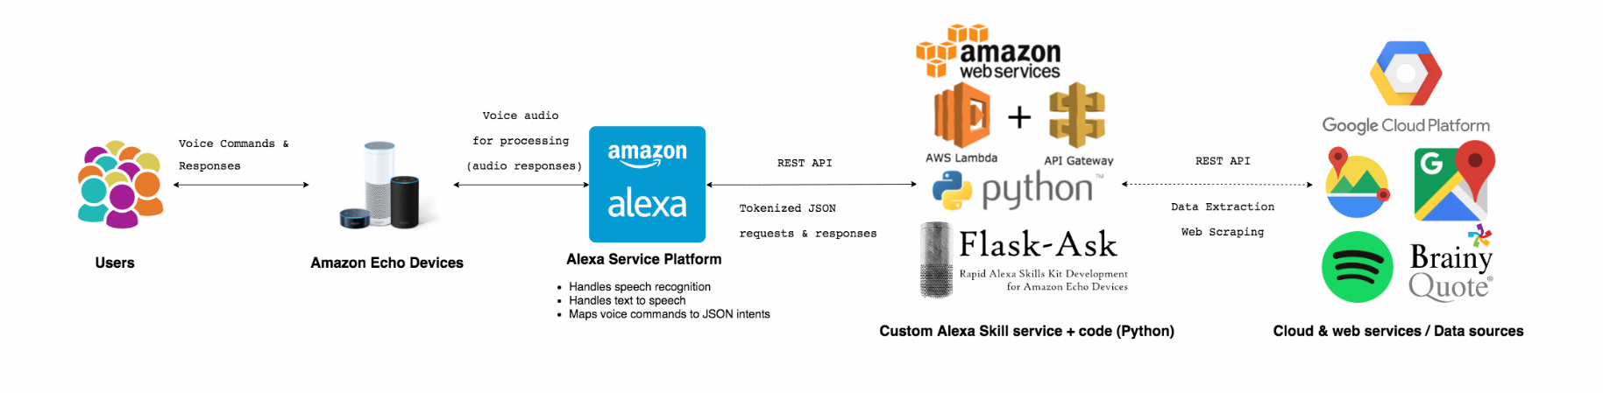
Architecture

Slide 5
Technology
Utopia is powered by Python, Flask-Ask (an extension of Flask, a micro web framework), and the Alexa Skills Kit.
Alexa Skills Kit (ASK)
Custom Interaction Model
Invocation (Utopia)
Custom Intents
Each feature is implemented as a custom intent
Custom Slot Types
Endpoint
Alexa sends requests to the endpoint
Options:
ngrok for secure local tunneling
AWS Lambda function - event driven, serverless computing platform

Slide 6
Features
Hamilton Depression Rating Scale Survey consisting of 16 questions to analyze and evaluate level of depression.
Added three bonus questions that uses NLTK sentiment analysis to contribute to the survey score.
Grab and read different types of quotes from BrainyQuote
A few popular categories of quotes include positive, motivational, inspirational, family, love, and positive.
Give advice and ideas for activities to improve mood
Examples include:
Listen to music that makes you feel good.
Take note of all the small things you've accomplished today.
Recommend therapists nearby using Google Places API by providing contact information, current availability, and open hours.
Finds nearby available therapists
National Suicide Prevention Lifeline
If certain trigger words are said, automatically trigger and provide user with contact information for the suicide hotline.
Trigger words include:
I want to kill myself, I give up, I have been thinking about suicide, etc.

Slide 7


Testing & Code Coverage
Travis CI (travis-ci.org)
Hosted, distributed continuous integration service that builds and tests software in a virtual environment hosted on GitHub with every commit
Set up using .travis.yml configuration file (set up environment variables, install necessary dependencies, etc.)
Used test build and run test cases (pytest) for main application code
https://travis-ci.org/k-chuang/utopia-alexa-skill
Codecov (Codecov.io)
Free, open source code coverage reporting tool that integrates with GitHub and Travis CI
Measures how much of the test cases cover the main app code
Configured in .travis.yml config file
Shows code coverage metrics as a percentage of main app code covered by test cases
https://codecov.io/gh/k-chuang/utopia-alexa-skill

Slide 8
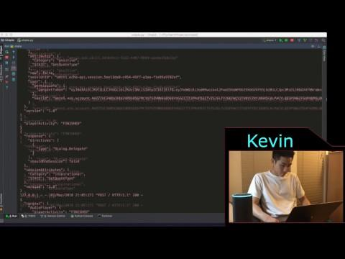
Video Demo

