Slide 1
Eklavya Project
By Viraj Shah
→ | ↓ | ← | ← | ← | ← | ← | ← | ← | ←
→ | R | L | ← | ← | ← | ← | ← | ← | ←
→ | ↑ | ← | I | N | A | T | O | R | ←
↑ | ↑ | ↑ | ← | ← | ← | ← | ← | ← | ←

Slide 2
Background Work
Mathematical Prerequisites
Linear Algebra
Probability Theory
Familiarization with the more General Concepts of Machine Learning

Slide 3
Intro to RL
Reinforcement Learning Terminologies
Where it all ‘fits’ with respect to other branches of Machine Learning
Contrasting Features

Slide 4
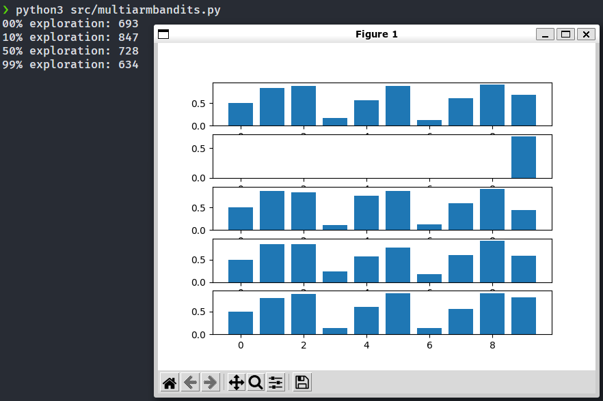
Multi-armed Bandits
Exploration vs. Exploitation
True Probabilities
Total Rewards
Learnt Probabilities

Slide 5
Dynamic Programming
Markov Decision Processes
Policy Evaluation, Policy Iteration, and Value Iteration

Slide 6
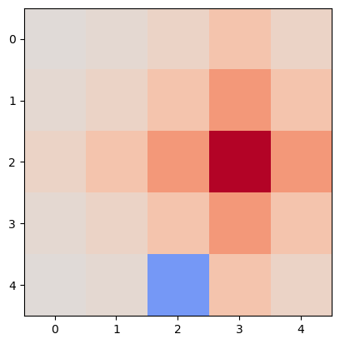
[[ 0. 0. 0. 0. 0. ]
[ 0. 0. 0. 0. 0. ]
[ 0. 0. 0. 1. 0. ]
[ 0. 0. 0. 0. 0. ]
[ 0. 0. -1. 0. 0. ]]
[['↘' '↘' '↘' '↓' '↙’]
['↘' '↘' '↘' '↓' '↙’]
['→' '→' '→' '✣' ‘←’]
['↗' '↗' '↗' '↑' '↖’]
['↗' '↑' '↗' '↑' '↖']]

Slide 7
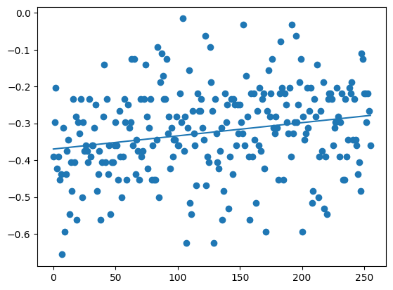
Monte Carlo Methods
Random Sampling to find state-action values
Wins: 27.93%
Losses: 67.68%
Draws: 4.39%
Wins: 42.77%
Losses: 49.71%
Draws: 7.52%

Slide 8
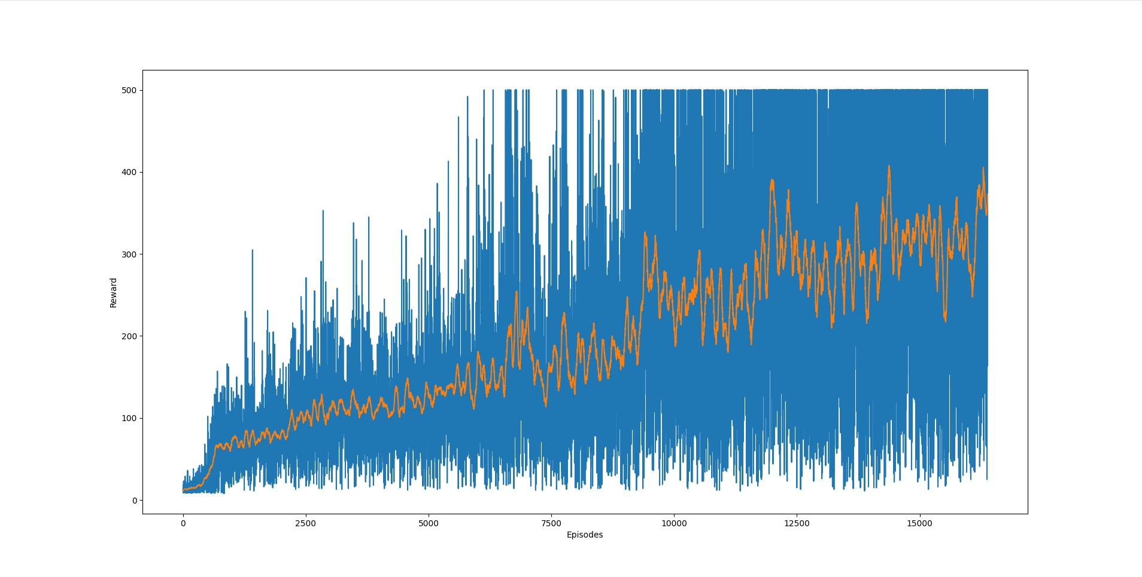
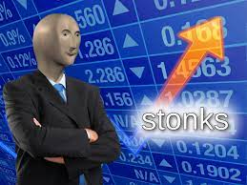
Temporal Difference Methods
Combine Dynamic Programming and Monte Carlo Methods
Q Learning

Slide 9
Deep Reinforcement Learning
Deep Q Learning

Slide 10
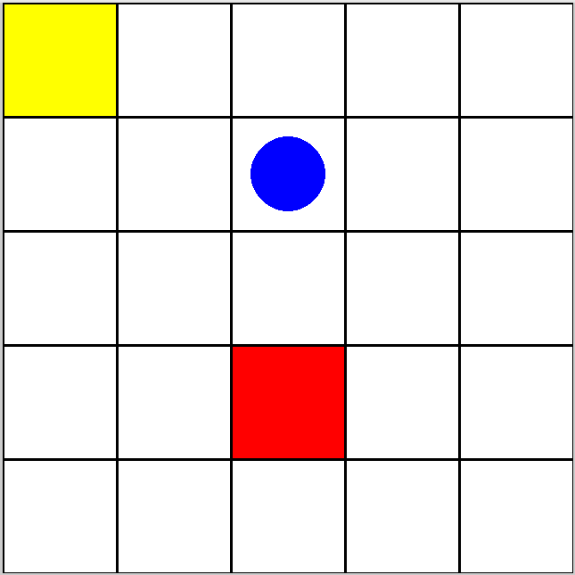
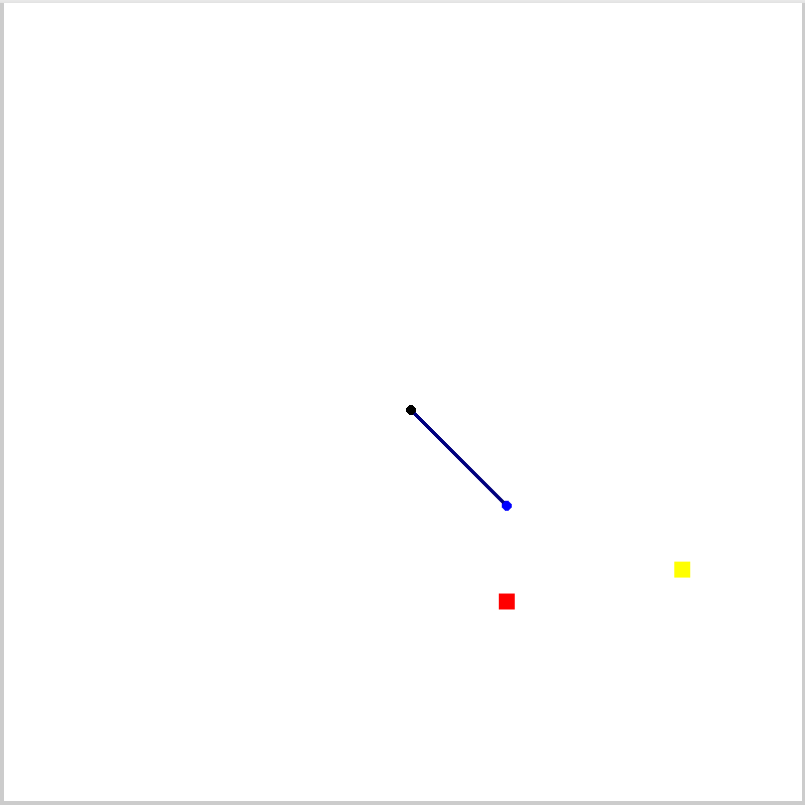

Custom Environments
Key + Chest Grid World
Pick and Place Manipulator
Classic Snake

Slide 11
Future Work
More Advanced RL Algorithms
Deep Deterministic Policy Gradient
Asynchronous Advantage Actor-Critic Algorithm
Trust Region Policy Optimization
Proximal Policy Optimization
Soft Actor-Critic
Complex / Specialized Applications
Research (?)

Slide 12
That’s All

