Slide 1
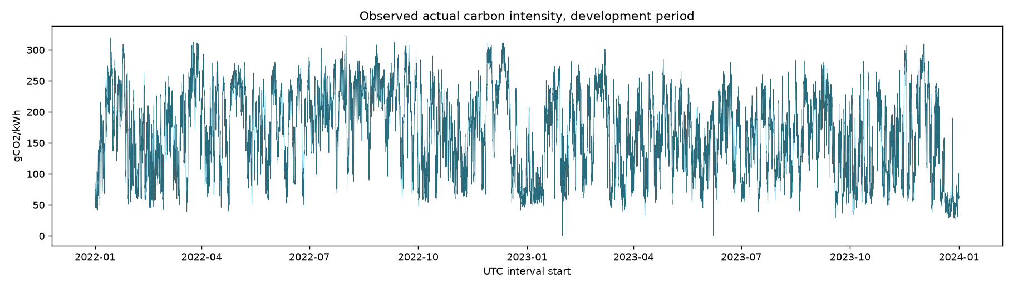
GridShift
Carbon-aware GPU workload scheduling with classical time-series forecasts
Study ID d2dee2d358735d7d
Target: NESO estimated GB intensity, gCO2/kWh
Development observations
Notes:
Introduce the study and its target. The figure is a stored development diagnostic, not a locked-test result. Source IDs S1-S8. See reports/gridshift_report.md References.

Slide 2
Research question and claim boundary
Do eligible forecasts improve feasible workload placement?
Compare with earliest-feasible execution and simple forecast baselines.
Report modeled operational CO2 under declared assumptions.
Do not claim measured GPU energy or causal grid-emissions reductions.
Notes:
The question is bounded by declared duration, energy, deadline, and capacity assumptions. Sources S1, S2, S4, S5, and S9.

Slide 3
Data coverage and quality
Observed slots: 69950 of 70128.
Missing actuals remain missing; provider forecasts stay separate.
The quality gate and monthly coverage are reported from stored artifacts.
Measure | Value
Slots | 70128
Observed | 69950
Missing | 178
Overall coverage | 0.9975
Lowest monthly coverage | 0.9388
Lowest test-month coverage | 1
Unique UTC intervals | true
Regular grid | true
Data gate passed | true
Assumed availability | true
Notes:
Quality values come from artifacts/data/quality.json. Monthly coverage chart source: C:\Users\viraj\Documents\Codex\2026-10-22\plan-gridshift-a-complete-ats-mini\outputs\GridShift\artifacts\data\monthly_coverage.csv. Source IDs S1-S8. See reports/gridshift_report.md References.

Slide 4
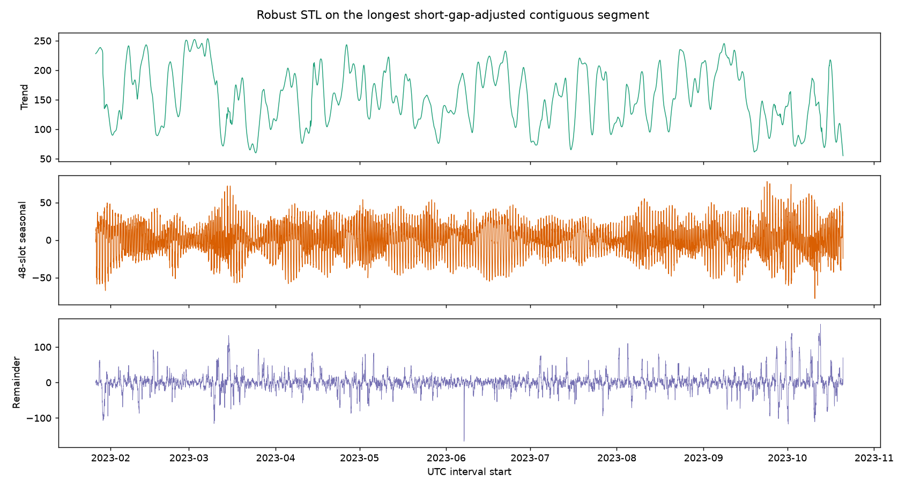
Development diagnostics
Diagnostic boundary: 2024-01-01T00:00:00+00:00.
Development-only STL status: ok.
ACF, periodogram, and stationarity checks guide candidates, not test conclusions.
Stored development-only robust STL components
Notes:
The source files are diagnostics.json, adf.csv, kpss.csv, acf_pacf.csv, and the named figure. Centered STL is descriptive, not an online feature. Source IDs S9-S13. Diagnostic figures and tables come from artifacts/diagnostics.

Slide 5
Forecast model catalogue
AR, MA, ARMA, ARIMA, and daily-seasonal SARIMA.
Persistence, seasonal-naive, and calendar-mean controls.
Failed fits and null outcomes remain visible in the source tables.
Role | Recorded choice
Forecast champion | SARIMA(1,0,1)x(1,0,0,48)
Strongest simple baseline | persistence
Scheduling model | calendar_mean
Selection boundary | Validation only
Notes:
These selections are read from results.json and are not recomputed from test data. Source IDs S9-S13. Validation and test rows come from the content-addressed forecast_metrics.csv files.

Slide 6
Evaluation design
Chronological development, validation, and locked-test partitions.
Common eligible targets and counts by lead time.
Paired block uncertainty for the primary scheduling contrast.
AIC and BIC compare only compatible likelihood groups.
Design item | Configured value
Validation | 2024-01-01T00:00:00Z to 2025-01-01T00:00:00Z
Locked test | 2025-01-01T00:00:00Z to 2026-01-01T00:00:00Z
Horizons | [1, 4, 12, 24, 48]
Bootstrap resamples | 2000
Notes:
Study settings come from the passed config. The full configuration digest appears in the report. Source IDs S9-S13. Validation and test rows come from the content-addressed forecast_metrics.csv files.

Slide 7
Validation forecast outcomes
Validation champion: SARIMA(1,0,1)x(1,0,0,48).
Strongest simple baseline: persistence.
The chart shows MAE by lead time only where the source table has a numeric value.
Model | Mean endpoint MAE
SARIMA(1,0,1)x(1,0,0,48) | 24.823
persistence | 28.754
Notes:
Validation scores are read from artifacts/runs/d2dee2d358735d7d/validation/forecast_metrics.csv. Source CSV tables and artifacts/results.json. No re-selection on test data.

Slide 8
Locked-test forecast outcomes
Test rows report the validation-selected champion and simple baseline.
The test does not change the selected model.
Null metrics and zero-count groups remain unfilled.
Model | Mean endpoint MAE
SARIMA(1,0,1)x(1,0,0,48) | 24.453
persistence | 29.122
Notes:
Test scores are read from artifacts/runs/d2dee2d358735d7d/test/forecast_metrics.csv. Source CSV tables and artifacts/results.json. No re-selection on test data.

Slide 9
Scheduling formulation
Minimize forecast intensity integrated over full job energy.
Keep deadlines, capacity, and reservations as hard constraints.
Use an oracle only as an unattainable opportunity bound.
Declared assumption | Value
Default duration (hours) | 2
Default slack (hours) | 10
Power (kW) | 0.4
PUE | 1.2
Primary model | calendar_mean
Notes:
Scheduling values come from config. They are scenarios unless measured telemetry appears in a verified artifact. Source ID S5. Energy and emissions are modeled under config values.

Slide 10
Primary scheduling outcomes
calendar_mean: 12.414% modeled reduction against earliest execution.
95% paired block interval: 10.951% to 13.828%.
Policy | Mean gCO2 | Delta %
earliest | 124 | NA
oracle | 97.22 | 21.61
forecast | 108.6 | 12.41
Notes:
Primary summary rows come from C:\Users\viraj\Documents\Codex\2026-10-22\plan-gridshift-a-complete-ats-mini\outputs\GridShift\artifacts\runs\d2dee2d358735d7d\test\single_job\primary_summary.csv. Bootstrap uncertainty comes from C:\Users\viraj\Documents\Codex\2026-10-22\plan-gridshift-a-complete-ats-mini\outputs\GridShift\artifacts\runs\d2dee2d358735d7d\test\single_job\primary_bootstrap.csv. A simple deployment choice does not establish added scheduling value from classical forecasting. Modeled isolated-job benefit under declared assumptions. The certified seven-day paired block estimate is 12.414% (95% interval 10.951 to 13.828%) across 2913 scheduled primary-policy jobs; the bootstrap paired 2913 jobs. This estimates modeled operational CO2 under the declared job, energy, and deadline assumptions. Source CSV tables and artifacts/results.json. No re-selection on test data.

Slide 11
Queue service and emissions
Table values are arithmetic means across the three frozen seeds.
Matched emissions differences are descriptive; accepted work differs.
Lower emissions from rejected work are not savings.
Load | Slack h | Reject early % | Reject selected % | Matched delta %
0.3 | 6 | 0.48518 | 2.373 | 6.7787
0.3 | 12 | 0.023624 | 0.36428 | 8.531
0.6 | 6 | 3.6671 | 9.7095 | 4.3856
0.6 | 12 | 0.41371 | 3.9073 | 5.1506
0.85 | 6 | 9.7584 | 17.737 | 3.571
0.85 | 12 | 3.8893 | 10.701 | 3.6974
Notes:
Queue summary rows come from C:\Users\viraj\Documents\Codex\2026-10-22\plan-gridshift-a-complete-ats-mini\outputs\GridShift\artifacts\runs\d2dee2d358735d7d\test\queue\queue_summary.csv. Full scenarios and policies remain in the source CSV and report. Source CSV table. Queue arrivals are synthetic and service outcomes remain part of the comparison.

Slide 12
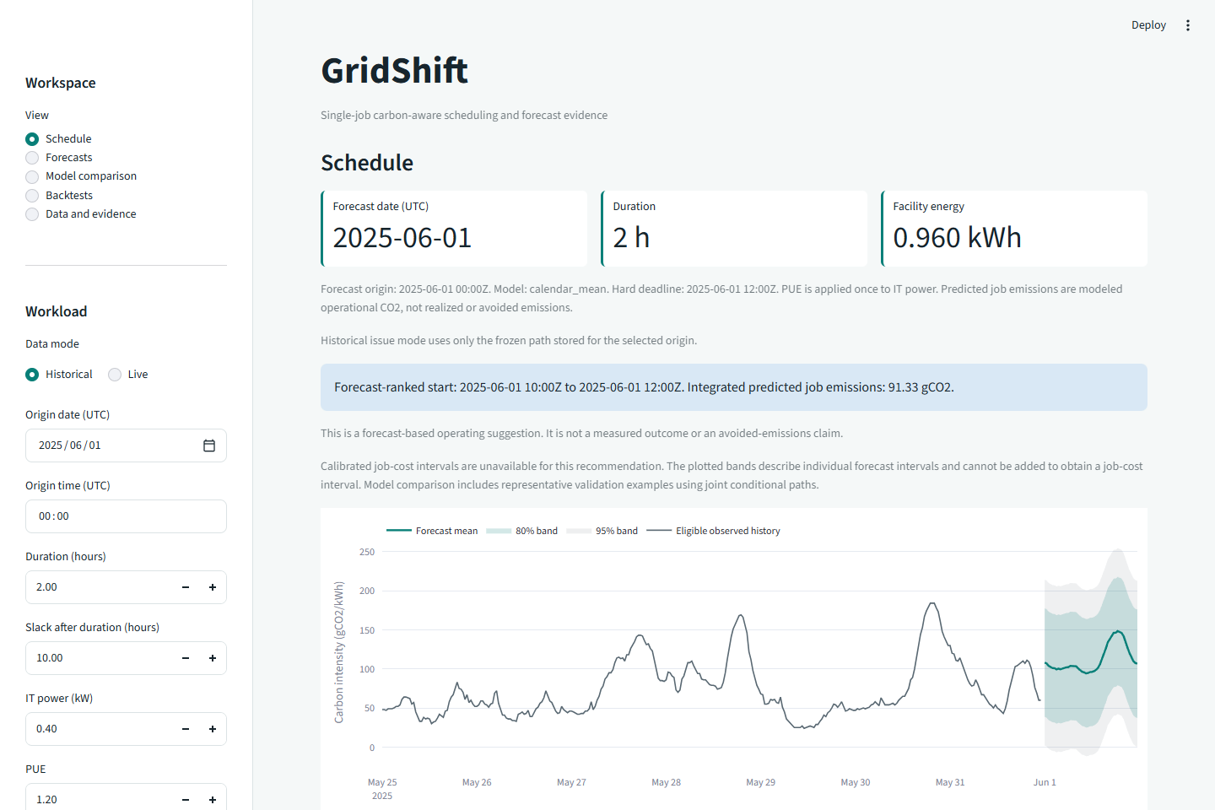
Dashboard and conclusion
Local recommendations remain predictions, not measured savings.
No verified vintages or GPU telemetry.
Selected policy: calendar_mean. The isolated effect is 12.414%.
Simple timing value and classical forecast skill are separate findings.
Verified local GridShift scheduling workspace
Notes:
Backup notes: realized job CO2 is the sum over intervals of overlap energy in kWh times estimated intensity in gCO2/kWh. The forecast scheduler minimizes the same integrated expression using the eligible forecast path. Failure cases include missing forecasts, incomplete truth coverage, infeasible deadlines, failed model fits, and unmatched queue work. Preserve each outcome in the tables. Source ID S5. Energy and emissions are modeled under config values.

