Slide 1
Diamond Retail Pricing & Product-Mix Analysis
Business question: where should management focus pricing and assortment attention?
Public dataset: 53,940 diamond records from ggplot2.
Management lens: price drivers, premium concentration and data quality.
1

Slide 2
Data & Methodology
Raw data: 53,940 rows × 10 columns.
Cleaning: removed 146 exact duplicates and 20 zero-dimension records.
Created volume, price-per-carat, size bands and price tiers.
Used descriptive statistics, segment comparisons, correlations and value concentration.
2

Slide 3
Key Findings
Carat is the strongest observed price driver (r = 0.922).
Premium cut average price is 32.3% above Ideal.
2+ ct products are 3.5% of records but 13.2% of value proxy.
Top 10% by price contribute ~34.4% of total price value.
3

Slide 4
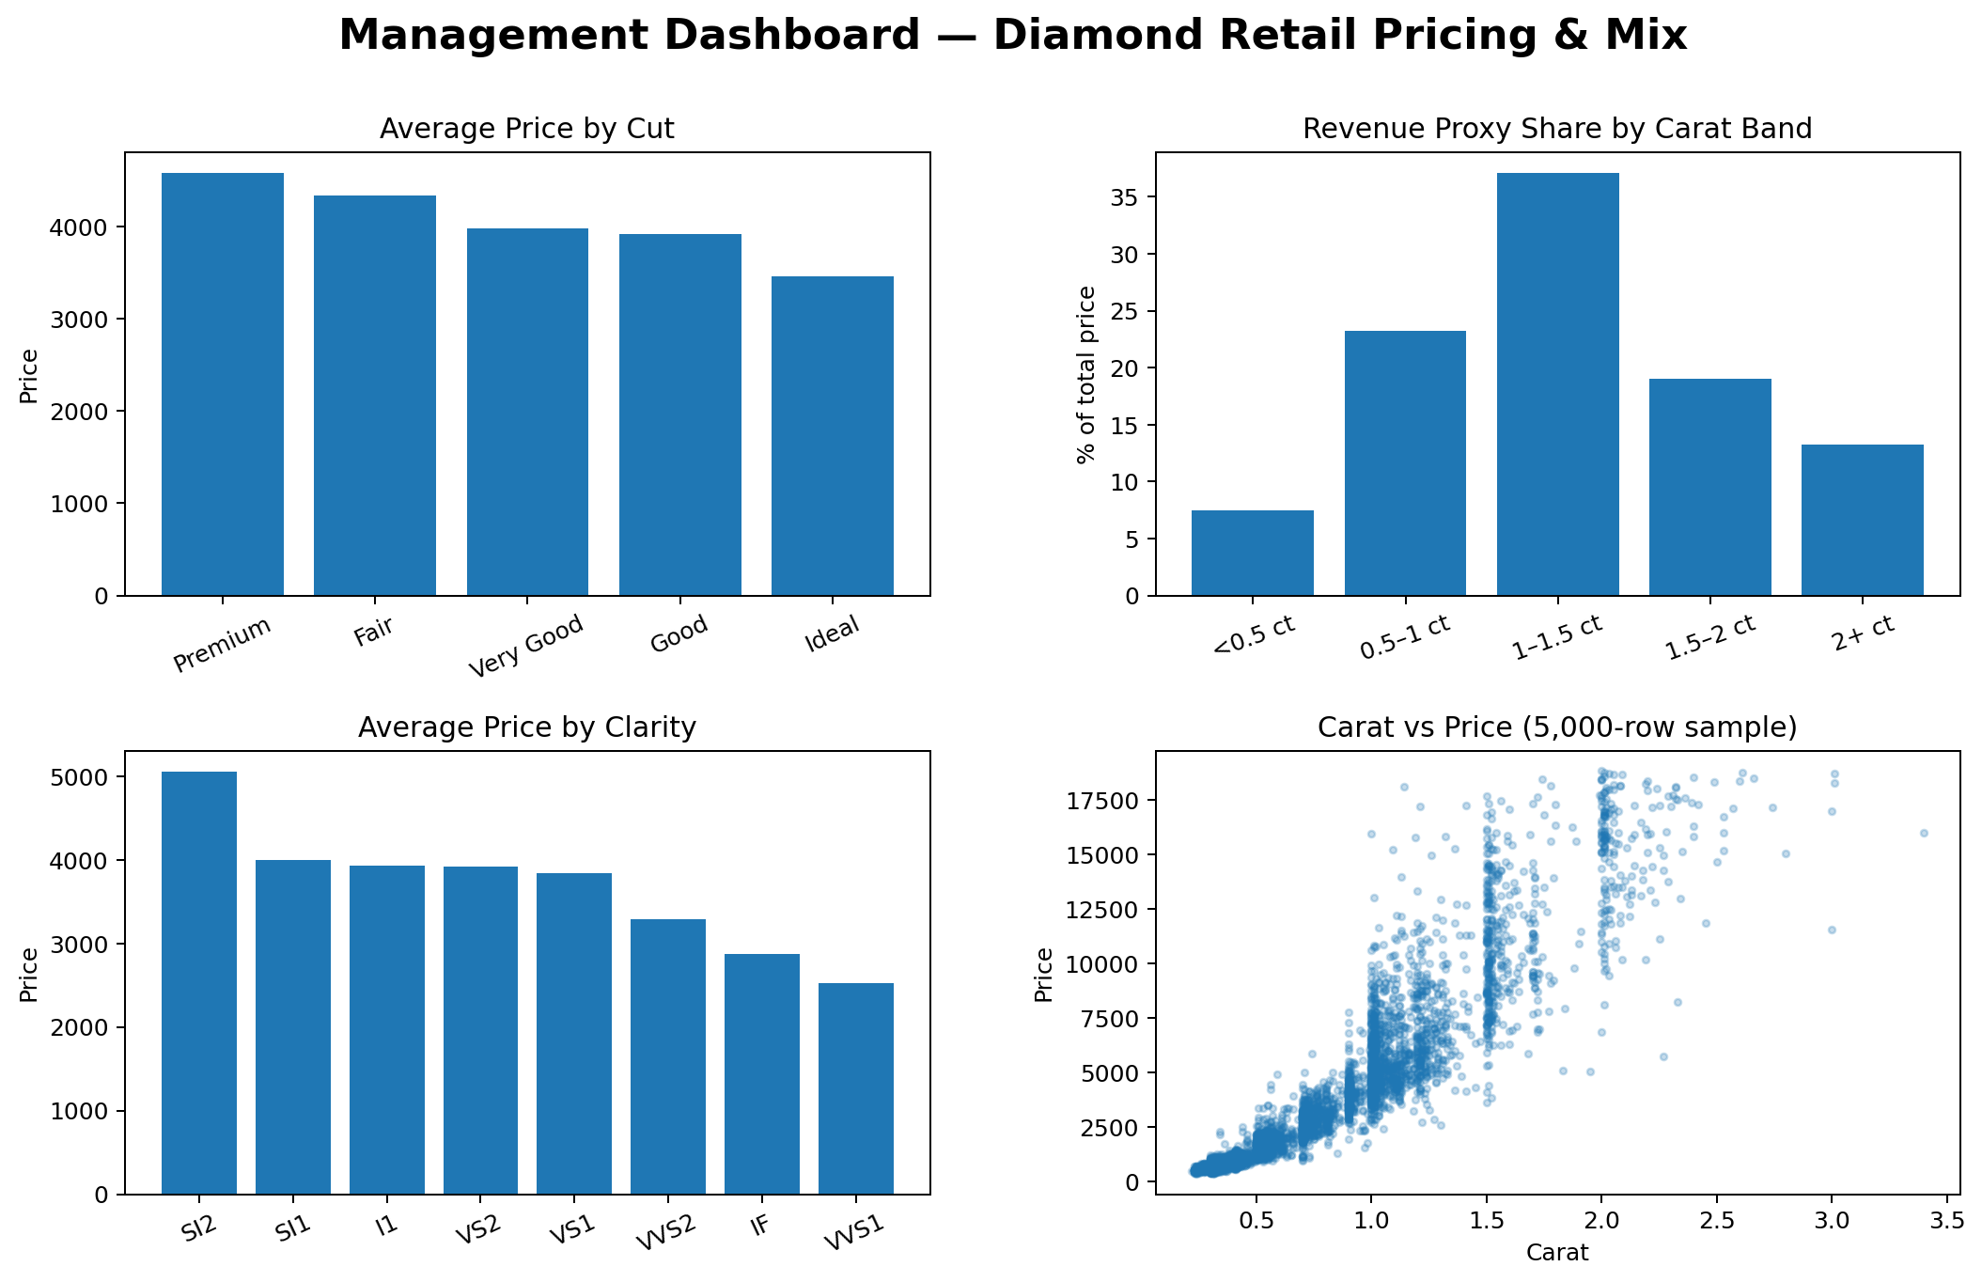
Deep-Dive: Size & Value Concentration

Slide 5
Recommendations
1. Make carat bands a core pricing and assortment lens.
2. Create a premium-product monitoring view for the top 10% by price.
3. Evaluate cut/clarity premiums only after controlling for carat.
5

Slide 6
Expected Business Impact & Measurement
Focus commercial attention on high-value inventory and improve pricing discipline.
Track average selling price, price per carat, premium mix, availability and markdown rate.
Evaluate success using future commercial outcomes, not only descriptive averages.
6

Slide 7
Limitations & Next Steps
No customer, channel, promotion, cost or margin data — profitability cannot be inferred.
Segment differences are descriptive and may be confounded by carat/product mix.
Next: build a carat-controlled pricing model and add richer commercial data.
7

