Slide 1
TICKET MANAGEMENT SYSTEM Virajitha Akella

Slide 2
INTRODUCTION
The purpose of this project is to help the customers who has house hold problems post their problems with respective accounts.
After posting their problems service provider technicians like electrician, Plumber go to customer house and resolve the problem.

Slide 3
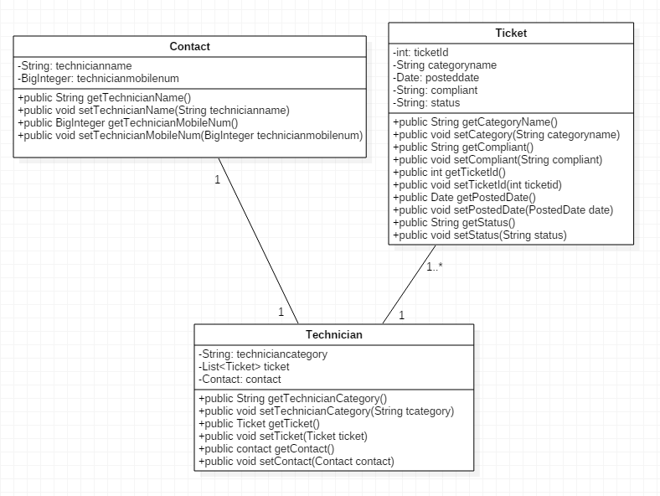
DTO Class

Slide 4
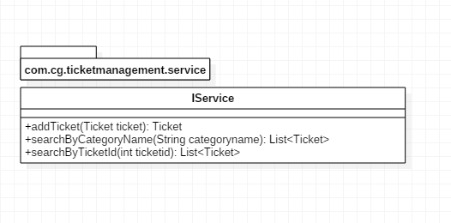
Service Interface

Slide 5
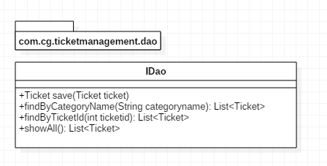
Dao Interface

Slide 6
THANK YOU

