Slide 1
SYBIL – the NFL play predictor
Milestone Report
Viraj P Modak
December 08 2019

Slide 2
SYBIL – WHAT PROBLEM DOES IT SOLVE?
Anticipating offensive play-calls – a key aspect of NFL defensive strategies
In obvious situations an experienced coach or an observer of the game can easily predict the play-type
What about ambiguous situations?
“Data driven decision making” is the answer

Slide 3
SYBIL – HOW DOES IT WORK?
10 years’ worth of NFL play-by-play data is available freely on the web
That data will be cleaned up and represented in the form of:
Independent variables: Quarter, down, yards to go, score diff...
Response variable: Pass play or Run play
SYBIL will be trained using this data and then used to predict pass/run play call given a new game situation

Slide 4
EDA suggests correlation b/w features and response
Strong correlations noted b/w play choice and the following variables:
Quarter/down
Yards to go
Score differential
Timeouts of team in possession
Weaker correlations noted with respect to following engineered features:
Dual threat of the team’s Quarterback
Hitherto pass/run performance of the team in the game

Slide 5
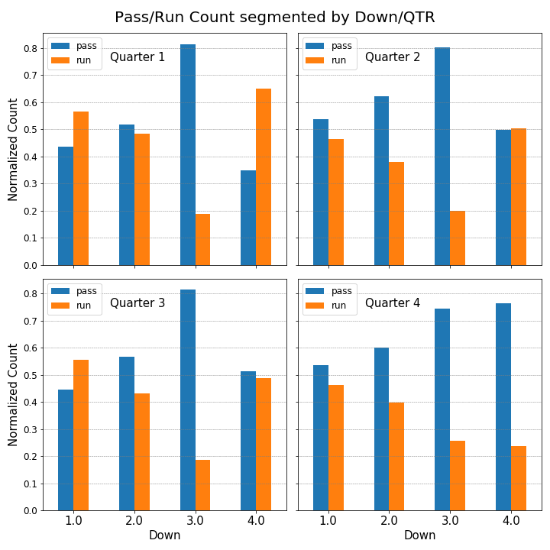
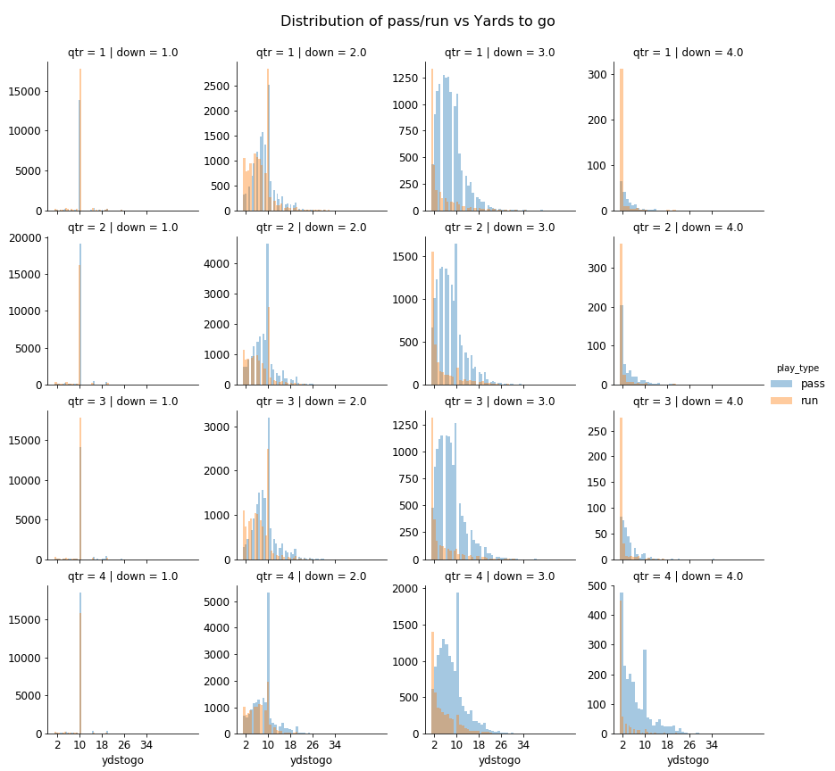
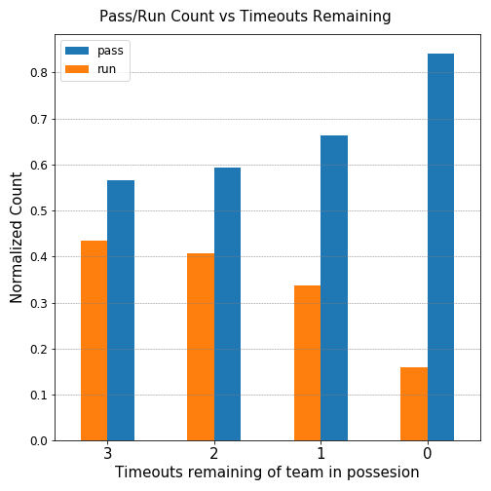
Play Type vs Game Situation
Down/Qtr
Score Differential
Timeouts

Slide 6
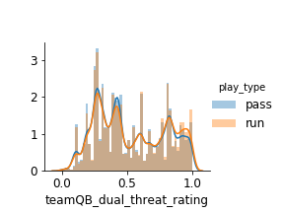
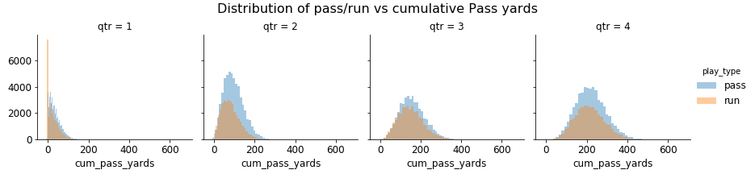
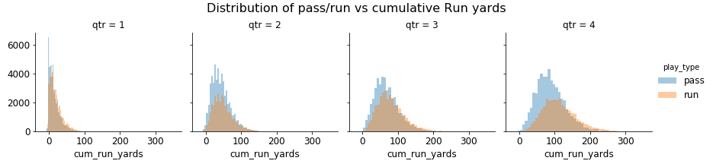
Play Type vs Game Situation
Dual Threat
Previous Pass/Run performance

Slide 7
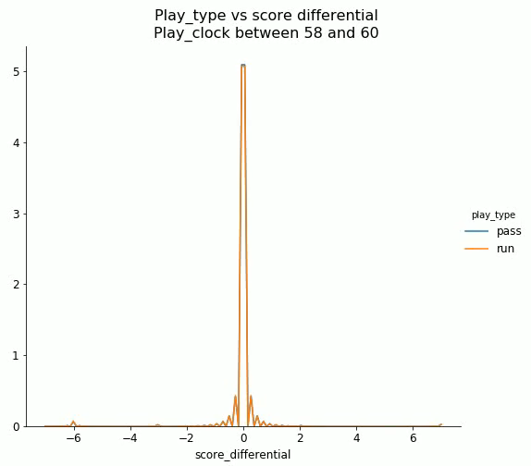
Pass/Run differentiation by
(1) play clock and (2) score delta

Slide 8
Training SYBIL...
Following ML techniques tried:
K-Nearest Neighbors
Logistic Regression (LogReg)
Decision Trees (DT)
Random Forests
Hyperparameter tuning in Each case
Feature Engineering to enhance performance:
Previous play, previous pass/run performance
QB dual threat
One-hot encoding
Feature scaling

Slide 9
Meet SYBIL....
Best performing RF based model with Engineered Features
Precision: Pass – 79%, Run – 71%
Recall: Pass – 79%, Run – 71%
Average Accuracy for both Run/Pass – 76%
Accuracy for other models
KNN – 65%
LogReg – 72%
DT – 74%

Slide 10
What do the numbers mean?
Predicting plays randomly: Accuracy of ~50%
Predicting all passes: Accuracy of 58% - based on baseline pass/run distribution
SYBIL achieves better accuracy than both

Slide 11
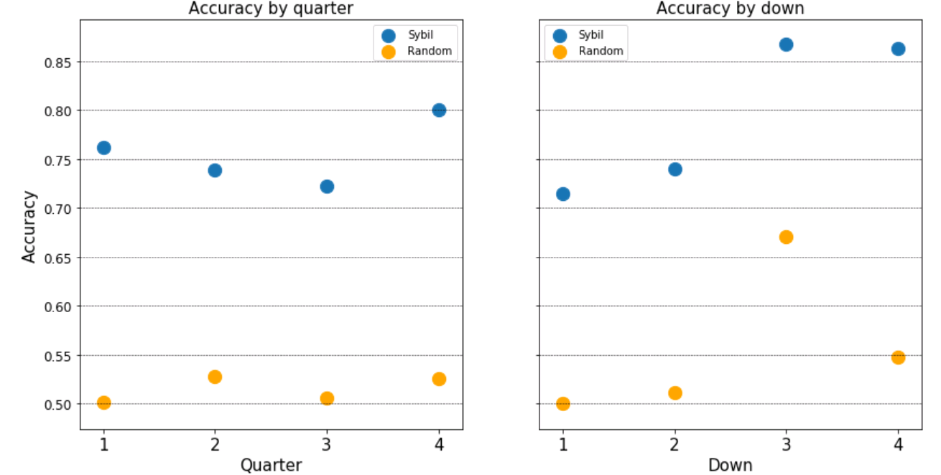
What about special Situations?
SYBIL performs best in “tight” situations
Quarter 4
4th down

Slide 12
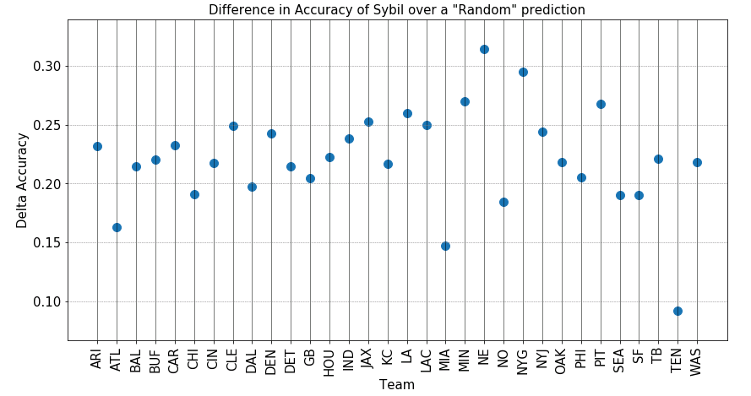
Some teams more “predictable” than others
New England
Highly predictable, but won the Superbowl!!
Tennessee
Unpredictable, but did not qualify for playoffs

Slide 13
SIGNIFICANCE?
Predicting sporting outcomes is incredibly hard: Laws of statistics good for post-game analysis, but insignificant during the game
SYBIL has an accuracy of 76% - compared to a random predictor which is a coin-flip
SYBIL has room for improvement...
SYBIL is one piece of the puzzle – execution equally important!

Slide 14
Backup / Appendix

Slide 16
Performance parameters of preliminary model training
LogReg coefficient by training feature
 | KNN | LogReg | DT | RF
Best hyperparameter grid/value | n_neighbors = 39 | C = 100 | max_depth = 13 | max_depth = 20 min_samples_leaf = 4 min_samples_split = 2
Training set accuracy | 67% | 72% | 76% | 82%
Test set accuracy | 65% | 72% | 73% | 75%
Precision | Run: 0.61 Pass: 0.66 | Run: 0.66 Pass: 0.76 | Run: 0.68 Pass: 0.77 | Run: 0.71 Pass: 0.78
Recall | Run: 0.44 Pass: 0.80 | Run: 0.67 Pass: 0.76 | Run: 0.68 Pass: 0.77 | Run: 0.70 Pass: 0.79
Feature | Coefficient
qtr | -0.123501
down | 0.554158
ydstogo | 0.089554
shotgun | 1.468002
no_huddle | -0.009586
posteam_timeouts_remaining | -0.152588
score_differential | -0.024096
play_clock | -0.009307
yards_to_goal | 0.001771
cum_pass_comp% | 0.551482
cum_pass_yards | 0.002881
cum_run_yards | -0.007682
teamQB_dual_threat_rating | -0.45137
Performance metrics for model training post Feature Engineering
 | LogReg | DT | RF
Best hyperparameter grid/value | C = 10 | max_depth = 11 | max_depth = 20 min_samples_leaf = 4 min_samples_split = 2
Training set accuracy | 72% | 75% | 82%
Test set accuracy | 72% | 74% | 76%

