Slide 1
SYBIL – the NFL play predictor
Milestone Report
Viraj P Modak
December 08 2019

Slide 2
SYBIL – WHAT PROBLEM DOES IT SOLVE?
Anticipating offensive play-calls – a key aspect of NFL defensive strategies
In obvious situations an experienced coach or an observer of the game can easily predict the play-type
What about ambiguous situations?
“Data driven decision making” is the answer

Slide 3
SYBIL – HOW DOES IT WORK?
10 years’ worth of NFL play-by-play data is available freely on the web
That data will be cleaned up and represented in the form of:
Independent variables: Quarter, down, yards to go, score diff...
Response variable: Pass play or Run play
SYBIL will be trained using this data and then used to predict pass/run play call given a new game situation

Slide 4
EDA suggests correlation b/w features and response
Strong correlations noted b/w play choice and the following variables:
Quarter/down
Yards to go
Score differential
Timeouts of team in possession
Weaker correlations noted with respect to following engineered features:
Dual threat of the team’s Quarterback
Hitherto pass/run performance of the team in the game

Slide 5
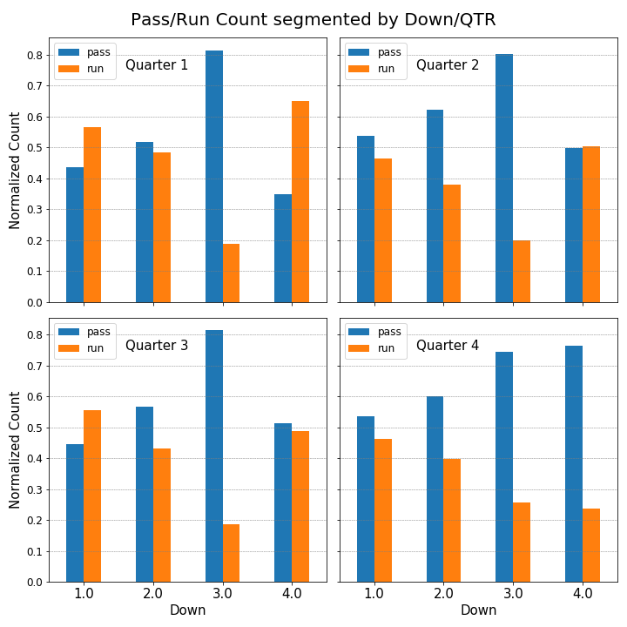
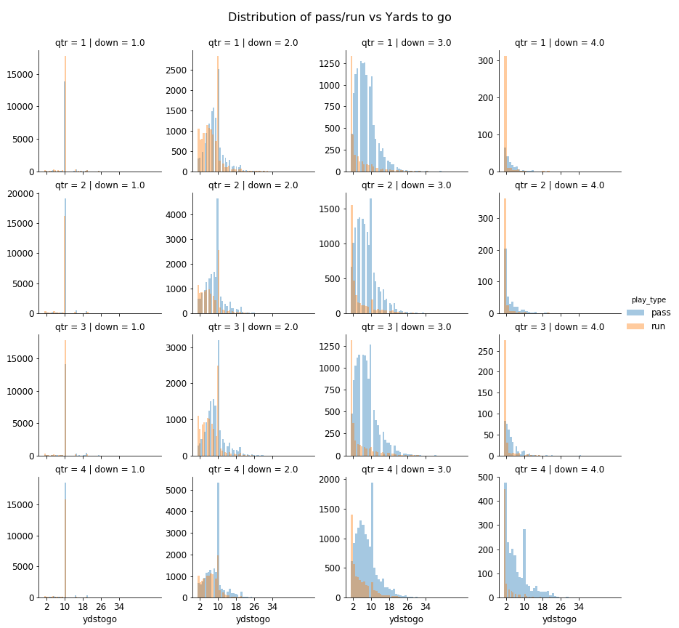
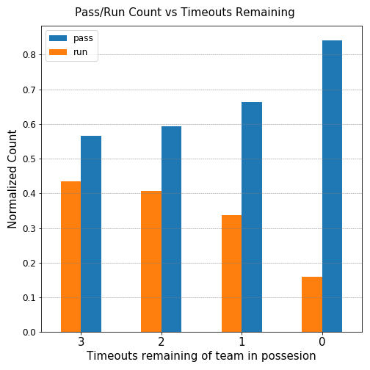
Some Examples

Slide 6
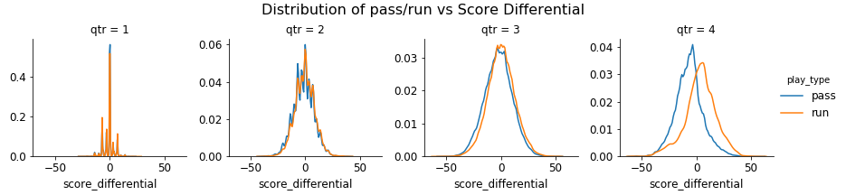
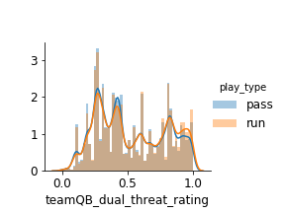
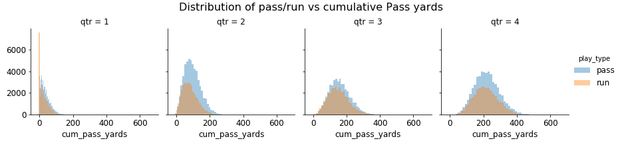
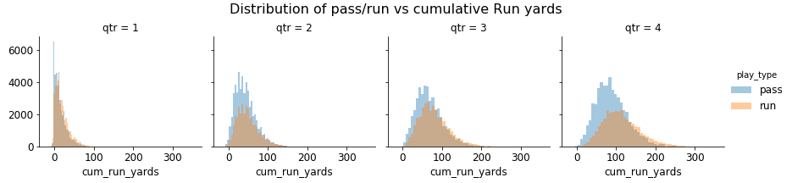
Some Examples

Slide 7
NEXT UP – SYBIL WILL BE TRAINED
Multiple ML techniques will be tried
KNN, Logistic Regression, SVM, Decision Trees, Random Forests
Hyperparameter tuning and model optimization
Model evaluation/performance metrics

Slide 8
Stay tuned – more to follow...

