Slide 1
Restaurant Recommender
Milestone Report
Viraj P Modak
February 04 2020

Slide 2
WHAT PROBLEM DOES IT SOLVE?
Recommender systems have become extremely popular (Amazon, Netflix, Facebook all use them)
This approach can be extended to recommending restaurants
Most decisions on identifying restaurants based on star rating
Data may be skewed by users with different preferences
Number of restaurants may be so high that some good restaurants never receive any attention
An ML based recommender system can use both user/restaurant characteristics to solve this problem

Slide 3
How will it work?
Restaurant review data freely available on Kaggle from Yelp
Data was cleaned up from raw JSON format to csv consisting of:
User info
Restaurant info
Review info
An ML model will make recommendations based on user preferences. Training approach can be of following types:
Collaborative (similarity calculated using user preferences)
Hybrid (K-Means Clustering + Content-based)
Vectorized review text used for identifying K-Means centroids and the content similarity

Slide 4
EDA & Statistical Analysis
Not a standard ML problem with independent and response variables
EDA/Statistical analysis may seem forced or inapplicable to the larger problem statement
It does serve an informational purpose of “visualizing the data”
Analysis restricted to single city (Phoenix) which can then be replicated

Slide 5
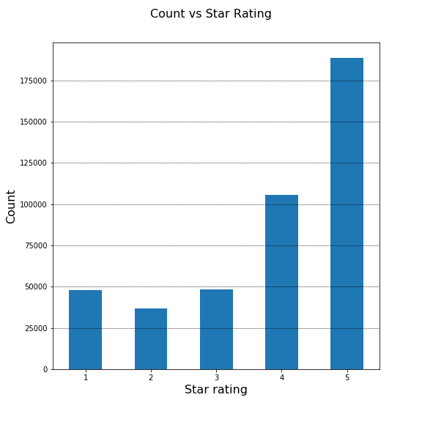
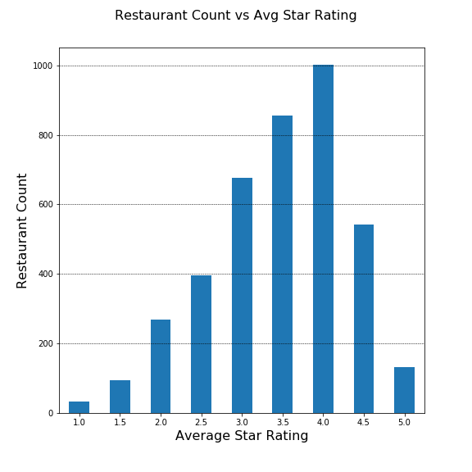
Trends in Restaurant Ratings

Slide 6
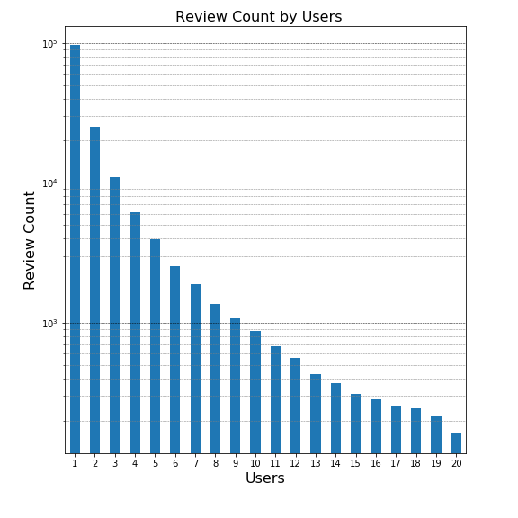
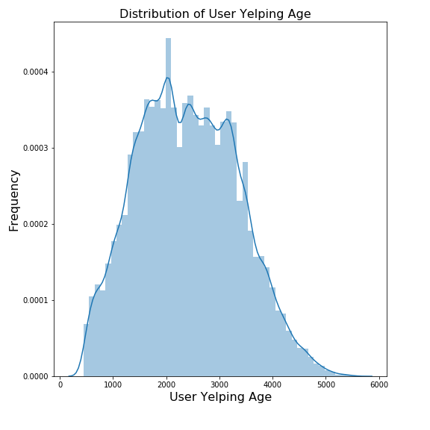
Trends in user characteristics

Slide 7
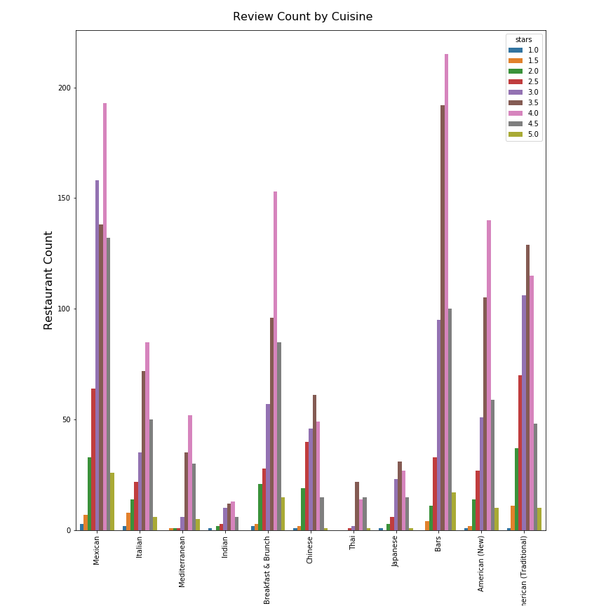
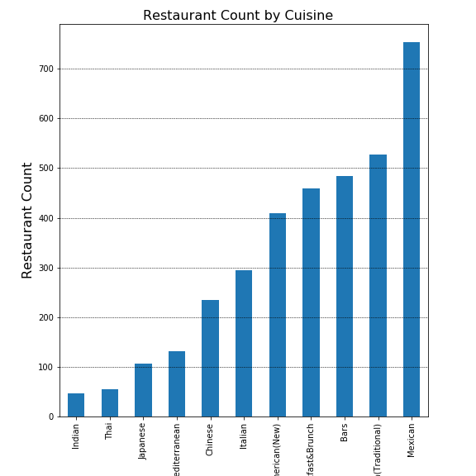
Ratings resolved by cuisine

Slide 8
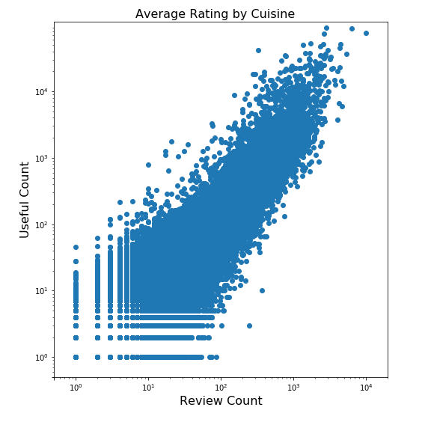
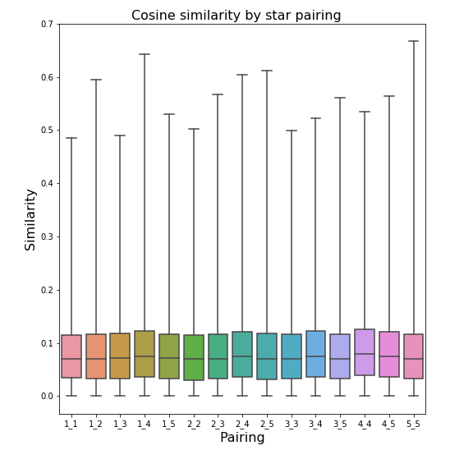
Trends in Review Characteristics

Slide 9
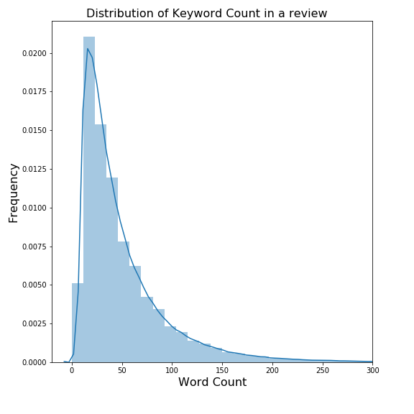
Statistical Analysis
Mean and stdev of restaurant ratings by cuisine
Mean: 2404 days
Stdev: 945 days
Median: 2372 days
Cuisine | Mean Rating | Stdev
American (New) | 3.656479 | 0.68597
American (Traditional) | 3.343454 | 0.7755
Bars | 3.691904 | 0.63072
Breakfast & Brunch | 3.684783 | 0.74579
Chinese | 3.25641 | 0.72985
Indian | 3.478723 | 0.74424
Italian | 3.568027 | 0.80557
Japanese | 3.551402 | 0.67619
Mediterranean | 3.927481 | 0.54815
Mexican | 3.570955 | 0.78113
Thai | 3.890909 | 0.50636

Slide 10
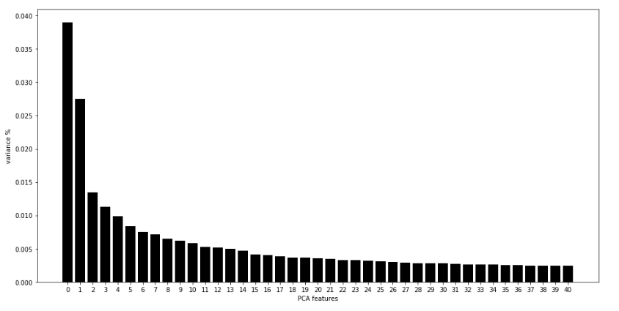
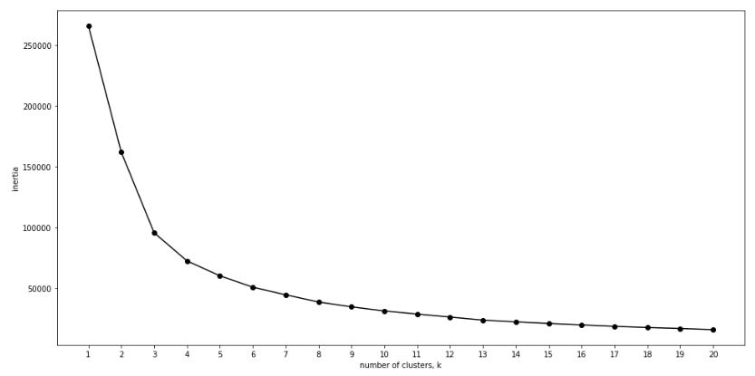
Building The Model
Hybrid (K-Means + Content Based Filtering)
Review Text vectorized using TFIDF vectorizer, which was then used to:
Calculate 20 centroid Clusters
PCA and Centroid inertia were explored
n_components and n_clusters were arbitrarily chosen
Content-based cosine similarities between reviews
Recommendations were obtained as an intersection of the recommendations from the two approaches

Slide 11
Building The Model
Hybrid (Collaborative Filtering)
User-User and User-Item collaborative filtering is used:
Rating matrix calculated: rows are user_ids and columns are business_ids
Item-based Collaborative Filtering: “Users who liked this item also liked…”
User-based Collaborative Filtering: “Users who are similar to you also liked…”
User-based similarities:
Prediction:
Final prediction included an intersection of the two recommendation sets

Slide 12
More Insight...
Because there is no right answer, a repetition feature was added to both models, where recommendations are pulled from a pool until the user is satisfied
Certain key parameters can impact performance:
For the hybrid model:
PCA features and n_clusters
Vectorizer
Type of similarity
For collaborative filtering:
Type of similarity
Using more than just “star rating” to calculate similarities
Building a recommender system is challenging – because there is no right answer

Slide 13
Enjoy your meal!

