Slide 1
Restaurant Recommender
Milestone Report
Viraj P Modak
February 04 2020

Slide 2
WHAT PROBLEM DOES IT SOLVE?
Recommender systems have become extremely popular (Amazon, Netflix, Facebook all use them)
This approach can be extended to recommending restaurants
Most decisions on identifying restaurants based on star rating
Data may be skewed by users with different preferences
Number of restaurants may be so high that some good restaurants never receive any attention
An ML based recommender system can use both user/restaurant characteristics to solve this problem

Slide 3
How will it work?
Restaurant review data freely available on Kaggle from Yelp
Data was cleaned up from raw JSON format to csv consisting of:
User info
Restaurant info
Review info
An ML model will make recommendations based on user preferences. Training approach can be of following types:
Collaborative (similarity between user preferences)
Content-based (similarity between restaurants, e.g. serving same cuisine)
Hybrid (mix of both)
An unsupervised learning (cluster-based) approach can also be taken

Slide 4
EDA & Statistical Analysis
Not a standard ML problem with independent and response variables
EDA/Statistical analysis may seem forced or inapplicable to the larger problem statement
It does serve an informational purpose of “visualizing the data”
Analysis restricted to single city (Phoenix) which can then be replicated

Slide 5
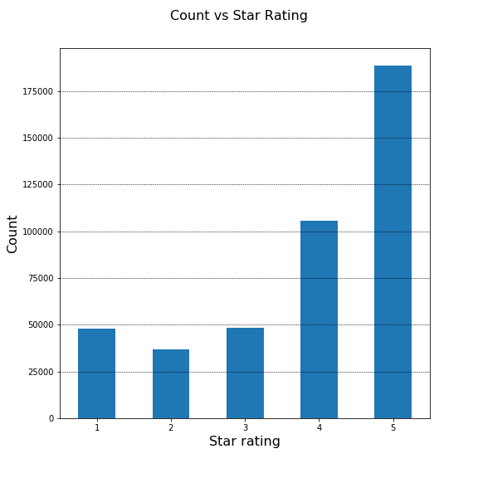
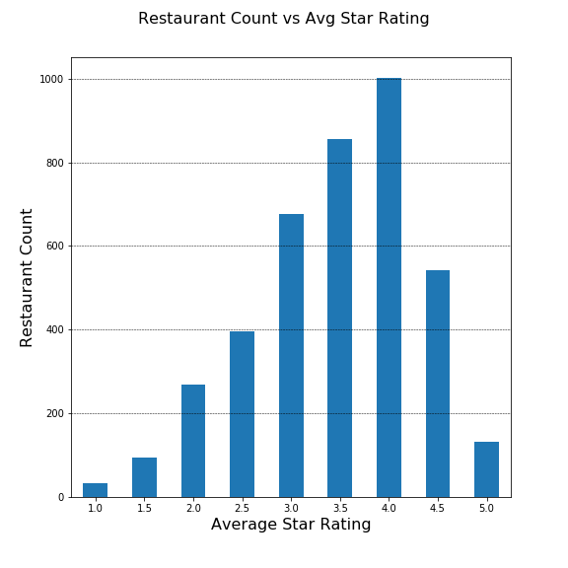
Trends in Restaurant Ratings

Slide 6
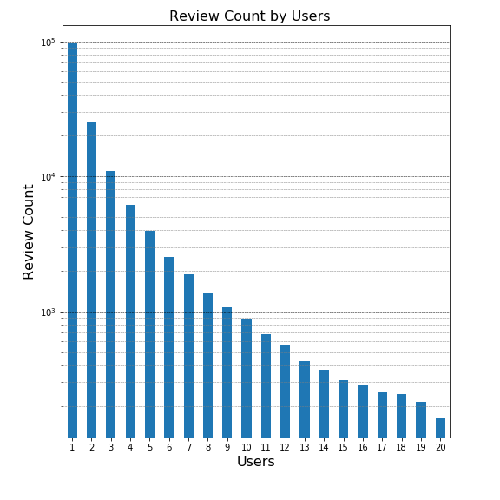
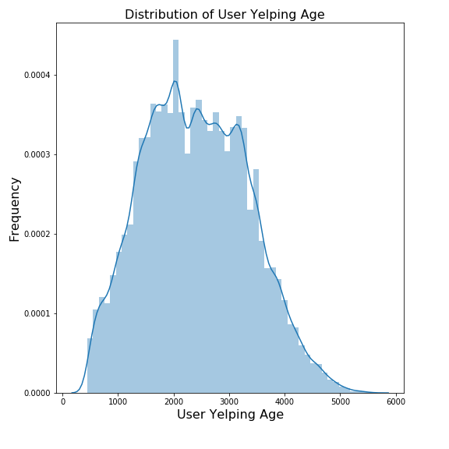
Trends in user characteristics

Slide 7
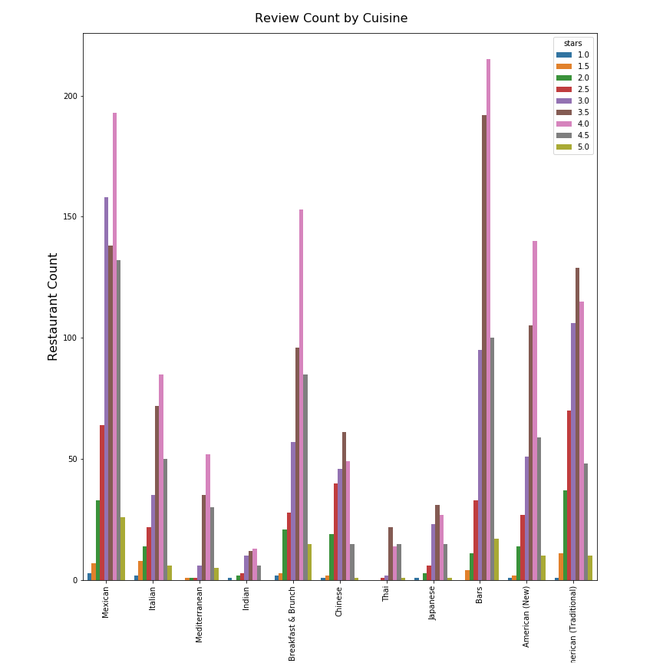
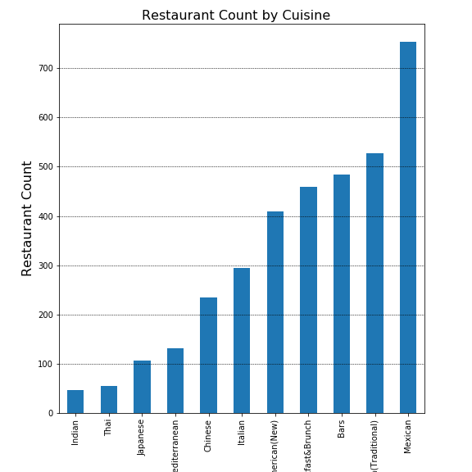
Ratings by cuisine

Slide 8
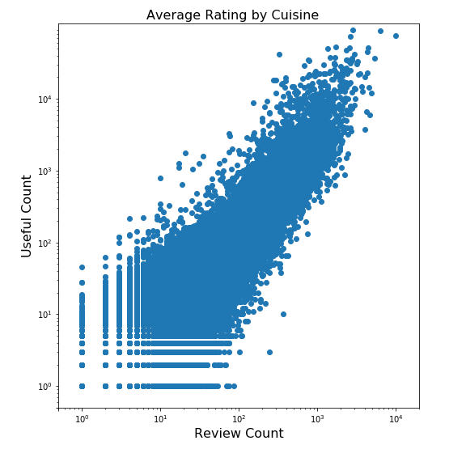
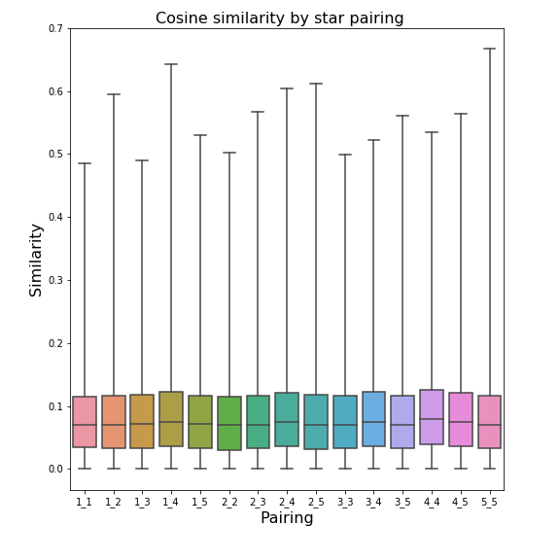
Trends in Review Characteristics

Slide 9
Next Steps – building the recommender system
Following approaches can be taken:
Collaborative filtering – based on user characteristics
Content-based filtering – based on restaurant characteristics
Hybird approach
A fully unsupervised model can also be used based on a clustering algorithm

Slide 10
More to follow...

