Slide 1
KUBERNETES
……best way to run microservices
…..best way for container orchestration
…….best way to run application on cloud platform

Slide 2
WHY KUBERNETES??????
Production growth 200%
companies using cloud native technologies in production, usage has increased by 200%
Best platform to run microservices applications….
IT industries are going from monolithic applications to microservices applications
A strong career for future
Number of industries migrating to cloud technology, where they want to deploy there applications

Slide 3
Understand KUBERNETES
To understand kubernetes we need to understand four things….
Monolithic vs Microservices applications
How container works
Kubernetes objects / terminologies
Kubernetes architechture

Slide 4
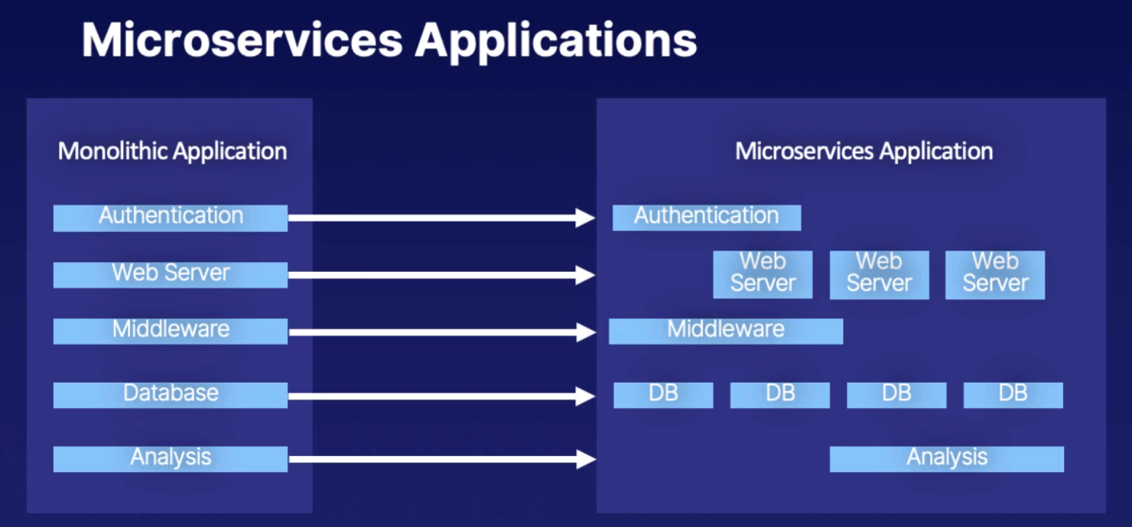
Type of Applications

Slide 5
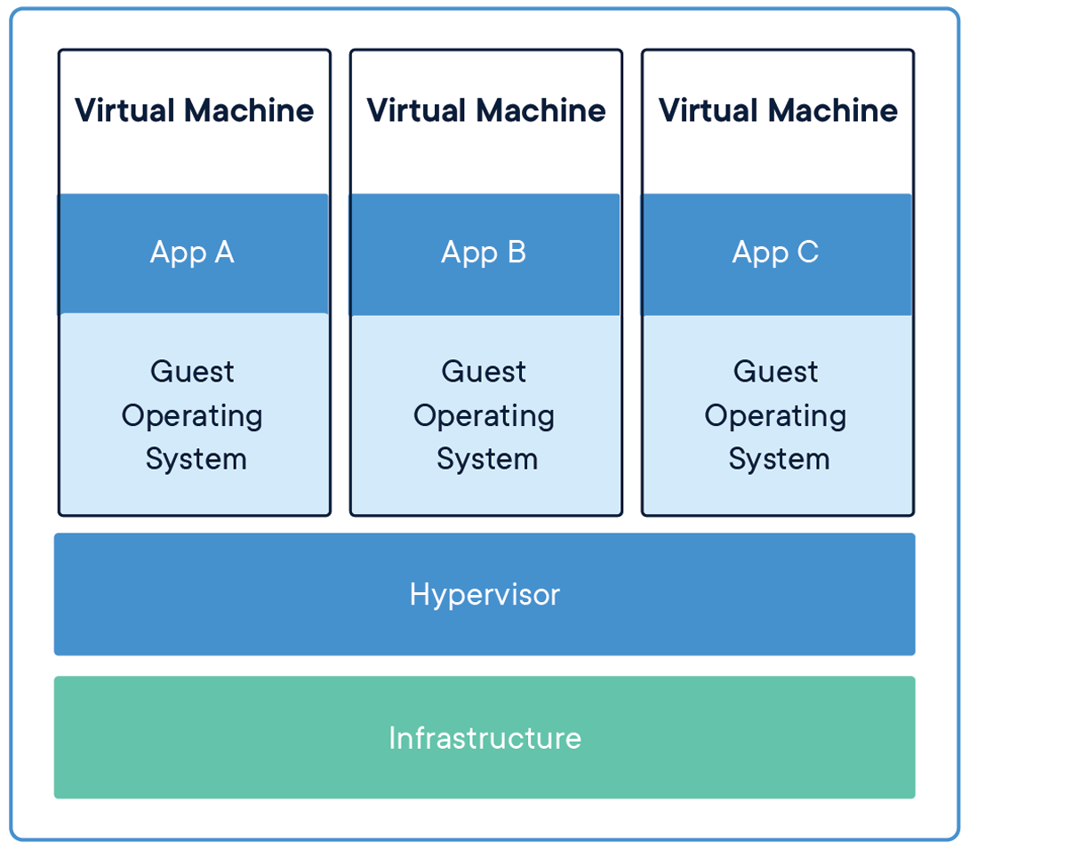
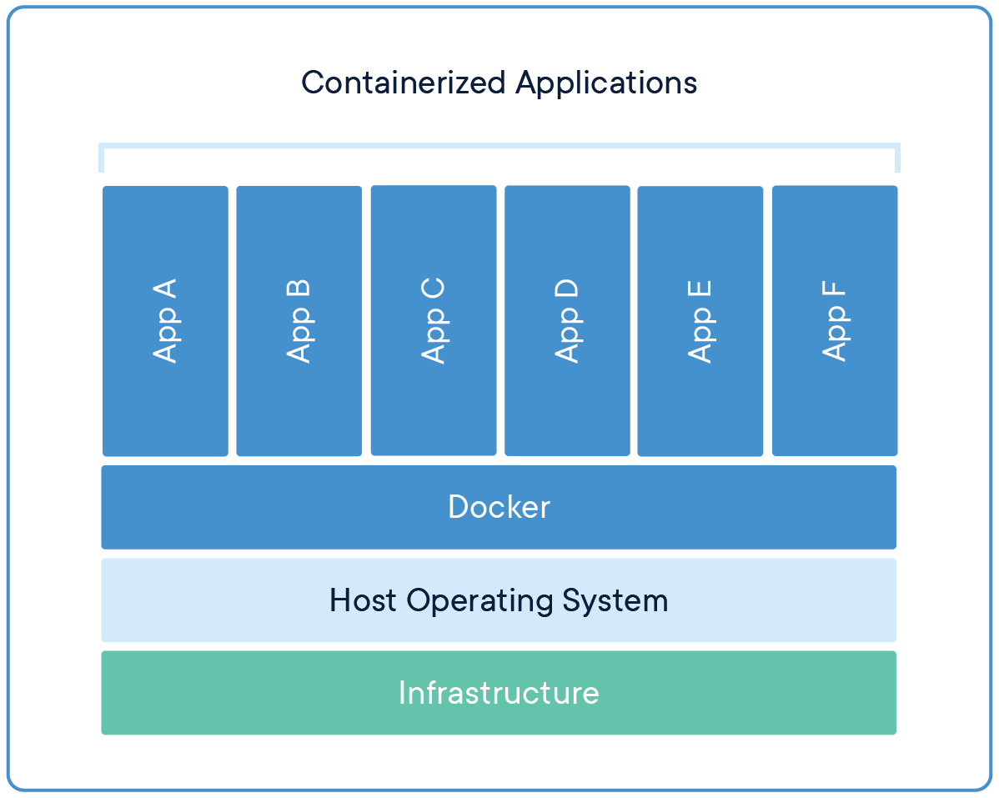
Understand docker and how it works VM / docker

Slide 6
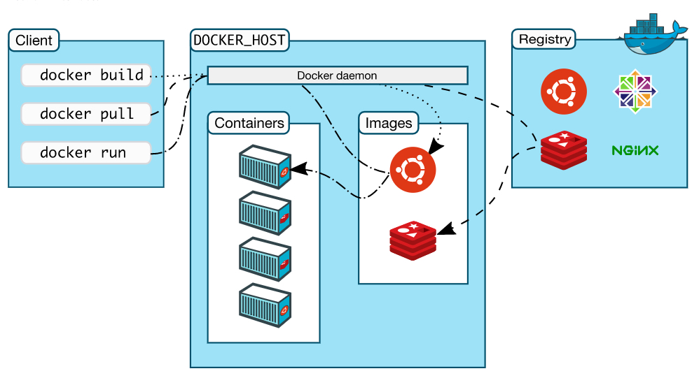
Understand docker and how it works Architecture

Slide 7
Kubernetes objects / terminologies
Container Orchestration
Cluster
Master
Node
Namespace
Pod

Slide 8
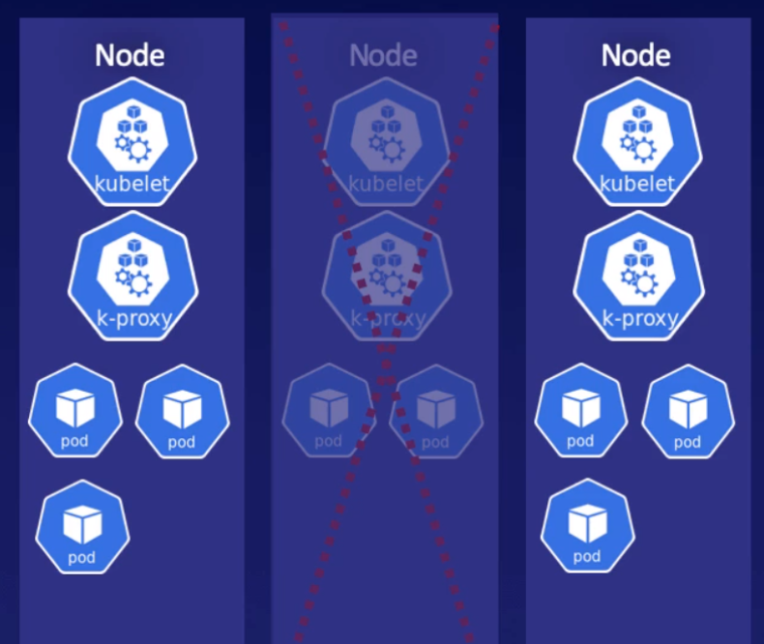
Container Orchestration
High availability
Load balanced
Resource management
Desired state configuration
Uses a “declarative model” – i.e. You can declare application availability, like you want at any given point of time 6 pods should be running for particular application, and one node goes down, then it automatically bring up 2 pods on another nodes.

Slide 9
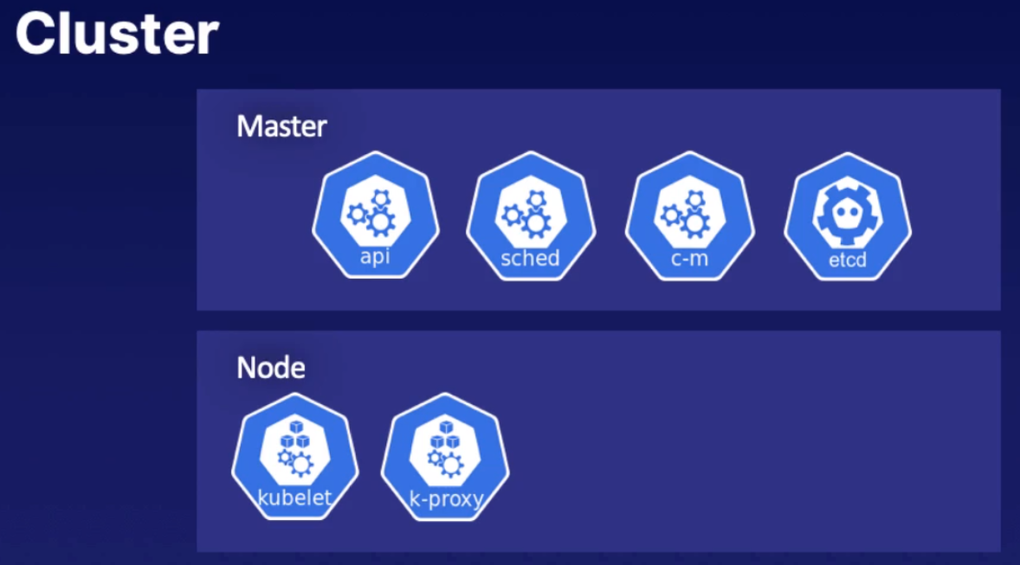
Cluster
A collection of nodes(hosts), storage and network resources, used to run your workloads
You may have one or multiple clusters
Every cluster will have at least one master

Slide 10
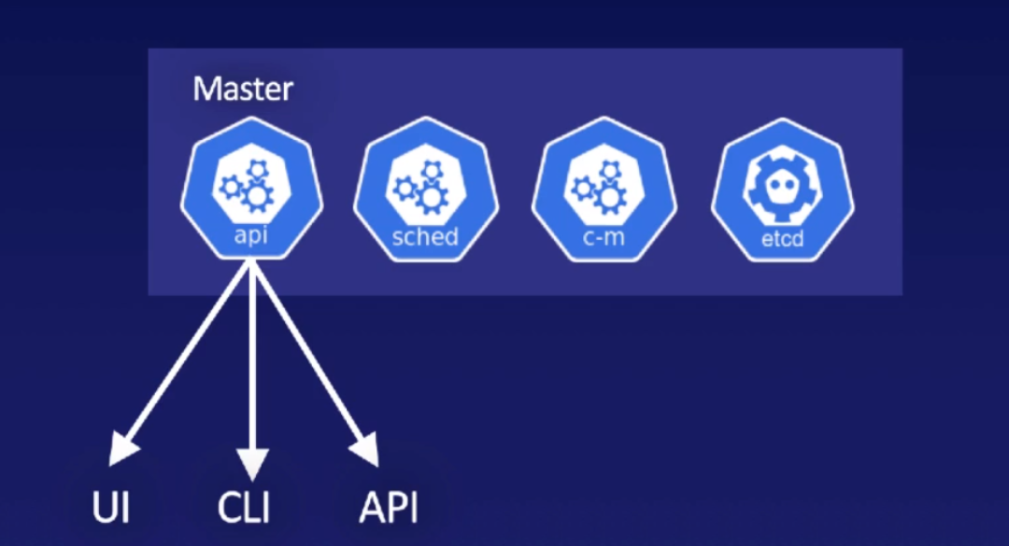
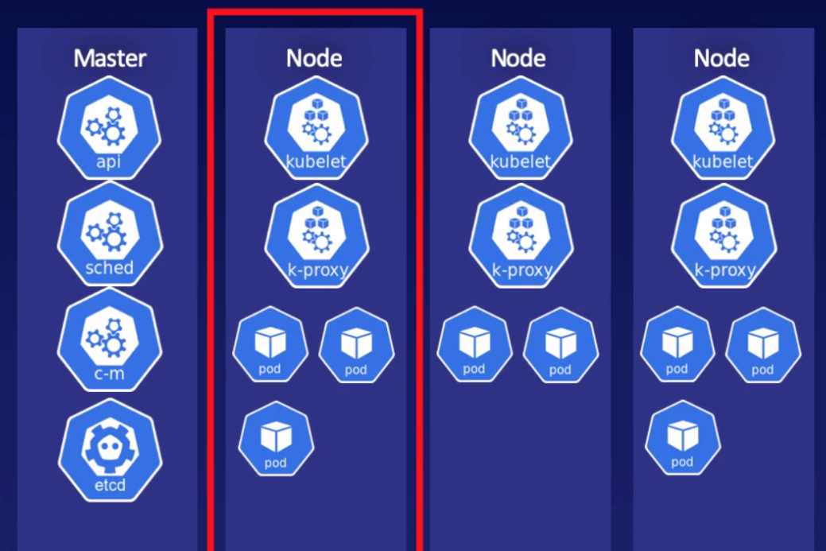
Master
Role is to schedule workloads in the form of pods and handle all events
Could be physical host or virtual machine/host
Could run on-premises or in the cloud
Node
Controlled by the master
Component of Node
Kubelet
Kube proxy
Pods

Slide 11
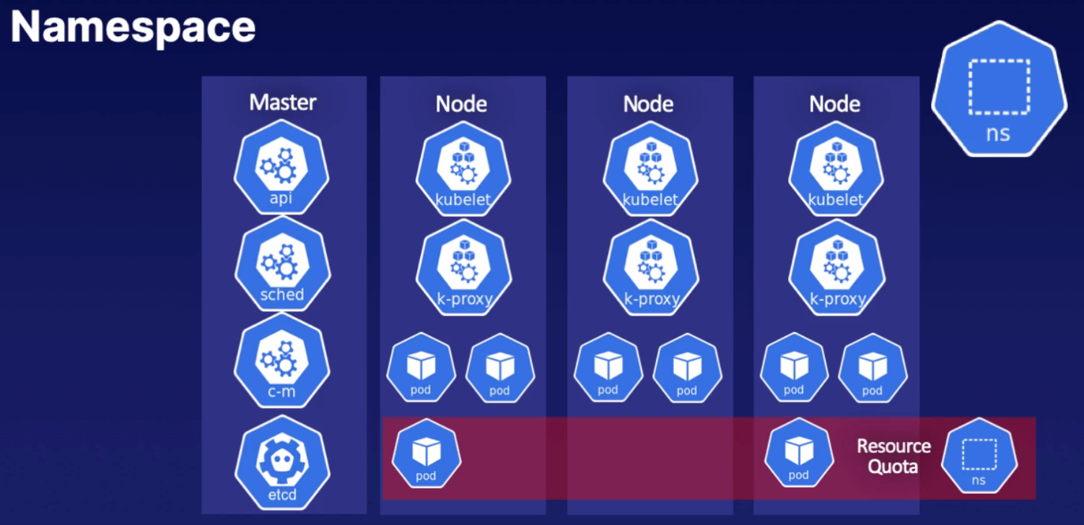
Namespace
A logical abstraction of the Kubernetes cluster tha allows you to support multiple virtual clusters. Resource quotas are used to mange resources consumed by each namespace.
Default namespaces are:
default
kube-system
kube-public

Slide 12
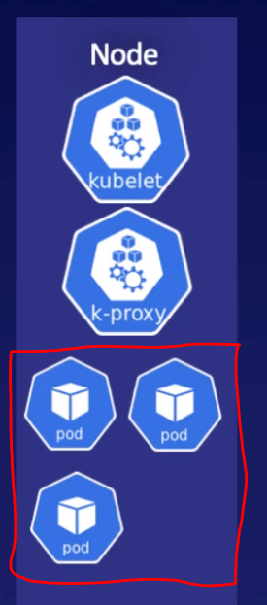
Pod
The unit of work in Kubernetes
Pods contain containers (One or multiple)
All containers in a pod have the same IP and can communicate with each other
All containers in a pod have access to the same shared storage
Every pod has unique UUID to identify it

Slide 13
Master Server

Slide 14
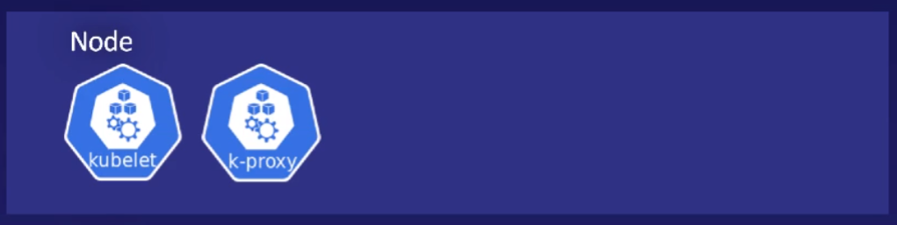
Node Server

Slide 15
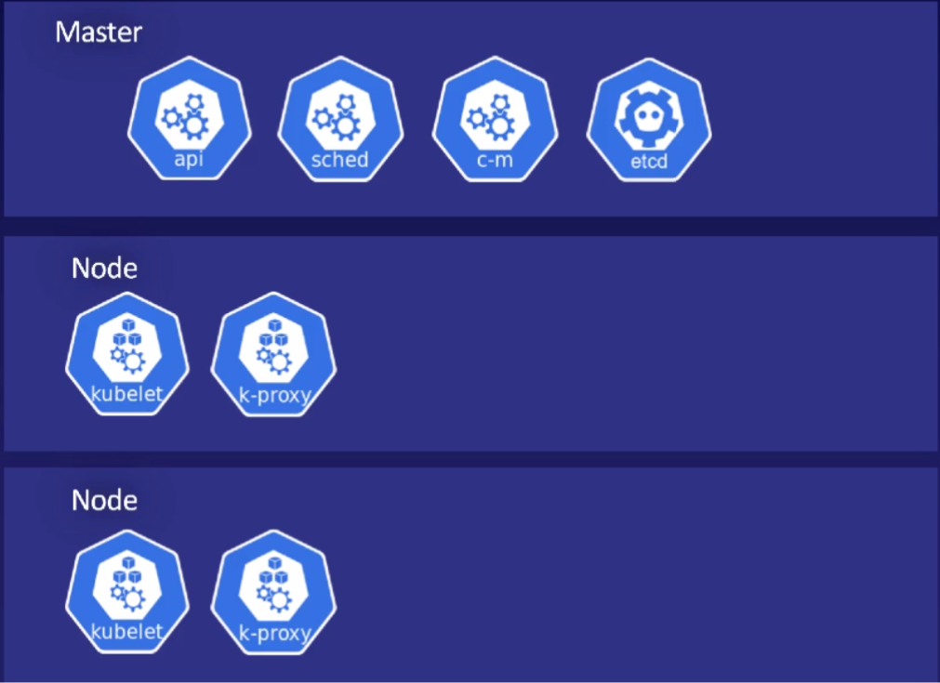
Architecture of Kubernetes

Slide 16
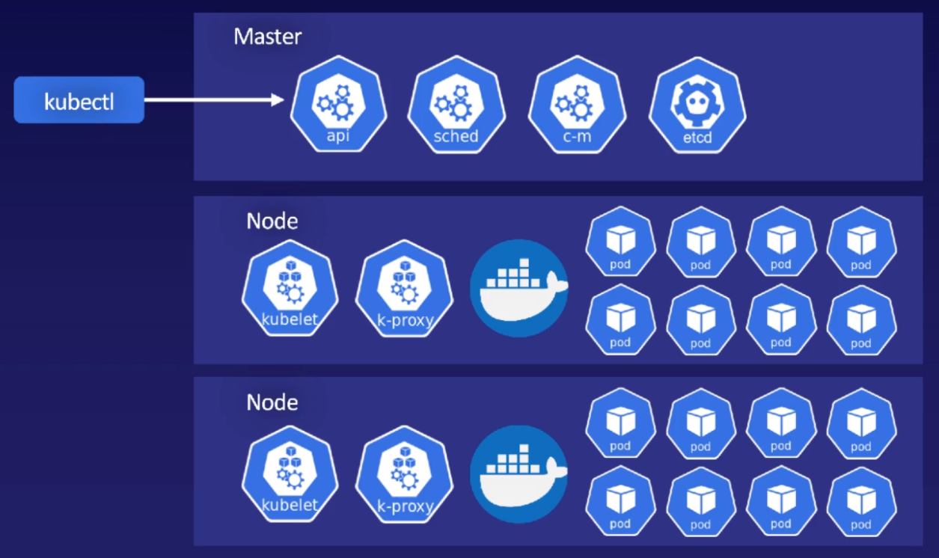
A whole playground

Slide 17
Summery
Why Kubernetes
Understand kubernetes
Monolithic vs Microservices applications
Understand docker and how it works
Kubernetes objects / terminologies
Cluster
Master
Node
Namespace
Pod
Kubernetes architechture

