Slide 1
Docker
A smart way to run micro services…..

Slide 2
What is Docker Container….
Docker is a set of platform as a service products that uses OS-level virtualization to deliver software in packages called containers. Containers are isolated from one another and bundle their own software, libraries and configuration files; they can communicate with each other through well-defined channels.

Slide 3
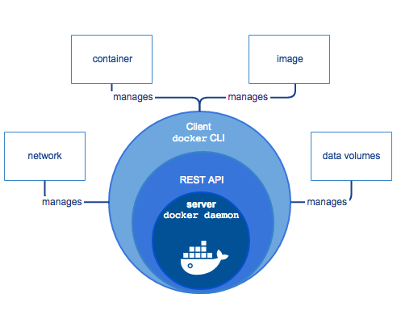
Docker engine

Slide 4
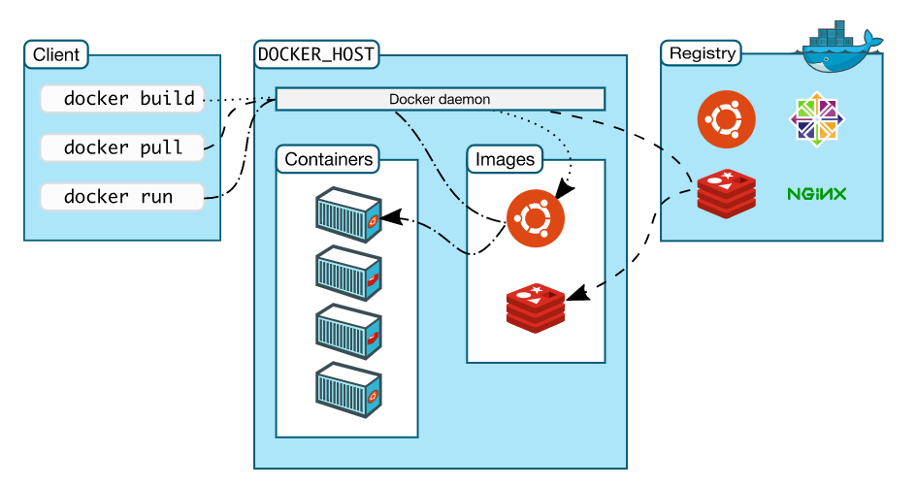
Docker Architecture

Slide 5
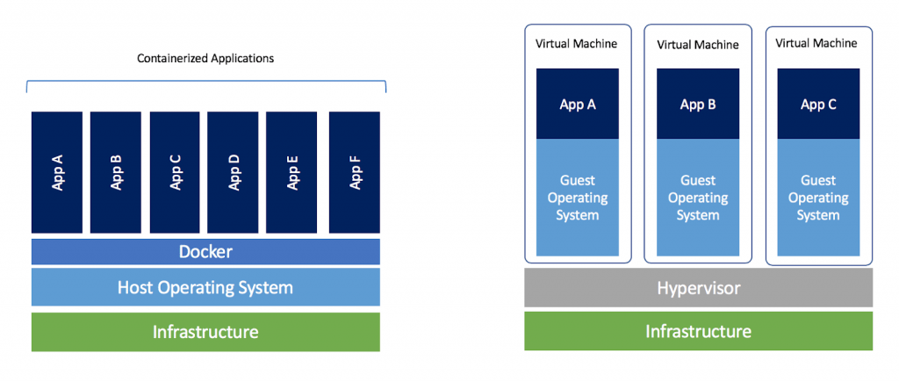
Docker vs VM

Slide 6
Docker Architecture
Docker uses a client-server architecture. The Docker client talks to the Docker daemon, which does the heavy lifting of building, running, and distributing your Docker containers. The Docker client and daemon can run on the same system, or you can connect a Docker client to a remote Docker daemon. The Docker client and daemon communicate using a REST API, over UNIX sockets or a network interface.
The Docker daemon – daemon who run Docker engine
The Docker client – system where containers will run
Docker registries – repository of Docker images
Services – way to scale container across multiple hosts
Docker objects
Images – iso/blueprint of container
Container - running virtual system
Volume – work as storage
Network – virtual network for containers

