Slide 1
Continuous Delivery Deployment Types
Minimum In-Service deployment
Rolling application updates
Blue/Green deployment
A/B testing
These four deployment types fall into two sub-categories: application and infrastructure deployment.

Slide 2
Minimum In-Service Deployments
With this method, we specify the minimum number of instances in our applications that stay in-service while updating the remaining percentage—therefore, deploying to as large a number of targets as possible. This process is repeated until all servers have been updated with the new release.

Slide 3
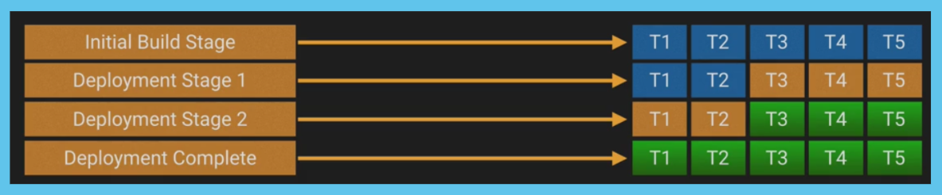
Example: If we have 5 containers each running our current application A, then we set our policy to keep a minimum in-service number of 2. We take 3 servers offline to update them to our new version B. Once these are completed and back online, we can update the remaining 2.

Slide 4
Disadvantages
The process happens in multiple stages, so support is necessary in the form of orchestration and health checks outside of Swarm
Does not work well for infrastructure changes
Changes are being run on live servers—recovery time may be necessary if one fails
Advantages
There are few moving parts, which means increased testing capability; make application and code changes within the process
No downtime and no additional infrastructure cost
The process is often quicker than a rolling deployment

Slide 5
Rolling Deployments
Consider rolling deployments as an extension of minimum in-service. However, rather than define the number of containers that should remain online, we specify the maximum number of containers to update in tandem.

Slide 6
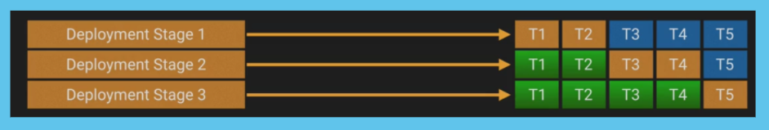
Example: We have the same 5 containers as before, but this time we initialize rolling updates by specifying the number of containers that may be updated simultaneously, e.g. 2. The process moves updates through 2 containers at a time until all the servers in the series are updated.

Slide 7
Disadvantages
Docker rolling updates deal with failure in two ways:
By pausing, allowing someone to jump in and rollback to fix
Or continuing regardless, meaning you may not discover a problem while the container is running
More complex than minimum in-service
Can be the least efficient in terms of deployment time; based on the time taken to update per stage
Again, we recommend orchestration and health checks outside of Swarm
Advantages
No downtime
Pausing is possible, permitting limited multi-version testing
Allows for automated testing—to assess deployment targets before continuing

Slide 8
Blue/Green Deployments
When following the Blue/Green (a.k.a. Red/Black) method, we replicate our “entire” infrastructure for a short time. The replicated infrastructure hosts the new application, while the old infrastructure continues to run until testing is complete and the new stack is adopted. The capabilities to achieve this have been around for a long time, but before the Cloud, it was an incredibly costly deployment method. Now, we can deploy stacks to a whole new environment—allowing for isolated evaluation—and thanks to the Cloud, at minimal costs. Once testing is complete, we switch our application over to the new version and shut down the legacy stack.

Slide 9
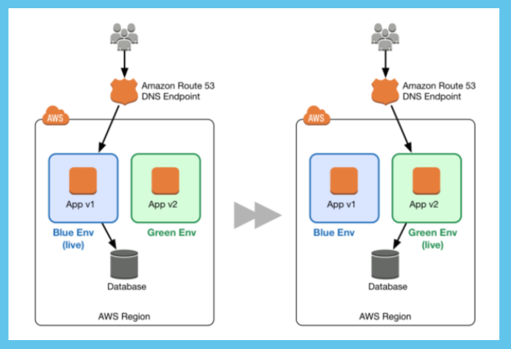
As the image depicts, Blue represents your current environment version, while the new variant you want to deploy is Green. Typically, this happens in the form of a DNS change, though you can deploy Blue/Green by modifying Auto Scaling Groups too.

Slide 10
Disadvantages
Requires advanced orchestration tooling
Some risk as the same database is necessary
Incurs some additional cost, though for a short time only
Unnatural user traffic will flood your servers—which is not the point for everything to break
Advantages
Reduced risk profile since infrastructure becomes immutable
Offers near zero-downtime
The switch is clean and controlled when using a DNS change
Process is fully automated and provides a larger validation window
It’s possible to test the entire environment’s health and performance before the switch

Slide 11
A/B Testing
A/B deployments are virtually identical to Blue/Green, but in this method, we send a small percentage of traffic to our new green environment. This method is capable of switching environments and changing infrastructure, but in a far more precise way than with Blue/Green deployment.

Slide 12
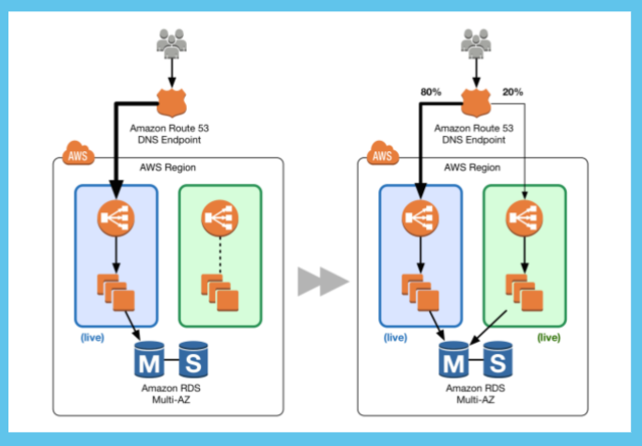
Selecting your method of deployment comes down to what best suits your business and technical needs. If it makes sense for your application and user base, it is highly recommend leveraging A/B testing where possible.

Slide 13
Disadvantages
In comparison to the aforementioned deployment methods, there are a lot of moving parts
Much more complex
Requires full automation of everything
Advantages
All the benefits of Blue/Green deployments, plus:
We can predictably scale capacity and pre-warm production
Use to test new features and make gradual assessments on performance, stability, and health
We gain customer validation while mitigating blast impact and widespread errors

