Slide 1
KUBERNETES
……best way to run microservices
…..best way for container orchestration
…….best way to run application on cloud platform

Slide 2
WHY KUBERNETES??????
Production growth 200%
companies using cloud native technologies in production, usage has increased by 200%
Best platform to run microservices applications….
IT industries are going from monolithic applications to microservices applications
A strong career for future
Number of industries migrating to cloud technology, where they want to deploy there applications

Slide 3
Understand KUBERNETES
To understand kubernetes we need to understand four things….
Monolithic vs Microservices applications
How container works
Kubernetes objects / terminologies
Kubernetes architechture

Slide 4
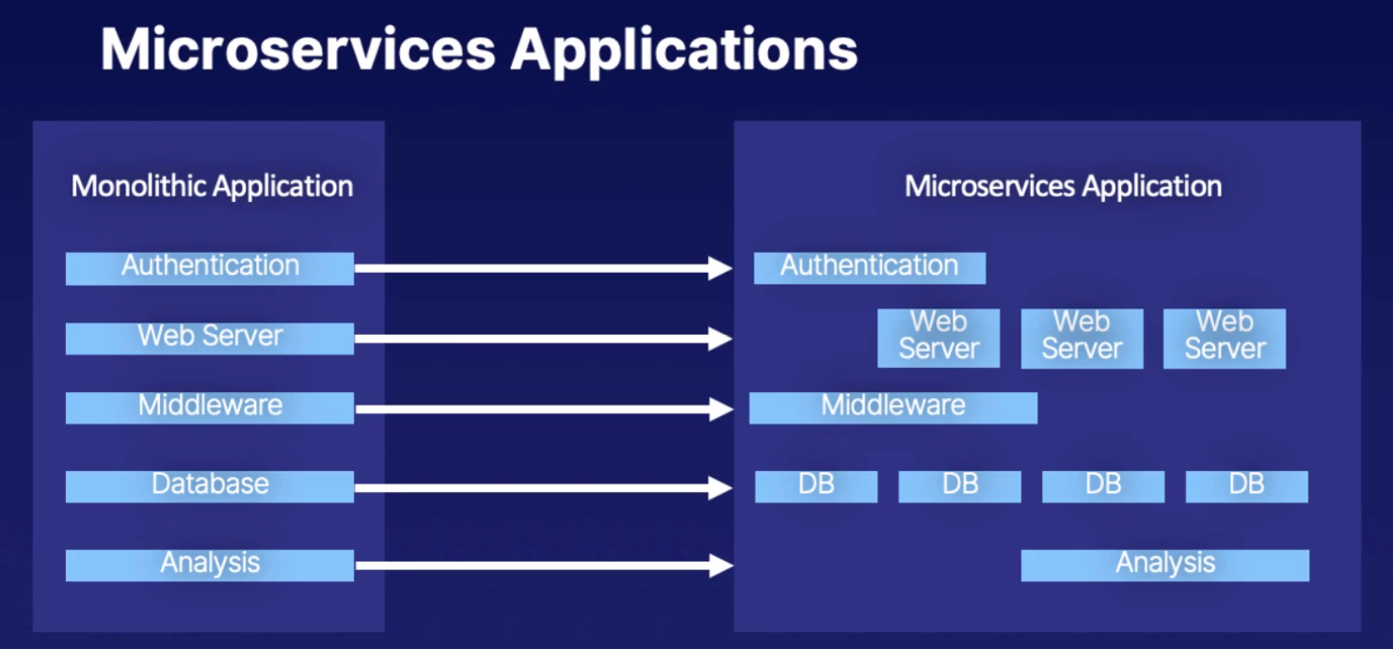
Type of Applications

Slide 5
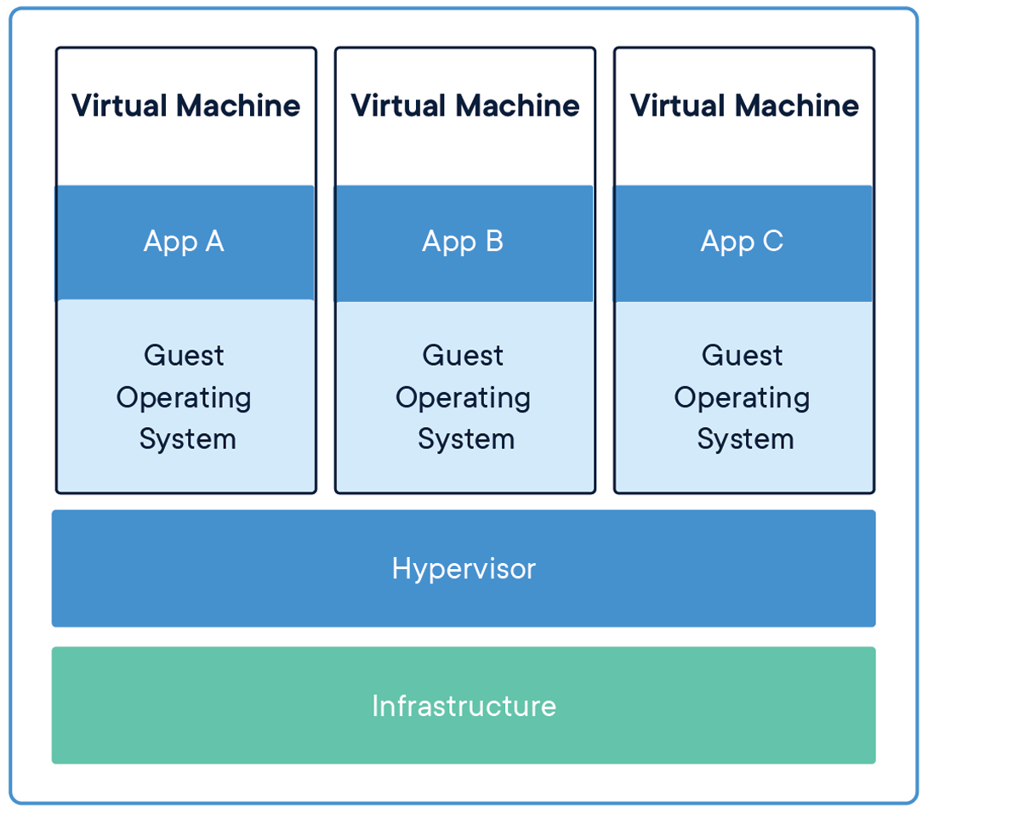
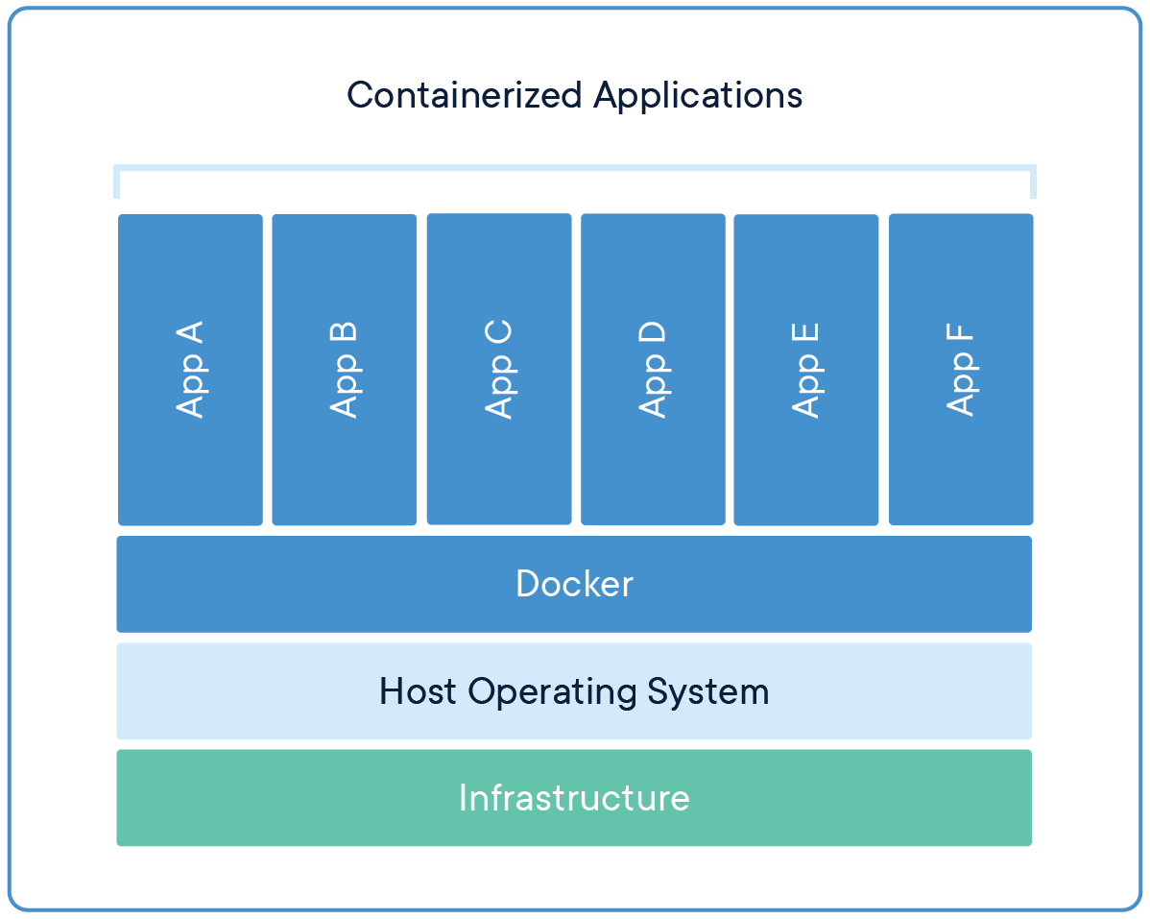
Understand docker and how it works VM / docker

Slide 6
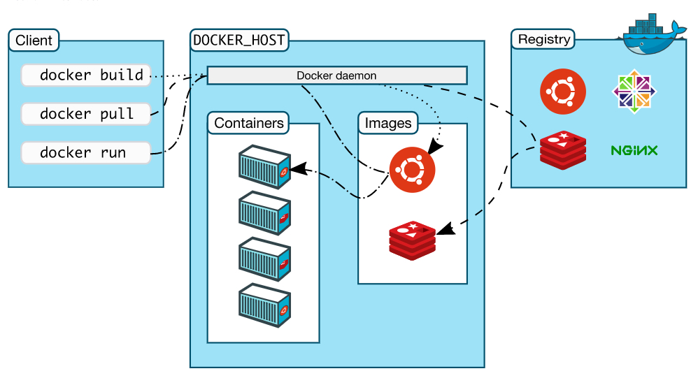
Understand docker and how it works Architecture

Slide 7
Kubernetes objects / terminologies
Container Orchestration
Cluster
Master
Api
sched
c-m
etcd
Node
K-proxy
Kublet
pod
Namespace
Pod

Slide 8
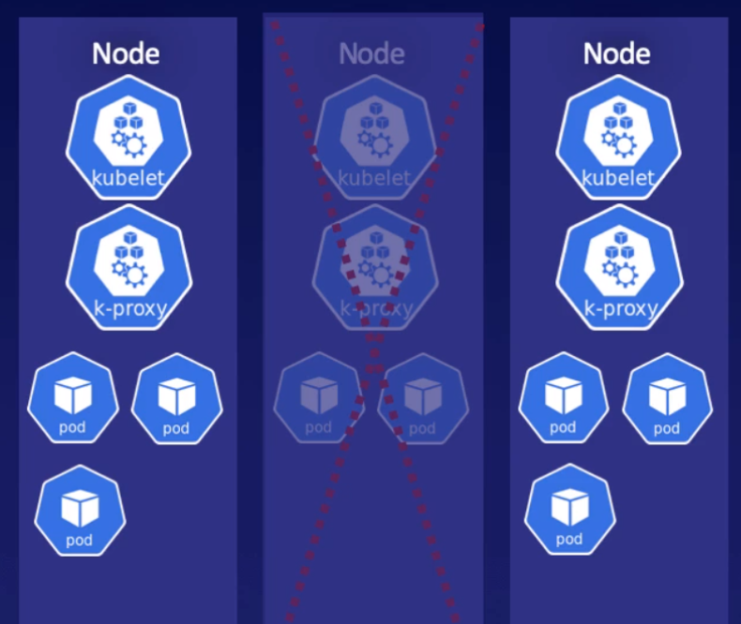
Container Orchestration
Container orchestration automates the deployment, management, scaling, and networking of containers.
Container orchestration can be used in any environment where you use containers. It can help you to deploy the same application across different environments without needing to redesign it.
High availability
Load balanced
Resource management
Desired state configuration
Uses a “declarative model” – i.e. You can declare application availability, like you want at any given point of time 6 pods should be running for particular application, and one node goes down, then it automatically bring up 2 pods on another nodes.

Slide 9
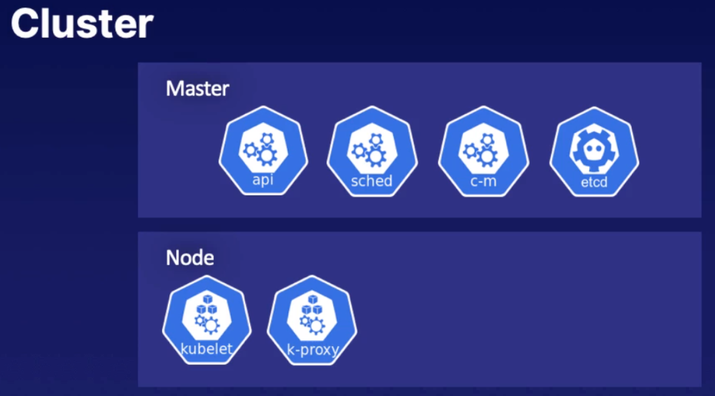
Cluster
A collection of nodes(hosts), storage and network resources, used to run your workloads
You may have one or multiple clusters
Every cluster will have at least one master

Slide 10
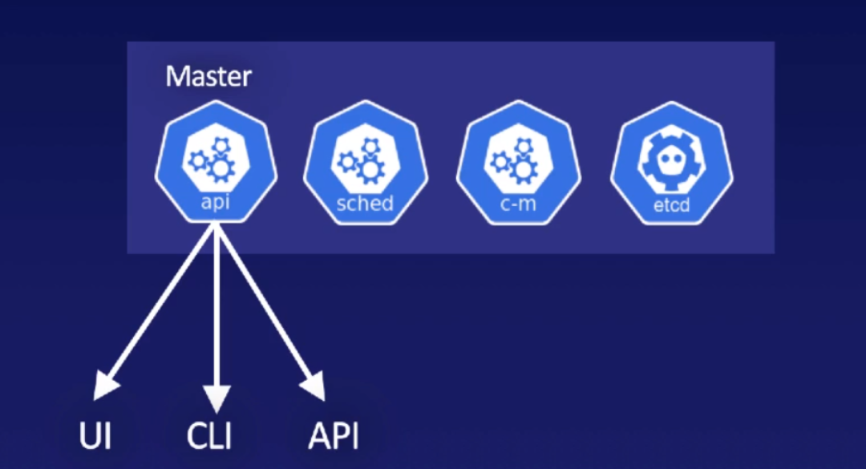
Master
Role is to schedule workloads in the form of pods and handle all events
Could be physical host or virtual machine/host
Could run on-premises or in the cloud
Components of Master
api
sched
c-m
etcd

Slide 11
kube-apiserver
The Kubernetes API server validates and configures data for the api objects which include pods, services, replicationcontrollers, and others.
The API Server services REST operations and provides the frontend to the cluster's shared state through which all other components interact.

Slide 12
kube-scheduler
The Kubernetes scheduler is a control plane process which assigns Pods to Nodes.
The scheduler determines which Nodes are valid placements for each Pod in the scheduling queue according to constraints and available resources.
The scheduler then ranks each valid Node and binds the Pod to a suitable Node.

Slide 13
kube-controller-manager
The Kubernetes controller manager is a daemon that embeds the core control loops shipped with Kubernetes.
In Kubernetes, a controller is a control loop that watches the shared state of the cluster through the api server and makes changes attempting to move the current state towards the desired state.
Examples of controllers that ship with Kubernetes today are the replication controller, endpoints controller, namespace controller, and service accounts controller.

Slide 14
etcd
Consistent and highly-available key value store used as Kubernetes' backing store for all cluster data.
If your Kubernetes cluster uses etcd as its backing store, make sure you have a back up plan for those data.

Slide 15
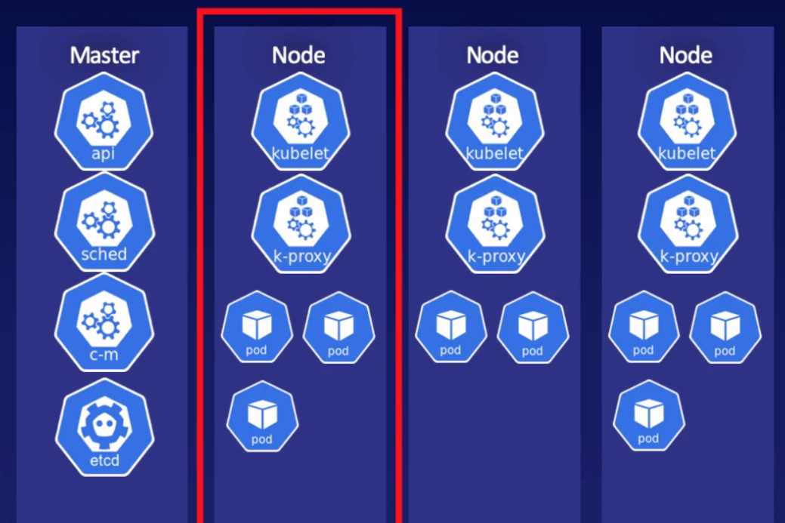
Node
Controlled by the master
Component of Node
Kubelet
Kube proxy
Pods

Slide 16
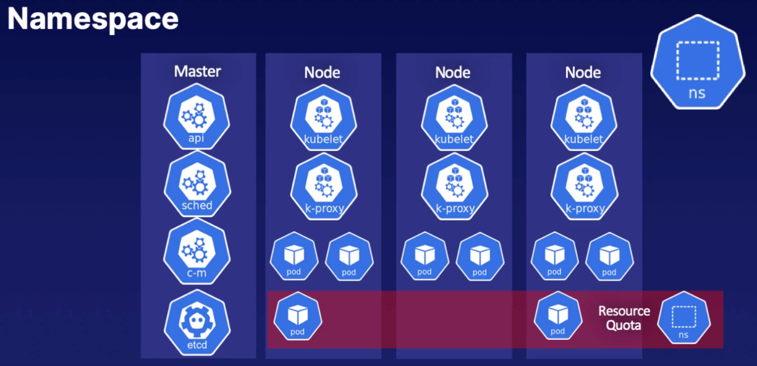
Namespace
A logical abstraction of the Kubernetes cluster that allows you to support multiple virtual clusters. Resource quotas are used to mange resources consumed by each namespace.
Default namespaces are:
default
kube-system
kube-public

Slide 17
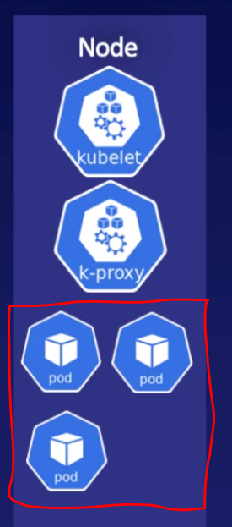
Pod
The unit of work in Kubernetes
Pods contain containers (One or multiple)
All containers in a pod have the same IP and can communicate with each other
All containers in a pod have access to the same shared storage
Every pod has unique UUID to identify it

Slide 18
Master Server

Slide 19
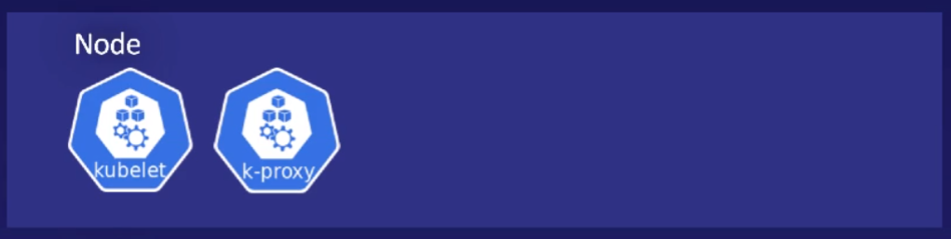
Node Server

Slide 20
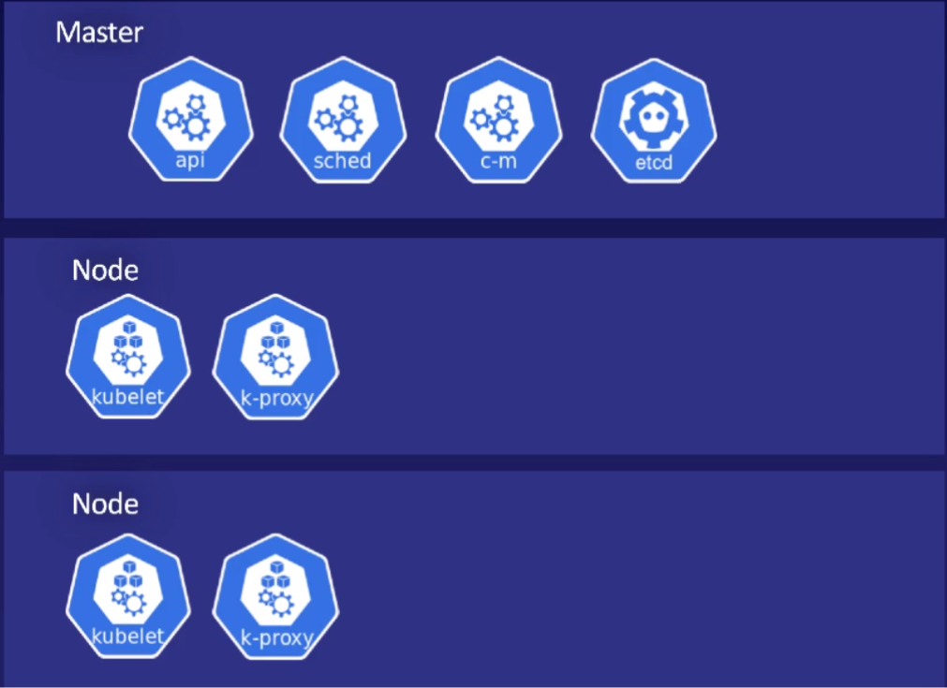
Architecture of Kubernetes

Slide 21
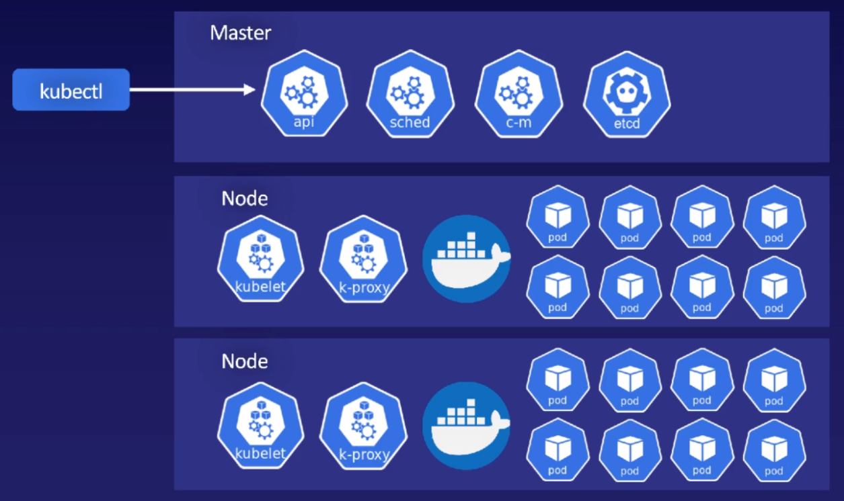
A whole playground

Slide 22
Summery
Why Kubernetes
Understand kubernetes
Monolithic vs Microservices applications
Understand docker and how it works
Kubernetes objects / terminologies
Cluster
Master
Node
Namespace
Pod
Kubernetes architechture

