Slide 1



Slide 2
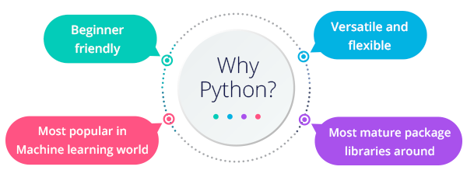
Why Phython

Slide 3
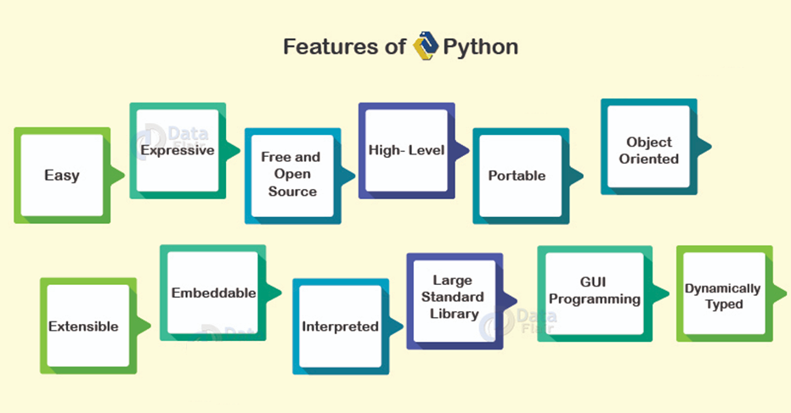

Slide 4
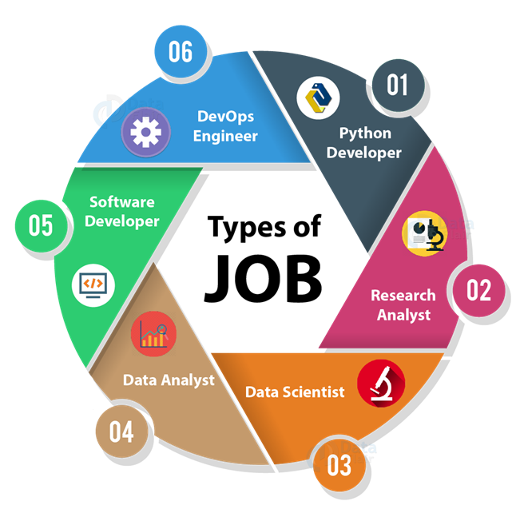

Slide 5
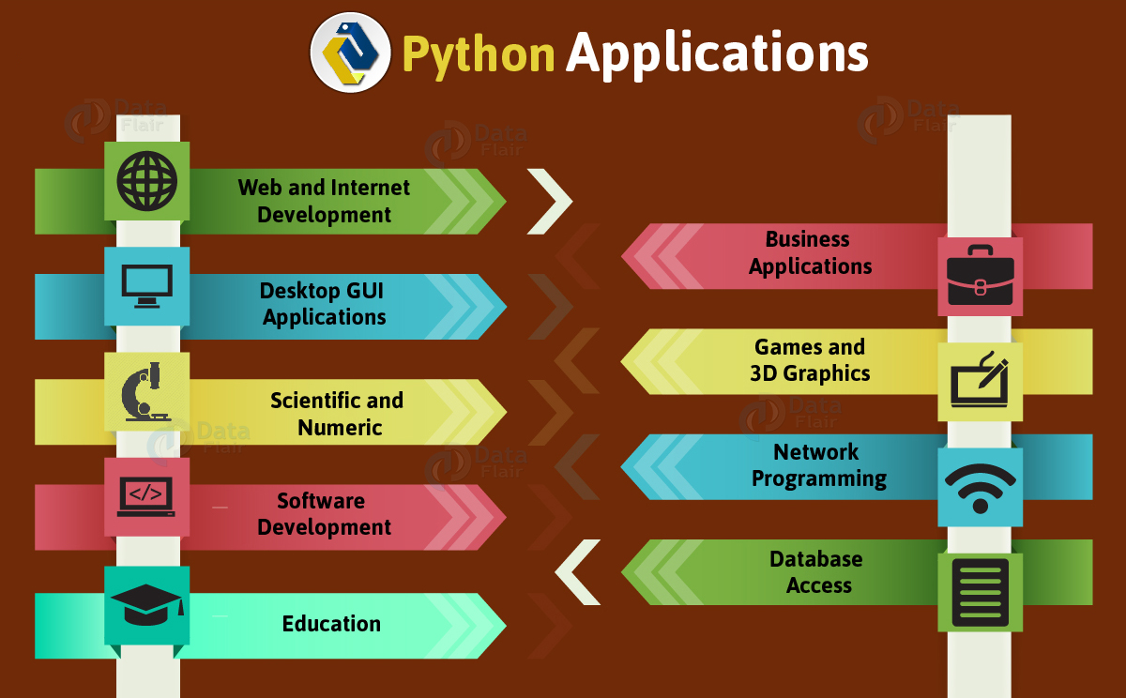

Slide 6
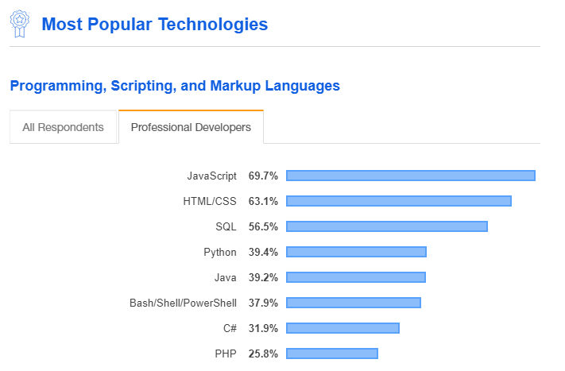
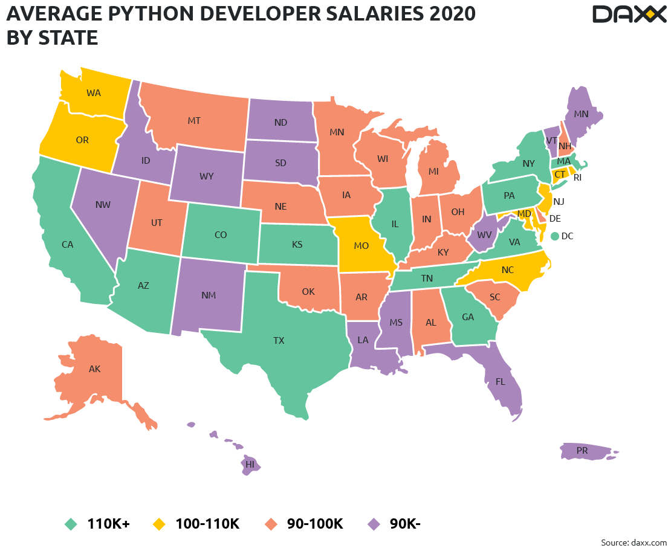
Python Popularity and Salary (Source – daxx.com)

Slide 7
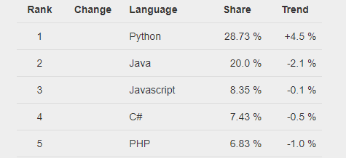
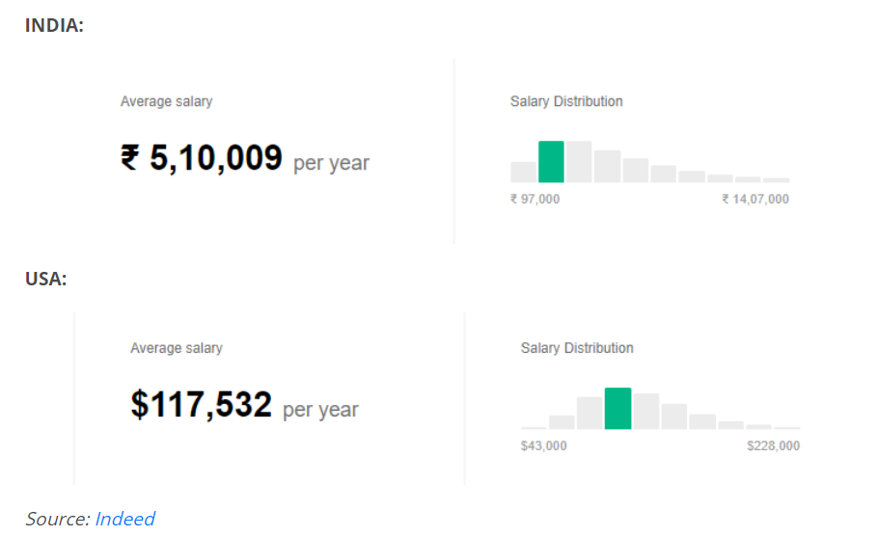
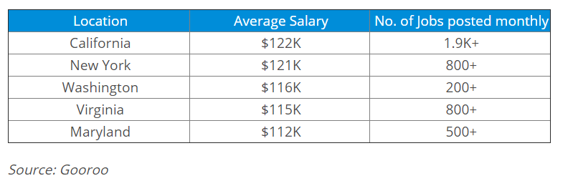
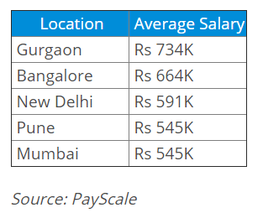
Source : GitHub

Slide 8
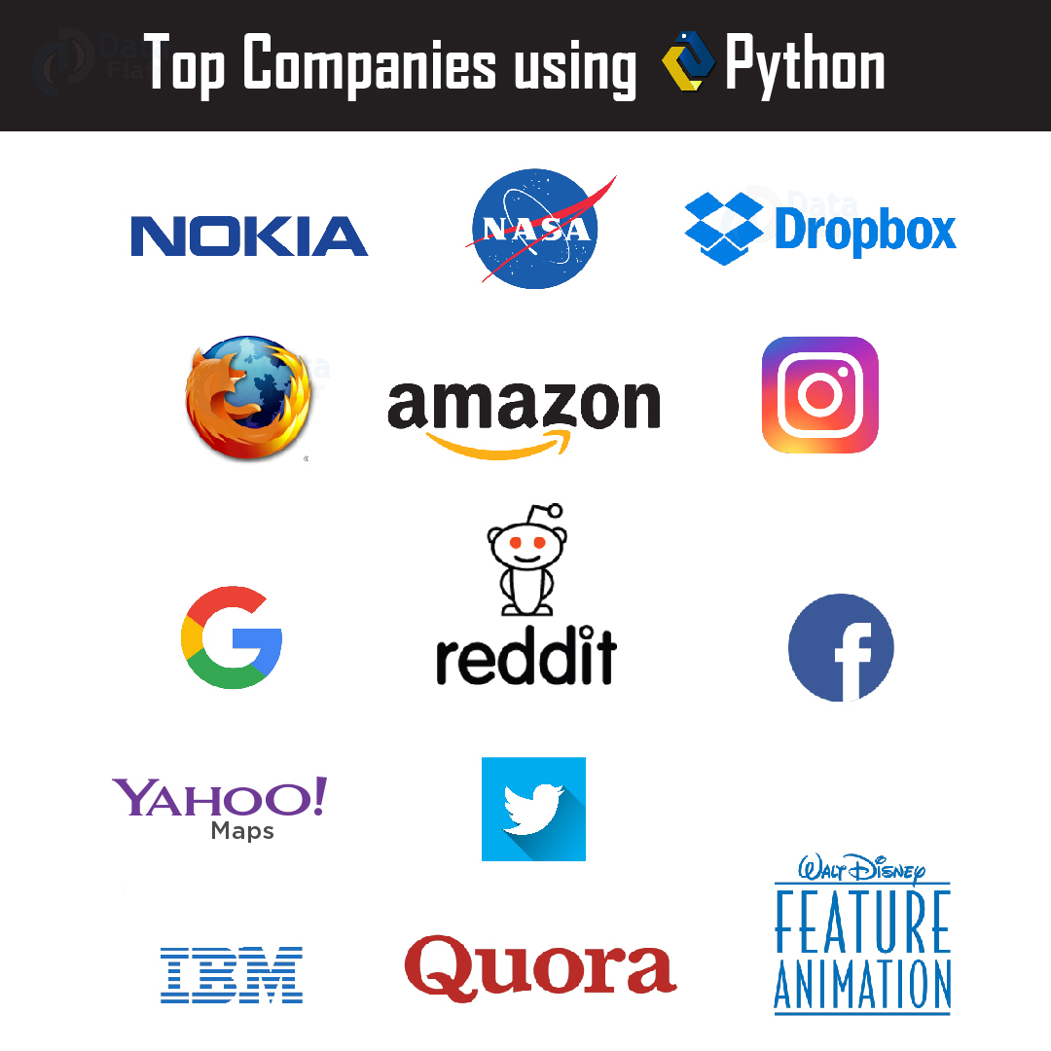

Slide 9
What we are going to cover
1. Installation
Python Object and Data Structure Basics
Default functions with data types
Operators
Mathematical operators
Comparison operators
2. Loops and Statements
3. Methods and Functions
4. OOPS concept
5. Modules and Packages
6. Errors and Exceptions Handling
7. Numpy and Panda (Foundation for Data Science)
8. Database(Mysql) with Python
9. Web development with Flask Web Framework (Foundation for Web Developer)

Slide 10
So….let’s start….

