Slide 1
Foot Step Based Power Generation For Mobile Charging
Made By -
Nishant Virakar
Rutik Raut
Nikhil Mote
Viraj Nikam
Under Guidance -
Prof.Bhagawat Uchale

Slide 2
Motivation
Harness piezoelectricity to convert footsteps into sustainable energy for mobile charging. Empower communities, reduce carbon footprints and step into an eco-friendly future with every step.

Slide 3
Introduction
As mobile devices proliferate, piezoelectric materials can convert footsteps into clean, renewable electricity, addressing energy depletion and environmental concerns for portable mobile charging solutions.
Piezoelectric materials convert footstep-induced vibrations into electrical energy, efficiently charging mobile devices while promoting sustainable and eco-friendly solutions for our environments.

Slide 4
Literature Survey
Applications
Early studies demonstrate the potential of piezoelectric cantilevers for ambient vibration energy harvesting.
Piezoelectric materials offer a unique method to convert mechanical stress from footsteps into electrical energy
Benefits
Provides renewable and clean energy source, reducing carbon footprints.
Practical Solution for using in open and public environment.

Slide 5
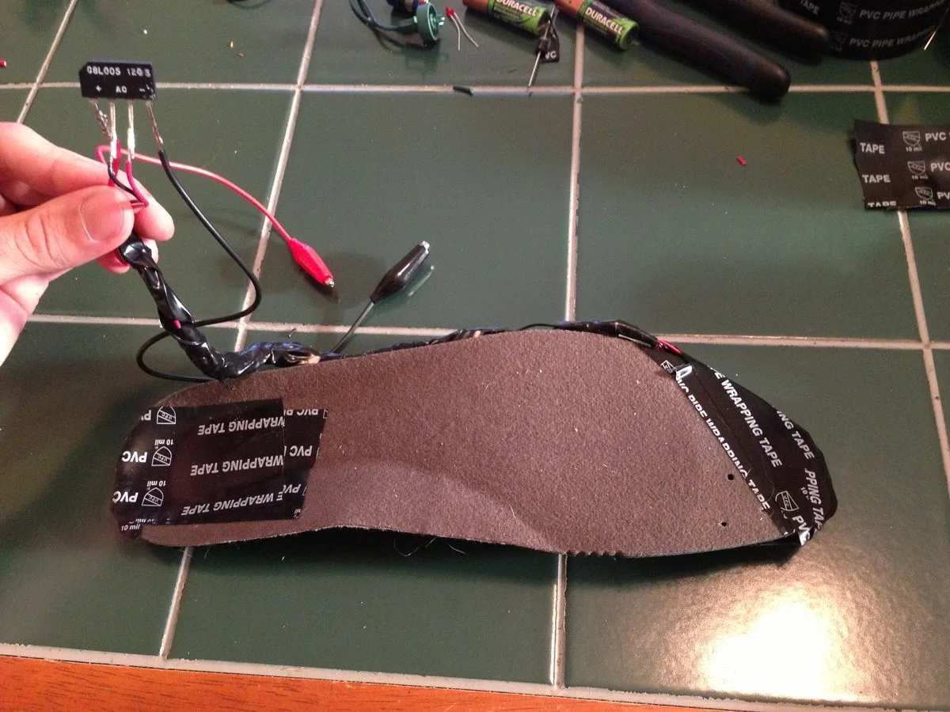
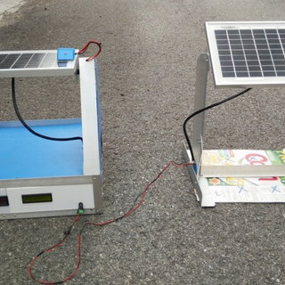
Existing System
Fig.1 Used in Shoes
Study Conduct By : Open Idea
Fig.2 Used in Solar Panels
Study Conduct By: Science Direct

Slide 6
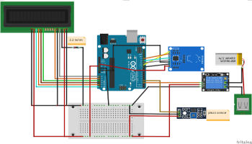
Proposed System
Piezo Disk
Arduino UNO
Lithium Battery
RFID Reader

Slide 7
Problem Occurs
Circuit Optimization for Produce large amount of Electricity
Piezo Material Choice
Quartz
Piezoelectric Polymers
Battery capacity

Slide 8
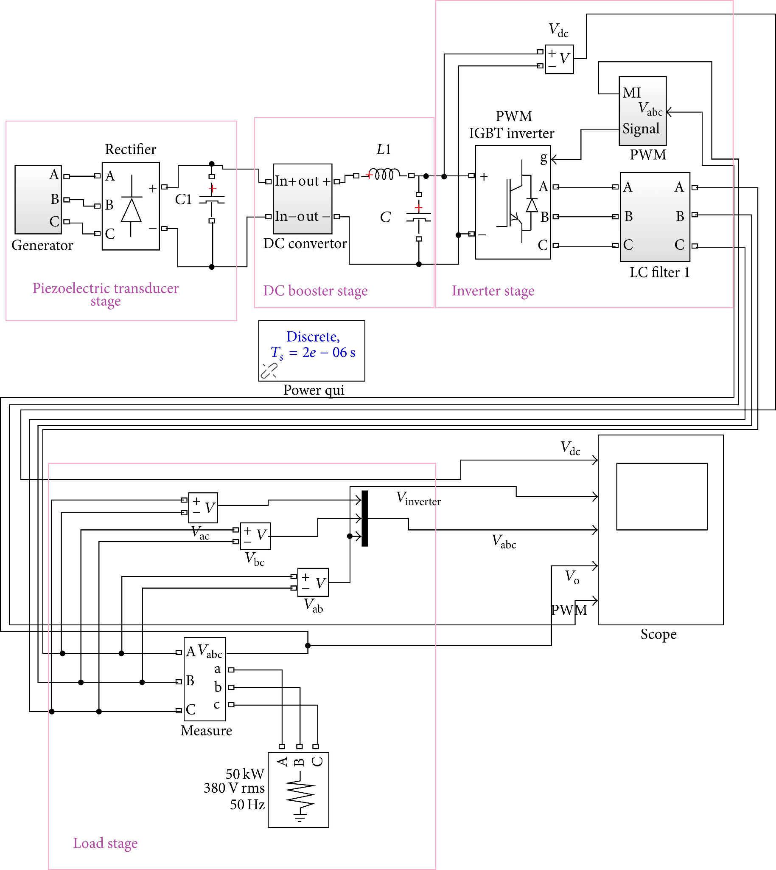
Piezoelectric Tiles:
Embed piezoelectric tiles in flooring or structural components to capture mechanical energy from foot traffic.
Energy Harvesting Circuit:
Convert mechanical energy from piezoelectric tiles into electrical energy using dedicated circuitry.
Energy Storage:
Store harvested energy in capacitors or batteries for later use or continuous supply.
Power Management System:
Manage distribution of stored energy to power electronic devices or feed back into the grid as needed.
System Architecture

Slide 9
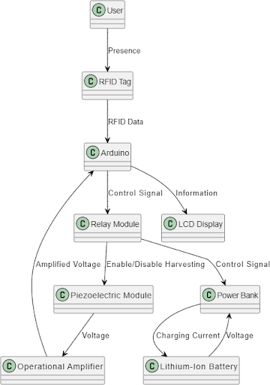
Application Design
Data Flow Diagram
Data Flow Diagram

Slide 10
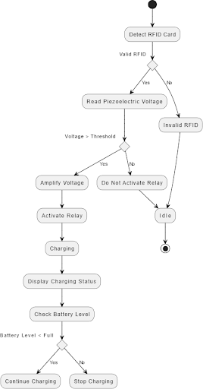
Application Design
Data Flow Diagram
Use case Diagram

Slide 11
Application Advantages
Renewable Energy Source:
Utilizes a renewable energy source generated by human activities, making it an environmentally friendly solution.
Off-Grid Power Generation:
Can be deployed in off-grid or remote areas, providing a sustainable power source where traditional power infrastructure is lacking.
Promotes Energy Awareness:
Raises awareness about energy consumption and encourages a more sustainable lifestyle by directly involving individuals in power generation.

Slide 12
Limitations:
Future Scope:
1 Limited Power Output:
The amount of power generated per footstep is relatively small, limiting the system's ability
2 Initial Installation Costs:
The upfront costs of installing the system, including piezoelectric materials, RFID readers, and electronic components, may be relatively high.
1. Technological Advancements:
2 Improvement Hardware Durability

Slide 13
Reference
Mazwin Mazlan and Mohamad Hazlami Abd Manan, "Modelling and Analysis Road Energy Harvester Using Piezoelectric Transducer", International Journal of Engineering & Technology, vol. 8, no. 1.7, pp. 94-100, 2019.
Mervyn Fernandes, Minal Patil, Vedant Desai and Asawari Dudwadkar, "Implementation of Piezoelectric Sensors for Generation of Power", International Journal of Innovative Research in Science Engineering and Technology, vol. 6, no. 4, April 2017.
S. S. Taliyan, B. B. Biswas, R. K. Patil and G. P. Srivastava, "Electricity from Footsteps", International Journal for Innovative Research in Science, 2013

Slide 14
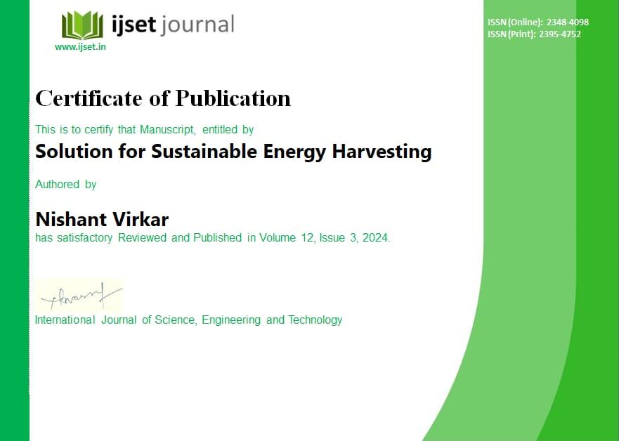
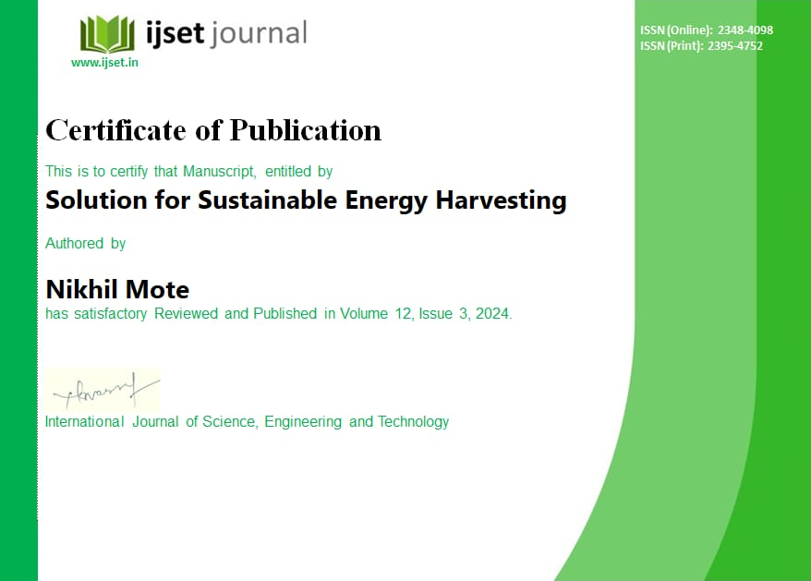


Publication

Slide 15
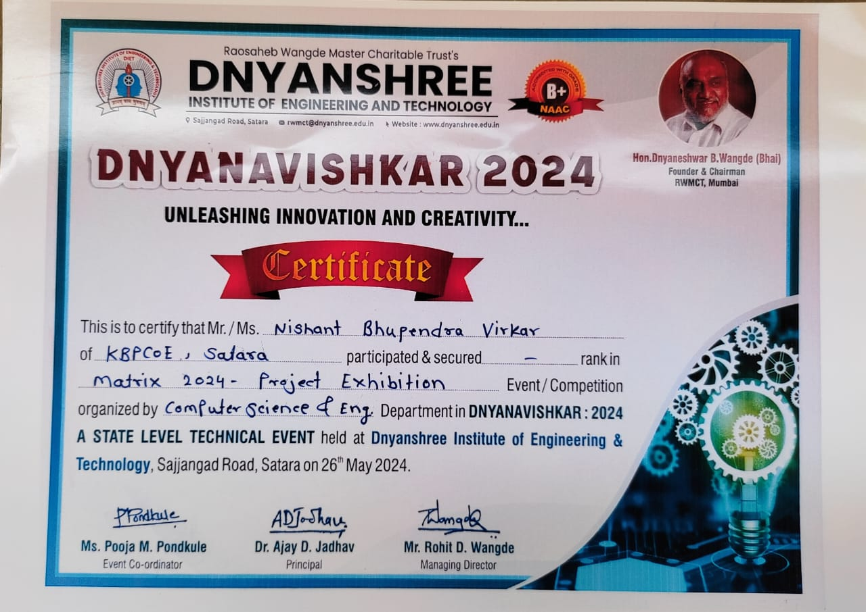
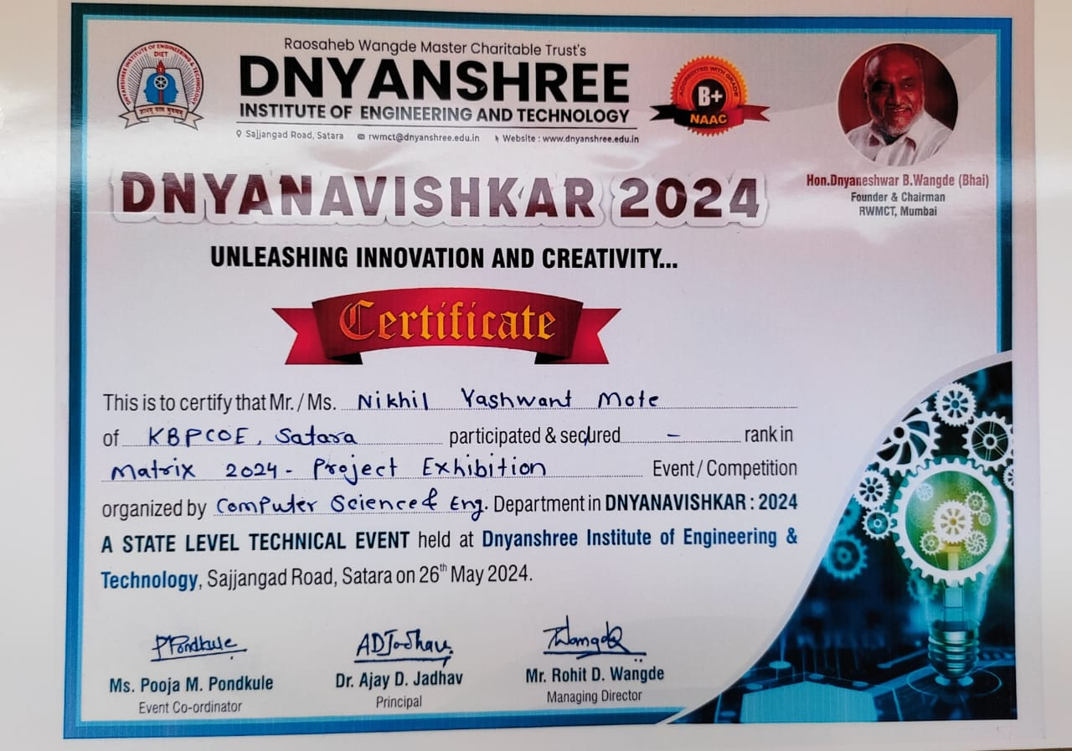
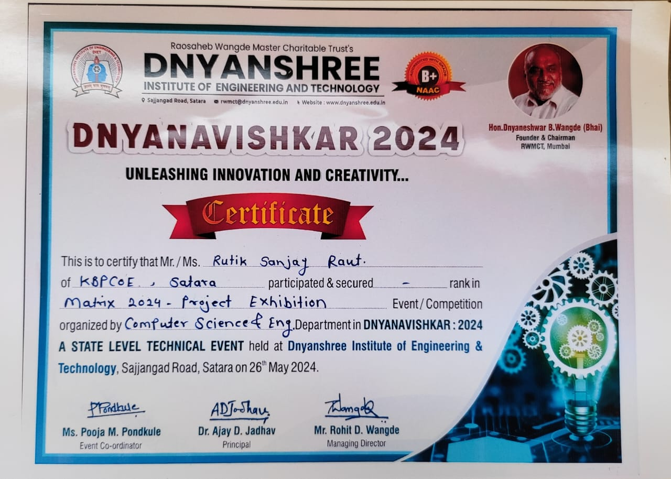
Participation

Slide 16
Project
Img upload kra project chi

