Slide 2
Design Maze Experiments
start and goal should be out of the danger zone
The greedy path must pass through the danger zone
the horizon must not be too long

Slide 3
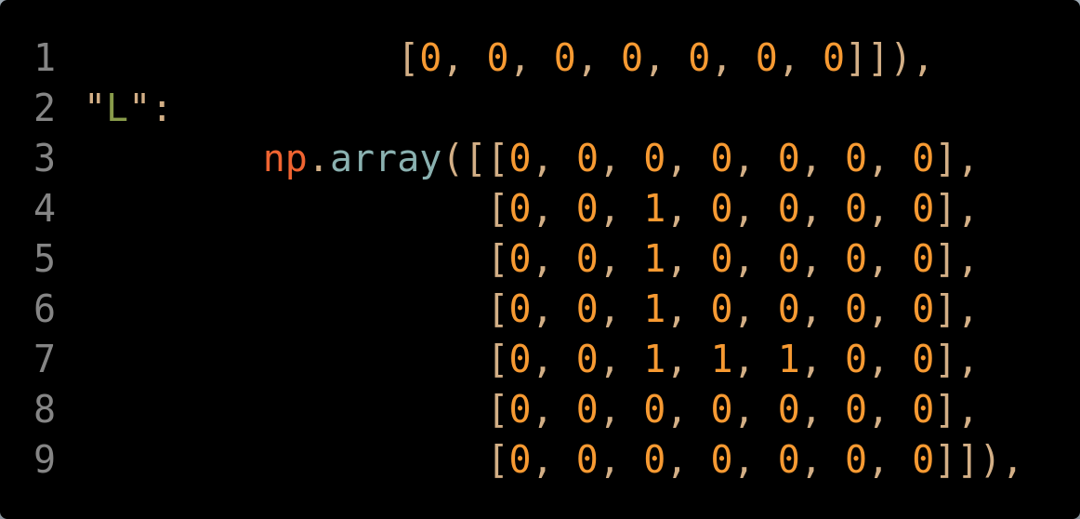
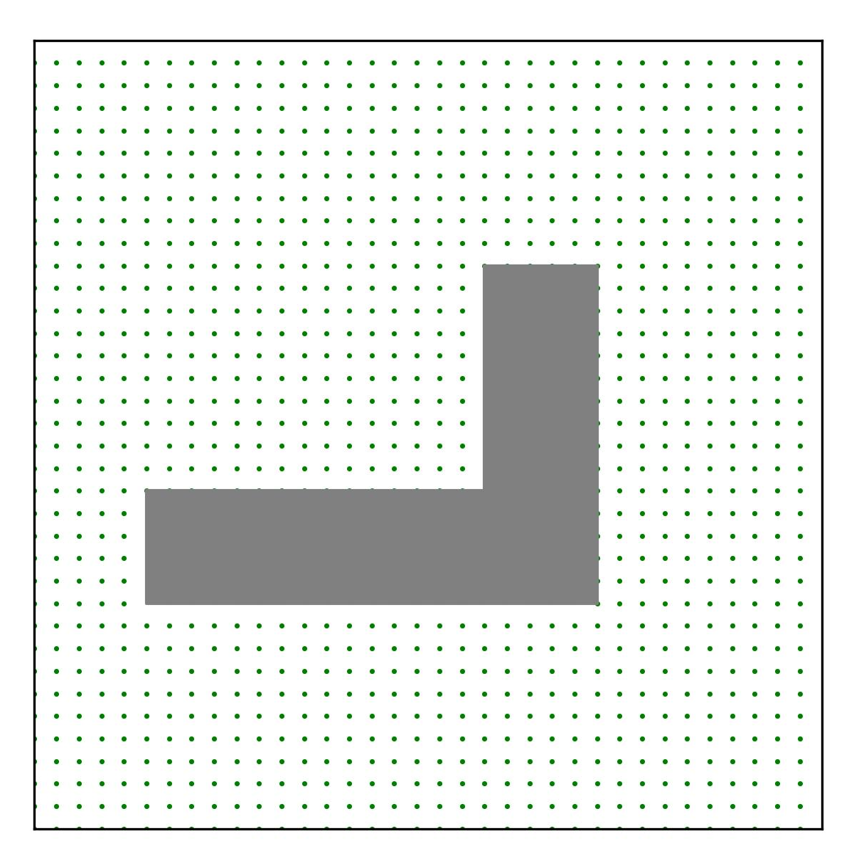
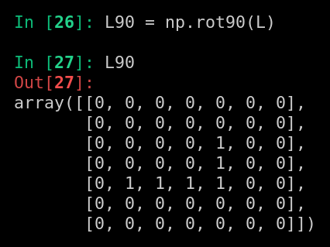

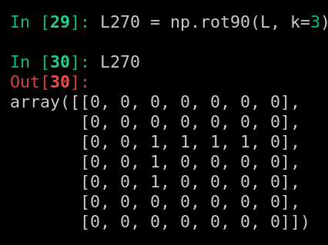

Numpy Array to Plot
mapping from numpy array to visual:
counter-clockwise 90 degree
code: pud/envs/safe_pointenv/unit_tests/test_plot_orientation.py

Slide 4
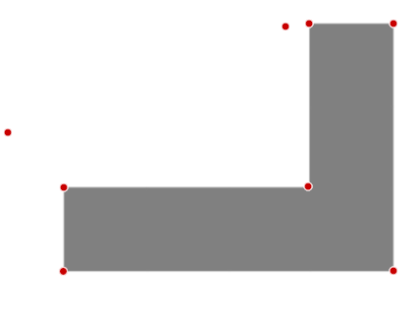
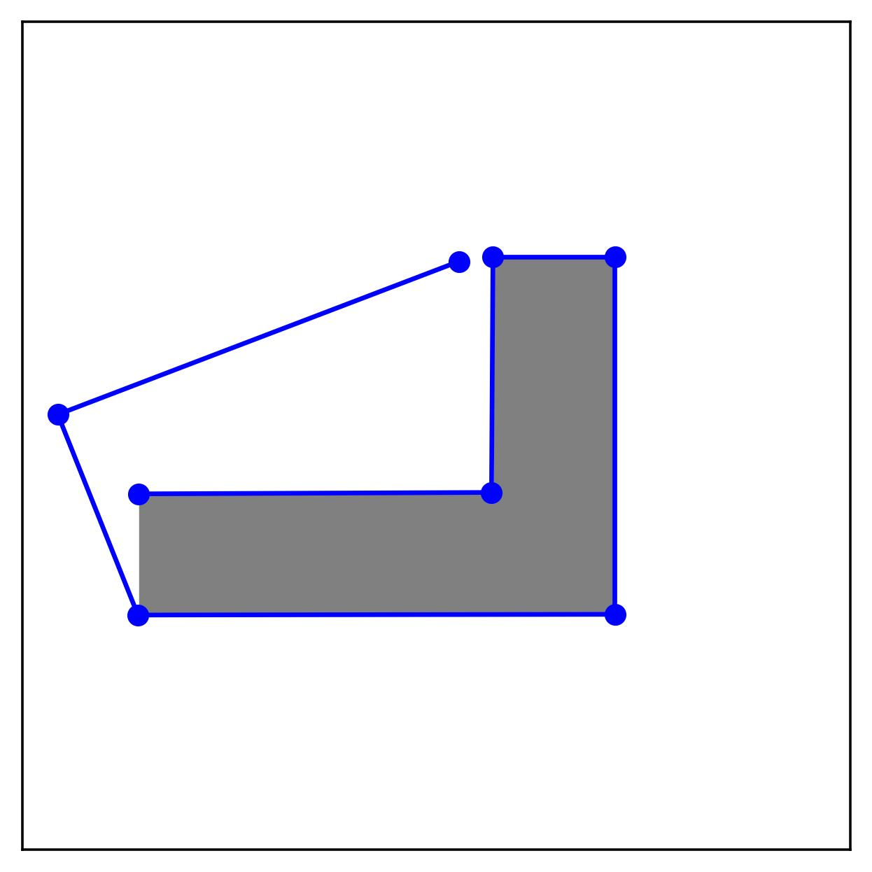
Plot Readings to Numpy Array
Points selected by Digitizer matches the visualization without change

Slide 5
Coord Mapping
map numpy array
plotted map
point coords from points selected on image
90 CCW visually
same
Conclusion: no flipping is needed as no need to match numpy array and plotted map. With the orientation mismatch (and don’t bother it), the coords are the same throughout

