Slide 1



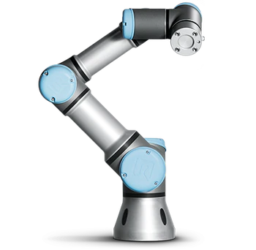


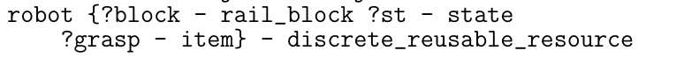

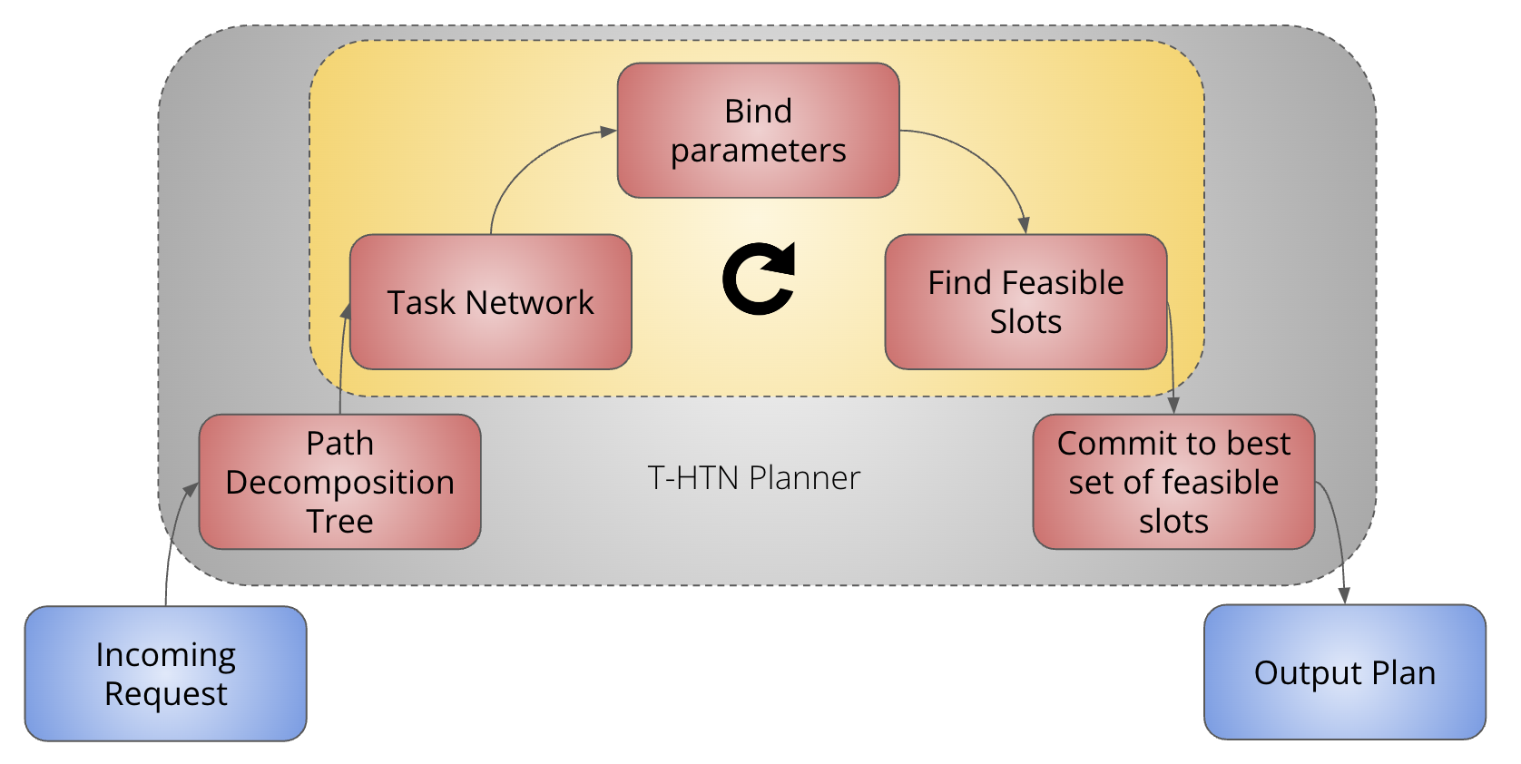
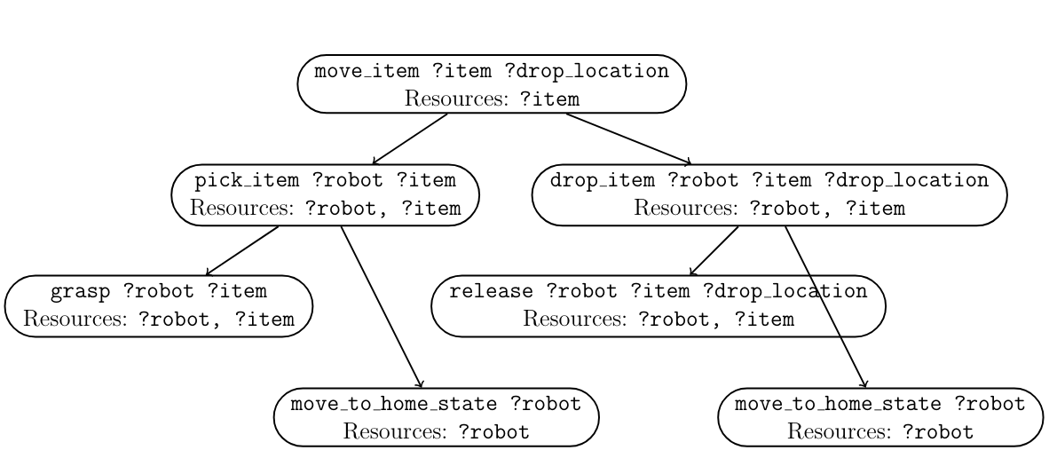

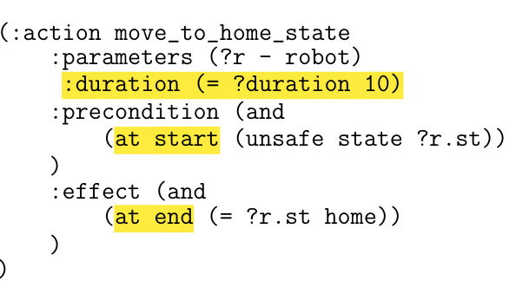
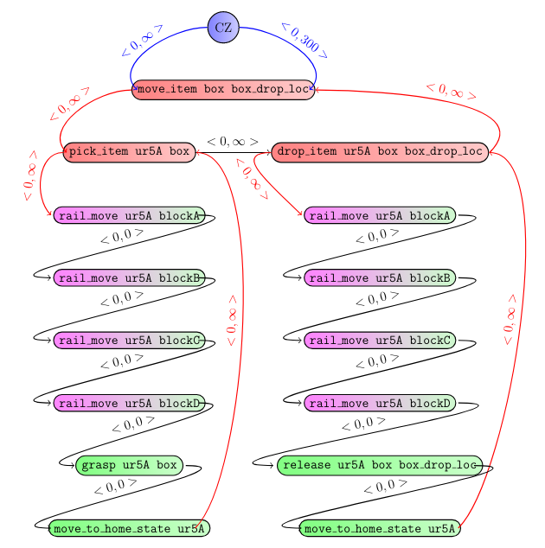
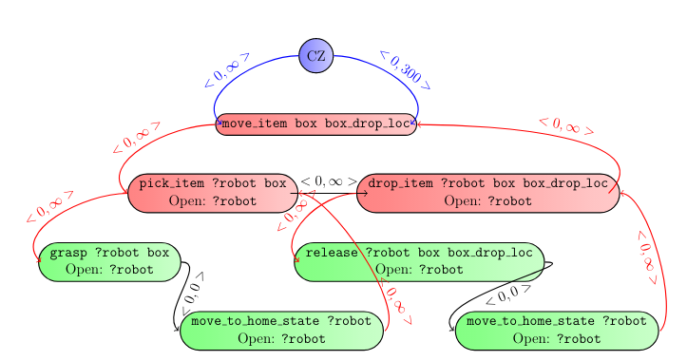
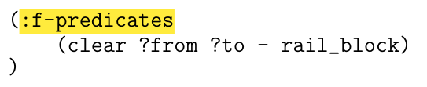
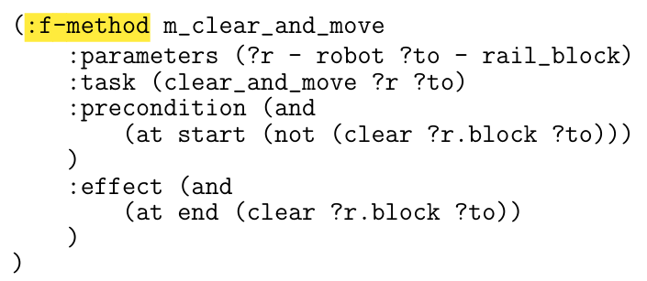
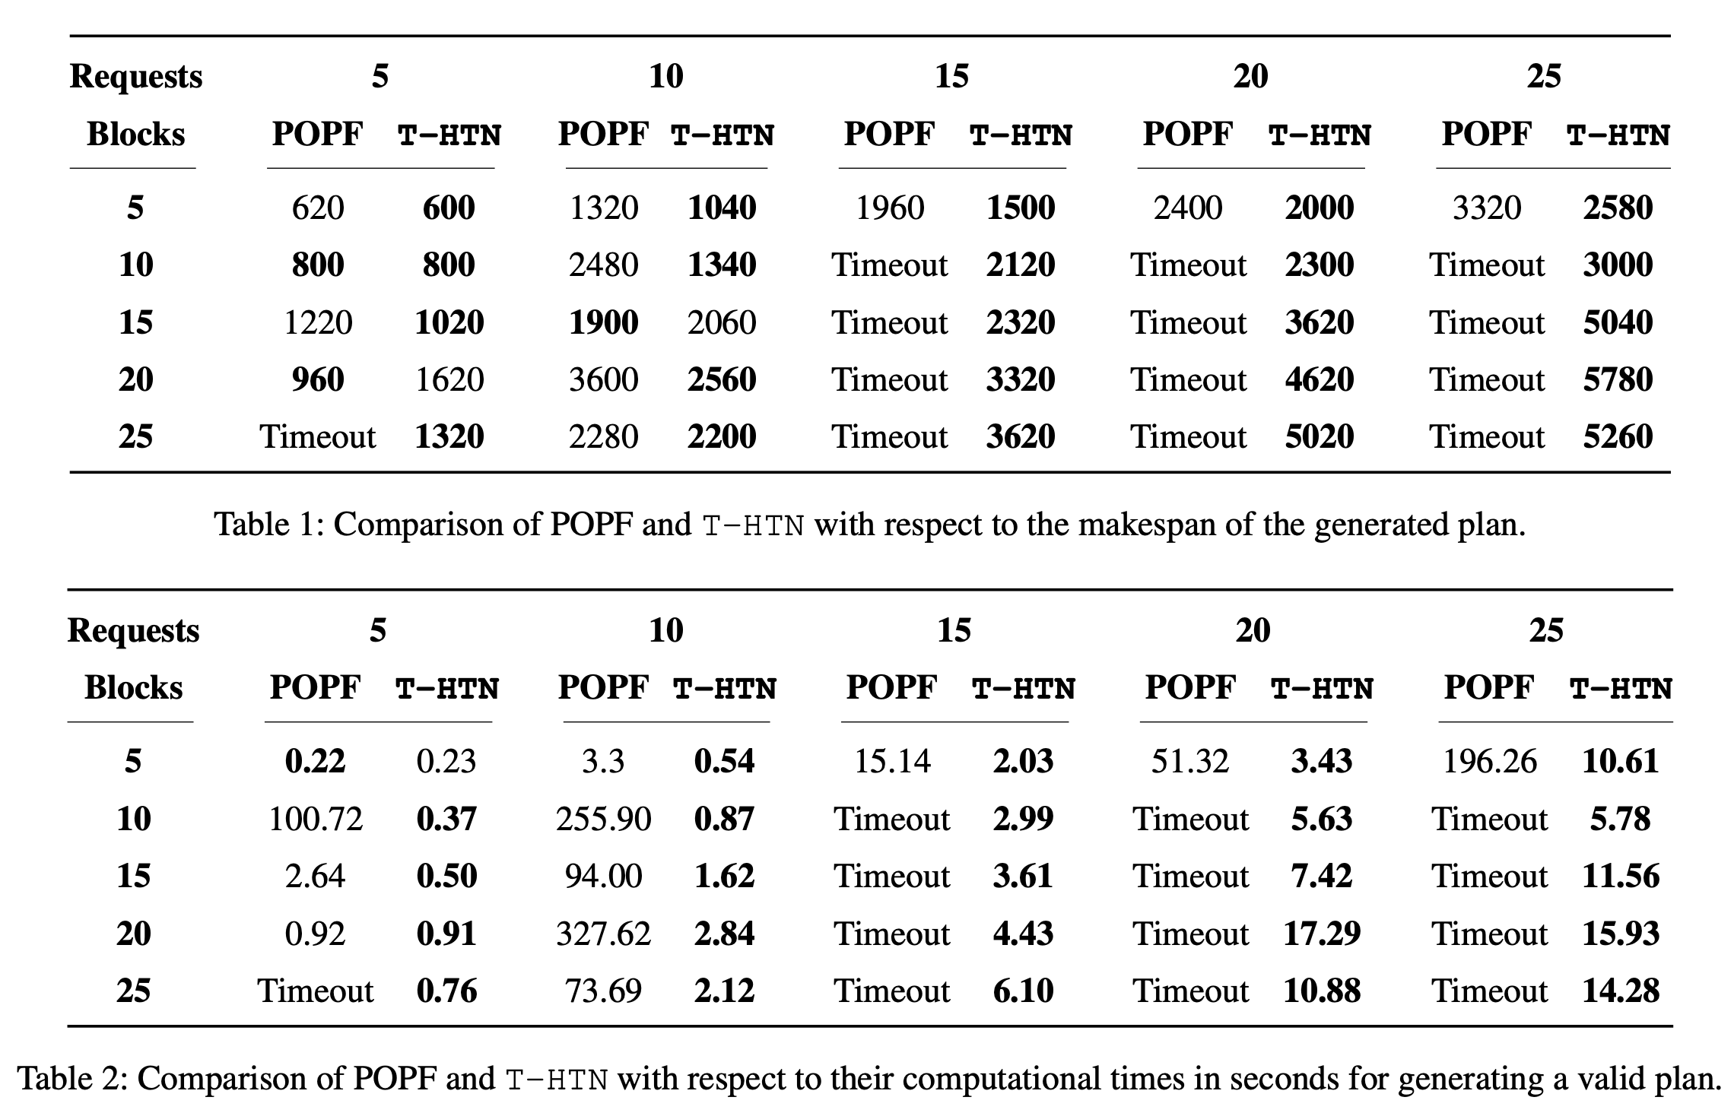
T-HTN: Timeline-Based HTN Planning for Multiple Robots
1Viraj Parimi, 2Zachary Rubinstein, 2Stephen Smith
1MIT CSAIL, 2Carnegie Mellon University
Carnegie Mellon
Motivation
Approach
Example Scenario
Our objective is to design and build a timeline-based HTN planner that can
Assign goals to robots
Handle complex spatio-temporal constraints
Accounts for durational uncertainty
Responsive to unexpected execution circumstances.
Couple timeline-based reasoning with an HTN planning model designed for resource allocation
Structural power of HTN representation
Expressivity and flexibility of timeline-based planning
Efficiency of goal regression and resource allocation
Move box from its initial location to the target location
Release Time = 0
Due Date = 300
Block A
Block B
Block C
Block D
Block E
Methodology
Language Extensions
Core Search Procedure
Objects and attributes
High-Level Overview
Enumerate Decompositions
Find Slots
Target
Temporal constraints
Token 1
Token 2
Token 3
Satisfying Preconditions
Instantiate Task Network
Functional Predicates and Methods
Experiments
Results
Takeaways
Better makespan results for 92% of experiments with upto 2 times improvement
100% solution rate compared to 52% due to timeouts
Upto 3 orders of magnitude faster
HTNs are powerful
Timeline-based planning is flexible and expressive
Decision-making should focus on resource allocation

