Slide 1
16-782 Planning & Decision-making in Robotics Discrete Sampling-based Planning
Dapeng Zhao (dapengz)
Quint Hester (rockeyh)
Viraj Parimi (vparimi)
Notes:
Slide 0: Name of the project/names of the participants
Slide 1: Motivation, explain the problem you are solving in English and why.
Slide 2: Mathematical definition of the problem planning representation including what defines a state, a goal, cost function if any.
Slide 3: How you are solving it (the algorithm).
Slide 4: Experimental Analysis & Results.

Slide 2
Motivation
Improve the sampling-based planning algorithms by discretizing the C-space

Slide 3
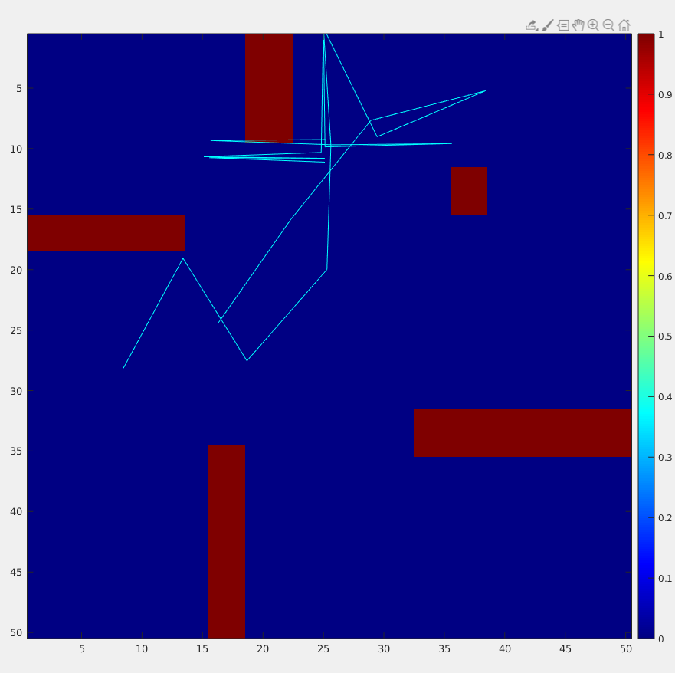
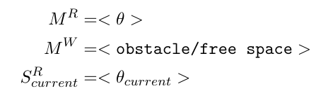
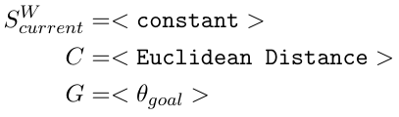
Problem Description

Slide 4
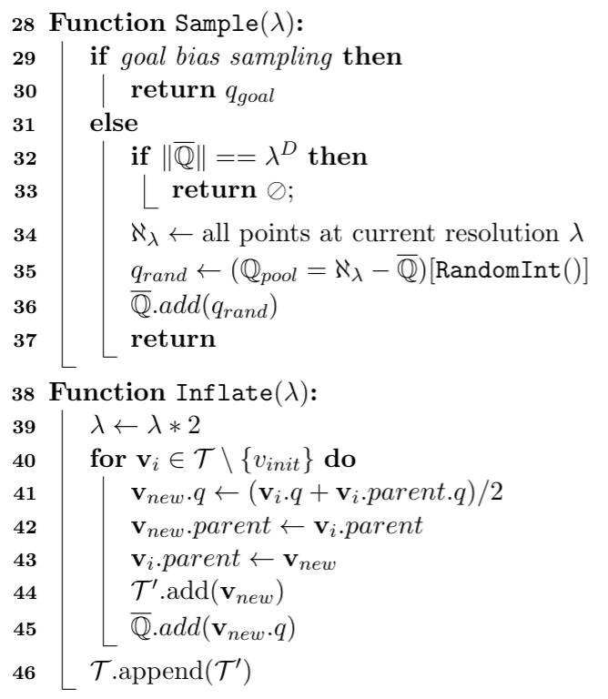
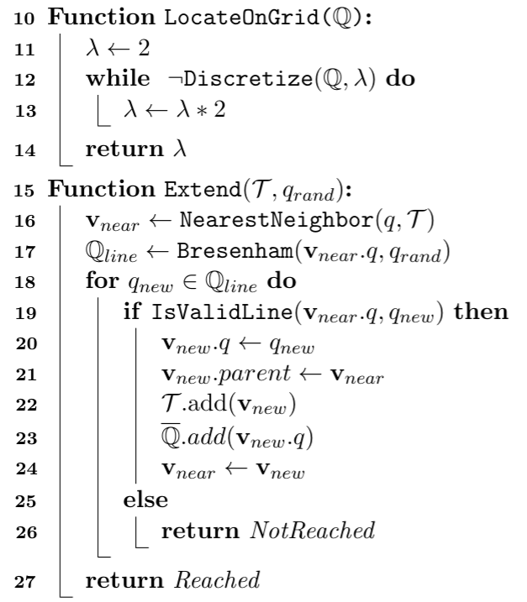
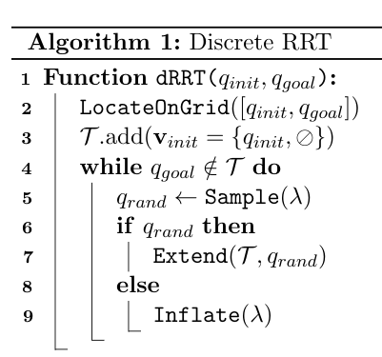
Algorithm

Slide 13
More than 1 node are added
with 1 q_rand

Slide 19
Demo

Slide 20
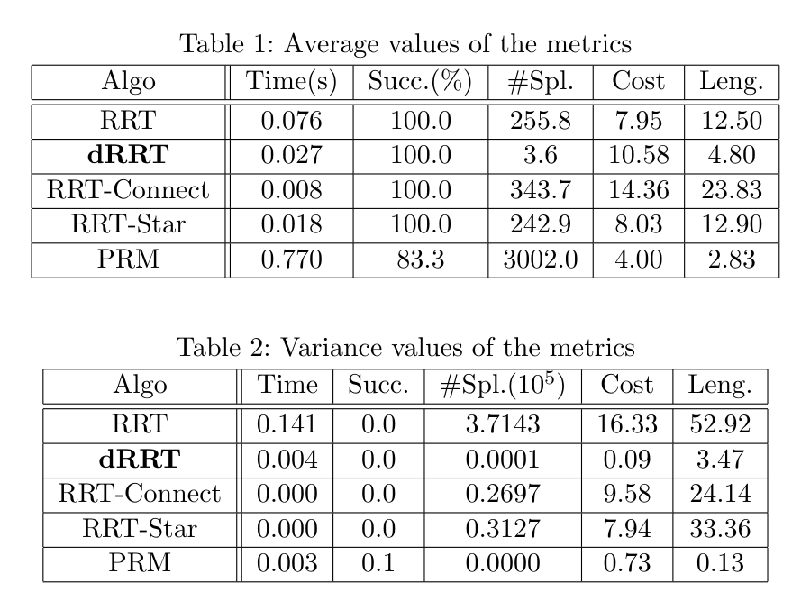
Results
Notes:
The metrics used for evaluation:
Time(s): how long the planner takes to return a feasible plan
Succ.(%): success rate
#Spl.: the number of nodes in the tree/graph
Cost: the euclidean length of the path in C-space
Len.: the number of configurations in the returned plan, the length of the plan
Average values of the metrics are shown in Table 1.
For each state-goal pair and each algorithm, variance of the 5 trials is calculated; variances are then taken average for each algorithm to be reported in Table 2.
Test cases are picked from a random pool to favor RRT-series over PRM.

Slide 21
Pro & Con
Resolution-based completeness guarantee
Hierarchical sampling, anytime solution improved with more time
Computation reused on collision checking (passing-by nodes, filling nodes)
Better consistency
Clearance need to be >ε
To guarantee completeness, low-ε space need to be exhausted to move on

Slide 22
Future Work
Implement dRRT-connect, dRRT-star
Design dPRM

Slide 23
Thank you!
Questions?

Slide 24
References
[1] “Sampling-based planning for discrete spaces” - Morgan and Branicky [2] “Finding a needle in an exponential haystack: Discrete RRT for exploration of implicit roadmaps in multi-robot motion planning ” - Solovey, Salzman, and Halperin [3] “Sampling-based A* algorithm for robot path-planning” - Persson and Sharf

Slide 25
Planning representation
Configuration space of arm.
Discretization parameter determining the level and bin size.
Start and goal are locations in configuration space.
Cost function is distance in configuration space (L2 Norm).

Slide 26
Search algorithms
RRT
PRM (and A* for searching completed roadmap)
RRT*

Slide 27
Software infrastructure
Proof of concept using C++/Mex setup that was provided as part of the assignments
C++ would be used for general planning based code
MATLAB would be used for plotting

Slide 28
Final Presentation - Min/Max
Min:
RRT and PRM where samples are taken from a discrete grid over the state space as opposed to over the continuous state space.
Anytime discrete RRT where plan is recomputed for increasing grid resolution
Experimental results and visualize planned motions showing the benefits.
Max:
As above but RRT* (and perhaps there’s a way to rewire using points on the grid in the neighborhood of your sample that haven’t been sampled yet)

