Slide 1


Task-driven Risk-bounded Hierarchical Reinforcement Learning Based on Iterative Refinement Viraj Parimi, Sungkweon Hong, Brian Williams

Slide 2
Human-Like Learning
MERS Research
Attain new skills
Observation
Imitation
Practicing
Feedback
Reflection
Solve complex tasks by decomposing it into primitive skills
Assess capability of skills for improvement
Capacity to balance tradeoff between risk and cost
Notes:
We are all here today to discuss ways on how we can extend AI agents to exhibit human-like learning. Before we propose extensions we need to identify the gaps in what current AI agents can do and what they cannot do in the context of human-like learning.
One of the key ways humans attain new skills is through
repeated observations,
imitation of the actions represented by those observations,
practicing those actions over time,
receiving feedback and
incorporating this feedback into the practice through reflection. An AI agent governed by policies learned using RL typically follow the same procedure.
Next, consider the task of making dinner like pasta. One would need to wash ingredients, chop them, boil pasta, pour sauce, mix everything together and then wash dishes. This complex task of making dinner is intuitively decomposed into smaller subtasks by humans on a daily basis. This core idea of divide and conquer has been incorporated into AI agents through HRL.
But each of these subtasks are specific skills that we attained over our lifetime. However, we know that some skills are harder to master than others. One might consider chopping vegetables to be harder than pouring sauce, for others washing dishes might be harder. Humans are capable to assess which skills require improvement quite naturally.
They also exhibit a remarkable capacity to balance the tradeoff between risk and cost across various domains. This cognitive process involves assessing potential negative consequences, evaluating factors such as the likelihood of adverse outcomes, severity of potential harm, and overall uncertainty. The nuanced ability of humans to consider the tradeoff between risk and cost highlights the complexity and adaptability of human decision-making that these DRL agents typically lack.

Slide 3
Hierarchical Reinforcement Learning
MERS Research
Natural approach to solve large problems
Divide and Conquer
Abstract representations
Decisions made over varying timescales
Reasoning over abstract states is easier
Affords generalizability
Efficient, Scalable and Transferable
Notes:
As mentioned earlier advancements in RL and HRL have typically shown that artificial agents can mimic human-like learning in at least the first two aspects ie the process of how new skills are attained and
incorporating the natural approach to solve large problems via
divide and conquer.
More specifically, the HRL approaches take advantage of the abstract representations that kind of parallels the mental models humans maintain to comprehend complex concepts. These abstract representations can be temporal or spatial.
The temporal abstraction leverages the idea that decisions are made over varying timescales. So you can represent a higher-level model that only concerns itself with the high-level subgoals needed to achieve in order to finish a task and then a lower-level model that is trained specifically for a subgoal.
Another advantage of abstract representations is that is enables the agents to reason over abstract states which is much easier than reasoning over lower-level states that makes is computationally intractable in many practical situations.
Finally, being able to work with abstract representations allows the agents to generalize as well. Consider the skill of chopping cylindrical objects. If the agent understands that a carrot and zucchini are cylindrical objects via this abstract representation then it can utilize the same skill it learned before to chop them.
The current HRL approaches are thus efficient, scalable and transferable.

Slide 4
Risk-Bounded Conditional Planning
MERS Research
Unconditional Plan
Conditional Plan
Start
End
Risk-Bounded Conditional Plan
End
Start
End
Start
Notes:
However, DRL agents are unable to capture the last two pieces of human-like learning that I touched upon before ie being able to assess which skill to improve upon while considering the tradeoff between risk and cost. But the field of Risk-Bounded Conditional Planning has tackled this problem before in a different context.
Typically, a plan is considered to be unconditional when each action is deterministic and
there is only one way to go from start to goal.
A conditional plan on the other hand is able to encapsulate scenarios where an
action can have multiple outcomes which is typically more realistic. Then the question becomes, how to find an efficient policy to go from start to goal. This essentially provides us with a structured way to prepare for all possible outcomes.
The risk-bounded variant of this problem includes a user-specified risk-bound and some constrained states. Landing in these constrained states adds to the probability that the agent might fail to reach its goal. Hence, the aim here is to find a plan which guarantees that its chance of failure does not exceed the user-specified risk bound.

Slide 5
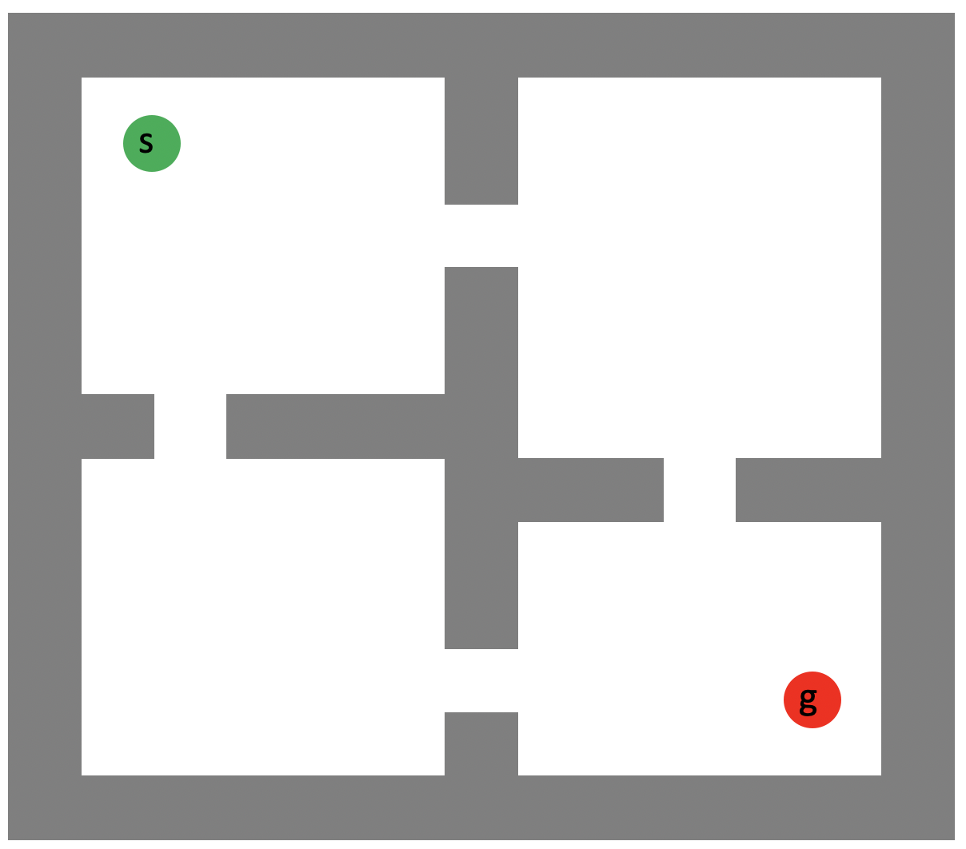
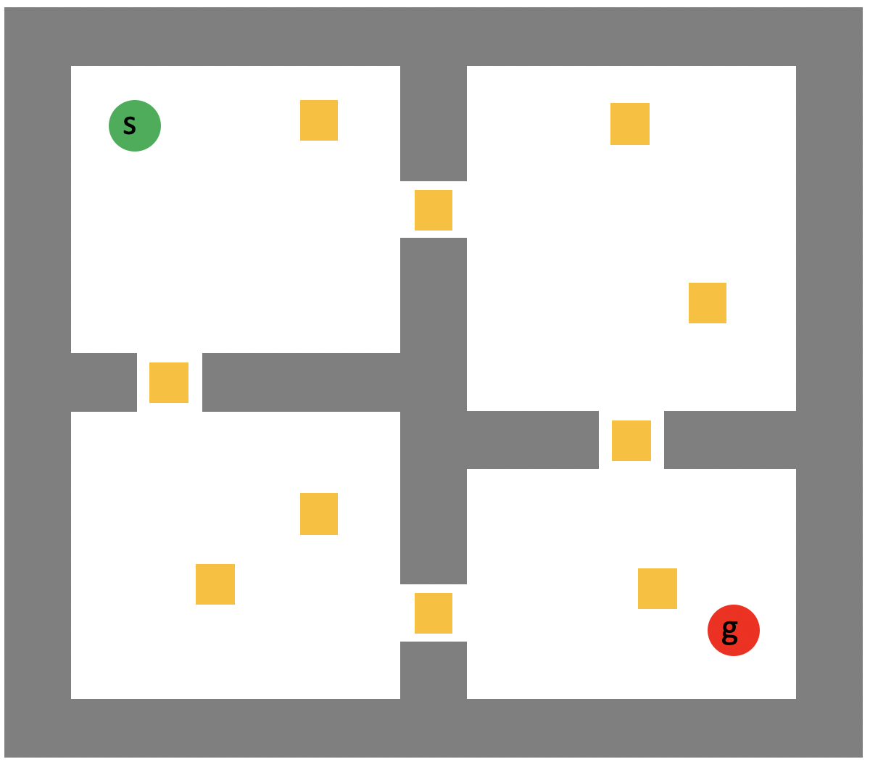
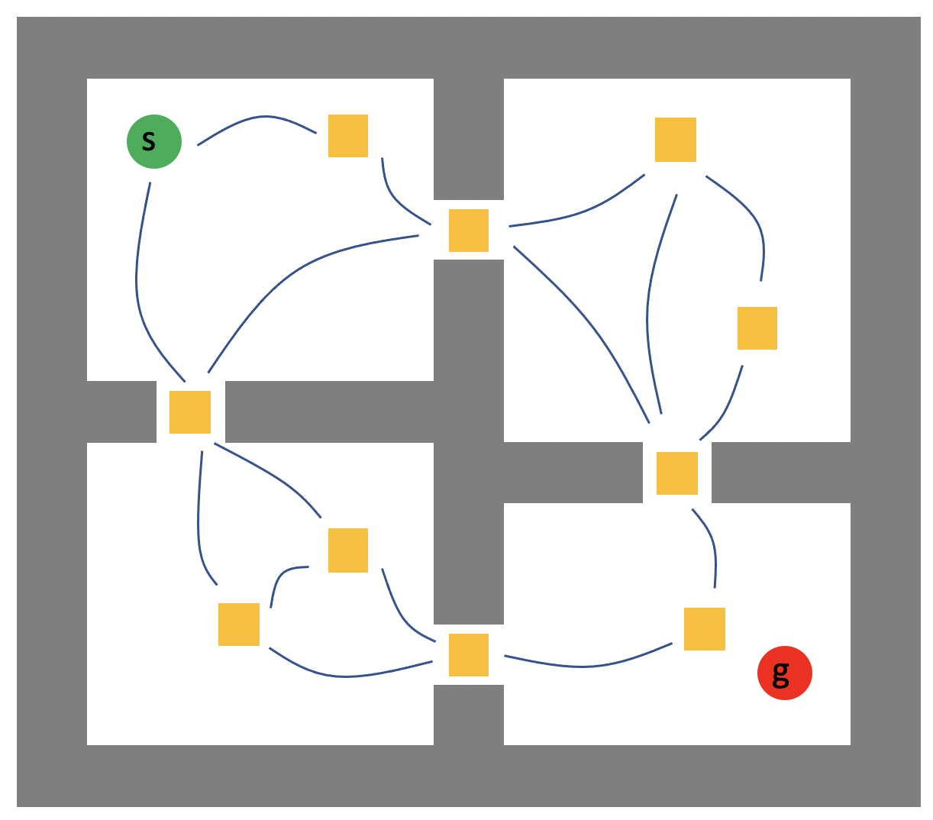
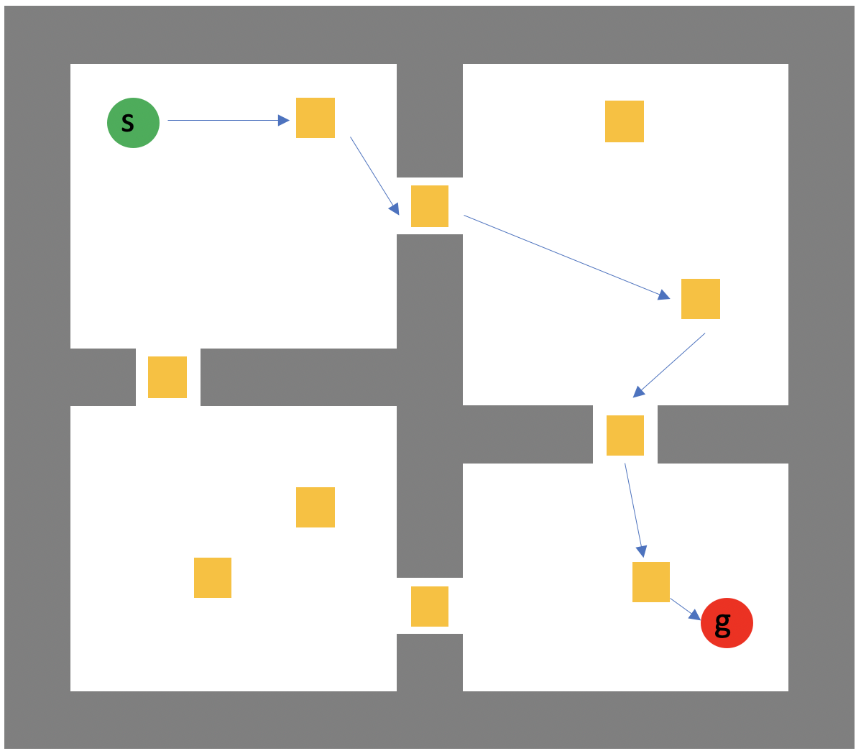
Bridging Planning and Learning
MERS Research
Learn policies for primitive actions
Chain primitive actions to achieve goal
Ensure risk-bound isn’t violated
Notes:
To capture the missing aspects of human-like learning in DRL agents, we highlight the need to bridge planning and learning.
So given an environment with start, goal and some landmarks
we wish to learn policies between pairwise landmarks mimicking the divide-and-conquer strategy of HRL approaches.
The using conditional planning we will chain the primitive actions to achieve the goal while
ensure that the risk-bound isn’t violated.
However, the natural question is what if the number of policies to learn are huge. Humans do not learn all the policies the same way. They spend more time on one than the other depending on how effective they think they are on those skills.

Slide 6
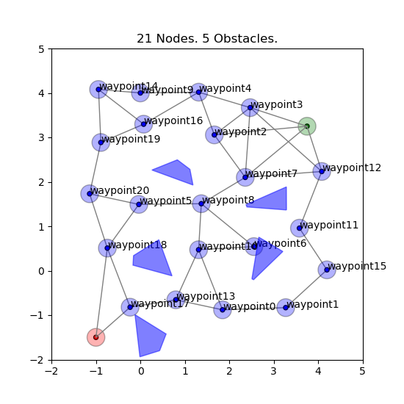

Proposed Approach
MERS Research
Environment / Landmarks
Primitive Learner
Learn primitive skills
Conditional Planner
Compute candidate policies
Policy
Failure Probability $∆$ < 0.3
Notes:
Here is another similar example environment with landmarks, start and goal.
A naive way to find a policy would be to learn the primitive skills between each pair of landmarks using the
primitive learner and
then compute candidate policies using the
conditional planner.
Here the green policy is easier to learn as its away from obstacles but it has high cost. Conversely both blue and red policies are closed to obstacles so they would be naturally harder to learn. However, its evident that the red policy is the least costly policy. As I mentioned before, humans looking at this would clearly identify that they need to improve the primitive actions along the red policy to get better cost but how do we make capture this intuition with DRL agents? Also what if none of these policies are feasible given the user-specified risk-bound. Hence there is a missing piece.

Slide 7

Proposed Approach
MERS Research
Environment / Landmarks
Primitive Learner
Learn primitive skills
Selecting subset of primitive actions
Conditional Planner
Compute candidate policies
Policy
Failure Probability $∆$ < 0.3
Notes:
This missing piece is a feedback loop where a model tells us which primitive action to improve to get better cost while adhering to the given risk-bound!

Slide 8
Proposed Approach
MERS Research
Environment / Landmarks
Primitive Improver
Primitive Learner
Learn primitive skills
Select primitive skill(s)
Conditional Planner
Select policy
Compute candidate policies
Anytime Feasible Policy
Failure Probability $∆$ < 0.3
Notes:
This model first needs to
select a promising policy where there is reasonable expectation that improving any
primitive skills that it comprises of can improve the quality of that policy and also the solution.
This primitive improver module is comprised of the policy selector and the primitive selector.

Slide 9
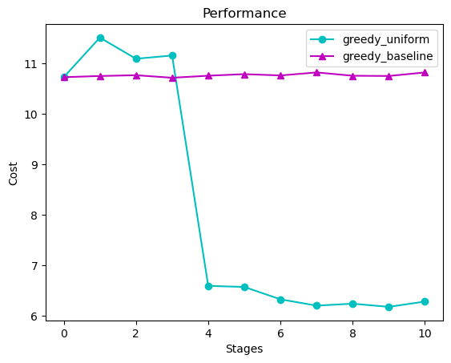
Prioritization matters a lot!
MERS Research
Incumbent policy’s cost
Outer loop iteration steps
Infeasible solution became feasible due to focused improvement
Greedy prioritization method
Baseline (no prioritization)
Notes:
Before I go into the key insight on how we can do that, I want to highlight that prioritization of which skill to improve it very important. On the right you see a graph where xaxis is the number of iterations of the feedback process and the yaxis represents the incumbent solutions cost. Initially the green policy was feasible with higher cost. If we did not prioritization of skill learning and learned all skills equally then we do not see any improvement of solution cost. However if we use a simple greedy prioritization where the red policy was chosen to improve each time given its potential, we see that we end up making the red policy feasible as well thereby lowering our cost even further!

Slide 10

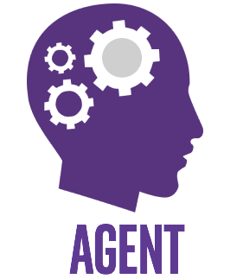
Idea
MERS Research
Which policy and primitive skill should we improve?
Multi-Arm Bandit Problem
Notes:
So we want to identify which policy and primitive skills we should improve upon.
The key idea we leverage is to propose this problem is a multi-arm bandit problem. Here an agent is presented with multiple bandit arms and pulling each arm gives stochastic reward. The job of the agent is to maximize its expected reward over some timesteps. In our context, the arms here can be represented by the policies or primitive actions and the stochastic reward is represented by the amount of improvement you might get upon learning that skill again. This case is a particular setting of multi-arm bandit called adversarial bandits due to the stochastic nature of the rewards where its not always guaranteed that learning a skill will improve it.

Slide 11

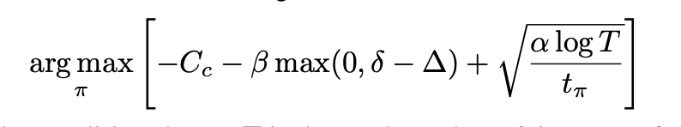
Policy Selection
MERS Research
Policy Selection
Greedy
Weighted
Upper Confidence Bound
EXP3 – Adversarial Bandits
Notes:
For policy selection, we have explore multiple approaches from simpler ones such as greedy and weighted to bandit inspired approaches like UCB and EXP3. EXP3 maintains a weight distribution over the candidate policies and updates those weights based on how much improvement was recorded before the next iteration.

Slide 12
Skill Selection
MERS Research
Skill Selection
Uniform
Cost
Risk
EXP4 – Adversarial Bandits
Consider alternate strategies as “experts”
Maintain probability simplex over “actions”
Sample an “action”
Update “expert” weights based on return
Notes:
For skill selection, we also explored simpler methods like uniform where we improve all skills along a policy equally or cost and risk where the skills is selected based on their inherent cost and risk. Finally we also explored the bandit inspired EXP4 which is same as EXP3 but with experts. Experts here are the alternate strategies where it maintains a probability simplex over them and samples an action based on those simplex and updates weights based on which expert agreed with that action.

Slide 13
Proposed Approach
MERS Research
Environment / Landmarks
Primitive Improver
Primitive Learner
Learn primitive skills
Select primitive skill(s)
Conditional Planner
Select policy
Compute candidate policies
Anytime Feasible Policy
Failure Probability $∆$ < 0.3

Slide 14
Conclusion
MERS Research
Human learning
Undergoes an iterative trial-and-error process
Understands hierarchical and abstract representations
Exhibit remarkable capacity to balance the tradeoff between risk and cost
Deep Reinforcement Learning (DRL)
Undergoes an iterative trial-and-error process
Maintains hierarchical and abstract representations using deep neural networks
Lack ability to balance risk and cost
Risk-Bounded Conditional planning
Able to balance risk and cost
Bridging DRL and conditional planning captures the missing piece
Notes:
To conclude, we know that human like learning undergoes an iterative trial and error process where they understand hierarchical and abstract representations and exhibit capability to balance the tradeoff between risk and cost.
We saw that DRL agents can capture the first two aspects of human-like learning but
combining it with the risk-bounded conditional planning
can allow these agents to capture that missing piece.

