Slide 1

Collaborative Filtering Recommender Systems
Assignment – 3
Task 2 – Presentation
Virajkumar Govindbhai Patel
S4126405
COSC 2670/2738
Practical Data Science with Python
13th June 2025

Slide 2
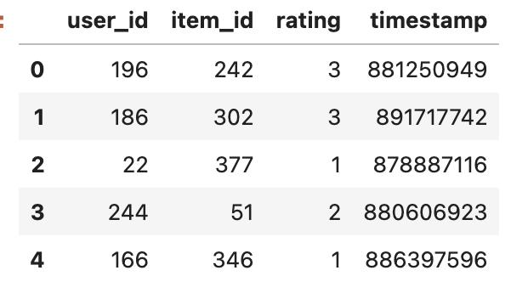
Dataset & Problem Statement
Dataset:
I used the provided ml-100k dataset, which contains over 100,000 ratings from 943 users on 1682 movies.
Problem Statement:
Estimating the current user's level of interest in a target item, usually represented as a predicted rating, is the fundamental challenge of recommender systems.

Slide 3
Methods Overview
Method | Description
1. User Average | Predicts based on a user’s average rating.
2. Item Average | Predicts based on a movie’s average rating.
3. User KNN | Uses ratings from similar users.
4. Item KNN | Uses ratings from similar movies.
5. Hybrid | Combines User KNN and Item KNN.

Slide 4


Method 1 & 2 – Baseline Approaches
The first two methods implemented were basic statistical baselines.
In Method 1, the system predicted a user’s rating for a movie based on that user’s average rating across all other movies they had rated. This assumes users are internally consistent in their preferences.
In Method 2, the predicted rating was based on the average score that the item (i.e., the movie) received from all users. This assumes that the movie’s overall popularity or quality is the main factor influencing its rating.
While both methods are simple and computationally efficient, they do not consider personalized preferences or similarities, which limits their predictive power.

Slide 5
Optimization of Method 3 (User KNN)
In Method 3, I implemented a user-based collaborative filtering algorithm using the K-Nearest Neighbors (KNN) approach.
For each prediction, the algorithm identified the top K most similar users set to k = 5, who had also rated the target movie.
Similarity was measured using cosine similarity between user’s rating vectors.
The predicted rating was then calculated as a weighted average of these neighbor’s ratings, weighted by their similarity scores.
In cases where no similar users had rated the movie, the algorithm defaulted to using the active user’s average rating.
This method accounts for personalization but is sensitive to data sparsity, especially when users have few overlapping ratings.

Slide 6
Optimization of Method 4 (Item KNN)
The fourth method used item-based collaborative filtering, which instead measures the similarity between movies.
For a given user and target movie, the algorithm identified similar movies that the user had already rated, again using cosine similarity.
The predicted rating was calculated as a weighted average of the user’s ratings on these similar items.
If the user hadn’t rated any similar movies, the fallback was the item’s overall average rating.
Item-based collaborative filtering tends to perform better in cases where items are commonly rated across many users, making the similarity computations more robust.
Compared to user-based filtering, this approach is less affected by user sparsity.

Slide 7
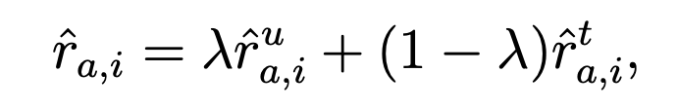
Optimization of Method 5 (Hybrid Method)
The final method combined the strengths of both user-based and item-based collaborative filtering in a hybrid approach.
The final predicted rating was computed as a weighted average of the user-based and item-based predictions.
A lambda value (λ) of 0.5 was chosen, meaning both components contributed equally.
This hybrid model leverages the personal preferences captured by user-based filtering, as well as the stable popularity trends captured by item-based filtering.
The combination addresses the limitations of either approach individually, providing a more balanced and reliable recommendation output.

Slide 8
Performance Comparison
The following table summarizes the performance of all five methods based on MAE and RMSE. Lower values indicate better accuracy.
Method | MAE | RMSE
Method 1 | 0.8259 | 1.0311
Method 2 | 0.7961 | 1.0013
Method 3 | 0.8247 | 1.0431
Method 4 | 0.7570 | 0.9845
Method 5 | 0.7329 | 0.9362

Slide 9
Performance Comparison and Insights
Our results clearly ranked the methods. The user and item averages had the highest MAE (0.8259 and 0.7961) and RMSE (1.0311 and 1.0013), reflecting their simplicity.
User KNN improved these metrics to 0.8247 and 1.0431, while Item KNN did slightly better at 0.7570 and 0.9845.
The hybrid method outperformed all others, achieving an MAE of 0.7329 and RMSE of 0.9362.
The hybrid method demonstrates the advantage of integrating both user and item perspectives into a unified prediction.
A key insight from this task was the impact of data sparsity. Many users in the dataset had rated only a small number of movies, which reduced the effectiveness of user-based similarity.
In contrast, items tended to have more consistent rating patterns across users, allowing item-based collaborative filtering to make more stable and accurate predictions.
The hybrid method proved to be the most robust, effectively balancing the strengths of both individual methods.

Slide 10
Conclusion
To conclude, the hybrid collaborative filtering method produced the best overall performance in this assignment.
While the baseline approaches were useful for benchmarking, their lack of personalization limited their effectiveness.
User-based collaborative filtering added personalization but struggled with sparsity, while item-based filtering provided better stability.
The hybrid model succeeded by combining both.
For future improvements, I would explore tuning parameters like the number of neighbors (K) and the lambda value.
Additionally, I would consider matrix factorization techniques like SVD or deep learning models to further improve recommendation accuracy and scalability.

