Slide 1




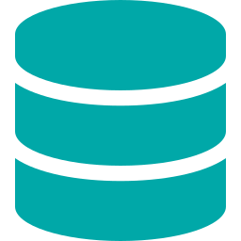
01
Ping Identity
Enterprise IAM Platform Overview
What is Ping Identity?
Enterprise-grade Identity & Access Management (IAM) platform
Secures users, devices, APIs, and applications at scale
Trusted by 60%+ of Fortune 100 companies
KEY COMPONENTS
PingFederate
PingID
PingAccess
PingDirectory
Federation Hub
SSO / OAuth2 / SAML
MFA / Adaptive
Authentication
API Gateway &
Access Management
LDAP / DS
User Store

Slide 2






02
Core IAM Concepts
AuthN vs AuthZ
Single Sign-On (SSO)
MFA (Multi-Factor Auth)
Authentication (AuthN): WHO are you?
Authorization (AuthZ): WHAT can you do?
Ping handles both via policies & tokens
Login once → access all apps
Uses SAML assertions or OIDC tokens
PingFederate is the SSO hub
Something you know + have + are
PingID: push, OTP, biometric
Adaptive MFA based on risk
Federation Protocols
Zero Trust
Token Lifecycle
SAML 2.0 — XML-based SSO (enterprise)
OAuth2 — delegated authorization
OIDC — identity layer on OAuth2
"Never trust, always verify"
Continuous auth + least privilege
Ping enforces per-request policies
Access Token (short-lived, API calls)
Refresh Token (long-lived, renew access)
ID Token (user identity — OIDC)

Slide 3





03
Authentication Flow — Real-World Demo
Enterprise Banking Login with PingFederate + PingID MFA
1
2
3
4
5
User
PingFed
AuthN
PingID
Access
Visits App
Redirects to IDP
Credentials Verified
MFA Push / OTP
Token Issued
WHAT HAPPENS IN THE BACKEND
PingFederate issues SAML assertion or OAuth2 token after successful authentication
PingID triggers adaptive MFA — risk score determined by device, location, behavior
Access Token (JWT) contains scopes & claims — validated by PingAccess at resource server
PingDirectory stores user attributes, policies, and identity data in real-time
PingAM Deep Dive | IAM Architecture | Confidential

