Slide 1
Outline
Data Understanding
Data description
Data exploration
Data quality
Data Preparation
Data preprocessing
Feature Engineering
Feature Selection
Modeling
Evaluation

Slide 2
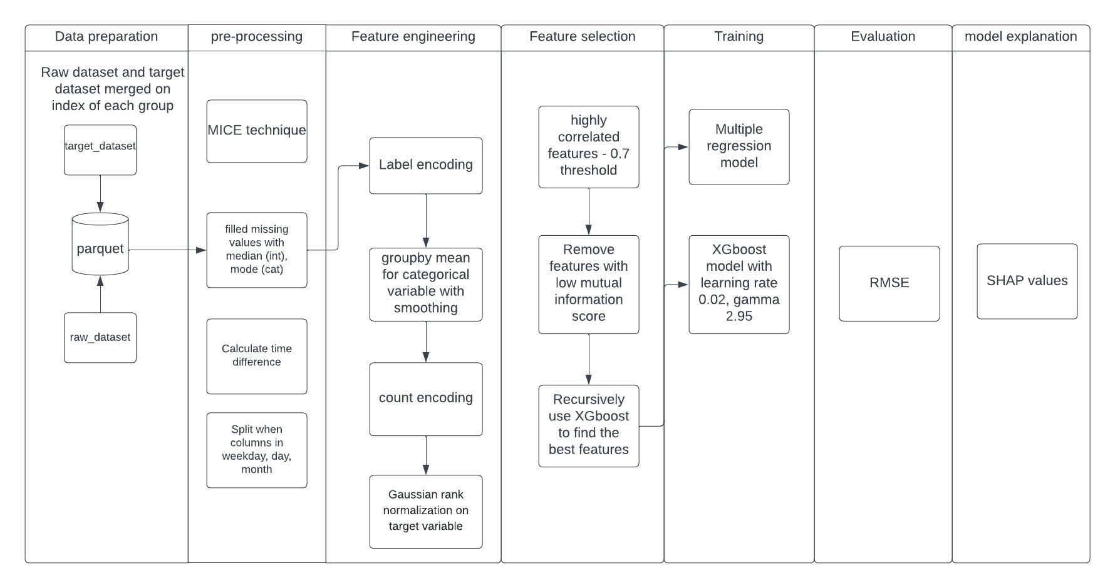
Process

Slide 3
Data Understanding

Slide 4
Data Description
Data Format csv: raw data (9592 rows, 35 columns ) and raw target – (9589 rows, 3 columns)
Continuous variable: 14
Discrete variables: 8
Data time variable: 10
The data contains missing values, duplicate columns, special character column.

Slide 5
Data Exploration

Slide 6
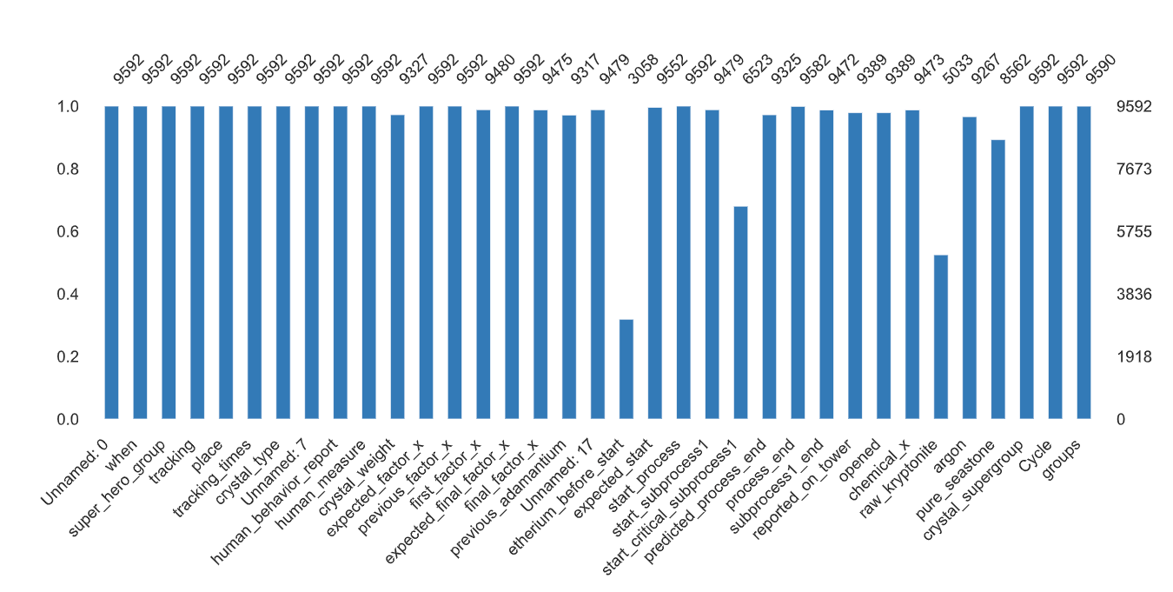
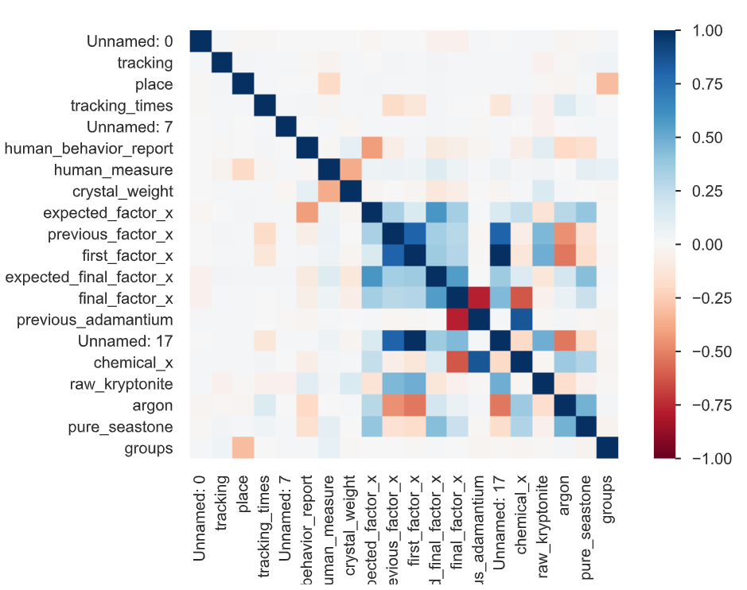
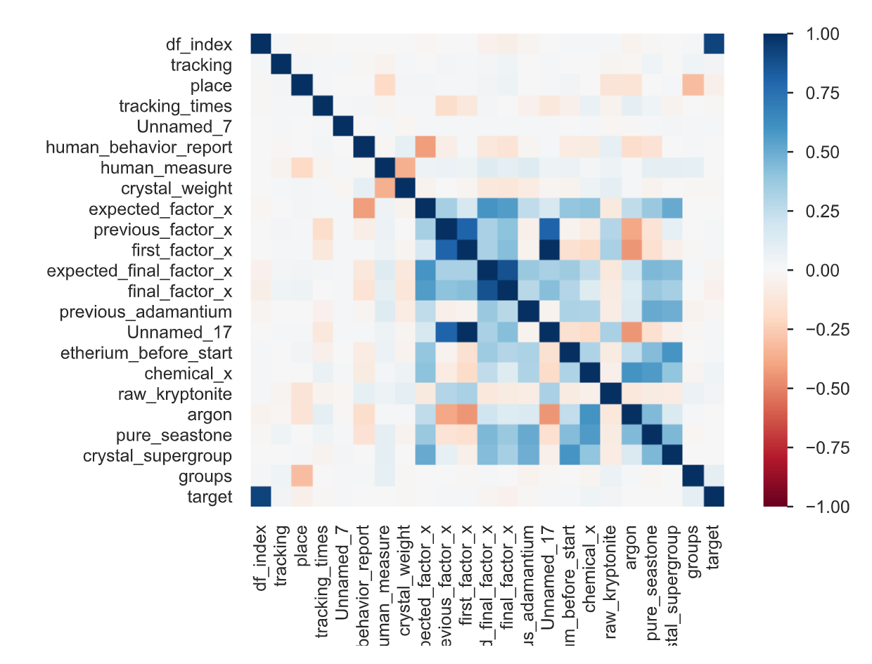
Data Exploration
Missing values
Pearson correlation
Pearson correlation
The Data contains missing values.
Multicollinearity exists
No correlation between dependent variable and independent variable

Slide 7
Data Preparation

Slide 8
Data Preprocessing
Imputed missing values for continuous with median and categorical columns with mode
Split “when” columns in weekday, day, month.
Calculate time difference between start and end of process, subprocess1 columns

Slide 9
Feature engineering

Slide 10
Feature engineering
Label encoding
Count of frequency encoding
Target encoding – Groupby mean for each category and smoothing done to prevent overfitting

Slide 11
Feature Selection
Feature selection was done using correlation, Mutual information score and recursive use of XGBoost on smaller sets of data

Slide 12
Modeling

Slide 13
Modeling
Tried Multiple regression as a base model
XGBoost with regularization.

Slide 14
Evaluation
RMSE:
Multiple linear regression RMSE: 0.70
XGBoost RMSE: 0.63

Slide 15
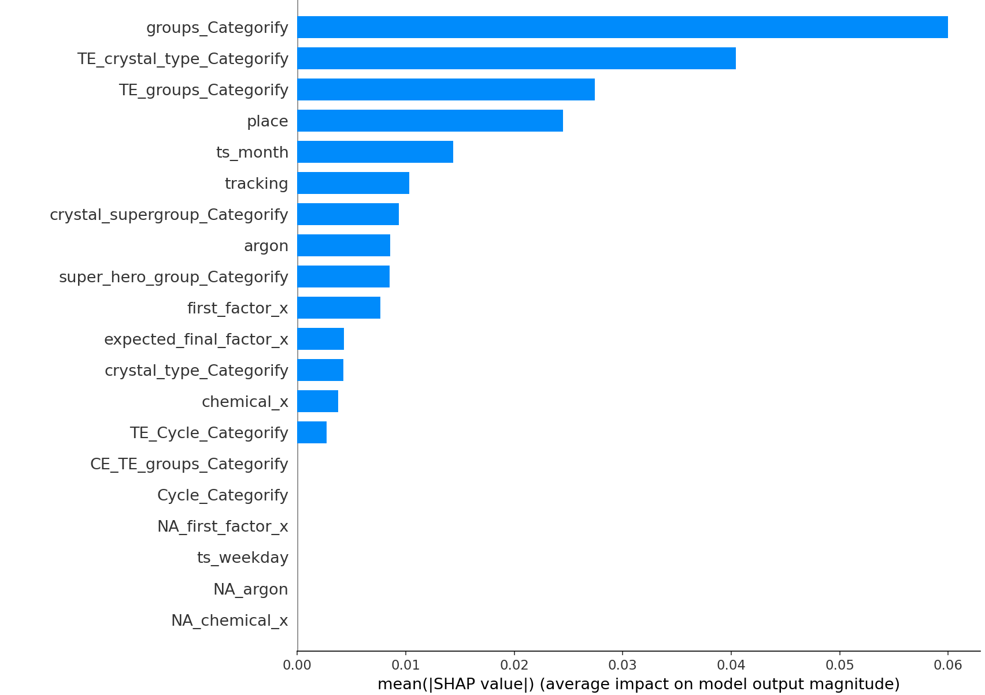
Model explanability

Slide 16
Suggestion for next steps
Hyperparameter tuning with cross validation.
Try different technique to address missing values.
Try different feature engineering technique like log transformation, box-cox transformation.
Try different feature selection techniques like OLS regression, Chi square test, ANOVA, Use Gini impurity from random forest, PCA.

