Slide 1
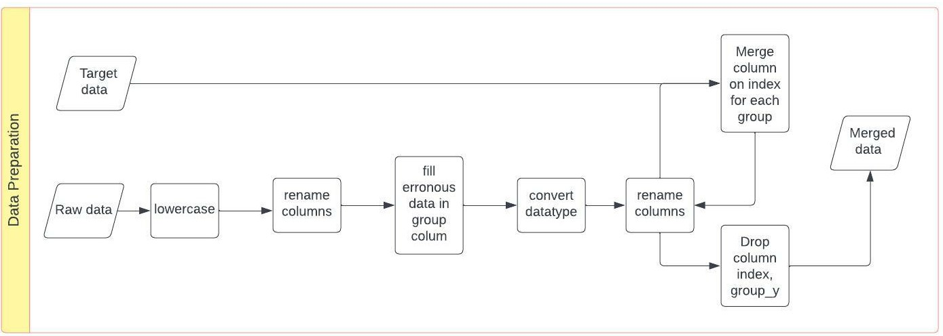
Data Preparation
1. Read raw data and target data.
2. Lowercase column names.
3. Rename column names: 'unnamed: 0' to index and 'unnamed: 17' to unnamed_17
4. Fill missing value of groups with the mode of the groups on date 21/01/2020.
5. Convert datatypes.
6. join raw data and target data on index for each group.
7. Rename and drop columns.

Slide 2
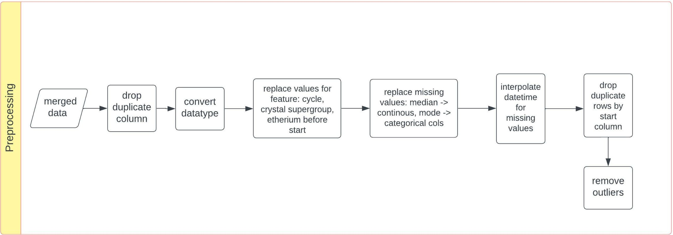
Data preprocessing
1. Drop duplicate column 'Unnamed: 17' which is a copy of 'first_factor_x'.
2. Convert datatypes of the features.
3. Replace values for columns cycle (label encode ['33', '1ª', '2ª', '3ª', '131']), crystal_supergroup (replace '1ª' with 0), etherium_before_start (replace datetime value with the mean of this column)
4. Replace missing values of continuous variables with the median of the variable and missing values of categorical variables with the mode of the variable.
5. Interpolate datetime columns.
6. Drop duplicate rows by ‘start’ column.
7. Remove outliers with IQR method.

Slide 3
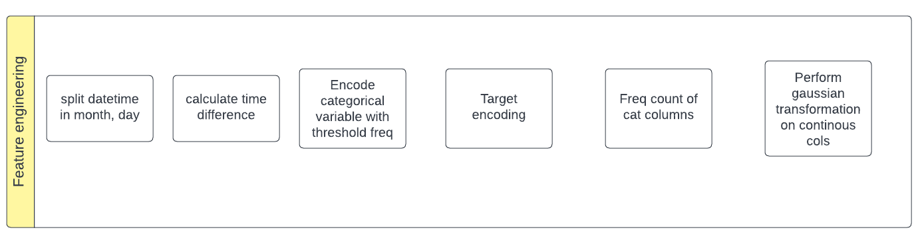
Feature engineering
1. Spit the 'when' column in day, weekday, month. Perform one hot encoding on the weekday column.
2. Calculate time difference between timestamps
3. Encoding for categorical columns. To deal with high cardinality and overfitting, we will replace the categories with low frequency with a single category.
4. Target encoding done to deal with high cardinality in the categorical columns. Target Encoding (TE) calculates the statistics from a target variable grouped by the unique values of one or more categorical features.
. Calculate mean for the target variable grouped by the unique values of the categorical features.
Since target encoding lacks to generalize well and it will tend to overfit. Smoothing is used to generalize the target encoding.
The smoothing parameter is calculated using the formula below
TE = (count(cat) * mean(target) + smoothing * global mean(target))
____________________________________________________________
count(cat) + smoothing
5. Count encoding on categorical columns. It is done to calculate frequency from one or more categorical features.
The advantage of Count Encoding is that the category values are grouped together based on behavior.
Particularly in cases with only a few observation, a decision tree is not able to create a split.
6. Gaussian rank normalization on continuous columns and target to normalize the data and reduce the effect of outliers.

Slide 4
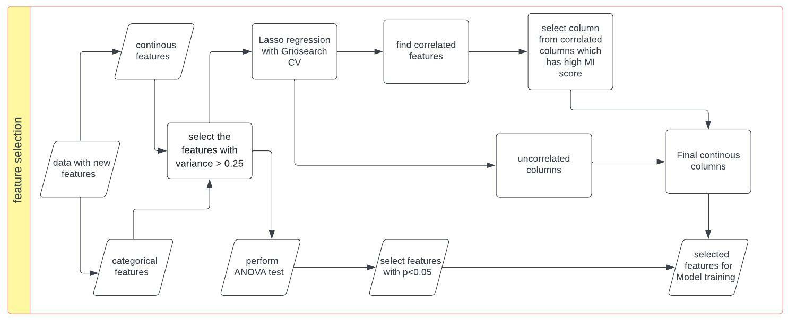
Feature Selection
Continous variable:
Removes all the low variance features from the dataset that are of no great use in model training.
Drop Columns that are 75% or more similar.
2. Perform Lasso regression with gridsearch CV for different values of alpha to select the best features from step 1.
3. Find correlated features from the best features selected in step 2 and drop the features that are highly correlated with low mutual information score.

Slide 5
Feature Selection
Categorical variable:
1. Removes all the low variance features from the dataset that are of no great use in model training. Drop Columns that are 75% or more similar.
2. Perform Oneway ANOVA test on categorical variables and target to check if there is any statistical differences among the means of two or more groups.
3. Take variables with p value < 0.05. since there is difference in the groups in those variables.

Slide 6
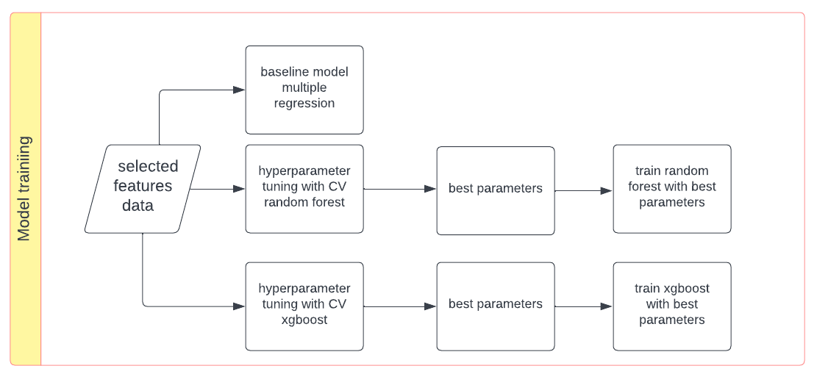
Modelling
Build a baseline model on the selected features. Multiple regression model was used as the baseline model.
2. Perform hyperparameter tuning on random forest model using randomized search CV.
3. Build Random forest model on best parameters from random search cv.
4. Perform hyperparameter tuninng on xgboost model using randomized serach CV. Then train xgboost model on best parameters from random search cv.

Slide 7
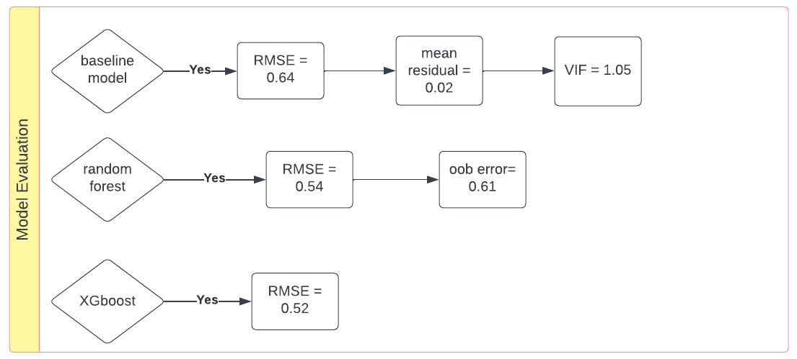
Evaluation
Baseline model: The Value of Root mean squared error is 0.65. and Normalized RMSE = 0.09.
The value of VIF is 1.16. This means that there is no multicollinearity in the model.
The mean_residuals is 0.01, the residuals are normally distributed
2. Random forest model: The value of Root mean squared error is 0.54. and Normalized RMSE = 0.07.
The value of OOB error is 0.54. The model will make an error of 54% on test data. The model is overfitting.
3. XGBoost model: The value of Root mean squared error is 0.52.

Slide 8
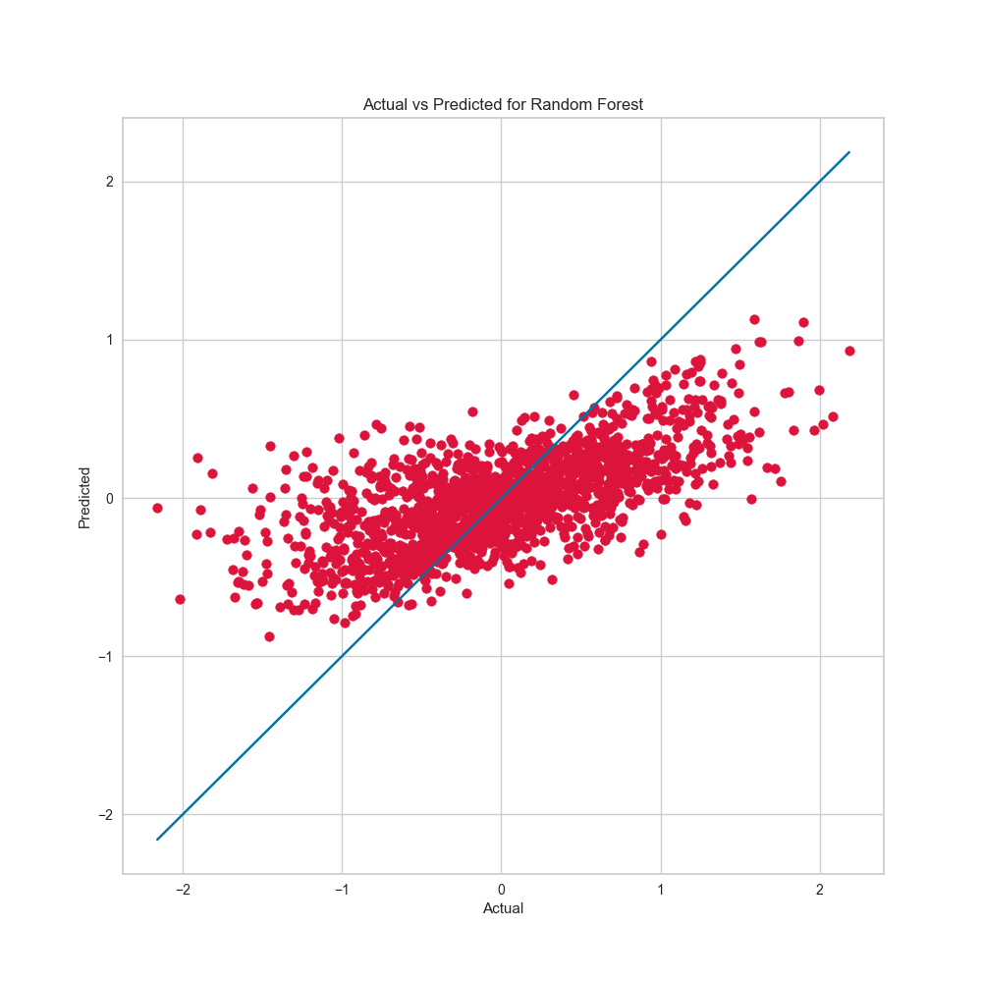
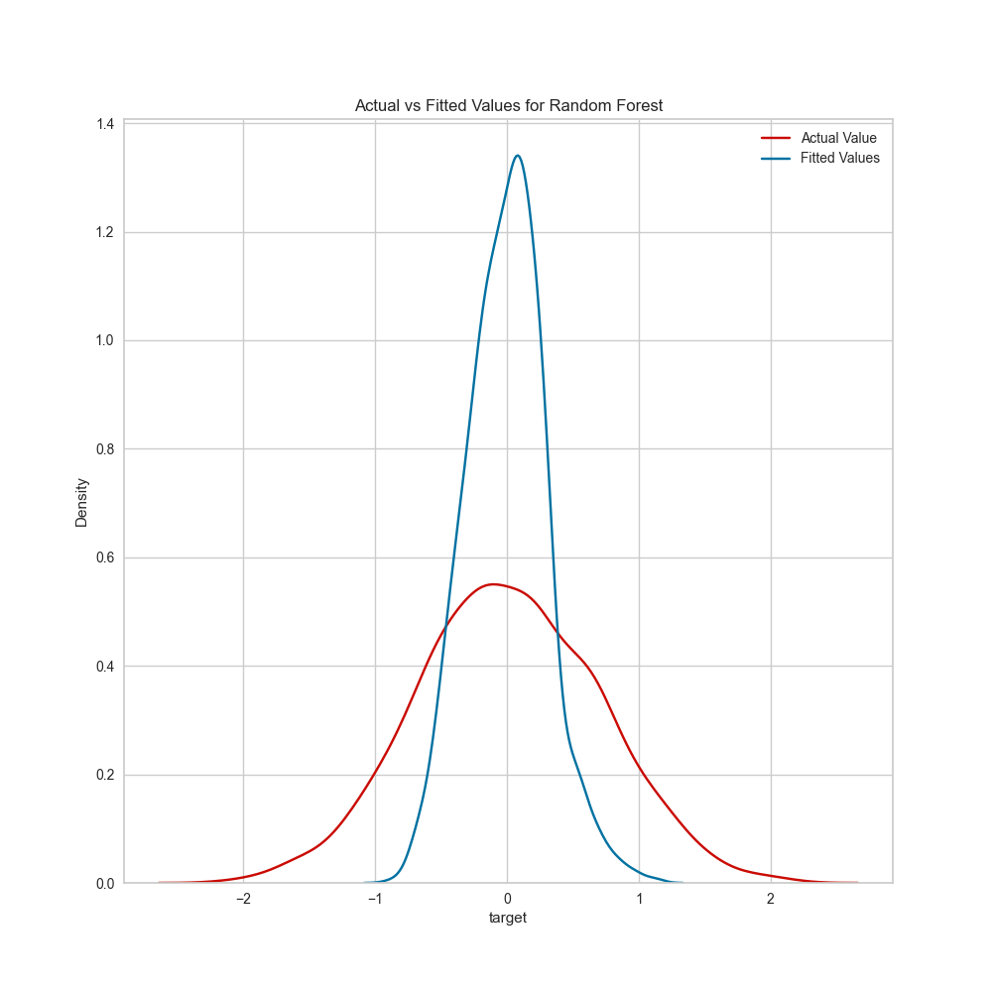
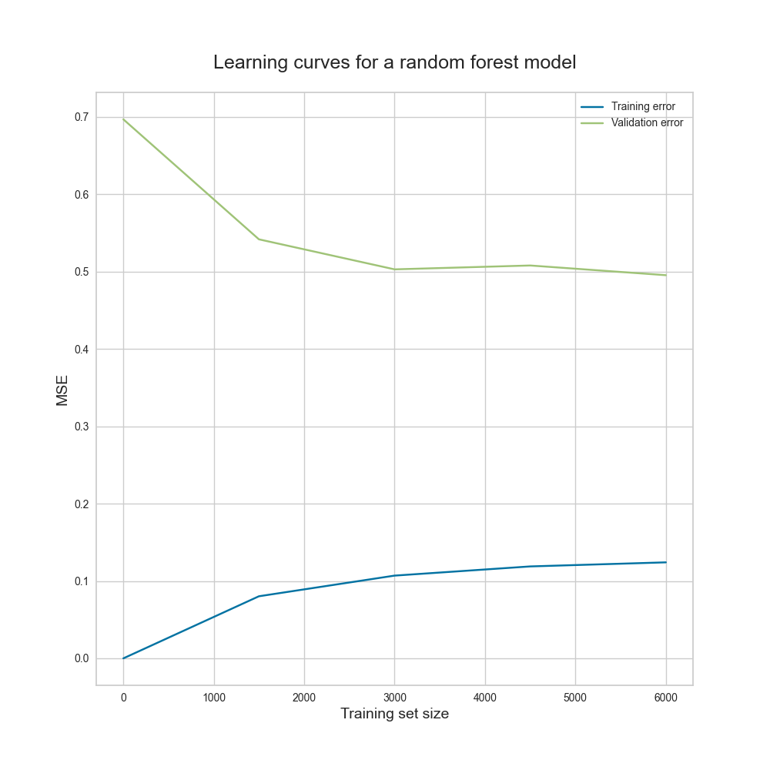
Random forest
There is no strong correlation between the actual and predicted values.
The predicted values are not close to the best fitted line.
The train error is low and validation error is high. The model has high variance.
The training error and validation error are not converging.
The distribution of the fitted values is different from the actual values.
The model performs poorly on the test data.

Slide 9
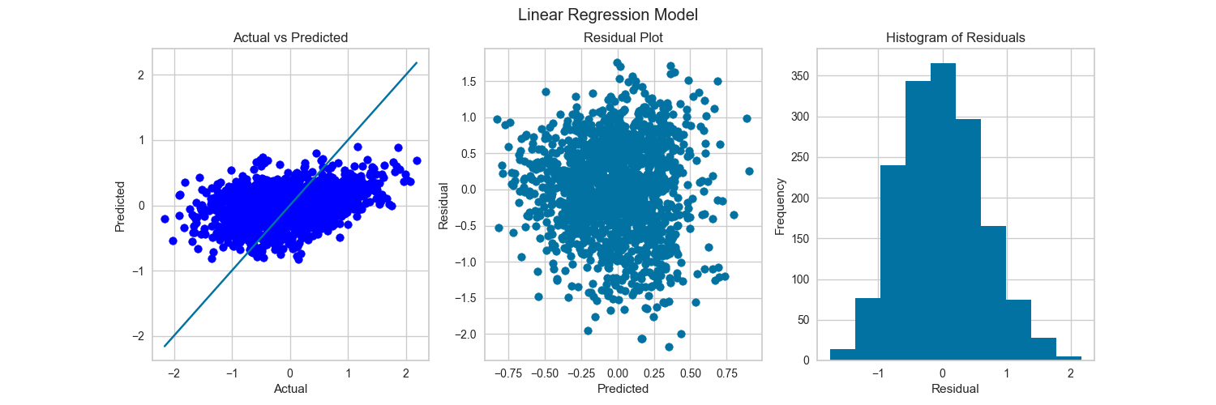
There is poor correlation between actual and predicted values.
The predicted values are not close to the best fitted line.
The residuals are not close to 0 for the predicted values.
The assumption of Homoscedasticity is violated
The residuals are normally distributed

Slide 10
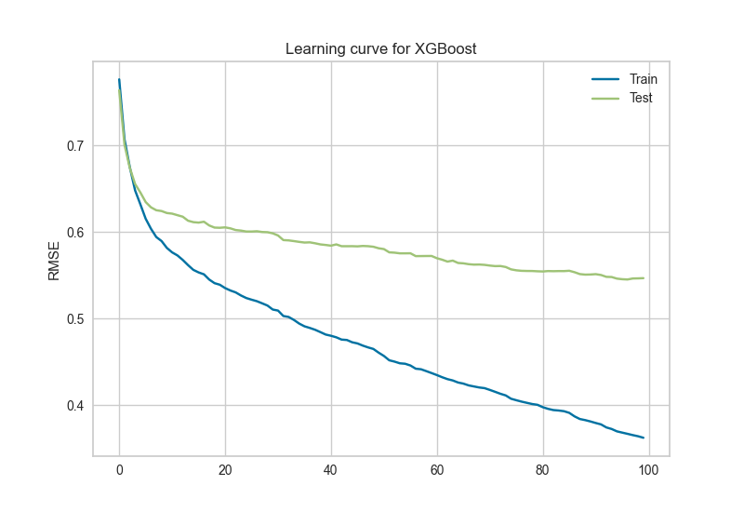
The learning curve shows the error on the y axis and no. of trees on the x axis. The training error is reducing while the
Validation error stops reducing when at 98th tree. Early stopping was used to avoid overfitting.

Slide 11
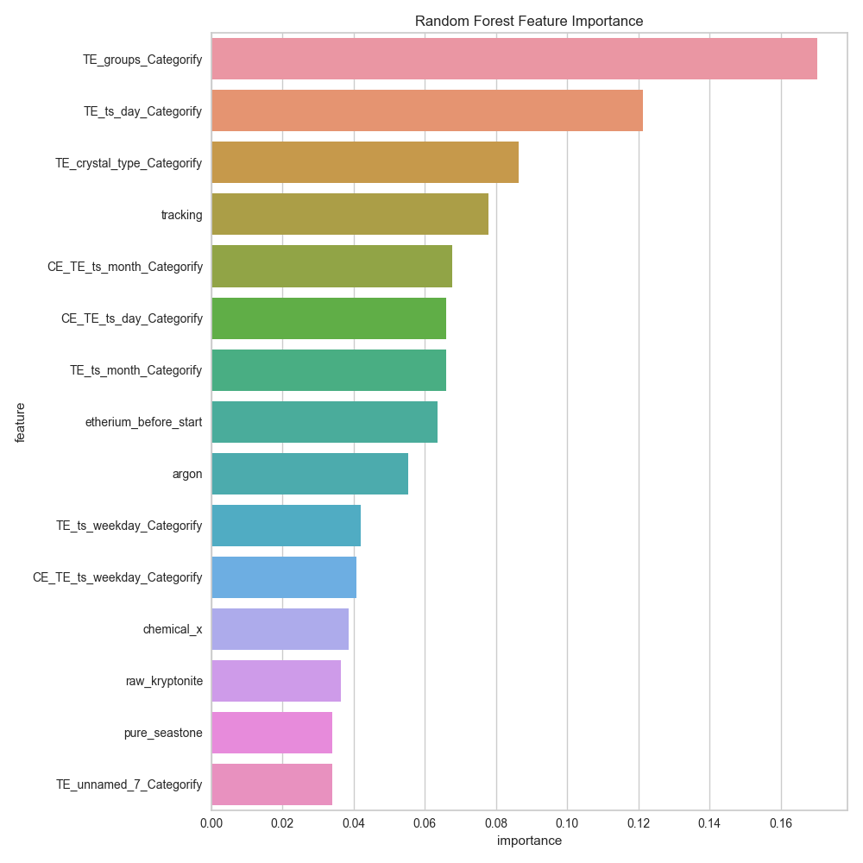
We can see the important features based on the Gini impurity.
We can see that groups, day and crystal type are important features.

Slide 12
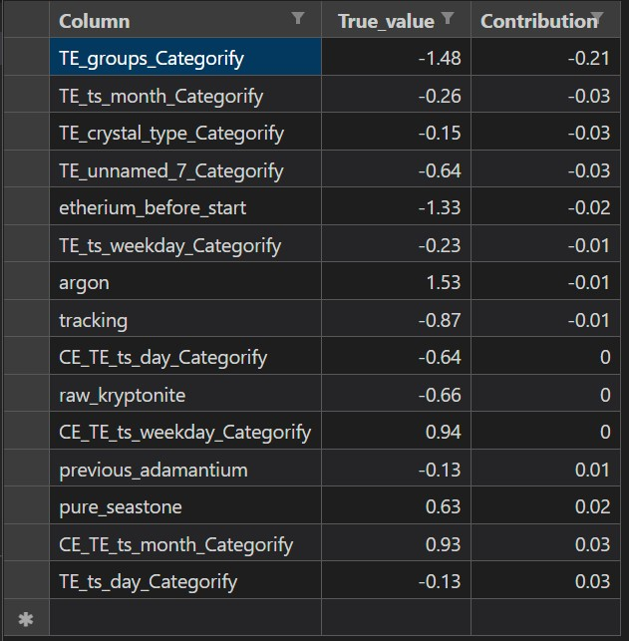
Model interpretation
For the value of 0.63 for pure_seastone it adds 0.03 to the prediction of the target prediction.
While for a value of -1.5 for column TE_groups_categorify it reduces 0.17 to the target prediction.

Slide 13
Compare results with AutoML
Best model:
{
"class_name": "XGBoostRegressor",
"module": "automl.client.core.common.model_wrappers",
"param_args": [],
"param_kwargs": {
"booster": "gbtree",
"colsample_bytree": 0.9,
"eta": 0.5,
"gamma": 0.01,
"max_depth": 8,
"max_leaves": 0,
"n_estimators": 50,
"objective": "reg:linear",
"reg_alpha": 1.3541666666666667,
"reg_lambda": 1.6666666666666667,
"subsample": 1,
"tree_method": "auto"
},
"prepared_kwargs": {},
"spec_class": "sklearn"
}
Normalized RMSE: 0.06124

