Slide 1

Flood Risk Priority Index
for Indian Catchments
Jessica Dhabhai - 25060242057
Viraj Rank - 25060242108
Notes:
Welcome. This deck walks through a complete analysis: from raw flood records to a ranked list of catchments, with checks on how reliable the ranking is. Each slide has detailed speaker notes explaining the code and how to read the figures. Data: INDOFLOODS, 4,548 flood events at 155 river gauges, July 1965 to September 2020, plus catchment characteristics and rainfall. Important framing: the index is a screening and prioritising tool, not a prediction of economic loss and not an official risk rating.
1

Slide 2
The idea: risk needs a hazard and something exposed to it
HAZARD
Flood frequency per year, severe-flood share, 95th-percentile duration
EXPOSURE + VULNERABILITY
Population density, urban share, roads, night lights, GDP per person, low HDI, total population
RISK PRIORITY
R = √(Hazard × Exposure)
0 to 1, higher = higher priority
  Floods are commonly compared using the number of recorded events. That approach can be misleading.
  A catchment may record many small floods but have a small exposed population.
  Another catchment may record fewer floods but contain dense cities, roads and economic activity.
  Therefore, flood frequency alone is not enough for deciding where to prioritise management and preparedness.
2
Notes:
A catchment is the land area draining to one river gauge. Hazard here means how often and how severely it floods: the score uses three indicators, flood frequency per monitored year, the share of floods labelled Severe, and the 95th percentile of flood duration. Exposure and vulnerability mean how much (people, roads, economic activity) is in the way and how poorly it can cope: population density, urban share, road density, night lights, GDP per person, reversed HDI and log total population. Every indicator becomes a percentile score from 0 to 1, group scores are averages, and the final score is the geometric mean, the square root of hazard times exposure. Rainfall and height above the danger level are also computed for each gauge, but they are reported rather than scored. Scores are relative: 0.76 means highest among the 46 ranked catchments, not a 76% chance of flooding.
2

Slide 3
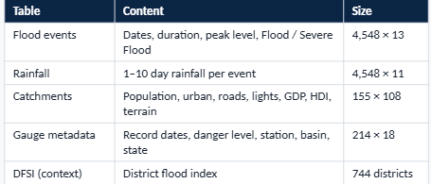
Data and cleaning
2,919
1,629
Flood events (64%)
Severe Flood (36%)
# durations: negative or impossible -> missing
events.loc[events.event_duration_days < 0, 'event_duration_days'] = np.nan
events.loc[events.event_duration_days > 60, 'event_duration_days'] = np.nan
# rainfall of exactly 0 = missing reading
for c in ['t3d','t5d']:
rainfall.loc[rainfall[c] == 0, c] = np.nan
3
Notes:
Five core tables were joined on gauge ID, which is extracted from the event ID (INDOFLOODS-gauge-643-12 belongs to gauge 643). Column names were standardised, dates parsed, numbers stored as text converted, duplicate events dropped. The key cleaning finding: durations had impossible values. The median flood lasts 2 days and 99% last under 68 days, but the maximum was 11,147 days, about 30 years, which is a date error. Anything over 60 days was set to missing (1.03% of events). Rainfall zeros were also treated as missing. Missingness was otherwise near zero in the core columns.
3

Slide 4
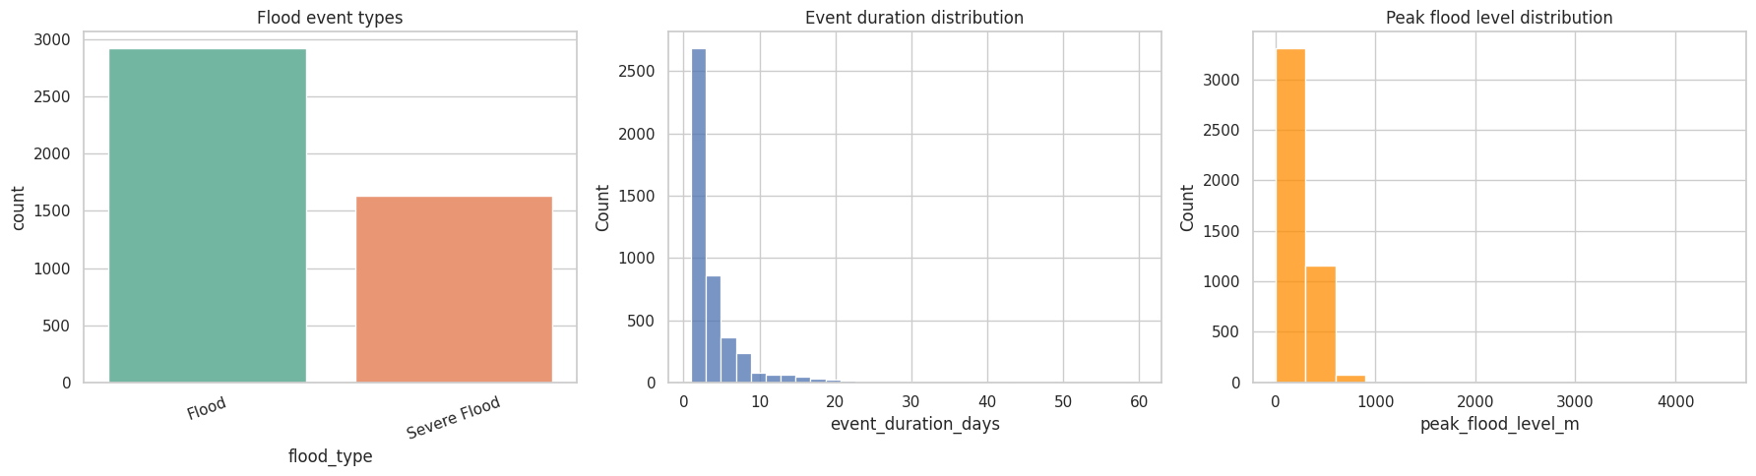
What the raw data looks like
  Most floods are short: median 2 days, 90% last 8 days or less
  Peak level is an elevation above sea level, not depth: never compare it across gauges
4
Notes:
Left panel: about two floods in three are plain Flood, one in three is Severe Flood. Middle: after capping, nearly all floods last under 10 days; before the fix a single bin held everything because of the 11,000-day errors (the panel currently draws two overlapping histograms, a plotting detail to tidy). Right: peak flood level reaches about 4,400 m. This is not flood depth. It is the height of the water surface above sea level, so a mountain gauge always reads high and a coastal one low. That is why the index never compares raw levels across catchments and instead measures height above each gauge own danger level.
4

Slide 5
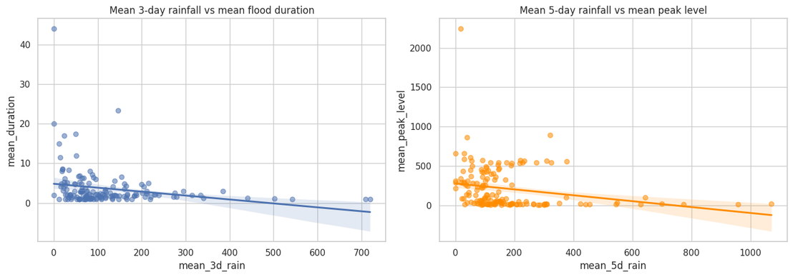
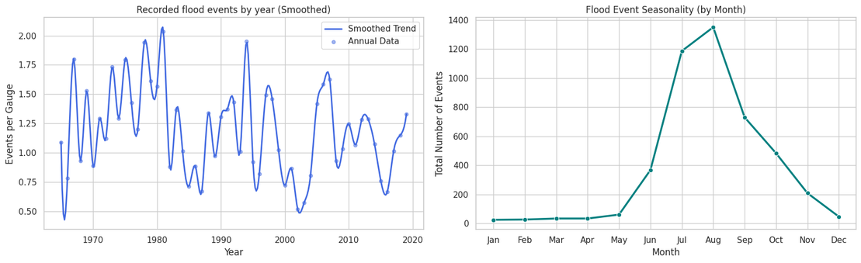
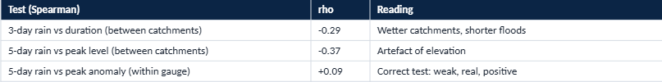
Floods over time, and does rain explain flood size?
5
Notes:
Left: recorded floods rise from about 10 a year in the 1960s to about 200 in 2019. Much of that reflects more gauges reporting over time, so it must not be read as floods tripling; counts per active gauge would be fairer. 2020 is a partial year and was dropped. Right: rainfall versus flood behaviour per catchment. Between catchments, 3-day rain versus duration gives rho of minus 0.29, and 5-day rain versus peak level gives minus 0.37. The second is misleading because peak level is an elevation: dry, high-altitude gauges read high. Comparing each gauge only with itself flips the sign to plus 0.09, highly significant but weak. So more rain does mean slightly higher rivers at the same place, but rainfall alone is a poor predictor of flood size.
5

Slide 6
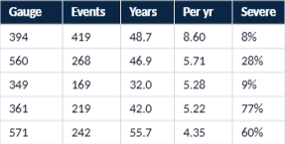
Step 1: hazard indicators per catchment
hazard = events.groupby('gauge_id').agg(
severe_share = ('flood_type', lambda x: (x=='Severe Flood').mean()),
p95_duration = ('event_duration_days', lambda s: s.quantile(.95)),
p95_above_danger = ('above_danger_m', lambda s: s.quantile(.95)), # reported
p95_rain_3d = ('t3d', lambda s: s.quantile(.95)), # reported
p95_rain_5d = ('t5d', lambda s: s.quantile(.95))) # reported
hazard['flood_frequency'] = event_count / monitoring_years
# scored: flood_frequency, severe_share, p95_duration
Top 5 by flood frequency
8.6 / yr
Gauge 394: most floods, only 7.9% severe
  Scored: frequency, severe share, p95 duration
  Reported only: p95 rain 3-day / 5-day, p95 height above danger
6
Notes:
For each gauge we compute hazard numbers from its flood events. Flood frequency is events divided by monitoring years, because a gauge watched 50 years naturally records more than one watched 5. Severe share is the fraction labelled Severe Flood. The 95th percentile of duration describes a bad case without being dragged by one odd event. These three feed the hazard score. The table also carries the 95th percentile of 3-day and 5-day rainfall and of height above the danger level; they are reported for interpretation but not scored, because 3-day and 5-day rainfall are almost the same variable (correlation 0.98) and the danger-level data had datum problems (next slide). Reading the top-frequency table: gauge 394 Biligundulu has 419 events in 48.7 years, 8.6 per year, but only 7.9% are severe, so frequent minor floods are not the same as severe hazard.
6

Slide 7
Step 2: exposure, scoring and the final index
risk_data = risk_data[(risk_data.event_count >= 20) &
(risk_data.monitoring_years >= 15)].copy() # 46 left
hazard_columns = ['flood_frequency','severe_share','p95_duration']
exposure_columns = ['population_density','urban_percentage','road_density',
'night_light','2015_gdp_pc_ppp']
def percentile_score(s):
return s.fillna(s.median()).rank(pct=True) # 0 to 1
risk_data['hdi_vuln_score'] = 1 - percentile_score(risk_data['2015_hdi'])
risk_data['pop_count_score'] = percentile_score(np.log1p(risk_data.population_count))
risk_data['hazard_score'] = mean of the 3 hazard percentile scores
risk_data['exposure_score'] = mean of the 7 exposure scores
risk_data['risk_priority_score'] = np.sqrt(hazard_score * exposure_score)
46 of 155
catchments with enough data
3 + 7
hazard + exposure indicators
ρ = -0.17
hazard vs exposure (weak, not significant)
8
Notes:
Exposure indicators come from the catchment table: population density, urban share, road density, night-time lights and GDP per person, plus reversed HDI as vulnerability and the log of total population so very populous catchments are not treated like small ones. Reliability filter: only catchments with at least 20 events and at least 15 monitored years are scored, because a percentile built on a handful of floods is unreliable. That leaves 46 of 155 catchments; 109 are shown grey and not ranked. percentile_score ranks values from 0 to 1 and fills missing values with the median. Hazard is the mean of three component scores, exposure the mean of seven, and the final score is the geometric mean. Categories: top 10% Very high, next 10% High, next 40% Moderate, bottom 40% Low. Note that population density, night lights and urban share are correlated at 0.82 to 0.85, so built-up area carries extra weight, and flood frequency is negatively related to most exposure indicators (-0.14 to -0.32).
8

Slide 8
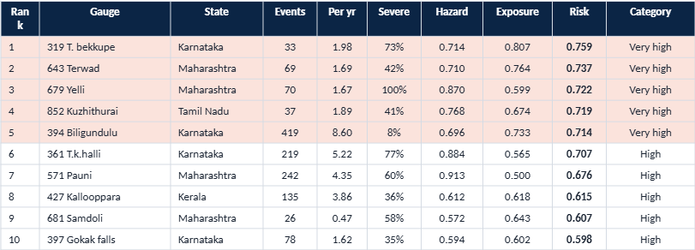
Result: the top 10 catchments
Shaded rows = Very high priority. Hazard, Exposure and Risk are percentile-based (0–1).
9
Notes:
This is the main output, ranked by risk priority score. Ranks 1 to 5 are Very high: T. bekkupe (319, Karnataka, Cauvery), Terwad (643, Maharashtra, Krishna), Yelli (679, Maharashtra, Godavari, 100% severe floods), Kuzhithurai (852, Tamil Nadu) and Biligundulu (394, Karnataka). Some catchments rank high because of hazard (Pauni 571 and T.k.halli 361 have hazard above 0.88 but modest exposure), others mostly because of exposure (T. bekkupe exposure 0.807). Terwad is high on both. Station names and states come from the gauge metadata table, which makes the gauge IDs readable.
9

Slide 9
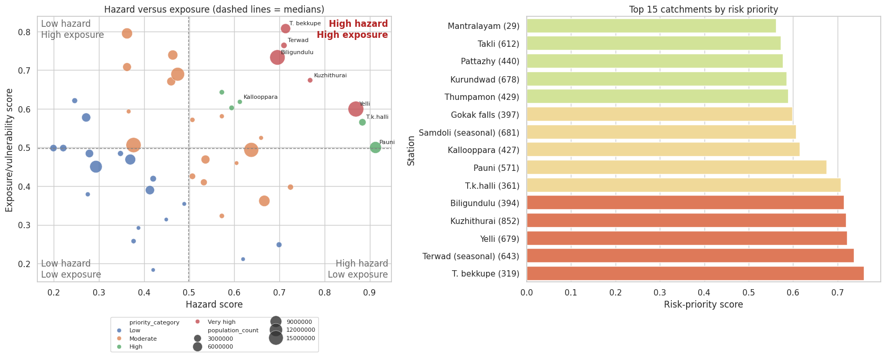
Hazard versus exposure: four quadrants
10
Notes:
Left: each dot is a catchment, bubble size is population and colour is the priority category. The dashed lines are the medians of hazard and exposure, splitting the 46 catchments into four quadrants. The top-right quadrant, high hazard and high exposure, holds 13 catchments and is the first priority list: it contains ranks 1 to 11, plus ranks 13 (Pattazhy) and 17 (Theni). Low hazard with low exposure holds 12, low hazard with high exposure 11, and high hazard with low exposure 10. Right: top 15 by risk score, with station names. Gauge 319 T. bekkupe leads on exposure, Yelli and Pauni sit far right on hazard but near the exposure median. Large bubbles that are blue or orange are heavily populated catchments with a lower combined score.
10

Slide 10
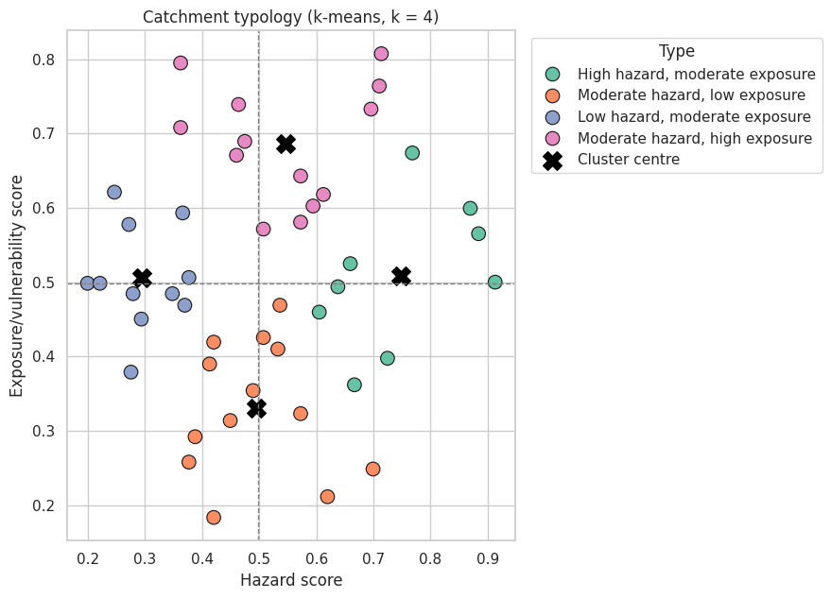
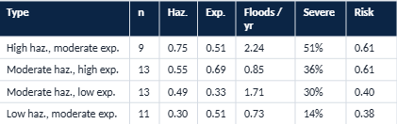
Catchment typology: four profiles (k-means)
  Two groups share top mean risk (0.61) for different reasons: flood-prone vs. asset-dense
  Typology guides the type of action, the ranking guides the order
11
Notes:
K-means clustering groups the catchments by hazard and exposure score. Silhouette scores for k from 2 to 6 were 0.36, 0.38, 0.35, 0.37 and 0.40, so no choice is sharply better; four groups were used because they are easy to name and interpret. Clusters are named from their average hazard and exposure. High hazard, moderate exposure (9 catchments, hazard 0.75): flood-prone, median 2.2 floods a year and about half severe. Moderate hazard, high exposure (13): fewer floods (0.85 a year) but the densest, brightest and most built-up catchments (night light 5.1 versus 0.9 to 2.1 elsewhere). These two groups have nearly equal mean risk (0.61), but they need different responses: flood control for the first, protection of assets and people for the second. The other two groups, moderate hazard with low exposure and low hazard with moderate exposure, are lower priority (mean risk about 0.4).
11

Slide 11
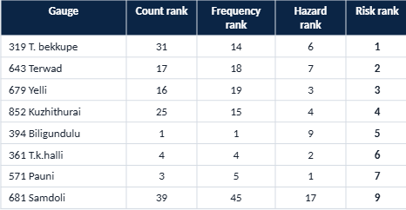
Is the ranking just a flood count?
0.27
0.23
ρ with event count (p = 0.07)
ρ with frequency (p = 0.12)
0.75
ρ with hazard score alone (p < 0.001)
  Rank is not driven by counts alone: exposure and severity reorder the list
  Read it as hazard and exposure together
12
Notes:
No. The final score is related to the raw event count only weakly (Spearman rho 0.27, p 0.07) and to flood frequency also weakly (rho 0.23, p 0.12); both are not statistically significant. It is more strongly linked to the hazard score alone (rho 0.75), as expected since hazard is half of the score. The table shows rank movement. Gauge 319 T. bekkupe is 31st by event count but 1st by risk; Samdoli 681 moves from 39th to 9th because of high exposure and severity. Gauge 394 Biligundulu is 1st by count and frequency but 5th by risk because most floods are minor. So the ranking should be read as hazard and exposure together, not where floods are most frequent.
12

Slide 12
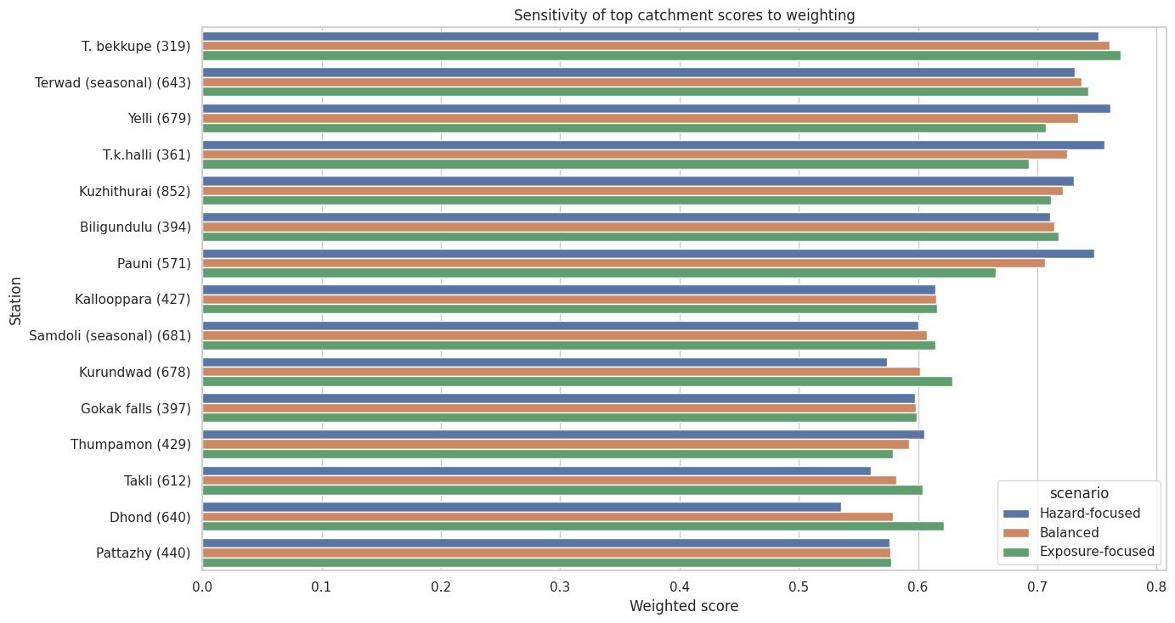
How stable is the ranking?
13
Notes:
Two tests. Weighting scenarios (left): the hazard weight is set to 60/40, 50/50 and 40/60 against exposure. Top-10 overlap is 9 of 10 for balanced versus hazard-focused, 9 of 10 for balanced versus exposure-focused, and 8 of 10 between the two extremes, so the list is not very sensitive to how hazard and exposure are balanced. Monte Carlo (right): the weights of every individual indicator were randomised 1,000 times and we counted how often each catchment stayed in the top 10. Gauges 643, 319, 852, 361 and 679 stay in more than 95% of runs, making them the most defensible priorities. 571 and 394 are in about 79% and 78%. 427 and 681 sit near 49%, i.e. borderline. Interpretation: a short list of five is robust, ranks 8 to 12 are close to a toss-up.
13

Slide 13
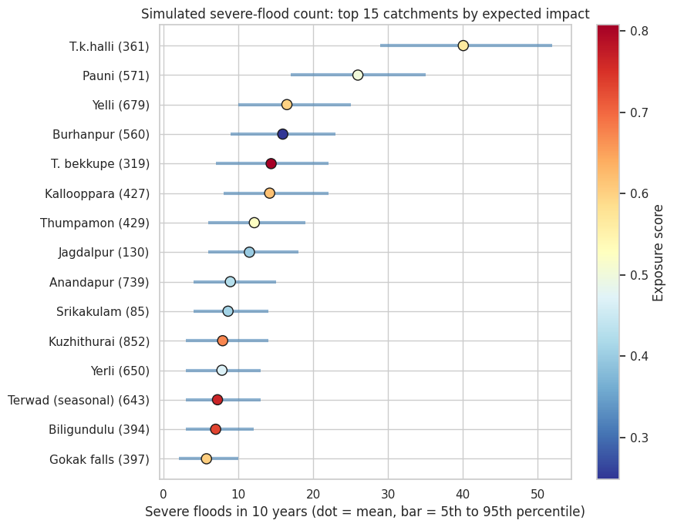
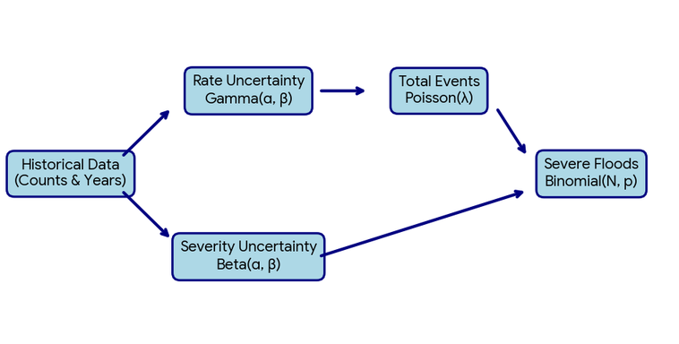
Monte Carlo simulation: would the list survive a different history?
def simulate_severe_floods(data, horizon_years, n_sim, seed=42):
rng = np.random.default_rng(seed)
draws = np.zeros((len(data), n_sim))
for i, row in enumerate(data.itertuples()):
rate = rng.gamma(row.event_count + 0.5,
1 / row.monitoring_years, size=n_sim)
n_floods = rng.poisson(rate * horizon_years)
share = rng.beta(severe + 1, total - severe + 1, size=n_sim)
draws[i] = rng.binomial(n_floods, share)
return draws
impact = severe_draws * exposure_score[:, None]
sim_ranks = pd.DataFrame(impact).rank(ascending=False)
14
Notes:
The index is built from a historical record that is short for many gauges, and the number of floods recorded is partly luck. The simulation draws 5,000 possible futures for every scored catchment. Step 1: the yearly flood rate comes from a gamma distribution built from the observed events and years monitored, so short records are more uncertain. Step 2: the number of floods in 10 years comes from a Poisson distribution at that rate. Step 3: the share that are severe comes from a beta distribution built from observed severe and non-severe events. Step 4: simulated severe floods are multiplied by the exposure score to give impact, and Step 5: catchments are re-ranked in every future. The chart shows expected severe floods over 10 years, dot = mean, bar = 5th to 95th percentile. T.k.halli 361 averages about 40 severe floods, Pauni 571 about 26, Yelli 679 about 16, Burhanpur 560 about 16 but with low exposure.
14

Slide 14
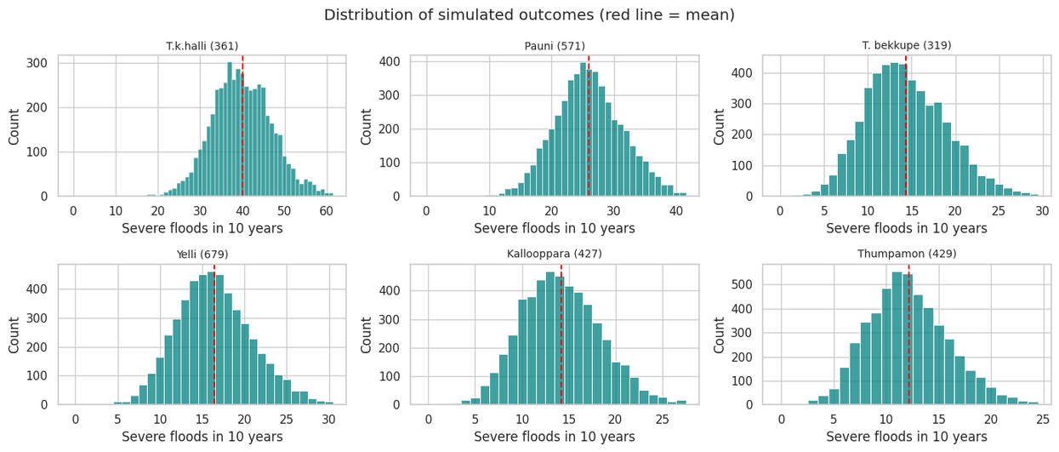
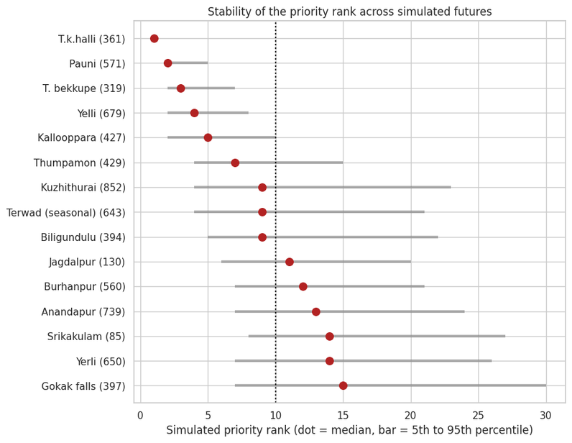
Simulation results: distributions and rank stability
ρ = 0.79
40 vs 26
index rank vs median simulated rank
expected severe floods: T.k.halli vs Pauni
15
Notes:
Left: distribution of simulated severe floods in 10 years for the six highest expected-impact catchments. The red line is the mean. Wider histograms mean more uncertainty; T.k.halli is far to the right, with 30 to 50 severe floods typical. Right: simulated rank, dot = median and bar = 5th to 95th percentile. T.k.halli is rank 1 in essentially every future, Pauni stays between 2 and 5, and T. bekkupe and Yelli stay in the top 8. By contrast Kuzhithurai 852, Terwad 643 and Biligundulu 394 have a median near 9 but bars that reach about 22: their position depends on how the history happens to fall. The index rank and median simulated rank agree reasonably (Spearman rho 0.79, p < 0.001), so the simulation largely supports the index but reorders the middle of the top 10.
15

Slide 15
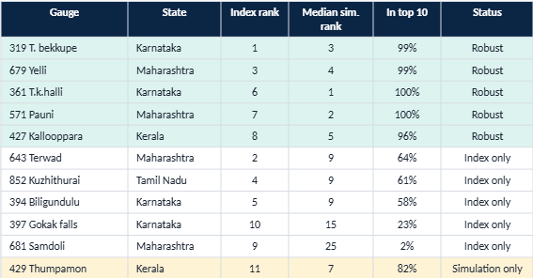
Robust priority list: index and simulation combined
5
robust priorities
5
index only (less stable)
1
additional candidate
Horizons 5 / 10 / 20 years: 8 of the index top 10 appear in every case.
16
Notes:
A catchment is a robust priority when it is in the index top 10 and also stays in the top 10 in at least 80% of simulated futures. Five qualify: T. bekkupe 319, Yelli 679, T.k.halli 361, Pauni 571 and Kallooppara 427. Five are in the index top 10 but are less stable, depending on the particular history recorded: Terwad 643 (64% of futures), Kuzhithurai 852 (61%), Biligundulu 394 (58%), Gokak falls 397 (23%) and Samdoli 681 (2%). One catchment outside the index top 10, Thumpamon 429, reaches the top 10 in 82% of futures and is flagged as an additional candidate. The result is not very sensitive to the horizon: with 5, 10 or 20 years, 9 to 10 catchments reach the top 10 in at least half of the futures and 8 of them are always in the index top 10.
16

Slide 16
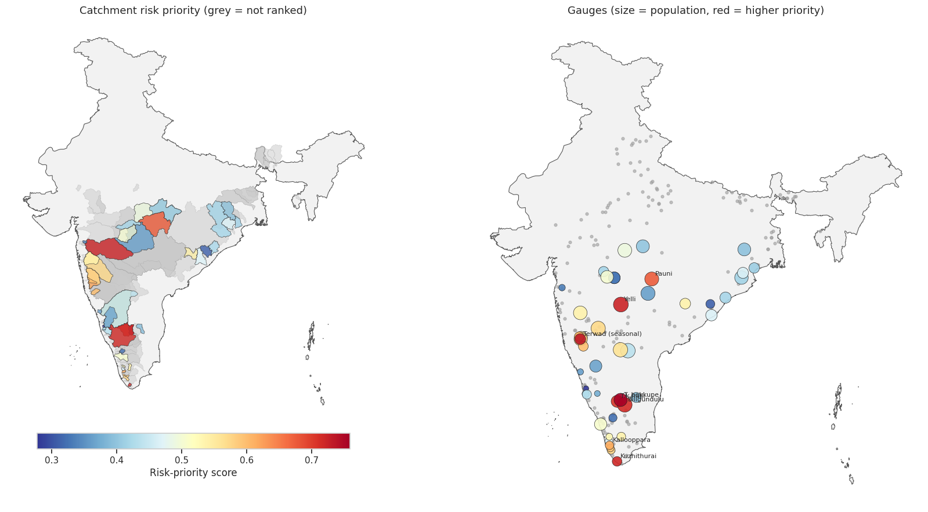
Where the priority catchments are
Red = higher priority. Grey = not ranked. The map does not cover the Ganga–Brahmaputra plains.
17
Notes:
Left: catchment boundaries coloured by score, blue low to red high; grey catchments are not ranked because of too few events or too short a record. Right: the gauges as points sized by population, with the top gauges labelled. The highest priorities cluster in peninsular India: the Cauvery basin in Karnataka, the Krishna and Godavari basins in Maharashtra, and the west-flowing rivers of Kerala and Tamil Nadu. Important caution: the north and the Ganga and Brahmaputra plains are largely unranked because the 20-event, 15-year filter removed gauges there, or no catchment polygon was available, so this map says nothing about flood risk in those regions. Also, catchments are nested, so upstream and downstream scores are not fully independent.
17

Slide 17
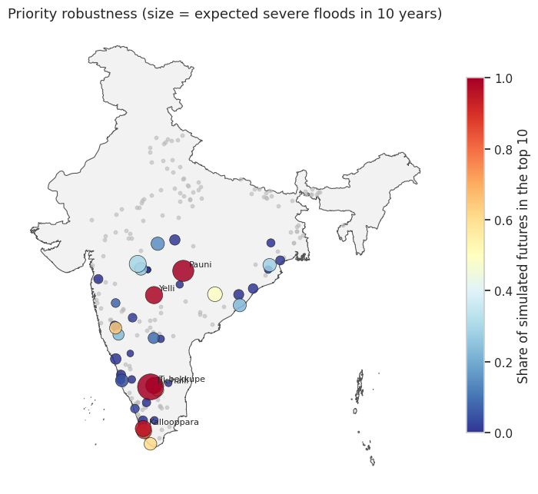
Map: how robust is each priority in the simulation?
  Size = expected severe floods in 10 years
  Colour = share of futures in the top 10
  Robust priorities (dark red): T.k.halli, T. bekkupe, Pauni, Yelli, Kallooppara
  Grey dots in the north: gauges not scored
18
Notes:
Each dot is a gauge. Size shows the expected number of severe floods in 10 years; colour shows the share of simulated futures in which that catchment stays in the top 10 by expected impact. Large dark-red dots are the robust priorities: T.k.halli and T. bekkupe in southern Karnataka (they overlap on the map), Pauni and Yelli in Maharashtra, and Kallooppara in Kerala. Many gauges are small and blue, meaning they almost never reach the top 10. Notice that robust priorities again sit in peninsular India, and that the many small grey points in the north are gauges that were not scored.
18

Slide 18
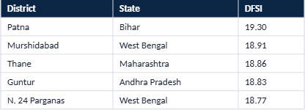
Context check: comparison with DFSI
ρ = 0.39
p = 0.26
by state, ~10 states
not significant
Highest-DFSI districts (of 744)
state_dfsi = dfsi.groupby(dfsi['State_Name'].str.upper())['DFSI'].mean()
comp = st.groupby('state')['risk_priority_score'].mean().to_frame().join(state_dfsi, how='inner')
print(spearmanr(comp.iloc[:,0], comp['DFSI']))
  Weak agreement: no independent validation yet; duplicate district names limit a finer match
19
Notes:
DFSI is a district-level flood index, so it cannot be matched exactly to catchments. The notebook averages both measures by state, leaving about 10 states in common. Agreement is weak and not statistically significant: Spearman rho 0.39, p 0.26. That means no clear support and no clear contradiction. DFSI itself has quirks: 744 districts with 1 missing, and district names that repeat within a state (for example two Aurangabad rows in Bihar and others for Raigarh, Hamirpur, Pratapgarh, Balrampur and Bilaspur), which is why the comparison is only done at state level. Conclusion: the index is not independently validated; treat it as a screening tool.
19

Slide 19
Conclusions and limitations
  Robust priorities: 319, 679, 361, 571, 427
  Top-5 but less stable: 643, 852, 394
  Ranking is not a flood count: it blends hazard and exposure
  Priorities cluster in peninsular India; north India is largely unranked
Limitations
  Relative scores, not absolute risk
  Only 46 of 155 catchments ranked
  Hazard uses 3 indicators; rain and danger level not scored
  Exposure data ~2015, floods 1965–2020
  Nested catchments, correlated indicators
  No independent validation (DFSI weak)
20
Notes:
Take-aways. One: gauges 319 T. bekkupe, 679 Yelli, 361 T.k.halli, 571 Pauni and 427 Kallooppara pass both the index and the simulation robustness test; 643, 852 and 394 are top-5 in the index but less stable. Two: the ranking is not a flood count; event count and frequency are only weakly related to the final score. Three: priorities concentrate in peninsular India, but this is partly a data coverage effect. Limitations to state when presenting: scores are relative; only 46 of 155 catchments ranked; hazard score uses three indicators, and rainfall and danger-level exceedance are not scored; exposure data are about 2015 while floods span 1965 to 2020; catchment averages hide local hotspots; nested catchments are not independent; correlated exposure indicators double count built-up area; the DFSI comparison is inconclusive. Next steps: extend coverage to north India, normalise the annual trend by active gauges, and test adding rainfall or danger-level exceedance to the score.
20

