Slide 1

Website Traffic
Forecasting
Virajsinh Parmar

Slide 2


Agenda
Introduction
Dataset Description
Methodology / Approach
Models Implemented
Results & Comparison
Conclusion & Future Work

Slide 3
Introduction
In today’s digital landscape, accurate website traffic forecasting plays a vital role in optimizing content strategies, allocating resources efficiently, and improving marketing outcomes. Our client, a website owner, seeks a robust forecasting system capable of predicting daily visits with high accuracy. To address this, the project leverages advanced time series forecasting techniques, machine learning models, and hybrid approaches to capture complex traffic patterns. This integrated methodology aims to enhance forecast precision, provide actionable insights into traffic trends, and support data-driven decision-making for content scheduling, server management, and campaign planning.

Slide 4
About Dataset
Row
Columns
Target Variable
Columns Name
2167
8
“Page. Loads”
(Number of page Load)
1. Row – Index of the Row
2. Day – Day of the month
3. Day.Of.Week - Day of the week
4. Date – Full date of traffic data
5. Page. Loads
6. Unique.Visits - Number of unique visitors
7. First.Time.Visits – Number of first-time visitors
8. Returning.Visits: Number of returning visitors

Slide 5
Project Workflow
5.
Evaluation
And
Model Comparison
2.
Data Preprocessing
1.
Data Collection
3.
Exploratory
Data
Analysis
4.
Model Building

Slide 6
Workflow Explanation
1. Data Collection :
The dataset for this project was officially provided by the company via email as part of my internship. It contains daily website traffic records for the period [Start Date] to [End Date], with the primary feature being “Page Loads.” The data was received in CSV format for further analysis.
2. Data Preprocessing :
Checked and handled missing value
Detected and treated outliers using IQR method in Page Loads
Converted date column to proper datetime format and set as index.
Ensured chronological ordering of data.
Split dataset into Training and Testing sets for modeling.
Removing commas from numerical fields.
Data Validation to ensure accuracy and completeness.
Dropping Unnecessary Columns to keep only relevant features.
Also done some kind of Encoding for Machine learning Models

Slide 7
3. Exploratory Data Analysis :
To understand the underlying patterns, seasonality, and statistical properties of the dataset, various exploratory analyses and statistical tests were performed as follows:
Daily Website Page Loads visualization to identify traffic trends.
Page Loads by Day of the Week to detect weekly patterns.
Average Monthly Page Loads to observe long-term seasonality.
Stationarity Check using Rolling Mean & Standard Deviation.
Seasonal Decomposition (Additive & Multiplicative models) to separate trend, seasonality, and residuals.
Statistical Tests:
Augmented Dickey-Fuller (ADF) Test
Kwiatkowski–Phillips–Schmidt–Shin (KPSS) Test
Correlation Analysis: ACF and PACF Plots.
Lag Plots to check autocorrelation.

Slide 8
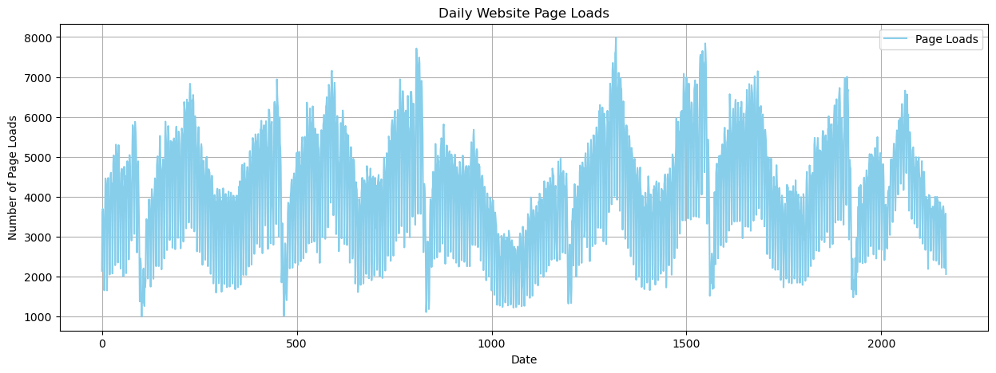
Daily Website Page Loads
The plot shows daily website page loads over the entire time period, highlighting clear seasonal patterns and fluctuations in traffic.

Slide 9
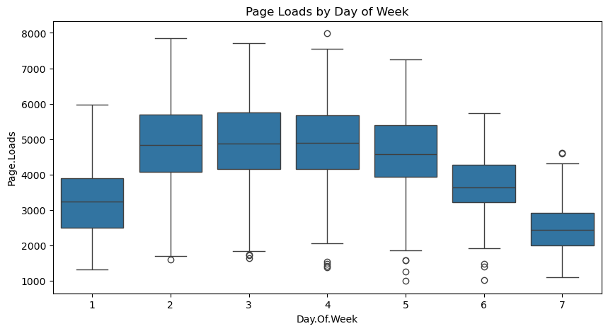
Page Loads by Day of the Week
Box plot showing page load distribution across different days of the week, indicating higher traffic on weekdays compared to weekends.

Slide 10
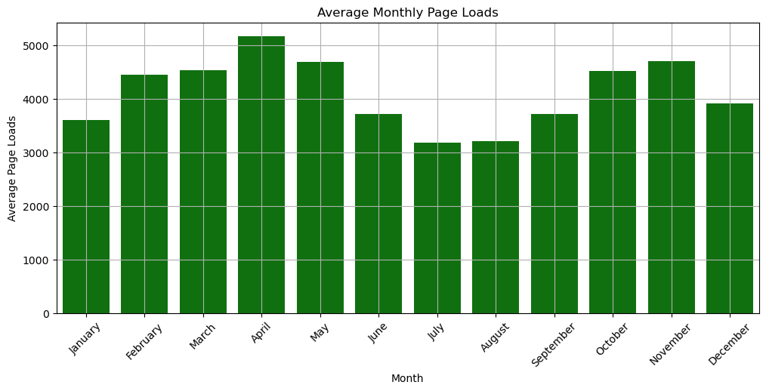
Average Monthly Page Loads
Box plot showing page load distribution across different days of the week, indicating higher traffic on weekdays compared to weekends.

Slide 11
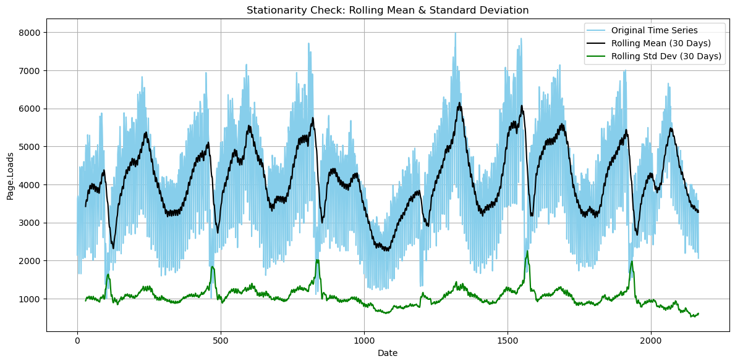
Stationarity Check using Rolling Mean & Standard Deviation
The rolling mean and standard deviation plot suggests noticeable trends and fluctuations, which could indicate non-stationarity. However, statistical test results confirmed that the series is stationary, and hence we rely on those results.

Slide 12
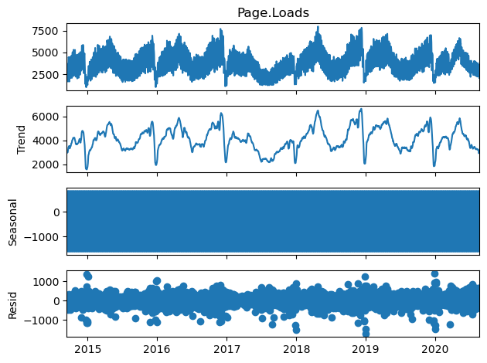
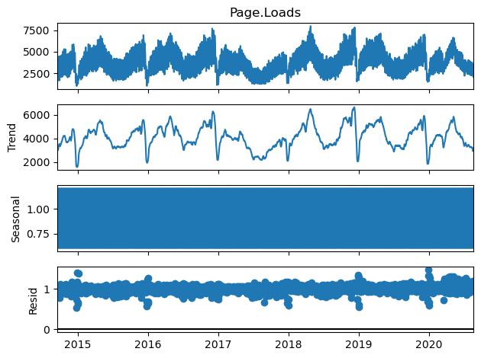
Seasonal Decomposition (Additive & Multiplicative models)
Seasonal decomposition was performed using both additive and multiplicative models. The additive model revealed clear trend movements and consistent seasonal patterns, while the multiplicative model showed proportional seasonal variations where the magnitude of seasonality changes along with the trend.

Slide 13
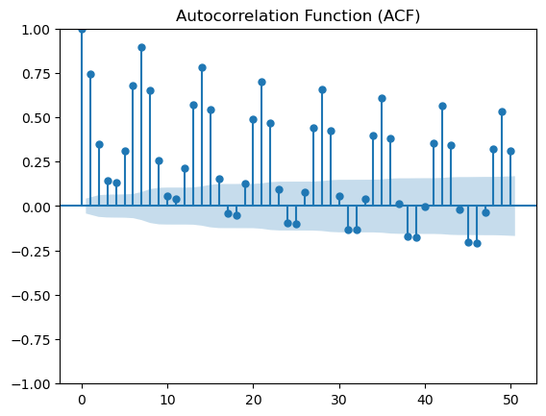
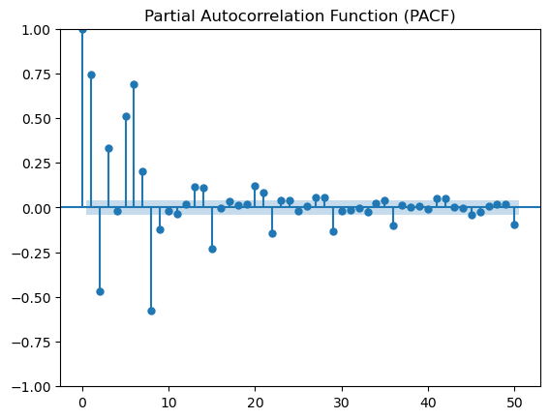
Correlation Analysis: ACF and PACF Plots
The Autocorrelation Function (ACF) plot shows a slow decay, while the Partial Autocorrelation Function (PACF) plot exhibits a sharp cutoff after a few lags, suggesting potential autoregressive patterns in the data. Although these plots might visually indicate non-stationarity, the statistical tests (ADF/KPSS) confirmed that the series is stationary. Therefore, we rely on the statistical test results for model parameter selection.

Slide 14
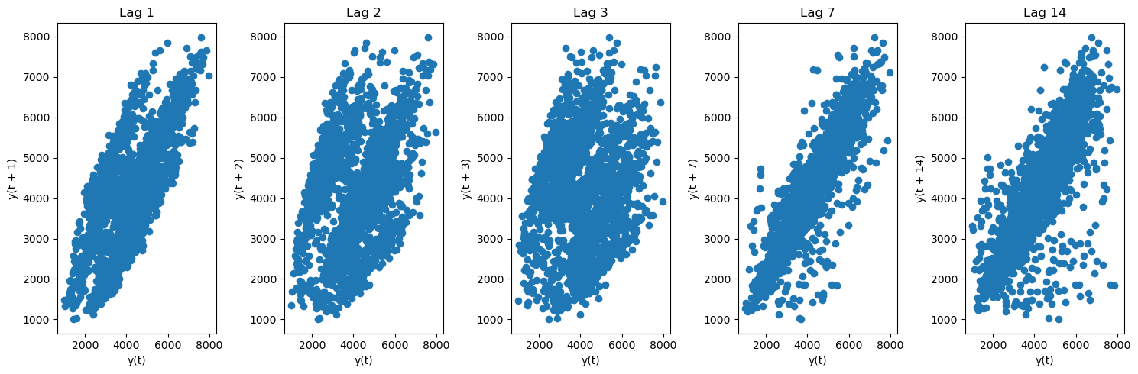
Correlation Analysis: Lag Plot
The lag plots for different time intervals (1, 2, 3, 7, and 14 days) show clear positive correlations, indicating strong autocorrelation in the data. This pattern suggests the presence of time-dependent structures suitable for time series modeling.

Slide 15
Statistical Tests for Stationarity
1. Augmented Dickey-Fuller (ADF) Test
ADF Statistic: -4.284
p-value: 0.00047
Interpretation : Since the p-value is less than 0.05 and the ADF statistic is less than the critical values, we reject the null hypothesis of non-stationarity, indicating that the series is stationary.
2. Kwiatkowski–Phillips–Schmidt–Shin (KPSS) Test
KPSS Statistic: 0.205
p-value: 0.10
Interpretation : Since the test statistic is lower than the critical values and the p-value is high (> 0.05), we fail to reject the null hypothesis of stationarity.
Conclusion : Both tests confirm that the dataset is stationary, meaning its statistical properties (mean, variance) remain constant over time.

Slide 16
Model Building
Time Series Forecasting Models
SARIMA
Prophet
Exponential Smoothing (Holt-Winters)
Machine Learning Models
Random Forest
XGBoost
LightGbm
Hybrid Model
Sarima + RandomForest
LighGbm + XGBoost

Slide 17
Results
Models | Train MAPE | Train RMSE | Test MAPE | Test RMSE
SARIMA | 7.27 % | 345.65 | 6.85 % | 330.65
Prophet | 10.12 % | 478.22 | 13.89 % | 520.27
Exp.Smoothing | 7.06 % | 342.79 | 7.65 % | 332.79
Random Forest | 1.17 % | 60.91 | 3.78 % | 133.56
XGBoost | 1.37 % | 68.93 | 2.54 % | 99.88
LightGbm | 1.65 % | 79.83 | 2.51 % | 96.16
SARIMA+RF | 9.39 % | 434.78 | 8.92 % | 375.98
LightGbm+XGB | 1.48 % | 72.39 | 2.46 % | 96.39

Slide 18
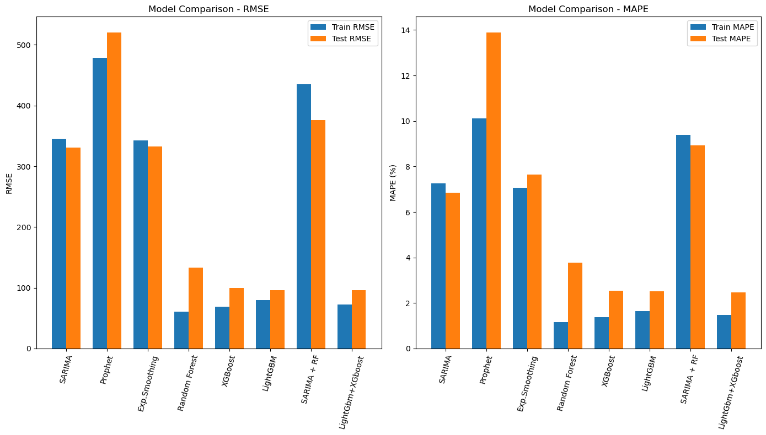
Result Comparison Plot

Slide 19

Model Performance Summary
Multiple forecasting methods — SARIMA, Exponential Smoothing, Prophet, Random Forest, XGBoost, LightGBM, and hybrid models — were evaluated for daily website traffic prediction.
Machine learning models clearly outperformed traditional statistical approaches in both RMSE and MAPE. The LightGBM + XGBoost hybrid achieved the best accuracy (Test MAPE: 2.46%, RMSE: 96.39), making it ideal for deployment.
Standalone LightGBM and XGBoost also delivered stable, high-accuracy forecasts.
Traditional models captured seasonality but showed higher errors. Prophet struggled with this dataset’s complexity, while SARIMA + Random Forest hybrids offered no notable improvement.
From a business standpoint, the chosen model enables better server resource allocation, optimized content release timing, and improved marketing planning through accurate, timely traffic forecasts.

Slide 20

Conclusion
The evaluation of multiple forecasting methods revealed that the Hybrid LightGBM + XGBoost model provides the most accurate daily website traffic predictions, outperforming traditional time series and other machine learning approaches. Accurate forecasts from this model will support better decision-making for server management, content scheduling, and marketing strategies.
Key Takeaways:
Hybrid ML model achieved the best accuracy (Test MAPE: 2.46%, RMSE: 96.39).
Traditional models captured seasonality but showed higher errors.
Forecasts enable optimized resource allocation and improved business planning.

Slide 21




Thank you
Virajsinh Parmar
virajsinhparmar17@gmail.com

