Slide 1
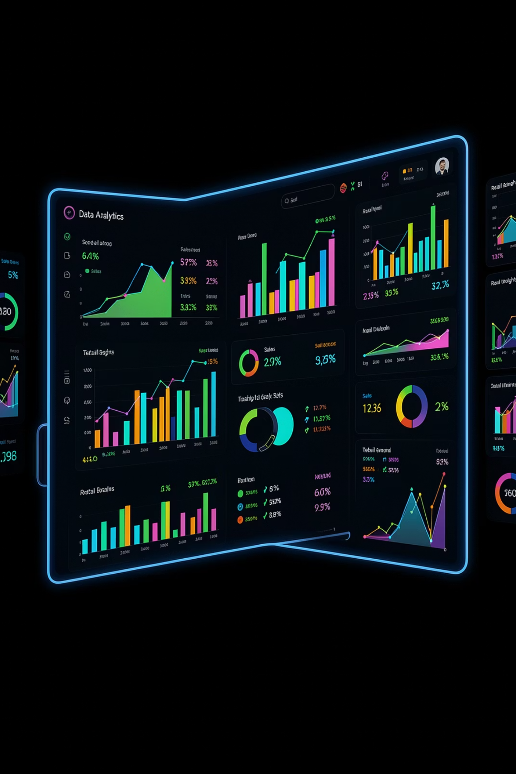
Customer Shopping Behavior Analysis
3,900 transactions · 18 features · 4 product categories · Python · SQL · Power BI

Slide 2
Dataset at a Glance
3,900
18
Transactions
Features
$59.76
3.75
Avg Purchase
Avg Rating
Demographics, purchase details, shopping behavior, payment, and shipping — 37 missing values in Review Rating imputed by category median.

Slide 3

Python: Data Preparation
01
Load & Explore
Import via pandas, inspect with info() and describe()
02
Clean
Impute missing ratings, standardize columns to snake_case
03
Engineer
Binned age_group, derived purchase_frequency_days, dropped redundant promo_code_used
04
Load to DB
Exported cleaned DataFrame to PostgreSQL for SQL analysis

Slide 4
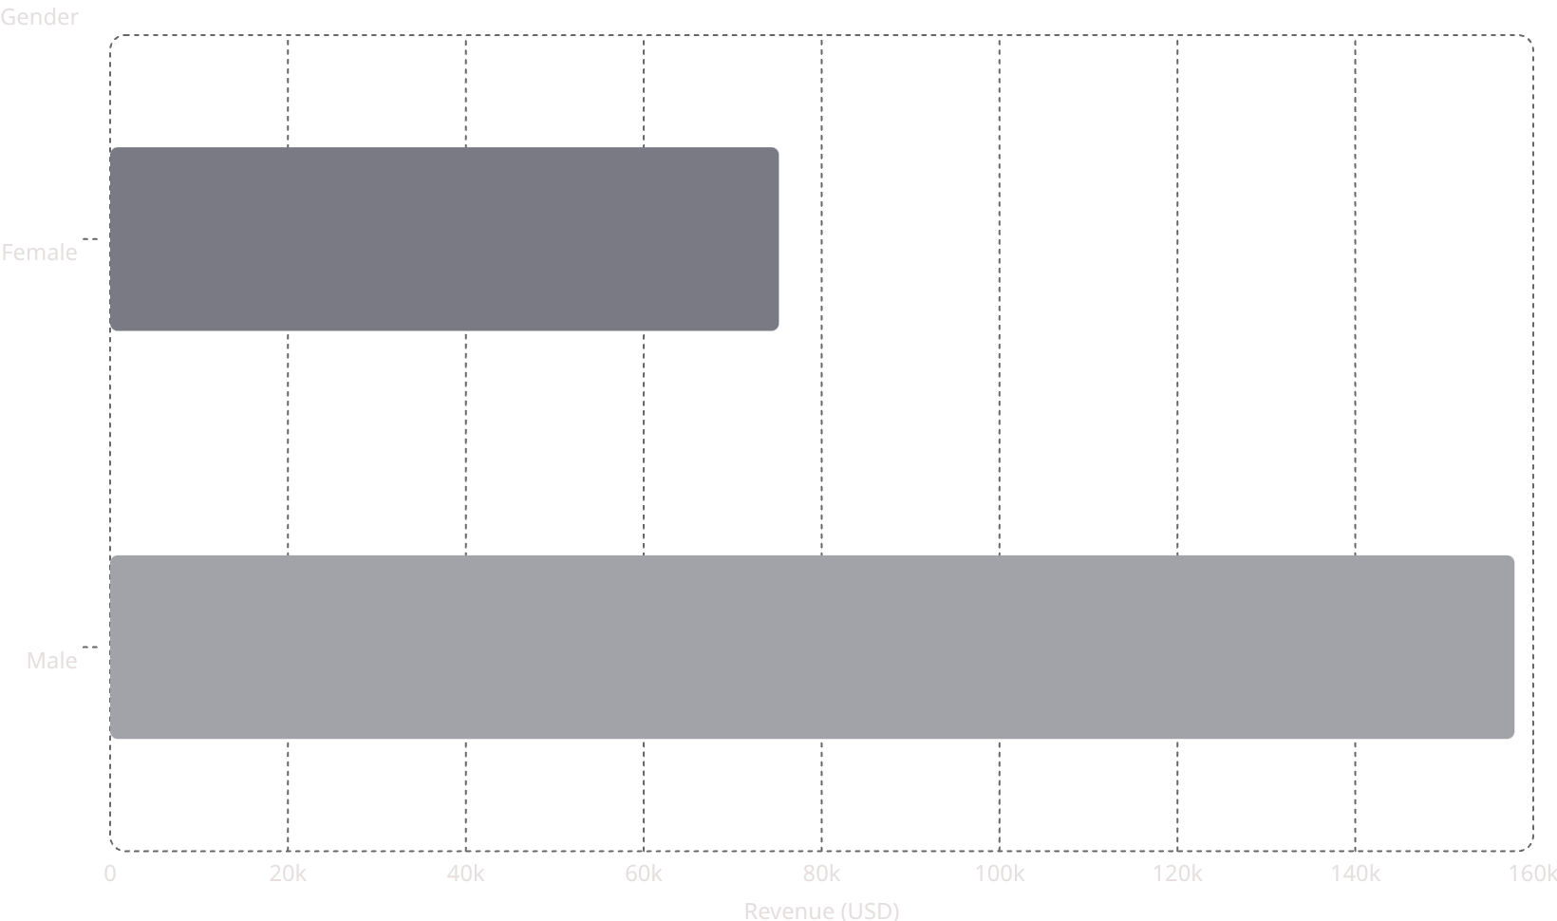
Revenue by Gender
Male Customers Drive Revenue
Male revenue is 2.1× higher than female — a key segment for targeted campaigns.

Slide 5
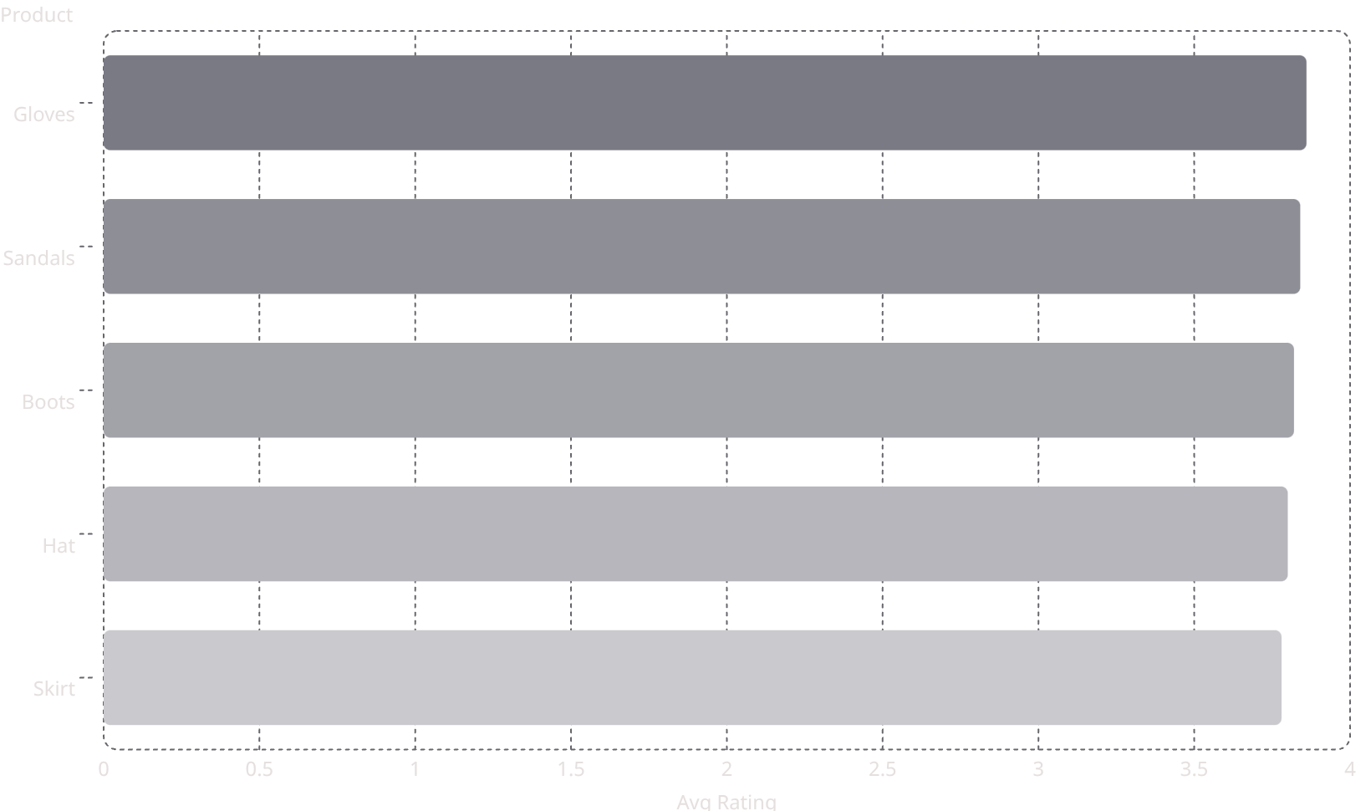
Product Insights
Top 5 Products by Rating
Most Discount-Dependent Products
Hat — 50%
Sneakers — 49.66%
Coat — 49.07%
Sweater — 48.17%
Pants — 47.37%

Slide 6
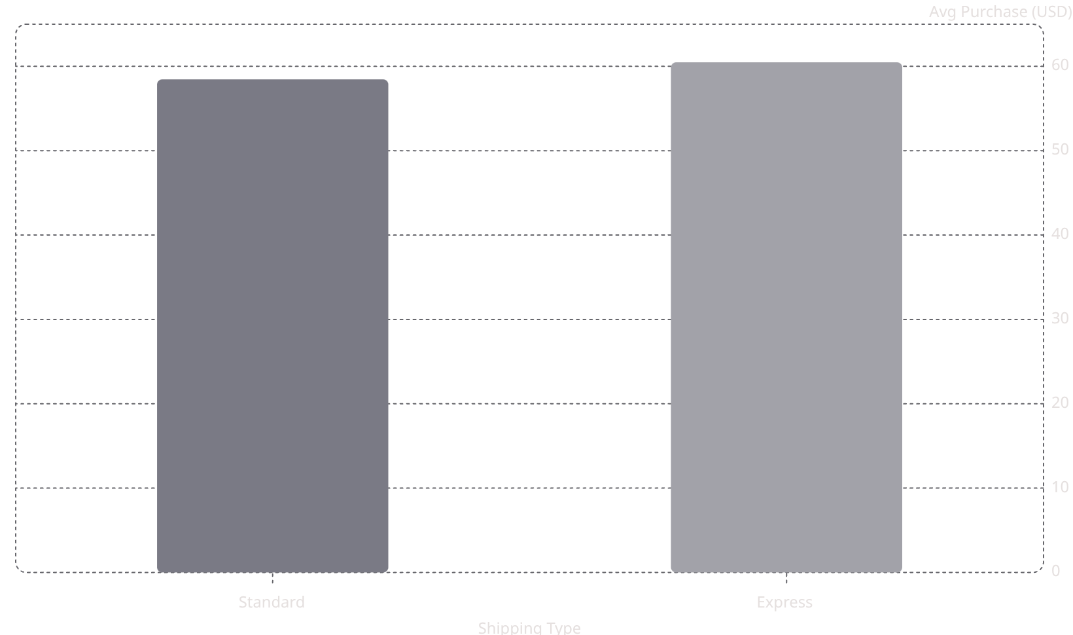
Shipping & Subscriptions
Express Shoppers Spend More
Express shipping averages $60.48 vs. $58.46 for Standard.
Subscription Revenue
Non-subscribers: 2,847 customers · $170,436 revenue
Subscribers: 1,053 customers · $62,645 revenue

Slide 7

Customer Segmentation
Loyal
Returning
3,116 customers — 80% of base
701 customers
New
83 customers
Of customers with >5 purchases: 2,518 non-subscribers vs. 958 subscribers — conversion opportunity.

Slide 8
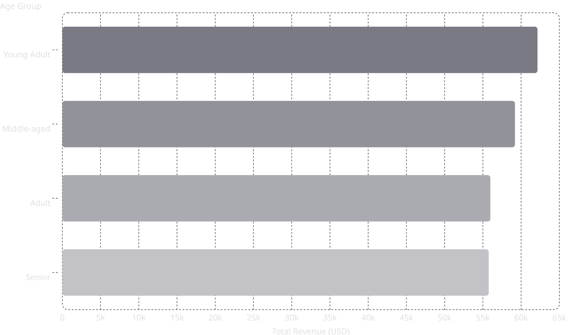
Revenue by Age Group
Young Adults Lead
Young Adults contribute the highest revenue at $62,143. Revenue declines slightly with age — a key targeting signal.

Slide 9
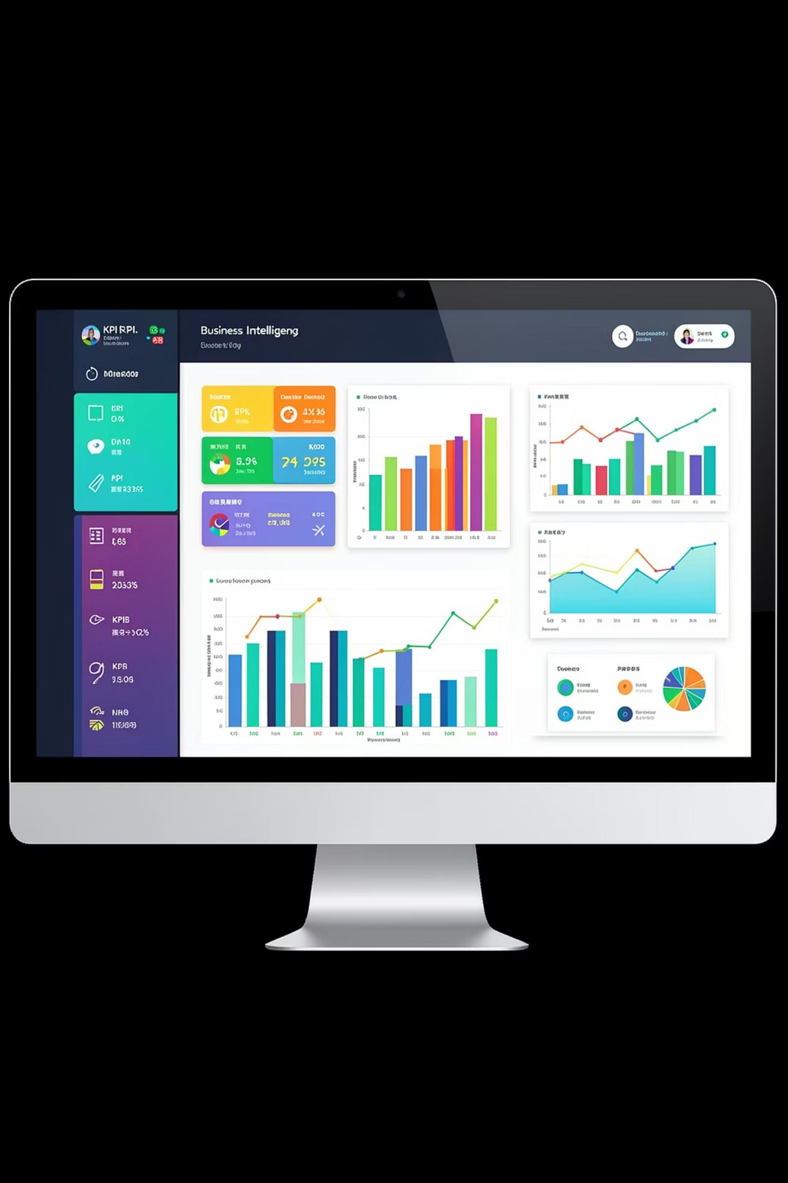

Power BI Dashboard
Subscription Split
27% subscribers vs. 73% non-subscribers
Revenue by Category
Clothing, Accessories, Footwear, Outerwear breakdowns
Interactive Filters
By gender, subscription, category, and shipping type

Slide 10
Business Recommendations
Boost Subscriptions
Promote exclusive subscriber benefits
Loyalty Programs
Reward repeat buyers toward "Loyal" segment
Review Discount Policy
Balance sales lift with margin control
Product Positioning
Highlight top-rated, best-selling products
Targeted Marketing
Focus on high-revenue age groups & express shippers

