Slide 1
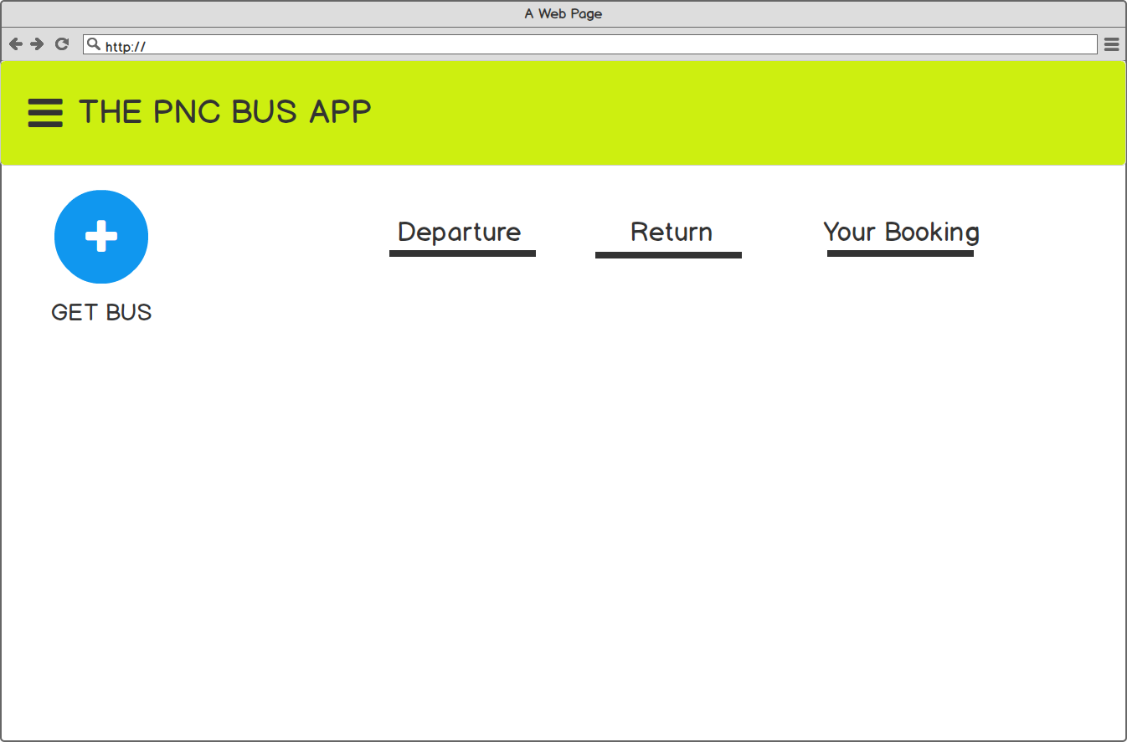
When user start system first.

Slide 2
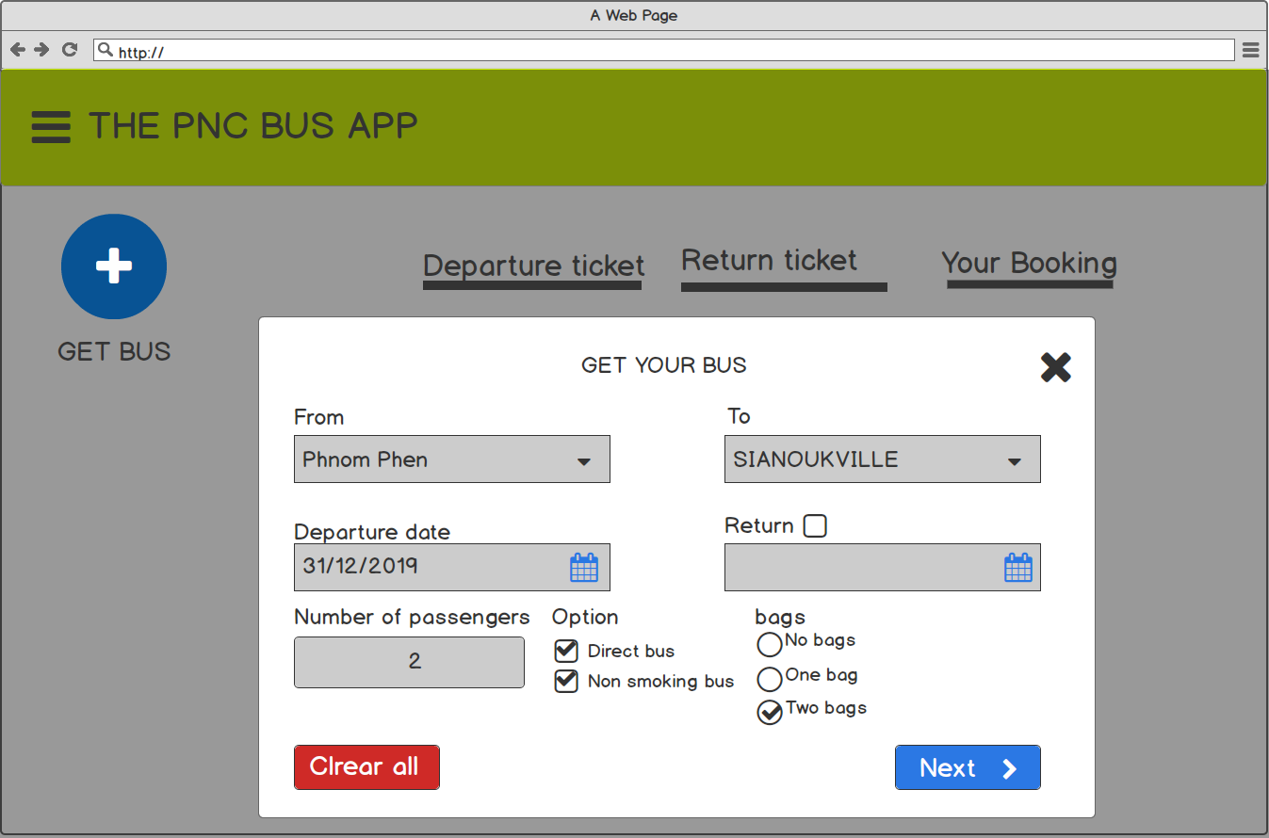
Click on GET BUS It display popup
User can fill information in form.
If user don’t check return, so input return will disable to fill date of return.

Slide 3
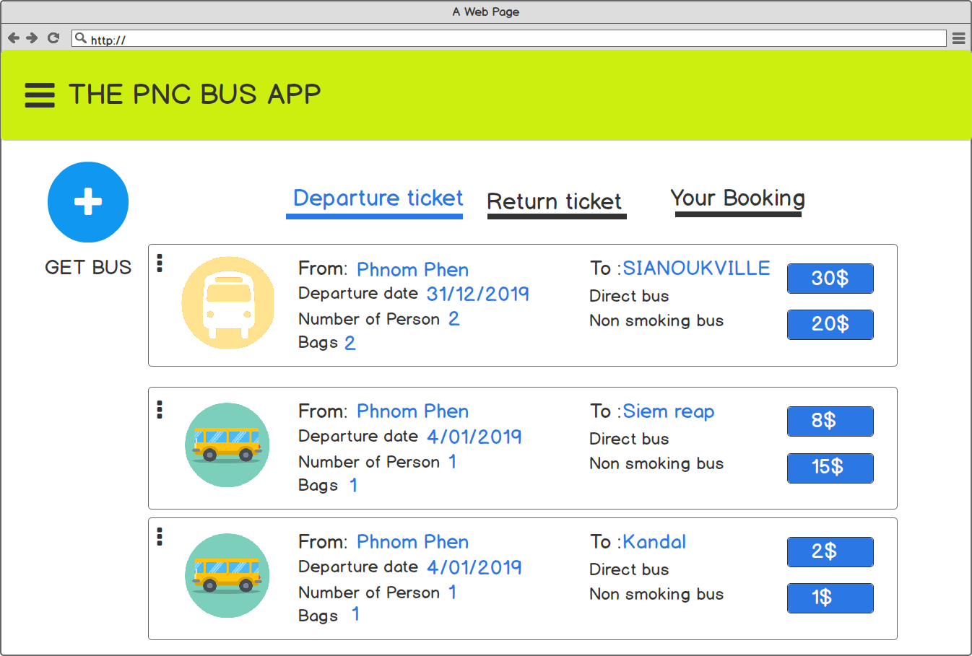
The system will be calculate the price follow number of people. For example, from Phnom Penh to Sianoukville one of people 15$, but this ticket has two people so, I will increase to 30$ for two people
This tab, It only display departure ticket and not available to display with return ticket
User can choose for the price.
.
User can
Edit
Delete

Slide 4
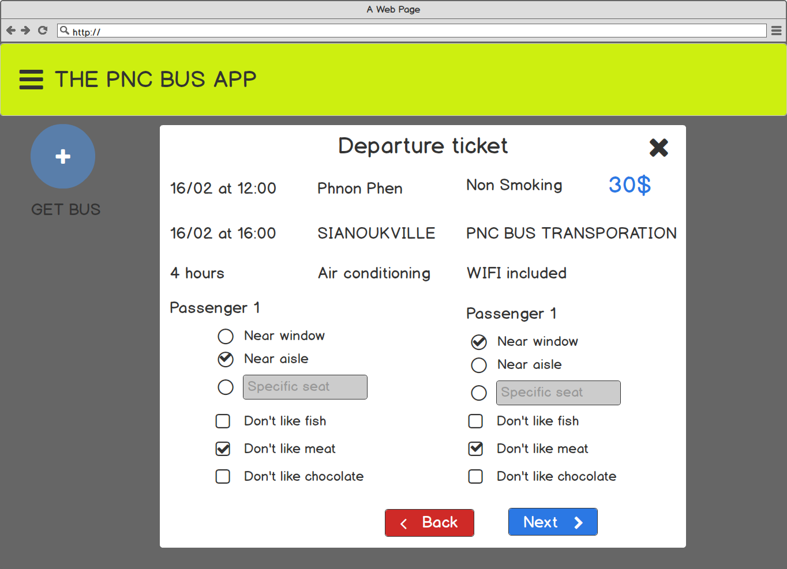
For example user choose 30
.

Slide 5

If user check return, so input return will enable to fill date of return.
.

Slide 6
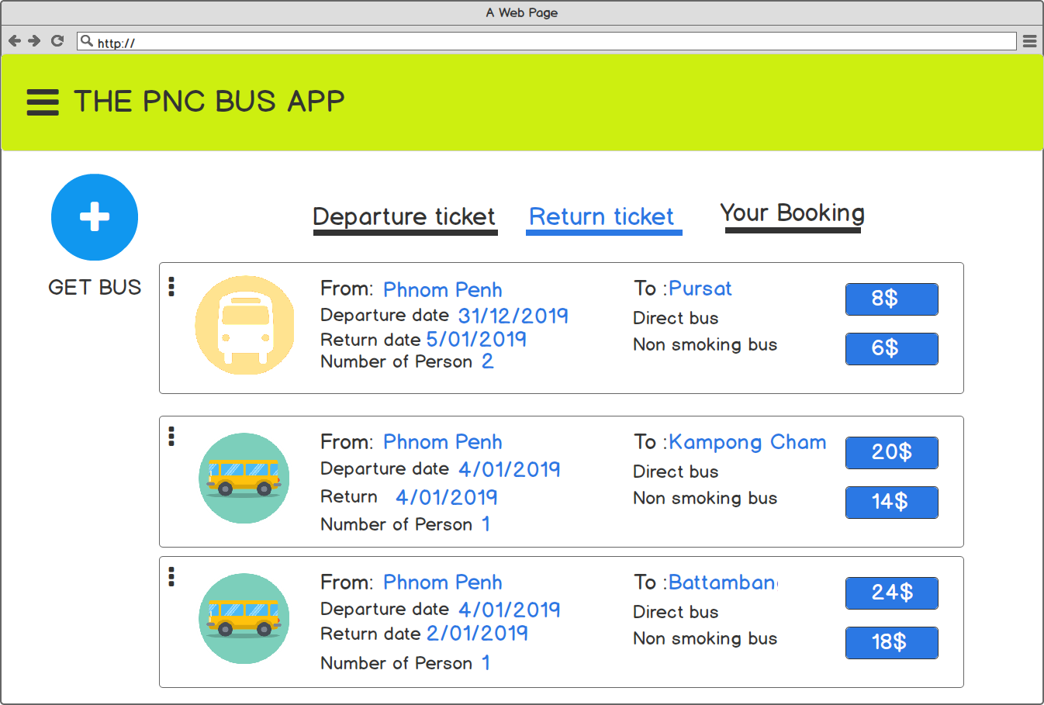
This tab, It only display return ticket and not available to display with departure ticket
.
User can
Edit
Delete

Slide 7
This tab, It only display return ticket and not available to display with departure ticket
.
User can
Edit
Delete

