Slide 1
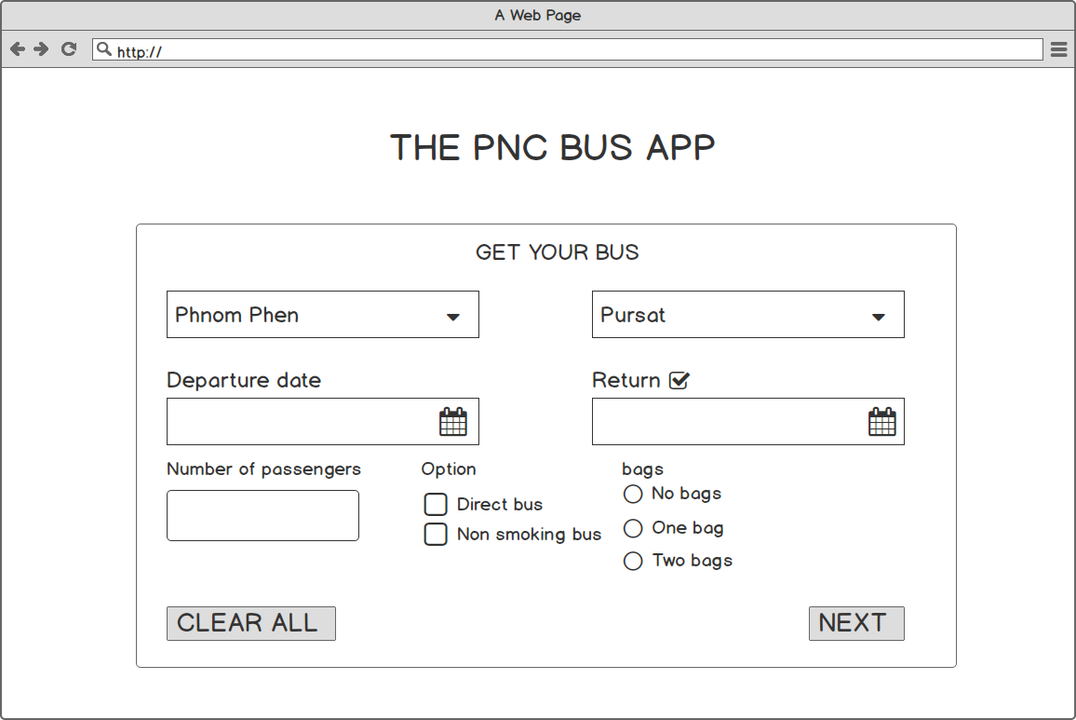
Before click return, Input will disable
After click return, Input will enable to select date.

