Slide 1
Plan for production ready Ingetion Project

Slide 2
For scaling Ingestion to production ready needs
Deployment
  CI/CD Pipeline
  A CI/CD pipeline automates your software delivery process. The pipeline builds code, runs tests (CI), and safely deploys a new version of the application (CD).
  Automated pipelines remove manual errors, provide standardized feedback loops to developers, and enable fast product iterations.

Slide 3
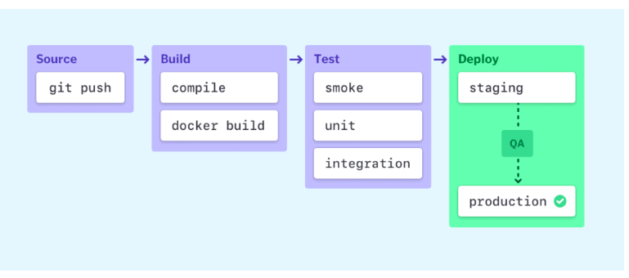
For scaling Ingestion to production ready needs
CI/CD Pipeline
  Stage of CI/CD pipeline

Slide 4
For scaling Ingestion to production ready needs
Testing
  Testing frameworks and Unit test-cases.
  We can add test framework for CI/Cd pipeline.
  Django itself provdies unittest framework for unit testing.
  We can add unit test-cases that covers all parts of data pipeline processing logic.

