Slide 1



ZEN CLUB PRESENTS
CODEAMBLE 2026
National Level Hackathon
Patient-Tap
Your medical record, encrypted on the chip you wear.
Team ZEN-T313 · Vishwakarma Institute of Technology
github.com/viralala/Patient-Tap · patient-tap-web.vercel.app

Slide 2


01
Team & Project Overview
Who are you and what are you building?
👤 Team Details
🚀 Project Overview
→ Team Name: Team Tadoww!
Project Title: Patient-Tap
Problem Domain: Select one below
→ Team ID: ZEN-T313
🤖 Agentic & Generative
🔐 Fintech & Cyber
→ College / Institution: Vishwakarma Institute of Technology
🌾 Agritech & Open
🏙 Smart & Mobility
→ Team Size: 4 members
❤ Healthcare & MedTech
🔗 Blockchain & Web3
© CODEAMBLE 2026
ZEN Club – Zone of Engineering Innovators
contact@zoneofengineeringinnovators.com

Slide 3
02
Problem Statement
What problem are you solving and why does it matter?
🎯 The Problem
When disaster strikes or the network goes down, first responders treat patients blind — with no access to their allergies, medications or DNR wishes. The result is preventable drug reactions and duplicated care as a patient is handed between responders, ambulances and field hospitals. Today's medical-ID apps live in the cloud or a locked phone, so they fail at the exact moment they are needed most.
📊
👥
⚠
Scale / Impact
Who is Affected
Why Unsolved
≈1.3M people are harmed by medication errors every year, at an estimated $42B global cost (WHO). In emergencies, missing history is a leading — and avoidable — risk.
Unconscious or non-verbal emergency patients, people with allergies or chronic conditions, the elderly — and the paramedics forced to treat them with no record at all.
Cloud apps need a network disasters take down. Phone Medical IDs need a charged, unlocked device. Engraved bracelets hold two static lines — no updates, no treatment log.
© CODEAMBLE 2026
ZEN Club – Zone of Engineering Innovators
contact@zoneofengineeringinnovators.com

Slide 4
03
Proposed Solution
What are you building and how does it work?
💡 Our Solution
Patient-Tap stores the patient's full medical record — encrypted with AES-256-GCM — directly on the NFC chip they wear (an NTAG215 card or wristband, ≤504 bytes). Any phone reads or writes it in under a second with zero network, and responders log the treatment they give straight back onto the tag.
⚙
🌐
📱
Encrypted on the Chip
Offline Conflict Checker
Patient + Responder App
The record lives on the tag itself, sealed with AES-256-GCM. No cloud, no account — it works even with no signal, and a tampered tag fails the auth check.
Before a responder administers a drug, Patient-Tap checks it against the patient's allergies and recent doses on-device, and blocks dangerous conflicts behind an explicit override.
One app, two modes: patients build and write their profile; responders scan, treat and log back to the tag. Native Android NFC, with a web build for demos.
© CODEAMBLE 2026
ZEN Club – Zone of Engineering Innovators
contact@zoneofengineeringinnovators.com

Slide 5
04
Innovation & Differentiators
What makes your solution stand out from the rest?
⚖ Vs Existing Solutions
⭐ Key Differentiators
What makes your solution unique? How is it different from existing solutions? List 2–3 key differentiators below:
Feature | Existing Solutions | Our Solution
Works fully offline | ✗ | ✓
Affordability | ⚠ | ✓
Responder write-back | ✗ | ✓
Drug-conflict check | ✗ | ✓
→ Offline by design: the record reads in under a second on the chip — no network, no account — exactly where cloud and phone IDs fail.
→ Built-in safety check: an on-device conflict checker blocks allergy and dose clashes before administration — a life-saver no medical-ID rival offers.
→ Travels with the patient: responders write treatment back onto the tag as a portable chain-of-custody; each NTAG215 tag costs only a few rupees.
© CODEAMBLE 2026
ZEN Club – Zone of Engineering Innovators
contact@zoneofengineeringinnovators.com

Slide 6
05
Impact & Benefits
Who benefits and how will you measure success?
🌱 Expected Impact
Faster, safer emergency care for anyone who cannot speak for themselves — with fewer preventable drug reactions and no duplicated treatment. Because it needs no network, the same record works in disaster zones, rural areas and ambulances alike. Success = decrypt-to-display in under one second, offline, with every field a responder needs.
👤 Target Users
📈 Scale / Reach
Emergency & chronic patients, the elderly, and first responders / paramedics.
Any NFC-capable phone — billions of devices; cent-cost tags deployable even in low-infrastructure regions.
💰 Economic Impact
🌍 Social Impact
Cuts costly adverse-drug-event care; tags cost a few rupees; tiered plans (Free / ₹999 Premium / ₹1999 B2B).
Advances SDG 3 (Good Health) and personal health-data sovereignty — equitable emergency care where networks don't reach.
© CODEAMBLE 2026
ZEN Club – Zone of Engineering Innovators
contact@zoneofengineeringinnovators.com

Slide 7
06
Market Research
Validate demand and identify opportunities
📊 Competitive Landscape
The emergency medical-ID market is real but network-dependent. The leading options — and where each one stops short:
→ MedicAlert — engraved bracelet + cloud profile: static, subscription-based, and needs a network to fetch the full record.
→ Apple Health Medical ID — phone lock-screen info: useless if the phone is dead, absent or locked, and no responder can write back to it.
→ Govt digital health IDs (e.g. ABHA) — cloud EHR: online-only, not emergency-first, with no offline tag or in-field treatment logging.
© CODEAMBLE 2026
ZEN Club – Zone of Engineering Innovators
contact@zoneofengineeringinnovators.com

Slide 8
07
Gap Analysis
Validate demand and identify opportunities
🔍 Gap Analysis
Where existing emergency medical-ID solutions fall short — and how Patient-Tap closes each gap:
Parameter | Existing Solutions | Patient-Tap
Works offline | Cloud-dependent — fails in a blackout | Full record on the chip, zero network
Data location | Cloud, or a locked / dead phone | Encrypted on the NFC tag you wear
Treatment log | None — not updatable in the field | Responders write back; chain-of-custody
Drug safety | Manual guesswork under pressure | On-device conflict check with override
Cost & access | Subscriptions; no field hardware | Cent-cost NTAG215 + freemium app
© CODEAMBLE 2026
ZEN Club – Zone of Engineering Innovators
contact@zoneofengineeringinnovators.com

Slide 9
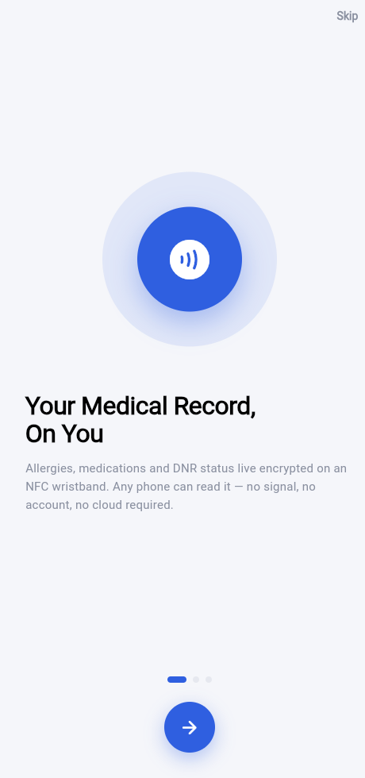
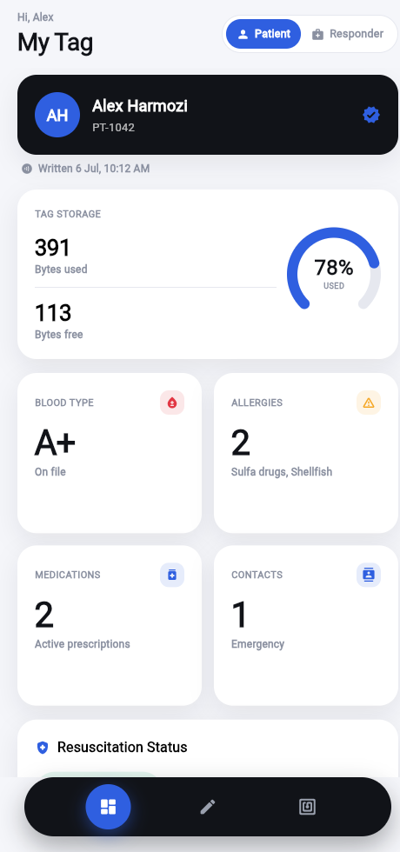
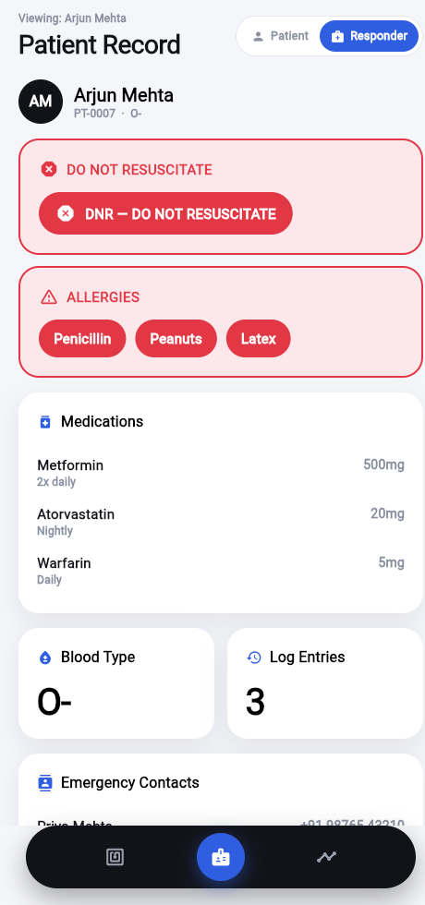
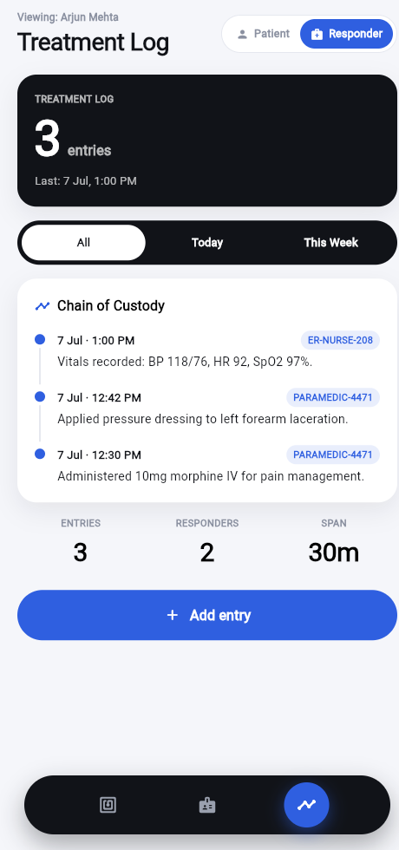
08
Product Walkthrough
Patient-Tap, running end-to-end and fully offline
📱 The app, end-to-end
Onboarding → write profile to tag → responder scan → offline chain-of-custody log.
Onboarding
Patient dashboard
Responder view
Treatment log
© CODEAMBLE 2026
ZEN Club – Zone of Engineering Innovators
contact@zoneofengineeringinnovators.com

Slide 10
PATIENT-TAP
THANK YOU
The record lives on the chip — not the cloud.
Questions & Feedback Welcome
We'd love to hear what you think.
Team ZEN-T313 · Vishwakarma Institute of Technology
github.com/viralala/Patient-Tap · patient-tap-web.vercel.app

