Slide 1
Bhagwan Mahavir Polytechnic Product Sales & Inventory Analysis Application.
Vaghasiya Om ViralBhai (2327010601182) Guide Name:
Sirsad Urvesh BachchanBhai (2327010601172)
Viradiya Rudra PareshBhai (2327010601187)
Bhamare Pranav KishorBhai (2327010601014)

Slide 2
Introduction
➤ 1.1 Overview:
• Project Title: Product Sales & Inventory Analysis Application. • Purpose: Provide a secure, powerful, and intuitive platform for deep sales transaction analysis and inventory logistics tracking. • Key Features: ◦ Secure Token-Based Authentication via GitHub PAT upload. ◦ Sales Dashboard with hierarchical filters (Month → Buyer → Bill). ◦ Dynamic Bill Preview with original invoice styling. ◦ Multi-layered Analytics. ◦ Inventory Tracker with date-range and cross-filtering (Buyer + Vehicle). ◦ Detailed Vehicle Usage Reports showing frequency, unique days, and
per-buyer breakdowns. • Technology Used: HTML, CSS, JavaScript, GitHub API, Day.js library. • Outcome: A lightweight, browser-based business intelligence suite that uses GitHub for secure, version-controlled data storage.

Slide 3
➤ 1.2 Objectives:
• Primary Objective: To create a centralized, cloud-based system for comprehensive sales and
logistics data analysis without a traditional backend server.
• Data Security & Access Control: To implement a robust authentication mechanism that
securely gates access to sensitive business data using dynamically loaded credentials.
• Sales Transaction Transparency: To enable granular inspection of individual invoices,
allowing users to verify details, view transaction history, and generate summaries for any
buyer or time period.
• Operational Intelligence: To provide actionable insights into product movement
(inventory sold) and asset utilization (vehicle usage) to support data-driven decision-making
for sales and logistics teams.
• User-Centric Design: To develop an intuitive, filter-driven interface that makes complex
data exploration simple and efficient for non-technical users.
• Technical Demonstration: To prove the viability of using common web APIs (GitHub) as
a powerful and reliable storage solution for structured application data.

Slide 4
Problem Definitions
➤ 2.1 Problem Identification:
• Data Silos & Inaccessibility: Sales and logistics data was stored in a fragmented manner
(e.g., individual JSON files per invoice), making it difficult to get a consolidated, company-wide view without a dedicated database system.
• Inefficient Analysis Process: Manually searching through hundreds of individual invoice files to find specific transactions, analyze buyer trends, or check vehicle history was time-consuming and prone to human error.
• Lack of Operational Insights: There was no easy way to answer critical business questions, such as "Who is our top buyer?", "What is our total sales volume?", "Which vehicle is used most frequently?", or "Which products are selling the most?" without performing manual calculations.
• Security Concerns: Storing sensitive business data, required a secure method that controlled access without the complexity and cost of setting up a private server infrastructure.
• No Unified Tool: The absence of a single, integrated platform forced users to switch between different methods or tools for sales analysis and logistics tracking, reducing overall productivity.

Slide 5
➤ 2.2 Problem Solution:
• Centralized Cloud Repository: Leveraged GitHub as a secure, version-controlled database, eliminating
data silos by storing all invoice JSON files in a structured, hierarchical repository, providing a single
source of truth.
• Dynamic Web Application Suite: Developed a interface within a single HTML framework that
transforms raw data into an interactive dashboard, enabling instant filtering, searching, and analysis
without manual file handling.
• Automated Business Intelligence: Implemented real-time analytics engines that automatically
calculate like top buyer, total sales, product-wise totals, and detailed vehicle usage reports, providing
immediate solution.
• Secure Access Gateway: Introduced a token-based authentication system where access is granted only
upon uploading a valid credentials file, ensuring data security without the overhead of a custom
backend login system.
• Unified User Experience: Created an intuitive, filter-driven interface that integrates sales transaction
analysis & inventory tracking into one lightweight, browser-based, enhancing productivity &
decision- making speed.

Slide 6
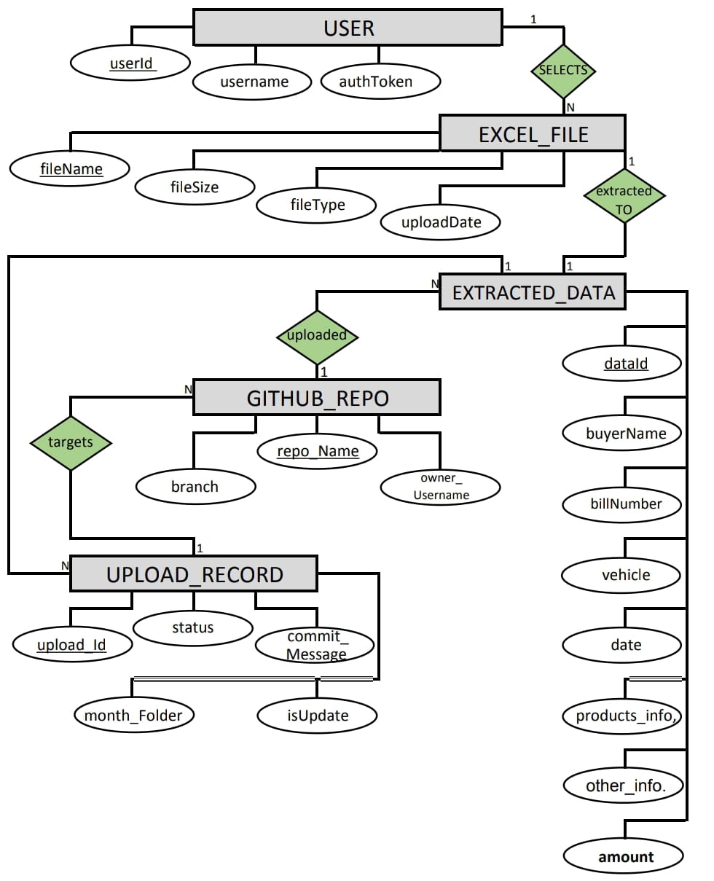
ER Diagram
1. Excel File_Uploading. :

Slide 7
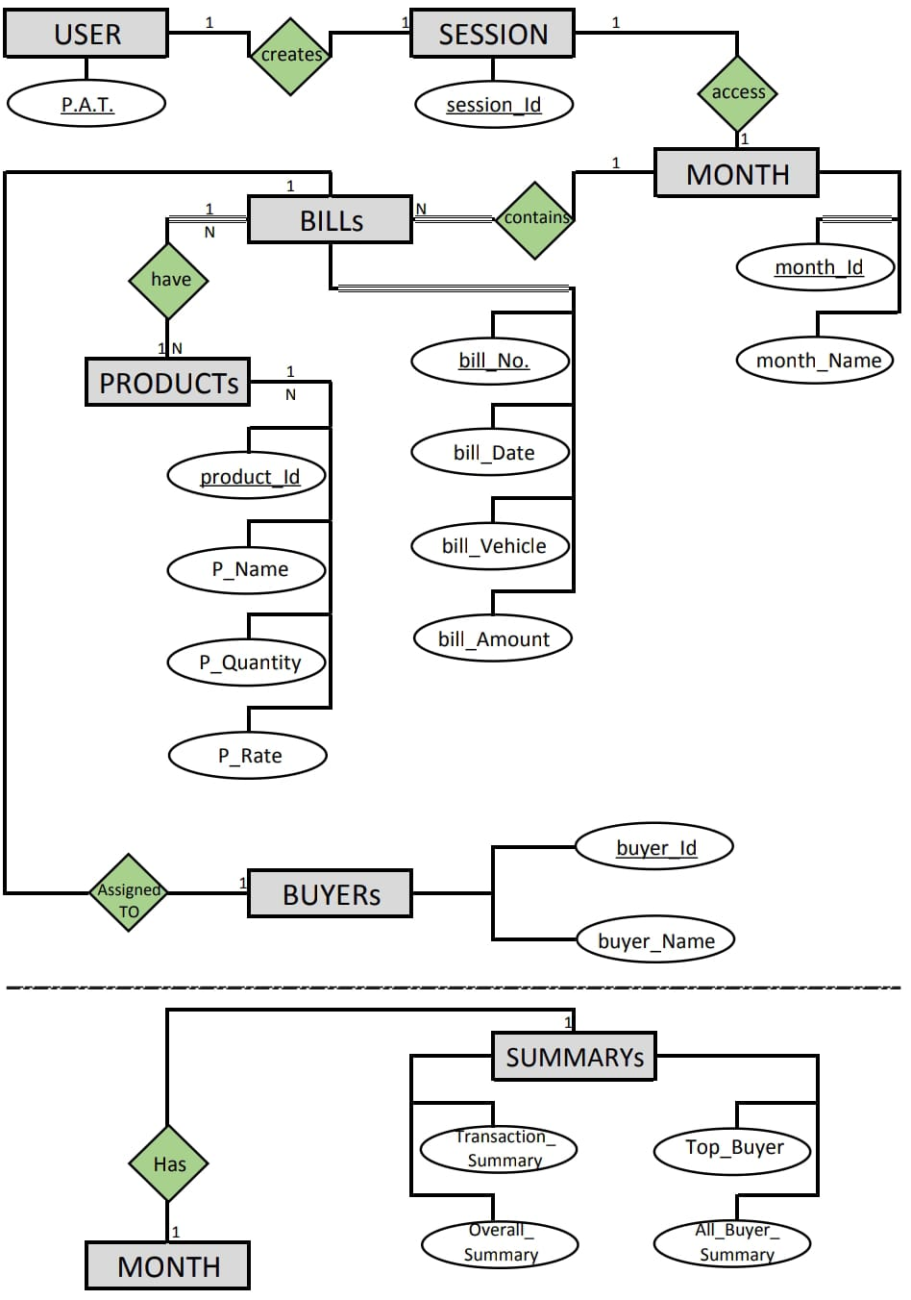
2. Sales Analysis. :

Slide 8
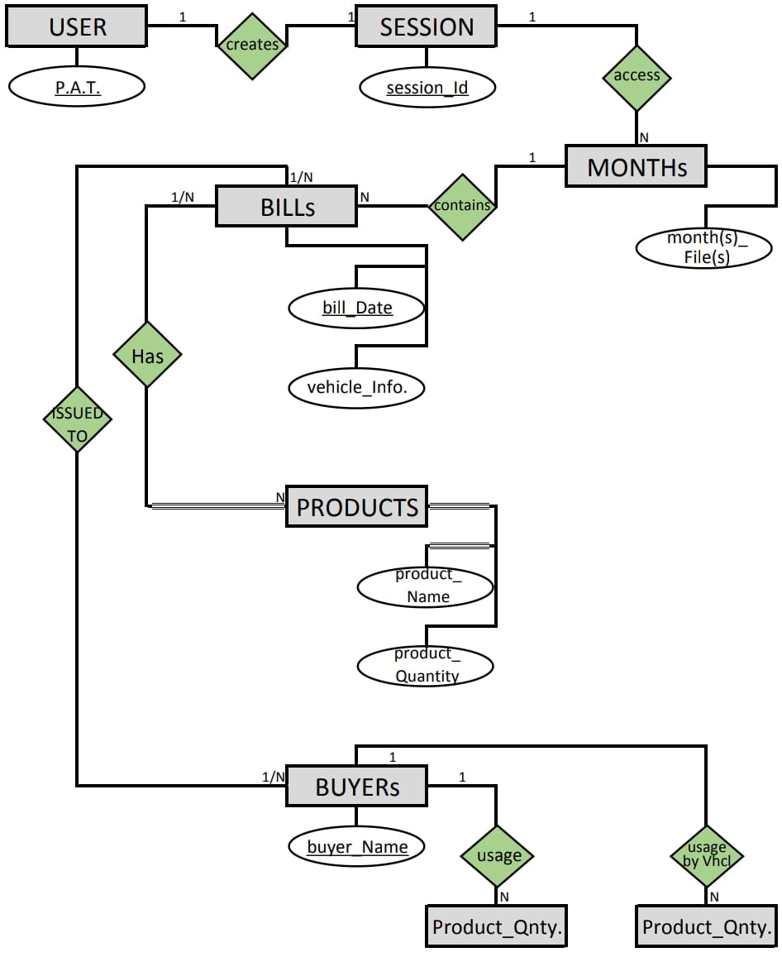
3. Products Analysis. :

Slide 9
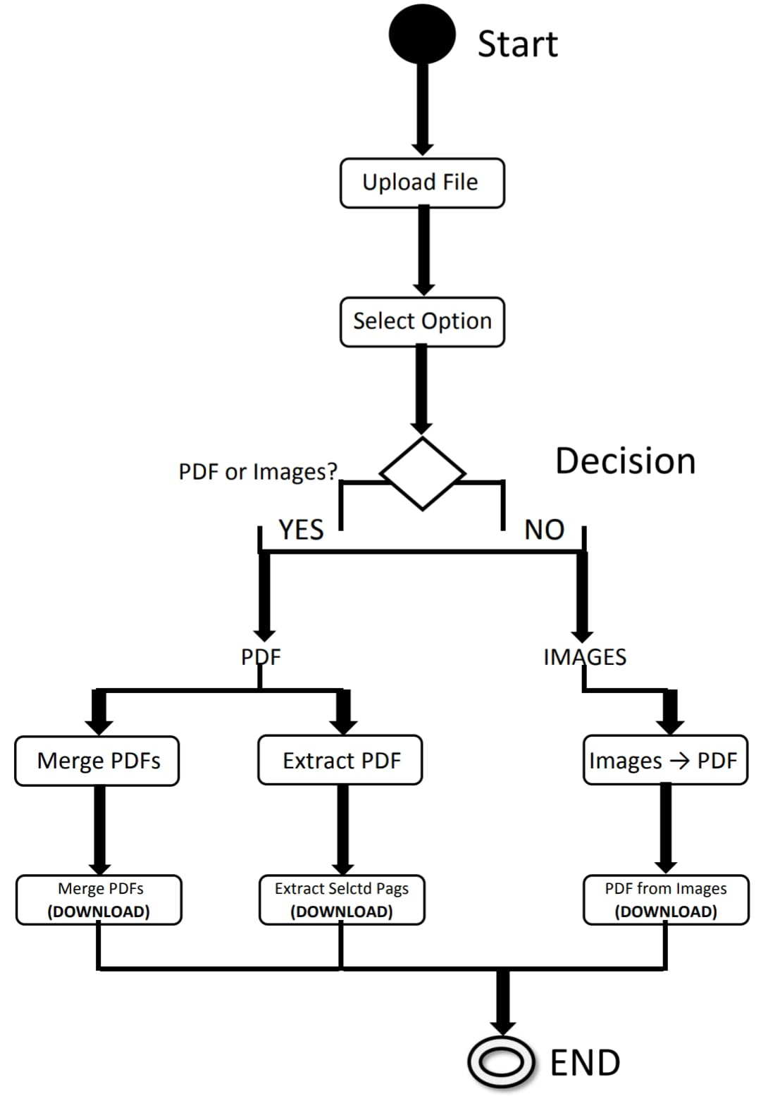
Activity Diagram

Slide 10
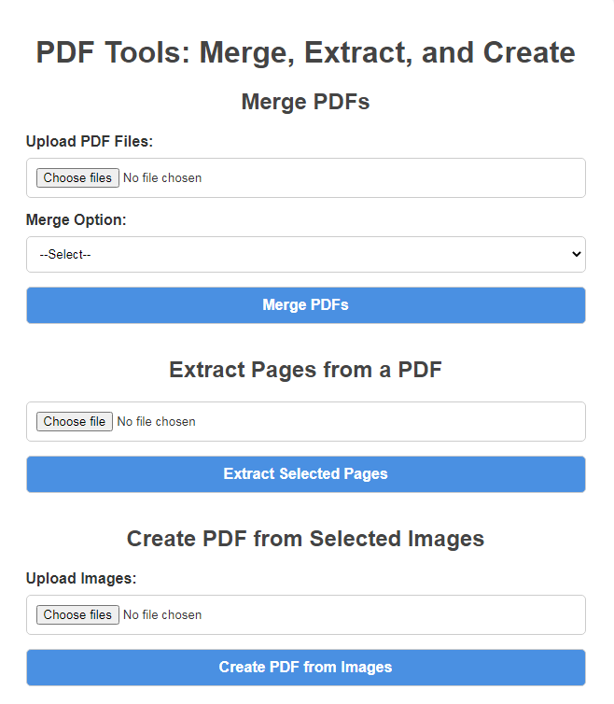
Snapshots
1. Main Page.

Slide 11
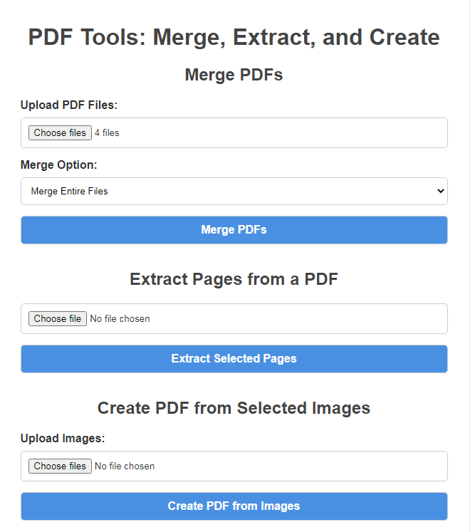
2.1. Merging
Entire PDFs.

Slide 12
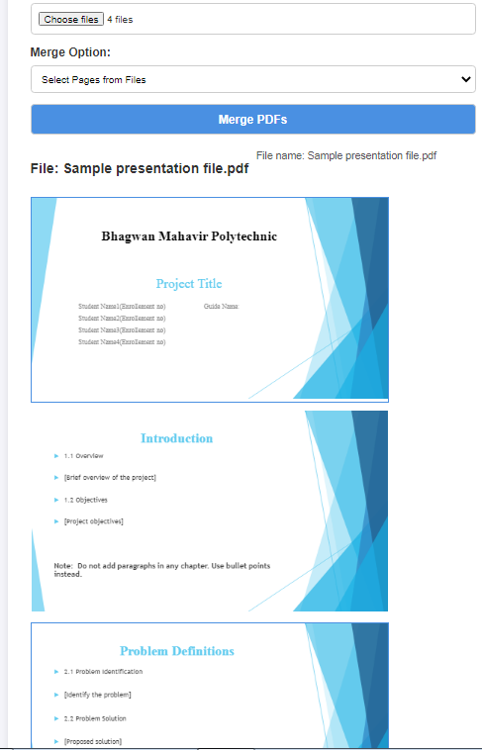
2.2. Merging
Specific Pages
From PDFs.

Slide 13
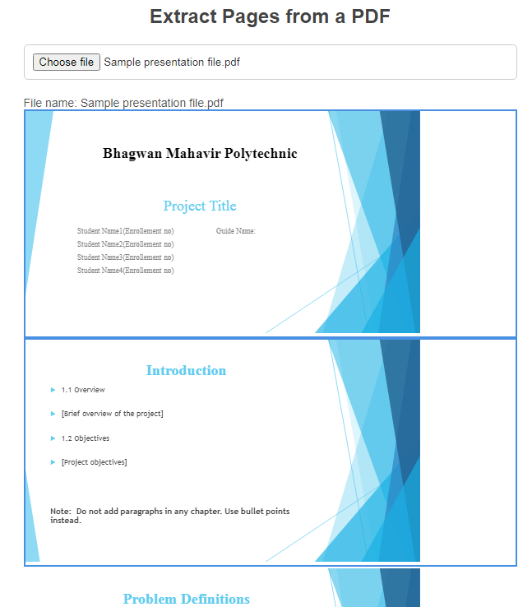
3. Extract Pages from a PDF

Slide 14
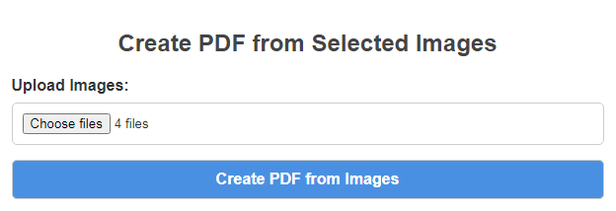
4. Extract Pages from a PDF

Slide 15
Advantages and Disadvantages
Advantages | Disadvantages
🚀 Zero-Cost Backend & Hosting. | 🚧 GitHub API Limitations.
⚔️ Powerful & Integrated Analysis. | ⏳ Latency and Performance.
🌐 Universal Accessibility. | ☣️ Scalability Concerns.
🛡️ Enhanced Security Model. | 📊 Limited Query Capabilities.

Slide 16
Conclusion
This provides a secure, powerful, and highly efficient method for analyzing sales transactions and logistics data without a traditional backend.
It supports multiple, integrated operations like granular invoice filtering, dynamic previews, buyer analytics, inventory tracking, and detailed vehicle usage reports.
It helps managers and accountants gain deep operational insights and make data-driven decisions quickly and for free.
Though dependent on API limits, it is lightweight, user-friendly, and extremely practical for small to medium-sized business analysis.
This innovative use of common web services is a guaranteed better option for organizations seeking a cost-effective, secure, and powerful business intelligence solution.

Slide 17
Future Scope
Interactive Data Visualizations: Integrate charts and graphs (using libraries like Chart.js or D3.js)
to visually represent sales trends, buyer contributions, and product performance over time.
📤 Data Export & Reporting: Add functionality to export filtered data, summaries, into standard
formats like PDF reports, Excel (XLSX), or CSV files for external sharing and record-keeping.
💾 Offline Functionality & Caching: Downloading .json Data Offline And Use It For Calculation
By Entering That File Into Program.
⚡ Shifting Data To DataBase: By This Way I Can Fetch Data @ 20-30x Faster Than Github.

Slide 18
Thank You

