Slide 1
WatchDawg - Keeping your models on the right track

Slide 2
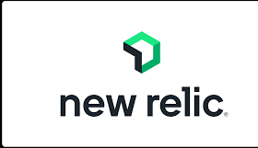
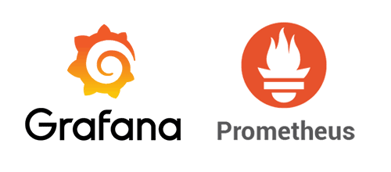
Problem Statement
ML-Specific Monitoring: Existing solutions are generic and don’t address the unique needs of machine learning workflows. Our tool tracks both system performance (CPU, GPU, memory) and ML-specific logs (training parameters, losses).
Seamless Background Logging: With a single function call, our package runs in the background, exporting logs to a central server without disrupting model training.
Cross-Platform & Pre-Configured: Our platform-independent solution includes a downloadable, pre-configured logging executable, simplifying integration into any training setup.

Slide 3
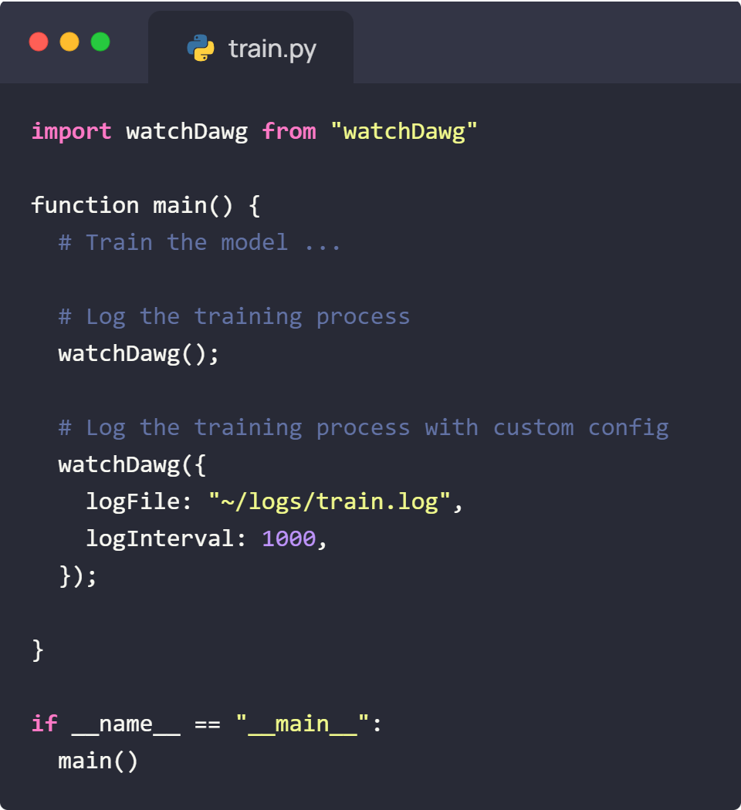
Proposed Solution
We will create a Python package that can be invoked within the training file.

Slide 4
Proposed Solution (System Architecture)

