Slide 1
Superstore Sales Performance Dashboard
Power BI Visualization | Dataset: Sample Superstore
Prepared by: viranch Dadheech

Slide 2
Dashboard Summary
• Dataset: Sample - Superstore
• Tool Used: Power BI
• Key Metrics: Sales, Profit, Quantity
• Visuals Used: Bar Chart, Line Chart, Pie Chart, Map, KPI Cards
• Filters: Product Name, Region, State

Slide 3
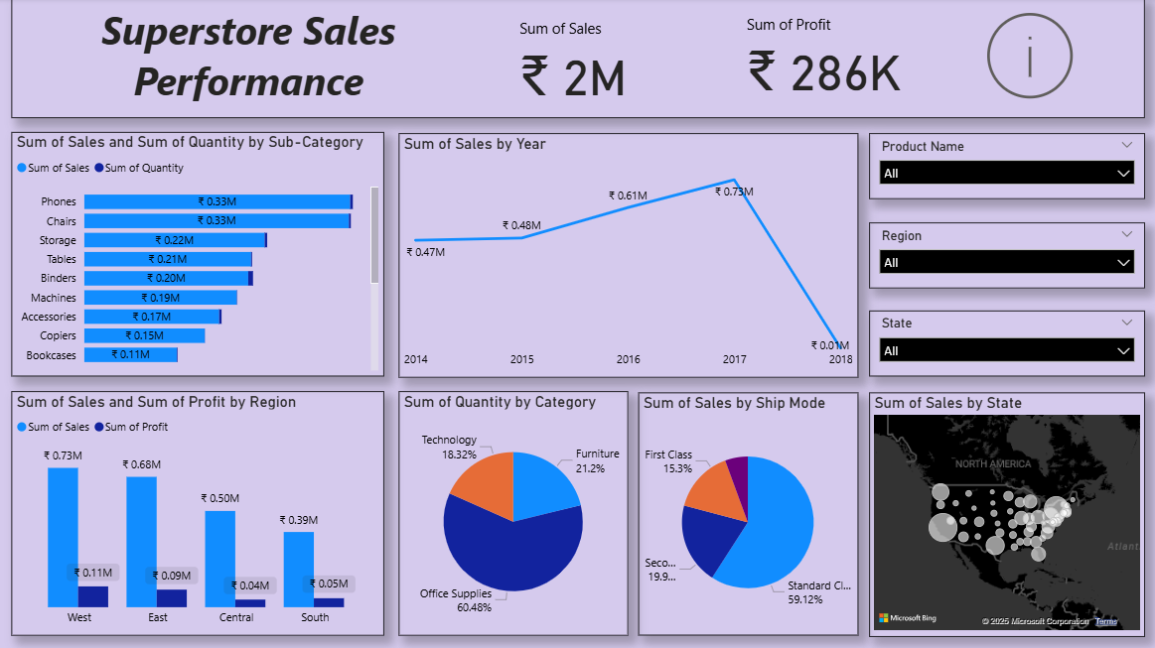

Slide 4
