Slide 1

National Institute of Technology, Karnataka
Parallel Computing
(15IT300)
Implementation of K-Means and K-Medoid Clustering
In Parallel Environment
Submitted to:
Dr. Geetha V
Submitted by:
Badheka Viranchi - 15IT111
Bhabesh Chanduka - 15IT113
Nihar Raichada - 15IT132
Poojan Shah - 15IT227

Slide 2
Parallel System Design
Data Clustering is a descriptive data mining task of finding groups of objects such that the objects in a group will be similar (or related) to one an-other and different from (or unrelated to) the objects in other groups.
Many researchers have worked in the area of parallel data clustering. Here, we have proposed an enhanced parallel algorithm using Master/Slave model and dynamic load balancing technique.
In the hybrid model a combination of MPI with OpenMP was tried where the data points were evenly distributed among the MPI processes and the task of data labeling for each local data within the process was done using OpenMP directives.

Slide 3
K means algorithm in OpenMP
Input: D={d1,d2,d3,d4,...dn}
K= Initial Clusters
Output: K Clusters
Procedure:
1.Initialize the OpenMP Processes {P1,P2,... Pn}
2.Take the preprocessed dataset and arrange the dataset in ascending order.
3.Partition the sorted dataset into k clusters and assign each part of dataset to each process
4.For each partition, calculate the k centroids of all the clusters.
5.Continue the process to form k final local clusters until the convergence is met.
Proposed parallel algorithm - Master - Slave model and dynamic load balancing technique

Slide 4
K medoid in OpenMP:
Input: D={d1,d2,d3,d4,...dn}
K= Initial Clusters
Output: K Clusters
Procedure:
1. Initialize the openMP processes {P1,P2…,Pn}
2: read N object from file
*/start parallel proccess by divide same amount of object to each processes/*
3: repeat
4:Choose K point as intial centroid randomly
5: Initiate each object to the closest centroid by using Euclidean Distance Formula
6: Choose K point non medoid randomly
7: Compute total cost K Medoid and K non Medoid then .
8: until centroid don’t change
*/merge the result from each processes/*
9: Generate cluster id for each processes
10: Generate centroid new cluster
11: Generate final centroid
Proposed parallel algorithm - Master - Slave model and dynamic load balancing technique

Slide 5
K means algorithm in MPI:
Input: Data, K Cluster
Output: K Centroid
1: MPI_INIT// start MPI Procedure
2: Read N object from file
*/start parallel proccess by divide same amount of object to each processes/*
3: repeat
4:Choose K point as intial centroid randomly
5: Initiate each object to the closest centroid by using Euclidean Distance Formula
6: until centroid don’t change
*/merge centroid procedure /*
7: Generate cluster id to each object
8: Generate new centroid cluster by centroid result in each processes
9: Generate final centroid
10: MPI_Finalize() // Terminate MPI Process
Proposed parallel algorithm - Master - Slave model and dynamic load balancing technique

Slide 6
K medoid algorithm in MPI:
Input: Data, K Cluster
Output: K Centroid
1: MPI_INIT// start MPI procedure
2: read N object from file
*/start parallel proccess by divide same amount of object to each processes/*
3: repeat
4:Choose K point as intial centroid randomly
5: Initiate each object to the closest centroid by using Euclidean Distance Formula
6: Choose K point non medoid randomly
7: Compute total cost K Medoid and K non Medoid then .
8: until centroid don’t change
*/merge the result from each processes/*
9: Generate cluster id for each processes
10: Generate centroid new cluster
11: Generate final centroid
12: MPI_Finalize() // terminated MPI process
Proposed parallel algorithm - Master - Slave model and dynamic load balancing technique

Slide 7
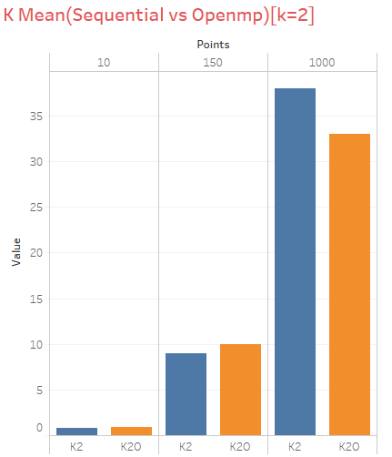
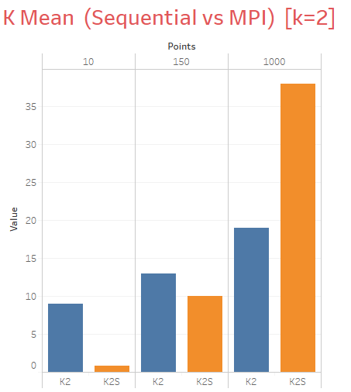
Results

Slide 8
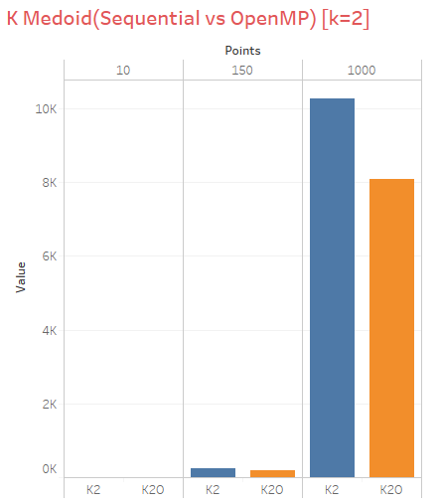
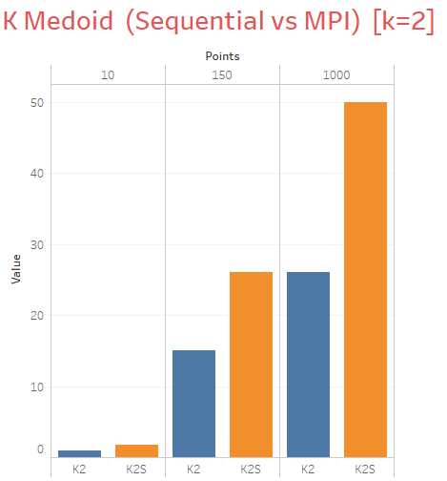

Slide 9
Conclusion
In this project we conclude the results of both K- mean and K-Medoids clustering algorithms with respect to the number of clusters formed and distance metric.
The comparison results show that time taken in cluster selection and space complexity of overlapping of cluster is much better in K-Medoids than K-Means.
The result from K-Means and K-Medoids algorithm and time performance using High Performance Computing (HPC) Cluster parallelize K-Means and K-Medoids algorithms and use Message Passing Interface (MPI) library and OpenMP .
The results showed that K-Means algorithm gives smaller SSE than K-Medoids.
And also parallel algorithm that used MPI and OpenMP gives faster computation time than sequential algorithm when dataset is having large number of tuples.
.

