Slide 1



How (not) to lie with visualization
cs5764: Information Visualization
Chris North

Slide 2


How (not) to lie with visualization
Show and tell
“USA Today” graphs…

Slide 3
Stock Market Crash?!
Market
$9000
8875
8750
8625
8500
1995 1996 1997 1998 1999 2000

Slide 4
Showing entire scale
Market
$10,000
7500
5000
2500
0
1995 1996 1997 1998 1999 2000

Slide 5
Shown in context
Market
$10,000
7500
5000
2500
0
1950 1960 1970 1980 1990 2000

Slide 6
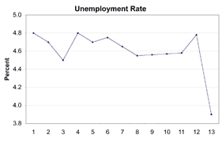
Another example

Slide 7
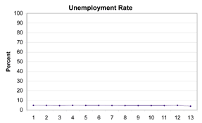
Percentages: 0% – 100%
Employment rate = 100 – unemployment rate

Slide 8
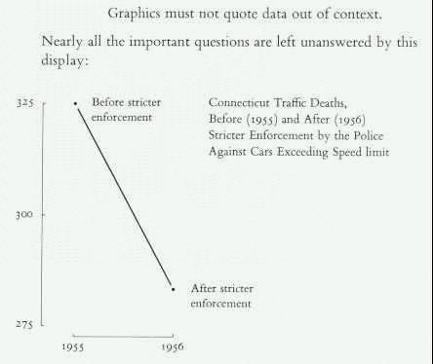

Slide 9
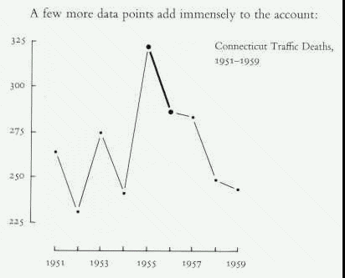

Slide 10
Tufte’s Rule
Visual attribute value should be directly proportional to data attribute value
Lie factor = (visual effect) / (data effect)
truth = 1.0

Slide 11
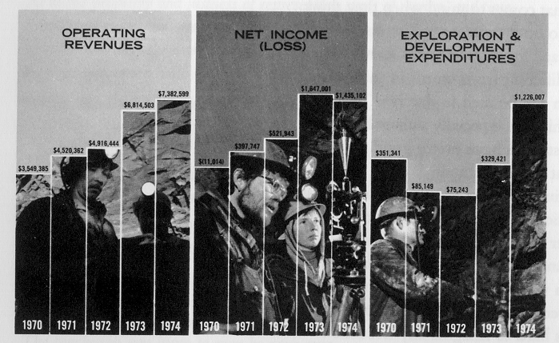
Company financial status

Slide 12
The hidden 0-points
Lie factor = ?

Slide 13
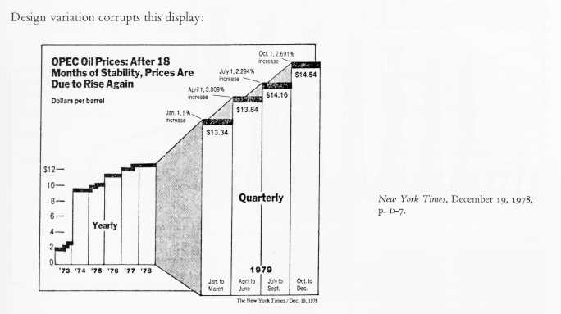
Changing Scale
0.5?
13

Slide 14
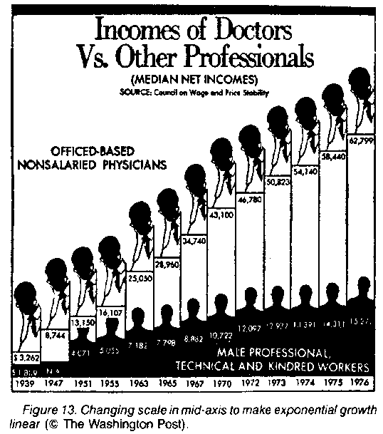
Changing
Scale

Slide 15
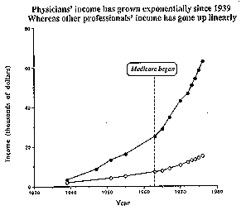
…with linear time scale

Slide 16
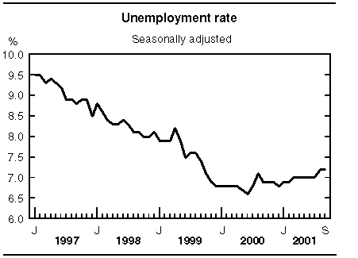
Down = Bad ?

Slide 17
Make it explicit
⇐ Better
Other examples: user performance, questionnaire results

Slide 18
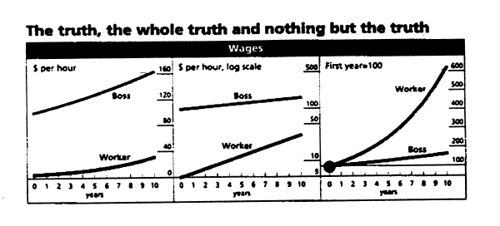
Logarithmic data ⇒ log scale

Slide 19
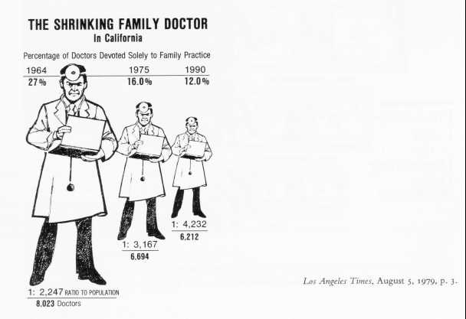
Size Encoding

Slide 20

Size Encoding: height or area?
=
?

Slide 21
Size Encoding

Slide 22
Height or Area
Height = value
Width = value
Area = value²
or
Area = value
height*width = value
height = width = value ^{0.5}
Problem:
Using 2 dimensions to
represent 1 dimension.

Slide 23
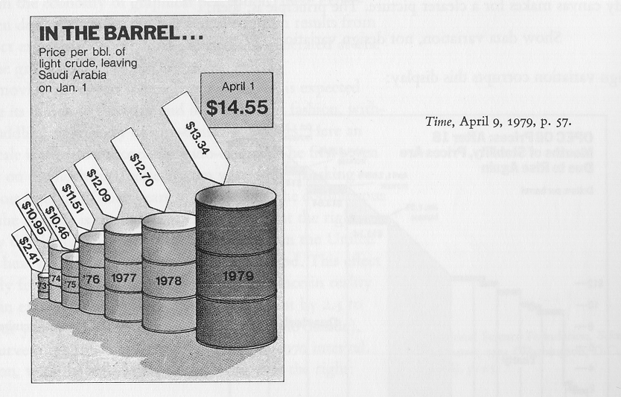
Volume encoding?
Height?
Diameter?
Surface area?
Volume?
73 – 79 data difference = 5.5x
73 – 79 volume difference = 270x

Slide 24
Problem with size encoding
1 2 3 4 5 6 7
Height
Area
Volume

Slide 25
Height & width encoding
1 2 3 4 5 6 7
Height
Height & Width

Slide 26
Solution: just use height

Slide 27
Size Encoding

Slide 28
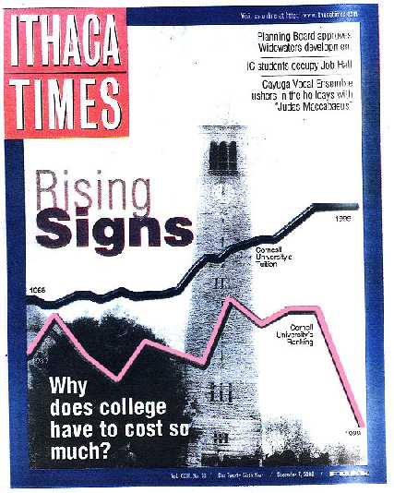
A Propaganda Classic

Slide 29
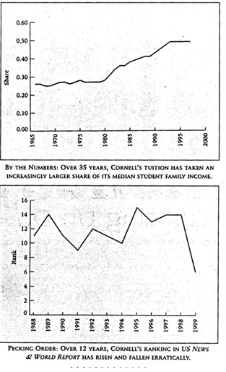
Hmmm…
Low rank = good!
Different time scales
Not really tuition
Artistic mood

Slide 30
How not to lie
Show entire scale
Show data in context
Consistent, linear scale
    Log scale for log data
Up vs. down: indicate direction of improvement
Avoid size encoding
    Use height OR width
    Don’t use both for same data attribute
    Avoid area, volume encoding

Slide 31
Visualization = Communication
Communication is person dependent
People have a lot of “baggage”

Slide 32
Expectations
Life
is a
a highway
Paris
in the
the spring
Now
is the
the time

Slide 33
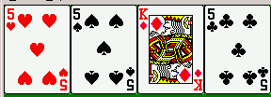
Re-training
Red spades, black hearts
Poor user performance even after being told

Slide 34
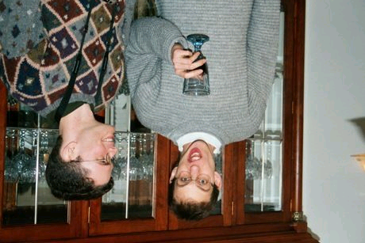
Orientation
Who are they?

Slide 35
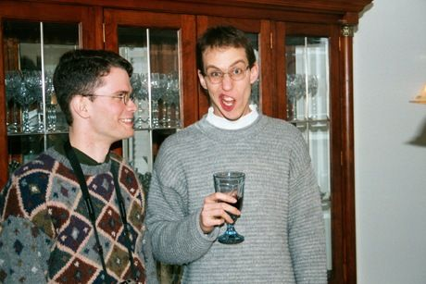
Orientation

Slide 36
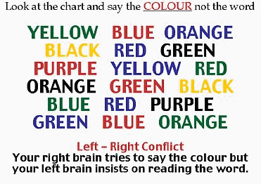
Verbal-visual conflict

Slide 37
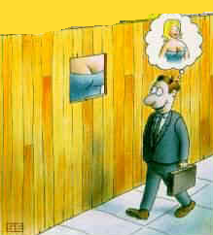

Slide 38
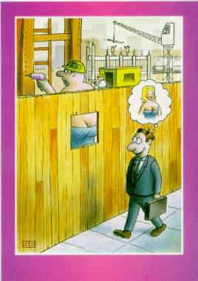

Slide 39
Fun with illusions

Slide 40
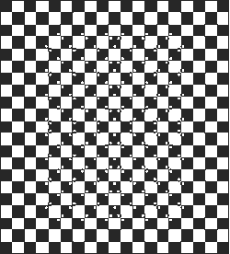
Is the grid OK?

Slide 41

Can you see gray squares?

Slide 42

A man playing saxophone or a woman’s head?

Slide 43
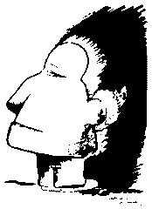
A head or a boy?

Slide 44

2, or 1 face?

Slide 45

Duck facing left or hare to the right?

Slide 46

Horrible!!! A woman before the mirror??

Slide 47
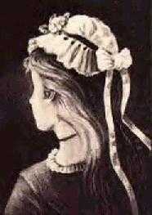
Young or old lady?

Slide 48
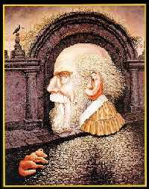
It is said there are nine faces in this picture

Slide 49
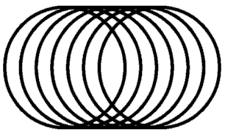
Will you go through it from left to right or from right to left?

Slide 50
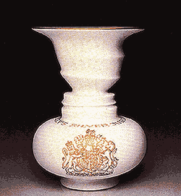
One vase or two faces?

Slide 51
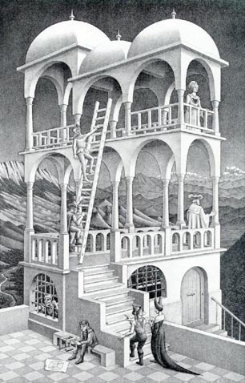
Can you build this?

Slide 52
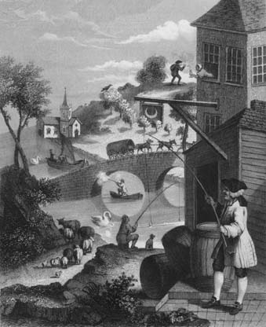
Where is the high land?

