Slide 1
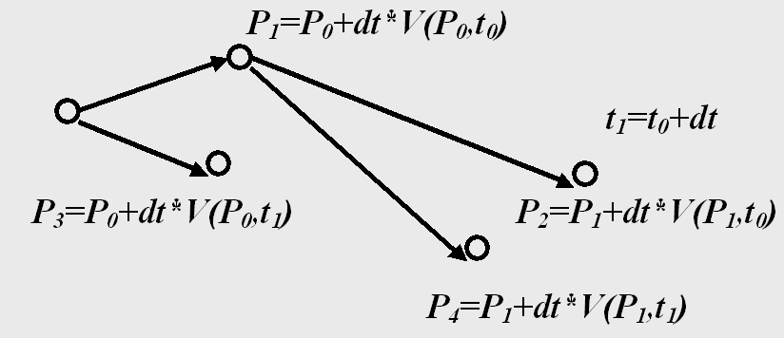
Flow Visualization: Characteristic Curves
Characteristic curves of a vector field:
Stream line: P₀, P₁, P₂
Path line: P₀, P₁, P₄
Streak line: P₀, P₃, P₄

Slide 2
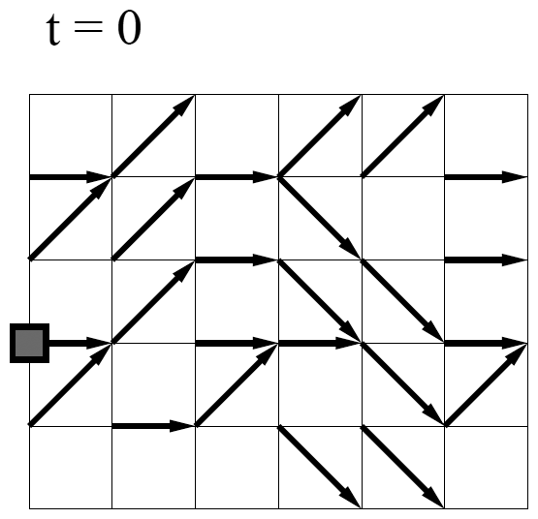
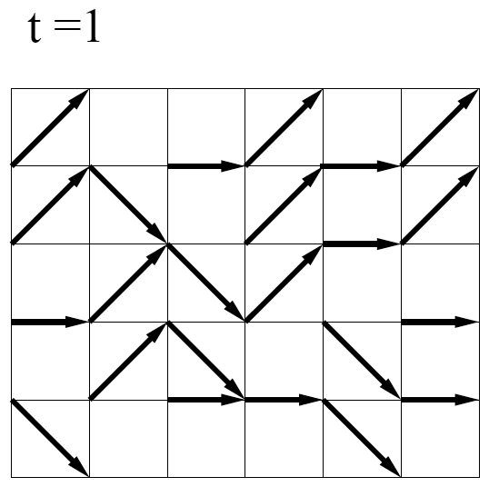
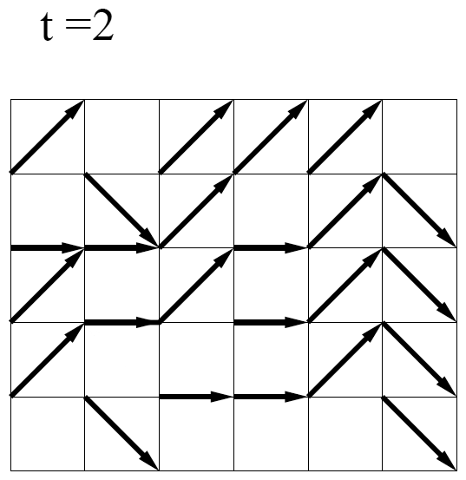
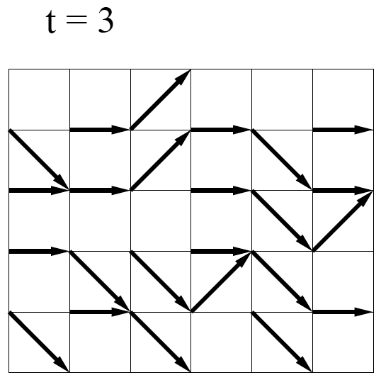
Flow Visualization: Characteristic Curves
A time-dependent (unsteady) vector field

Slide 3
Flow Visualization: Characteristic Curves
Stream line
curve tangential to the vector field in each point for a fixed time

Slide 4
Flow Visualization: Characteristic Curves
Stream line
curve tangential to the vector field in each point for a fixed time
solution

Slide 5
Flow Visualization: Characteristic Curves
Path line motion of a particle over time in an unsteady flow field

Slide 6
Flow Visualization: Characteristic Curves
Path line motion of a particle over time in an unsteady flow field

Slide 7
Flow Visualization: Characteristic Curves
Path line motion of a particle over time in an unsteady flow field
solution

Slide 8
Flow Visualization: Characteristic Curves
Streak line
location of all particles set out at a fixed point at different times

Slide 9
Flow Visualization: Characteristic Curves
Streak line
location of all particles set out at a fixed point at different times
solution
particle started at t=0
particle started at t=2
particle started at t=1
particle “started” at t=3

