Slide 1




GAMING CENTRE HUB USING CISCO PACKET TRACER

Slide 2

Team Members
M AFNAN
AM.EN.U4ECCE22023
M Y RAVI TEJA
AM.EN.U4ECCE22024
N VIVEKANANDA
AM.EN.U4ECCE22028
SAI VIRASITH M
AM.EN.U4ECCE22040
M VINEETH
AM.EN.U4ECCE22056

Slide 3
introduction
This project is a smart Gaming Centre Hub designed using Cisco Packet Tracer and a live web dashboard. It helps monitor which systems are free and manage billing from a single Admin PC. Only the Admin PC can access the website using access control settings. The setup is secure, efficient, and ideal for gaming centers.

Slide 4

objective
To create a centralized management system for a gaming center.
Ensure only the Admin PC can control billing and system usage.
Use networking principles to restrict access securely.
Improve efficiency using automation and real-time monitoring.

Slide 5

system design
31 PCs are connected through two switches to a router.
A server hosts the admin dashboard on a different subnet.
Static IPs are assigned, and ACLs control web access.
Only the Admin PC can access the billing website.

Slide 6

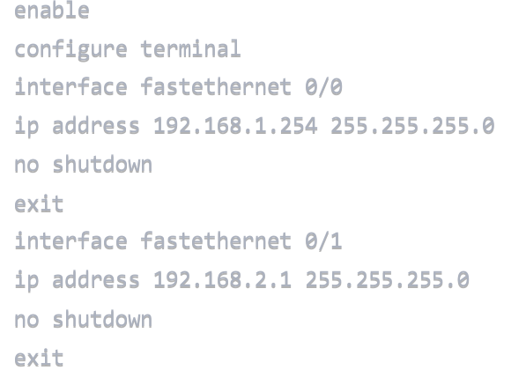
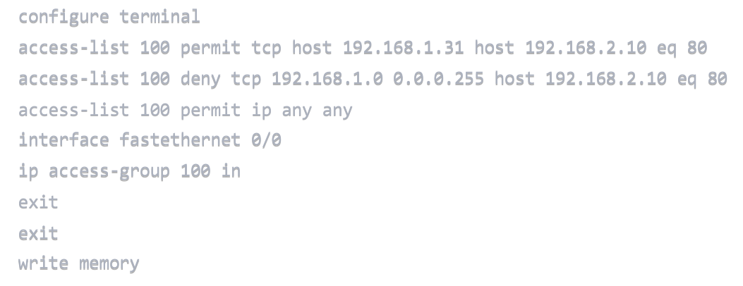

acl commands
host will run at : 192.168.2.10

Slide 7


website integration
b.
A.
A live website is hosted at https://gaming-zone-three.vercel.app/.
Only the Admin PC is allowed to open it via browser.
The site tracks free systems and handles billing.
It bridges the network simulation with real-time control.

Slide 8
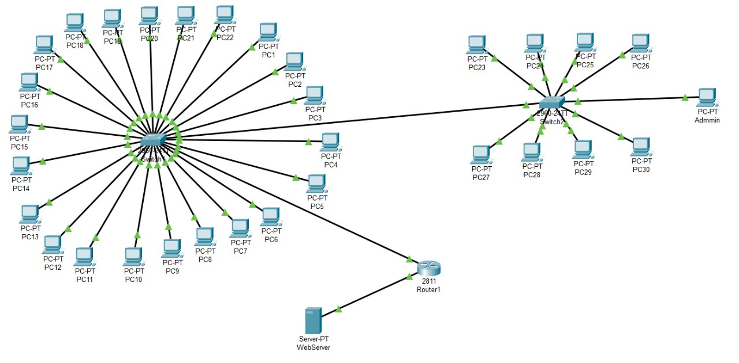
circuit diagram

Slide 9
The Admin PC successfully accessed the billing website, while all other PCs were blocked as expected. Internal communication like ping worked across all systems. The ACL rules applied on the router functioned correctly. The system proved effective for secure and centralized management in a gaming center setup.
Results

Slide 10
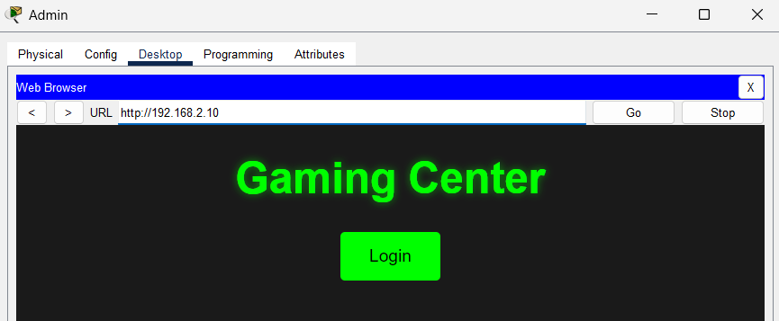
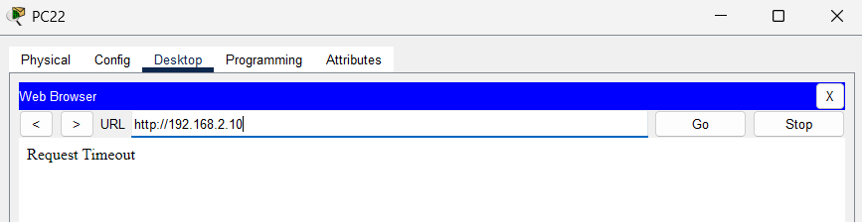
ADmin pc
Remaining pc’s

Slide 11
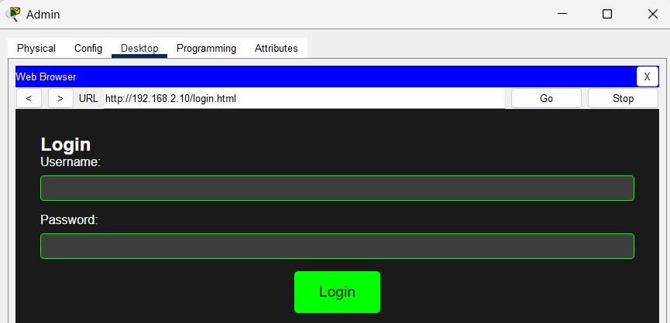
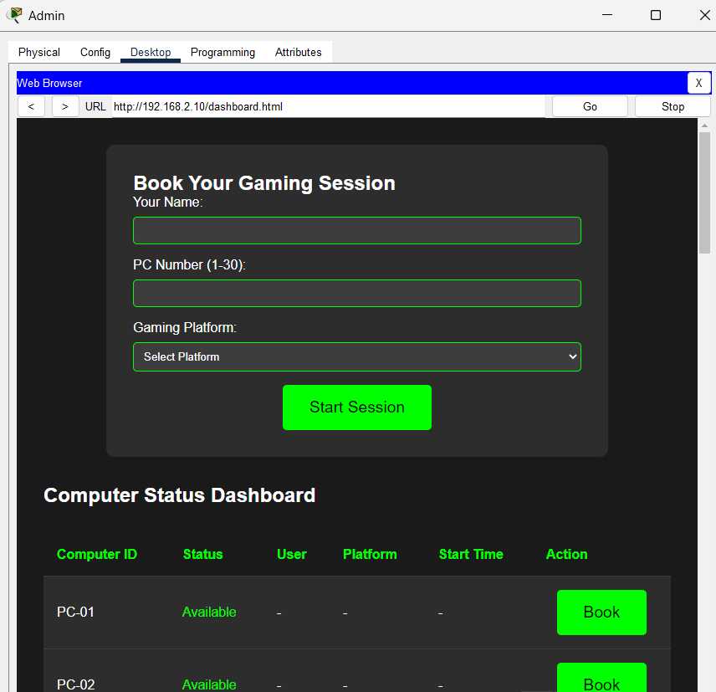
Admin page
dashboard page

Slide 12
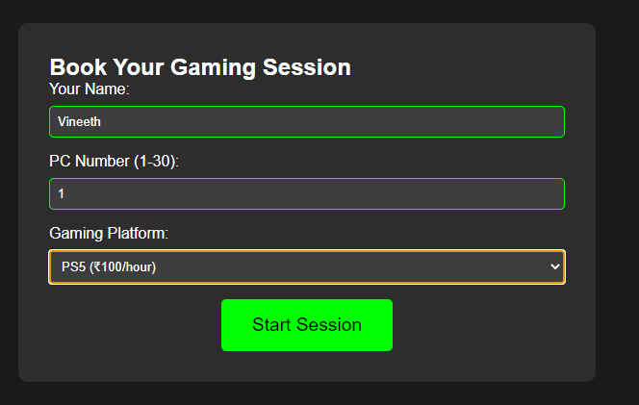
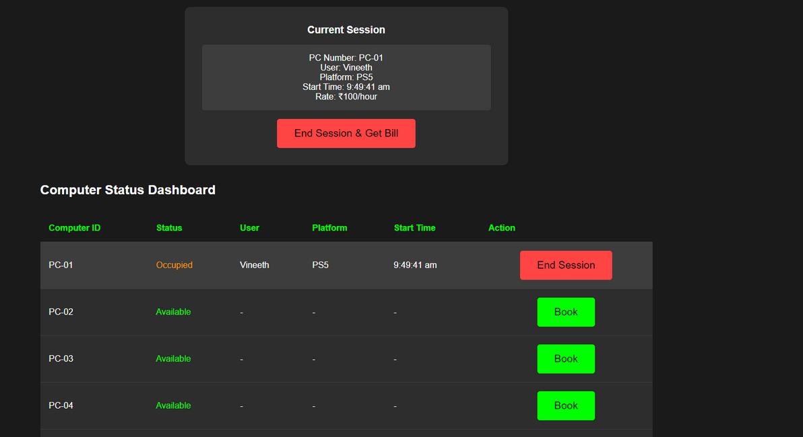
user session login
When a user is using System-1

Slide 13
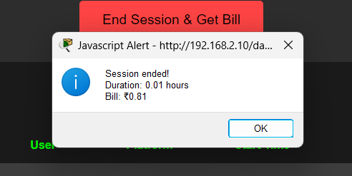
After completion the session by user we can logout and when we will click on logout we can get the bill by going to records

Slide 14
THANK YOU

