Slide 1


Slide 2


Project Title
First Year Project Synopsis
Submitted by
ROLL | NAME
Virat Dagar | 2501010356
Krishang | 2501010277
Daksh | 2501010293
Jasleen | 2501010291
Aprajita Mishra | 2501010313
Faculty Mentor:

Slide 3


Design and Development of a Behavioural Academic Integrity Checker
Team LUMIX
First Year Engineering Project | Faculty Mentor: Megha Sharma

Slide 4

Project Overview
What This System Does
Monitors behavioral interaction metadata
Analyzes typing patterns and editing behavior
Logs paste activity and session timing
Generates explainable priority indicators
Detect AI-generated text
What This System Does NOT Do
Evaluate content quality
Label misconduct or assign penalties
Decision-support tool for human review

Slide 5





Specific Objectives
Research Limitations
Behavioral Analysis
Capture Indicators
Study constraints of traditional plagiarism and AI-detection systems
Analyze how assignments are written rather than what is written
Record typing rhythm, paste actions, editing frequency, and duration
Generate Indicators
Ethical Framework
Create explainable integrity risk indicators with human-readable reasons
Maintain human-in-the-loop decision making for all evaluations

Slide 6
Key Features
01
02
Monitored Web Editor
Real-Time Logging
Controlled assignment writing environment
Continuous behavioral metadata capture
03
04
Rule-Based Engine
Explainable Indicators
Weighted integrity risk scoring system
Transparent, interpretable results
05
06
Faculty Dashboard
No Automated Penalties
Centralized review interface
Supports informed human decisions only

Slide 7

Project Use Cases & Scope
Primary Applications
Key Principles
Faculty academic integrity review
Contextual insight into creation behavior
Digital written assignment evaluation
Fair and informed academic evaluation
Enhanced transparency and trust
Human oversight at all stages
Important: Not intended for punishment or automated enforcement

Slide 8






System Architecture & Flow
Student Writes
Assignment in monitored web editor
Event Logging
Frontend captures typing, paste, editing, timing
Data Submission
Text, session timing, behavioral logs packaged
Feature Extraction
Backend processes raw events into metrics
Pattern Evaluation
Rule-based engine identifies unusual behavior
Report Generation
Integrity indicators displayed to faculty

Slide 9
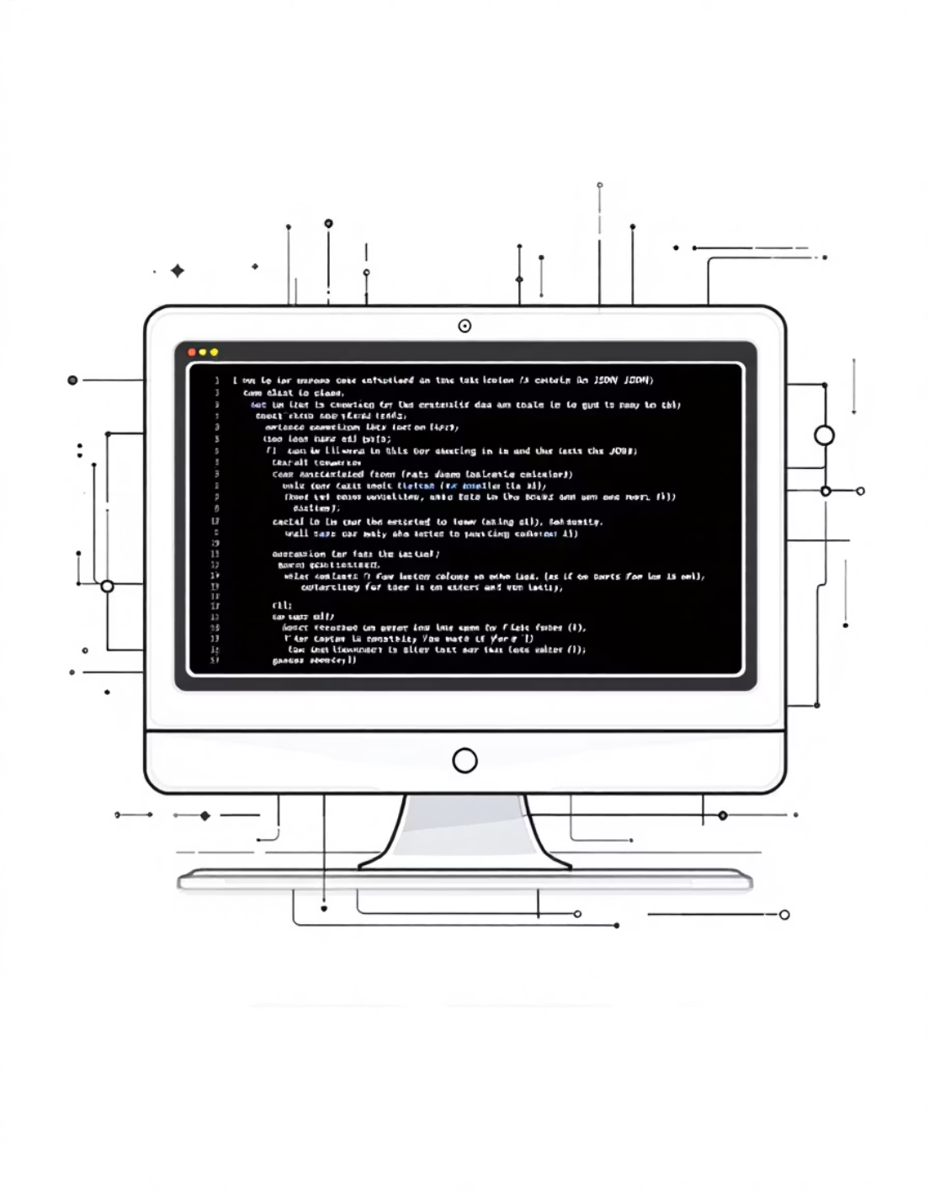
Data & Resources
Primary Data Sources
Behavioral interaction metadata
Keystrokes, paste events, edits
Session timing: start, end, duration
Structured JSON payloads
Implementation Environment
No external content databases
Local development prototype
Web-based architecture

Slide 10
Methodology
Frontend Implementation
Backend Framework
Feature Extraction
Browser event listeners capture behavioral events
FastAPI with Python for data processing
Convert raw events into behavioral metrics
Rule-Based Heuristics
Faculty Interface
Weighted integrity indicators with explanations
Results presented for human interpretation

Slide 11
Expected Results & Impact
Enhanced Transparency
Reduced Opaque Systems
Contextual Insight
Clear visibility into academic integrity evaluation processes
Move away from black-box plagiarism and AI-detection tools
Understanding writing behavior beyond content analysis
Ethical Support
Strengthened Trust
Explainable integrity indicators for informed decisions
Improved relationships between students and faculty

Slide 12
Project Timeline
Phase 1
1
Problem analysis and literature review
2
Phase 2
System design and architecture
Phase 3
3
Frontend and backend implementation
4
Phase 4
Rule-based scoring and reporting
Phase 5
5
Testing, refinement, and documentation
Team LUMIX | Faculty Mentor: Megha Sharma

Slide 13
THANK YOU

