Slide 1
Will This Program Pay Off?
Predicting which college programs beat their field’s national earnings median
BUAN 6341 Applied Machine Learning · Group Project · Fall 2026
Group members: ____________________
Notes:
Introduce the group and the one-sentence question: given a field of study, does this particular school’s program pay more than the national norm for that field? (~30 seconds)

Slide 2
Our approach: the machine learning workflow, end to end
1 · MOTIVATION
1
2
3
4
5
6
Define
Clean
Explore
Engineer
Train & tune
Evaluate
Frame a balanced yes/no target vs. the field median
Leakage, duplicates, outliers, missing values
Distributions, segments, correlations
Log transforms, tuition gap, encoding, scaling
4 models, grid/random search, group CV
AUC, PR-AUC, F1, log loss on unseen schools
Tools: Python, pandas, scikit-learn, XGBoost, matplotlib/seaborn · Jupyter notebook · Git/GitHub for version control
Notes:
A roadmap of how we did the project. It follows the ML workflow from Lecture 1 and the five sections of the project outline. Each step maps to a lecture: preprocessing (supplementary module), tuning and CV (Lecture 3), classification metrics (Lecture 4), trees (Lecture 7), ensembles (Lectures 8 and 10a). (~1 min)

Slide 3
Same major, very different payoff
1 · MOTIVATION
Our prediction task
Bachelor’s in Nursing, 4 years after graduation
Will this program’s graduates earn more than the national median for their field and degree?
$74K – $105K
1
Binary classification
median earnings, 10th–90th percentile of 880 schools
47.3% of programs are above, so the classes are balanced
$89K
2
Pre-enrollment inputs only
School, cost, selectivity, debt, and occupation outlook
national median for the same field and degree
3
Who benefits
Students, advisors, and policymakers comparing similar-looking options
Notes:
Students pick a school as much as a major. Example: bachelor’s in nursing. Across 880 schools that report earnings, graduates four years out range from about $74K at the 10th percentile to $105K at the 90th, around a national median of $89K. Our question: can we tell, before enrolling, whether a program will land above its field’s national median? We only use information a student can see at decision time. (~1.5 min)

Slide 4
Reformulating the target removes the "major effect"
1 · MOTIVATION
Raw salary (rejected)
Salary vs. field median (chosen)
Dominated by field: engineering > education
Tells a student what they already know
Skewed, with a long right tail
Isolates the school effect within a field
Balanced: 47.3% positive
Directly actionable once a major is picked
Target = 1 if the program’s median earnings exceed the national median for the same field (CIP) and credential level
Notes:
Raw salary is mostly about the field: engineering pays more than education. A model predicting raw salary would mostly learn the major, which a student already knows. By comparing each program to its own field-and-credential national median, the target isolates the school effect and becomes balanced. (~1 min)

Slide 5
From 228K programs to a clean modeling set
2 · DATA
227,980 programs in the raw file
Sources merged by program
72 columns
College Scorecard
58,112 have 4-year earnings
Program earnings and debt by field of study
74.5% privacy-suppressed
IPEDS
51,867 after de-duplication
Control, region, admission rate, SAT, tuition, enrollment
6,245 duplicate campus rows
40,986 / 10,881 train / test, split by school
BLS / O*NET
Linked occupations: jobs, growth, wages, AI tools
no school in both sets
Notes:
Three sources merged at the program level. Earnings are privacy-suppressed for 74.5% of programs, so those have no label. We also found an anomaly: multi-campus schools that report one shared outcome were repeated once per campus with identical earnings, so we removed 6,245 duplicate rows. Finally we split by institution so the test set contains only unseen schools. (~1.5 min)

Slide 6
Preparation: no leakage, clean inputs, honest split
2 · DATA
1
Leakage control
2
Duplicates
3
Skewed data
Dropped all post-graduation and earnings-derived columns (1-yr/5-yr earnings, debt-to-earnings, employment rates)
Removed 6,245 repeated campus rows with identical shared outcomes; kept the main campus
log(1+x) for enrollment, completions, debt, occupation employment and openings
4
Outliers
5
Missing values
6
Encoding & split
Winsorized tuition, growth and wage at the 1st/99th percentile, caps learned on training data only
Missing-SAT and missing-admission-rate flags (open-admission signal) + median imputation in the pipeline
Standard scaling; one-hot for 7 nominal features; train/test and CV folds grouped by institution
Notes:
Walk through the six steps. Emphasize leakage control (we dropped every post-graduation variable), and that the winsorizing caps and imputation are learned from training data only. The group split is the reason our test scores are realistic. (~2 min)

Slide 7
Who beats the field median? Type and location stand out
2 · DATA
Notes:
For-profit programs beat their field median least often; private non-profits most often. New England, the Far West and the Mid East lead; the Southeast trails. Overall rate is 47.3%. These patterns preview what the models will find. (~1.5 min)

Slide 8
Four class models, tuned with group cross-validation
3 · MODEL
Model | Lecture | What we tuned | Selected
Logistic Regression | L3, L4 | C; L1 (LASSO) vs L2 (Ridge) | C=0.1, penalty=l2
Decision Tree (CART) | L7 | depth, leaf size, ccp_alpha pruning | ccp_alpha=0.0001, max_depth=None, min_samples_leaf=100
Random Forest | L8 | trees, depth, leaf size, max_features | n_estimators=200, min_samples_leaf=3, max_features=sqrt, max_depth=25
XGBoost | L8, L10a | learning rate, trees, depth, min_child_weight, gamma, reg_lambda, subsample | subsample=0.8, reg_lambda=5, n_estimators=600, min_child_weight=1, max_depth=6, learning_rate=0.03, gamma=0
Grid search for small spaces, randomized search for large ones. Test set used once, at the end.
Notes:
All four share one pipeline and are tuned with grid or randomized search plus 3-fold GroupKFold on ROC-AUC (Lecture 3): logistic regression, CART, random forest and XGBoost, all covered in lectures. Read the selected settings: L2 won for logistic, a moderately pruned tree, and a well-regularized XGBoost. (~2 min)

Slide 9
Spotlight: bagging (Random Forest) vs. boosting (XGBoost)
3 · MODEL
XGBoost
Random Forest
Lectures 8 & 10a
Lecture 8 (bagging)
How: start from a constant, add small trees that fit the negative gradient of log-loss, with shrinkage
Overfit control: gamma (leaf penalty) + reg_lambda (L2), max_depth, min_child_weight, subsample
Speed: histogram split-finding ("cut each variable into L pieces")
Chosen: lr 0.03 × many trees, subsample 0.8, stronger L2
How: grow many deep trees, each on a bootstrap sample of rows, then average their votes
Decorrelation: each split looks at a random subset of features (max_features = sqrt)
Overfit control: averaging cuts variance; depth and leaf size limit each tree
Chosen: 200 trees, max depth 25, min leaf 3, sqrt features
Notes:
XGBoost: boosting plus gradient plus trees, with a complexity penalty (gamma, reg_lambda) and histogram split-finding, exactly the Lecture 10a recipe. The search picked a slow learning rate with many trees, row subsampling and stronger L2, which is a well-regularized setup. Random forest: bagging, many deep trees built in parallel on bootstrap samples and averaged, which lowers variance. XGBoost builds trees one after another, each fixing the last one’s errors, which lowers bias. Both come from Lecture 8. (~2 min)

Slide 10
XGBoost ranks programs best on unseen schools
4 · MODEL COMPARISON
Model | AUC | PR-AUC | Acc. | Prec. | Recall | F1 | LogLoss
XGBoost | 0.781 | 0.768 | 0.703 | 0.698 | 0.650 | 0.673 | 0.556
Random Forest | 0.778 | 0.764 | 0.700 | 0.697 | 0.640 | 0.668 | 0.565
Logistic Reg. | 0.735 | 0.704 | 0.673 | 0.664 | 0.619 | 0.640 | 0.601
Decision Tree | 0.698 | 0.660 | 0.646 | 0.627 | 0.610 | 0.618 | 0.642
All models beat the 52.7% majority-class baseline. XGBoost also has the lowest log loss, so its probabilities are the best calibrated.
Notes:
Primary metric is ROC-AUC because the classes are balanced and we care about ranking. We also report PR-AUC, accuracy, precision, recall, F1 and log loss, all on 10,881 programs from schools the models never saw. Majority-class baseline accuracy is 52.7%. (~2 min)

Slide 11
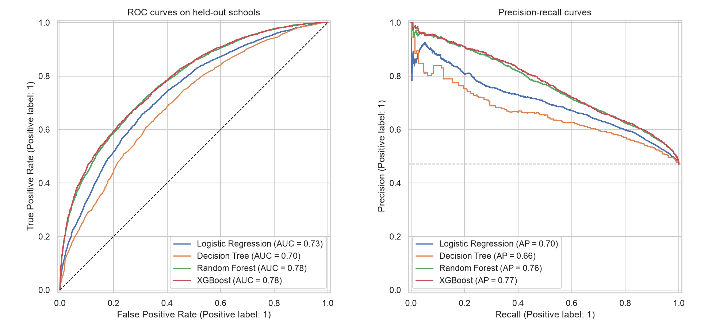
ROC and precision-recall curves agree
4 · MODEL COMPARISON
Notes:
Left: ROC. The tree ensembles sit on top across the whole range, logistic regression below, and the single tree lowest. Right: precision-recall. At any recall level, the ensembles give the highest precision. (~1 min)

Slide 12
Ensembles beat their building block, the single tree
4 · MODEL COMPARISON
0.698
0.778
0.781
test AUC
test AUC
test AUC
Decision Tree
Random Forest
XGBoost
one pruned CART tree
bagging: average 200 trees
boosting: fix residual gradients
For reference: Logistic Regression 0.735. Non-linear interactions matter (e.g., SAT matters differently by credential), and trees capture them best on tabular data.
Notes:
Lecture 8’s wisdom-of-the-crowd effect, live in our data. A single pruned CART tree gets 0.698. Bagging the same trees (random forest) gets 0.778, and boosting them (XGBoost) gets 0.781. Both ensembles also beat the linear model. (~1 min)

Slide 13
What drives the prediction: location and school profile
4 · MODEL COMPARISON
1
Location
Longitude, latitude, state and region: regional labor markets
2
Field baseline
The field’s national earnings floor (25th percentile) and credential level
3
School profile
Size, out-of-state tuition, SAT, admission rate, for-profit status
Notes:
Permutation importance: how much test AUC drops when we shuffle one feature. Longitude is the top single feature, likely regional wage levels, and latitude, region and state also make the top ten. School size and out-of-state tuition are next, then the field’s own earnings floor, credential level and selectivity. Logistic coefficients agree: for-profit lowers the odds; the Far West and Mid East raise them. (~1.5 min)

Slide 14
Takeaway: where and what kind of school matters
5 · CONCLUSION
0.78
#1
+8
test AUC on unseen schools
driver is location
AUC points from ensembling
XGBoost flags above-median programs correctly about 70% of the time using only pre-enrollment information.
The same major pays very differently by region. Students should weigh the regional labor market, not just the major.
Bagging and boosting trees beat a single tree and a linear model on this tabular data.
Notes:
Back to the question: yes, using only pre-enrollment information we can flag programs that will beat their field’s median, with an AUC of 0.78 on unseen schools. Three insights for students and for us as modelers. (~1.5 min)

Slide 15
What we learned along the way
5 · CONCLUSION
1
Check for leakage first
2
Split by the right unit
About a third of the columns were measured after graduation. Including them would have produced a near-perfect but useless model.
A random split lets models memorize schools. Grouping by institution keeps the test honest.
3
Inspect "duplicates"
4
Reframe the target
6,245 rows were one shared campus outcome repeated, which is a data-structure issue rather than an error.
Benchmarking against the field median turned an obvious question into a useful, balanced one.
5
Tune with CV, test once
6
Ensembles win on tabular data
CV and test AUC stayed within ~0.01 for most models, so tuning did not overfit.
Bagging and boosting beat a single tree and a linear model.
Notes:
Lessons from the process, not just the results. These are the moments where a careless choice would have given a misleadingly good or wrong answer. (~1.5 min)

Slide 16
Limitations and next steps
5 · CONCLUSION
Limitations
Next steps
Only reported programs
Cost-of-living adjustment
74.5% of programs are privacy-suppressed; small programs may differ
Separate a high-wage region from a high-value program
Location ≠ quality
Segment models
Regional wages and cost of living likely drive part of the location effect
Separate models for undergrad vs. grad, or K-Means school clusters (Lecture 10)
Association, not causation
Explain each prediction
Schools differ in who enrolls, not only in what they teach
SHAP values so a student sees why a program was flagged
Notes:
Be upfront about limitations: only reported programs, location may proxy for cost of living, and these are associations, not causes. Next steps connect to later course topics: K-Means segments (Lecture 10) and explainability. (~1.5 min)

Slide 17
Thank you · Questions?
Code, figures and report: github.com/____/college-earnings-ml
GenAI disclosure: analysis code, report text and these slides were drafted with Claude (Anthropic); the conversation is submitted per course policy.
Notes:
Open for Q&A (~5 minutes). Likely questions: why the group split (memorizing schools); why AUC as the primary metric (balanced classes, ranking); why not raw salary (the field effect); what the location effect means (regional wages).

