Slide 1

Team - Manogna
HyClean
Smart waste management for a smart city like Hyderabad
By -
C.Rahul Reddy
Virat Mankali
CH Bharath Kumar

Slide 2
Statement: Smart Waste Management solution for a smart city like Hyderabad.
Description: In the present-day scenario, many times we see that the garbage bins or dustbins placed at public places in the cities are overflowing due to the increase in waste every day. It creates an unhygienic condition for the people and creates a bad smell around the surroundings that leads to the spread of some deadly diseases & human illness. For this, we need a new way through which the waste generated should be managed smartly in such a manner that the work done should be monitored by the officials.
Problem

Slide 3
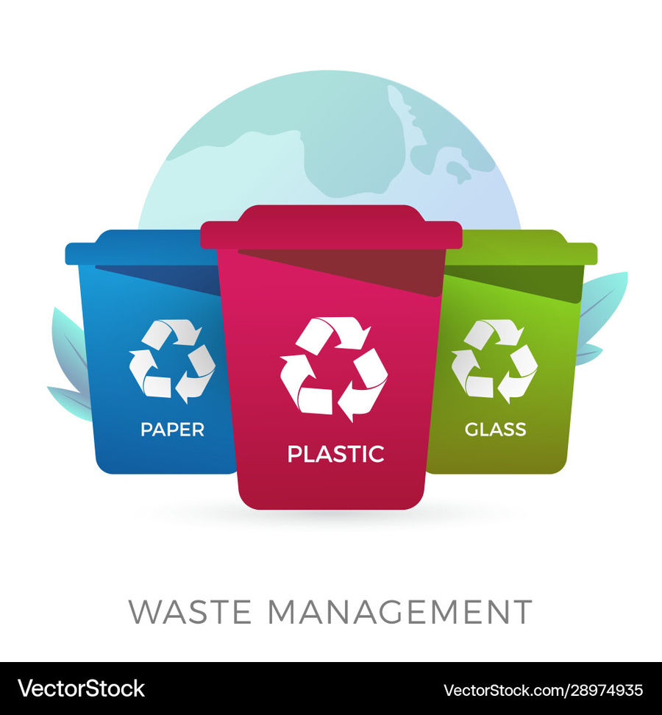
Solution
Installing ultrasonic sensors to the bins or directly installing smart bins to monitor waste levels and their location in real-time.
Data collection and transmission to a central system to track fill levels and predict waste accumulation patterns.
Path Recommendation: Using an algorithm, the app will recommend the route with the most garbage (shown in red) for the user to clean and optimize waste collection routes based on bin status.
Application for the local supervisors regarding the information on trash fill percentage issues and collection schedules with current status on the workers.

Slide 4
Technical Feasibility
IoT Sensors - Using ultrasoinic sensors for monitoring
Cloud Computing: Real-time data analysis and storage using MongoDB.
Dashboard for GHMC: Providing real-time monitoring, data visualization, and insights for waste collection teams.
AI-Based Route Optimization: Reduces operational costs by optimizing collection routes based on bin fill levels and waste prediction.

Slide 5
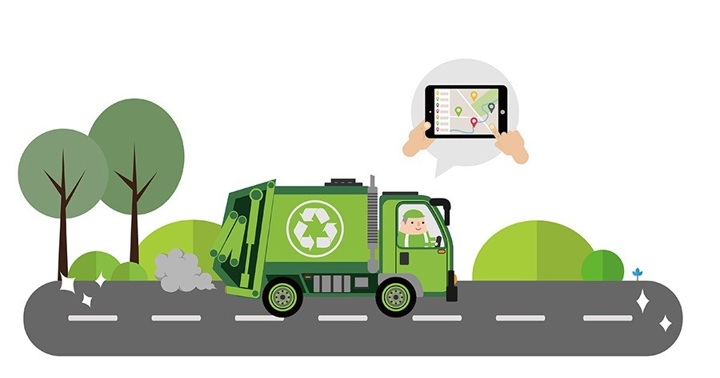
Financial Feasibility
Initial Setup Costs
Ongoing Maintenance
Cost Savings
Return on Investment (ROI)

Slide 6
Literature Review
Traditional Waste Management:
Issues: overflowing bins, inefficient collection, and environmental hazards.
Impact: Spreading of diseases, and inefficient resource use.
IoT in Waste Management:
Key Technologies: smart sensors, wireless communication, and cloud computing (Gutierrez et al., 2020).
Successful Implementations: Cities like San Francisco and Amsterdam have seen a 30–50% reduction in collection costs and fuel consumption through smart waste systems.
Environmental and Economic Benefits:
Reduction in carbon emissions: Smart systems can significantly reduce the number of collection trips and greenhouse gas emissions.
Long-Term Savings: Despite high initial costs, IoT solutions for waste management provide substantial savings in the long run, especially in densely populated cities like Hyderabad.

Slide 7
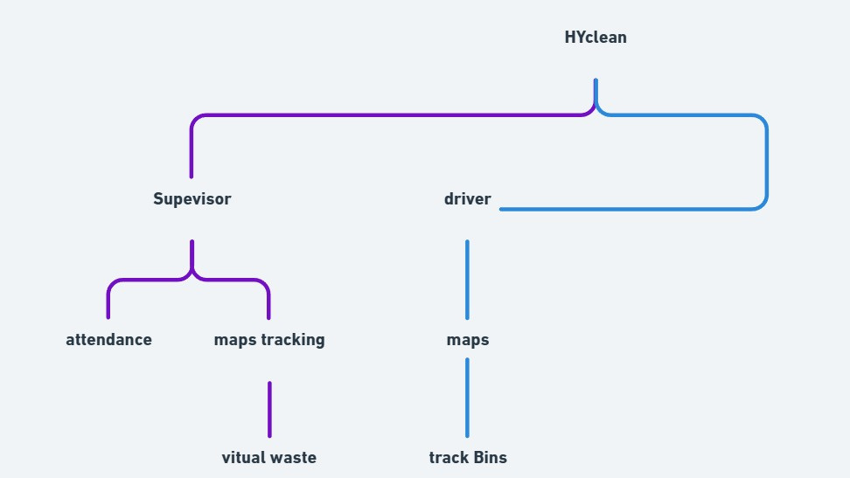
ER Diagram

Slide 8
Acknowledgement
https://nordsense.com/the-ultimate-guide-to-smart-waste-management/
https://www.researchgate.net/publication/341870789_Smart_Waste_Management_System_using_IOT
https://developers.google.com/maps/apis-by-platform

Slide 9
Thank You

