Slide 1
ANIMATIONS

Slide 2
Animation:
Animation is a method in which pictures are manipulated to appear as moving images. In traditional animation, images are drawn or painted by hand on transparent celluloid sheets to be photographed and exhibited on film. Today, most animations are made with computer-generated imagery.

Slide 3
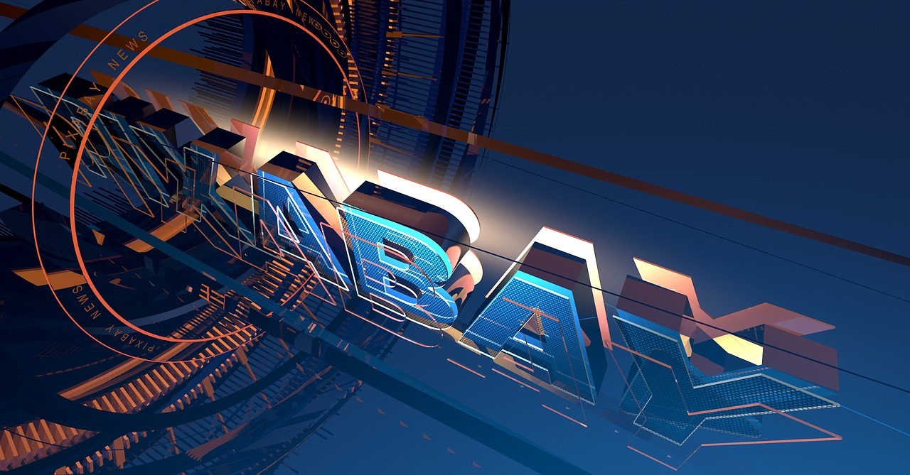

Slide 4
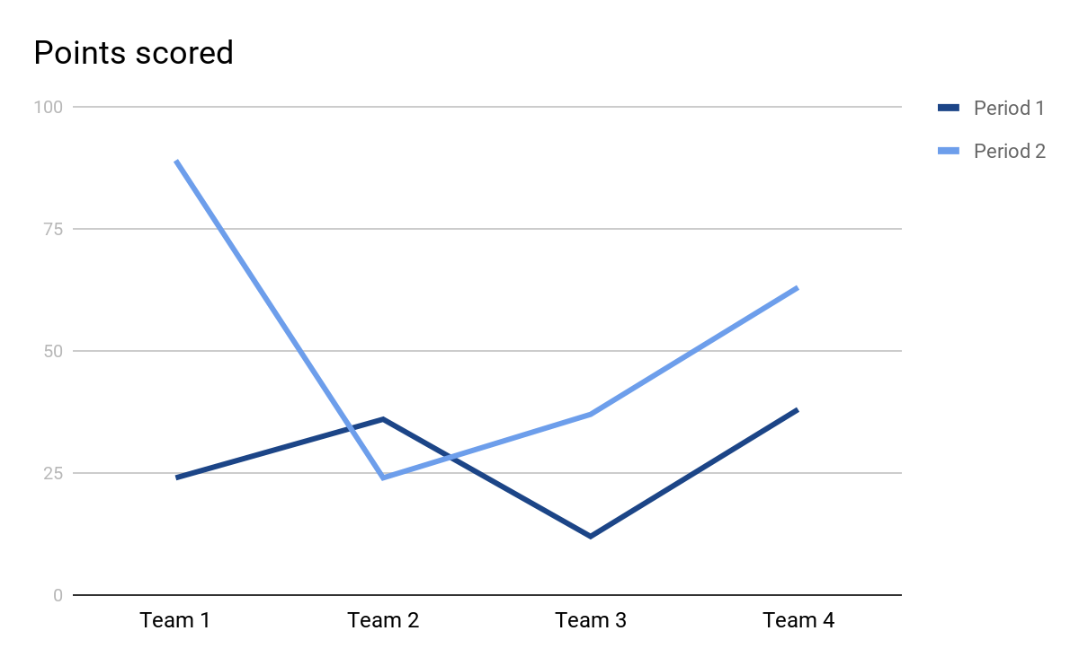
Animation:
To create a games

Slide 5
CONCLUSION:
We can animate images,text.

Slide 6


