Slide 1
Tobacco Retailers Data Analysis Project
Submitted by: Rishav Kumar
Roll no: 06
Registration no: 12326151
Course Code: INT375
Sumitted to: Dr. Manpreet Singh Sehgal

Slide 2
Introduction
This project focuses on analyzing a dataset of active cigarette and tobacco retailers in the state of Texas.
The analysis is structured around five key objectives using real-world data.
Tools such as Python, Pandas, Seaborn, and Matplotlib were used for data manipulation and visualization.

Slide 3
Dataset Overveiw
Name: Active_Cigarette_Tobacco_Retailers.csv
Records: 59,401 entries
Columns: 14 fields including:
Taxpayer & Location Info
Permit Type & Date
Geographic Details (City, County, Zip)
Scope: Retailers located in Texas

Slide 4
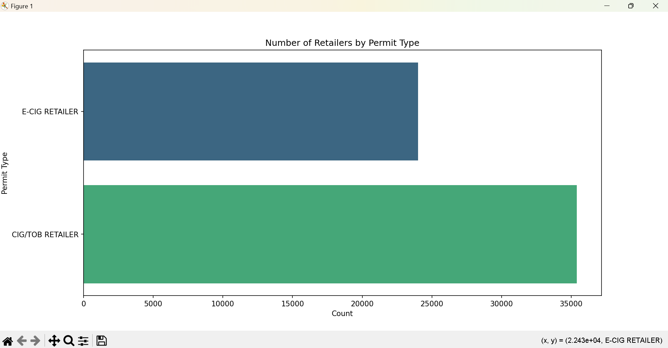
Objective 1: Number of Retailers by Permit Type
Goal: Count of each Permit Type issued.
Result: CIG/TOB RETAILER and E-CIG RETAILER dominate.
Insight: Traditional tobacco retailers still lead.
Visualization: Bar chart representation

Slide 5
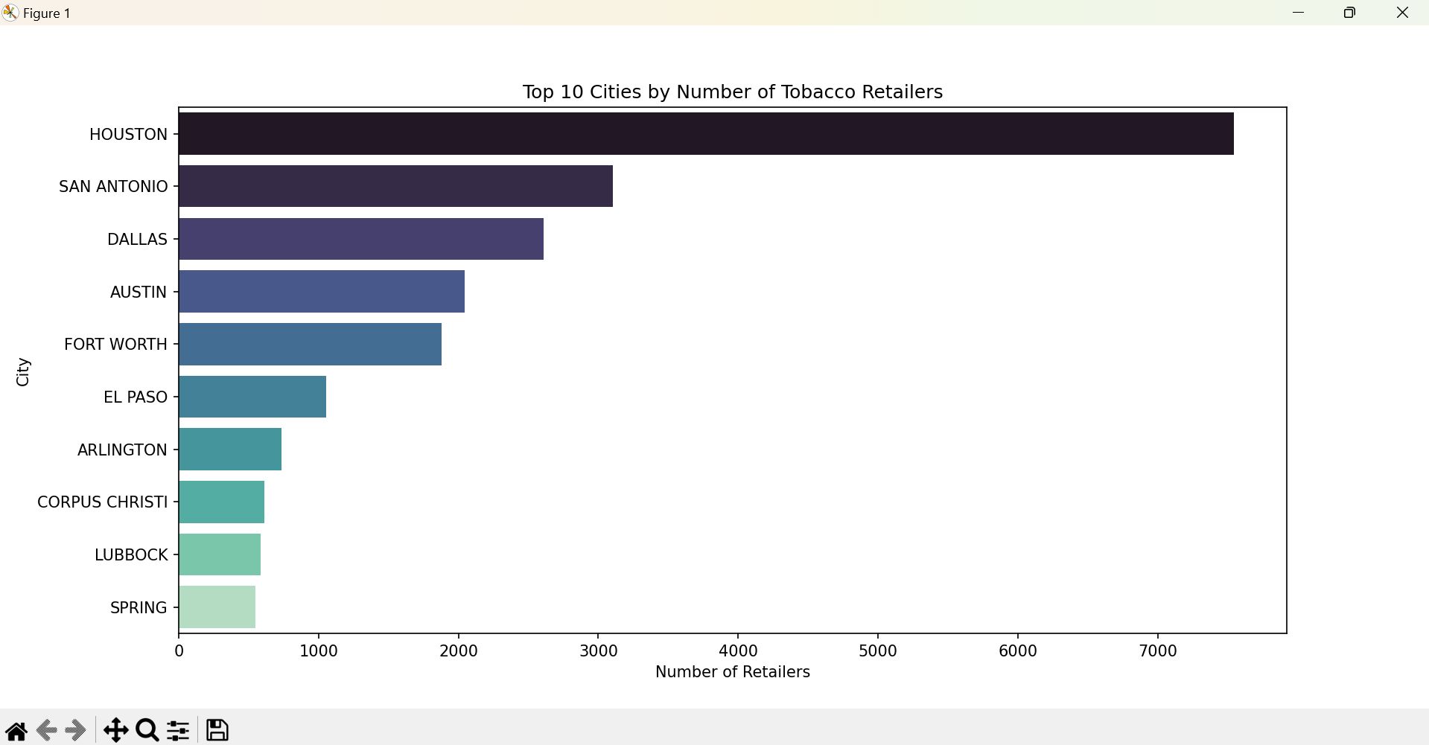
Objective 2: Top 10 Cities by Retailer Count
Goal: Identify cities with the most retailers.
Method: Grouped data by 'City' and counted permits.
Result: Houston, Dallas, and San Antonio top the list.
Insight: Urban areas are major tobacco retail hubs.

Slide 6
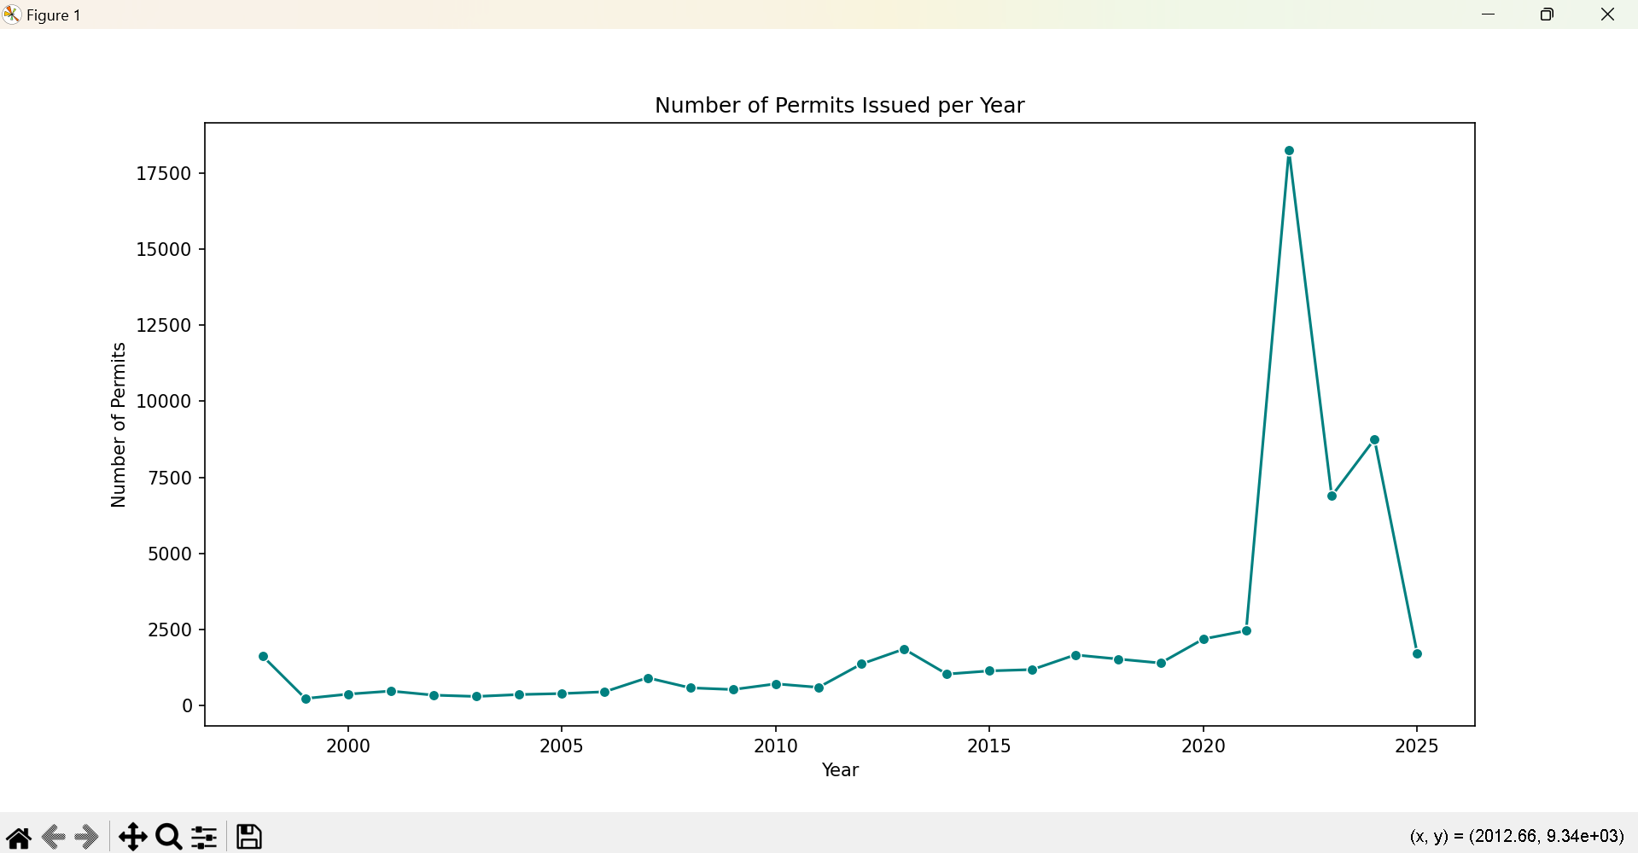
Objective 3: Permit Trends Over Time
Goal: Analyze permit issuance year-over-year.
Method: Extracted year from 'Permit Begin Date'.
Result: Peaks and dips observed over time.
Insight: Trends may relate to policy or economic shifts.

Slide 7
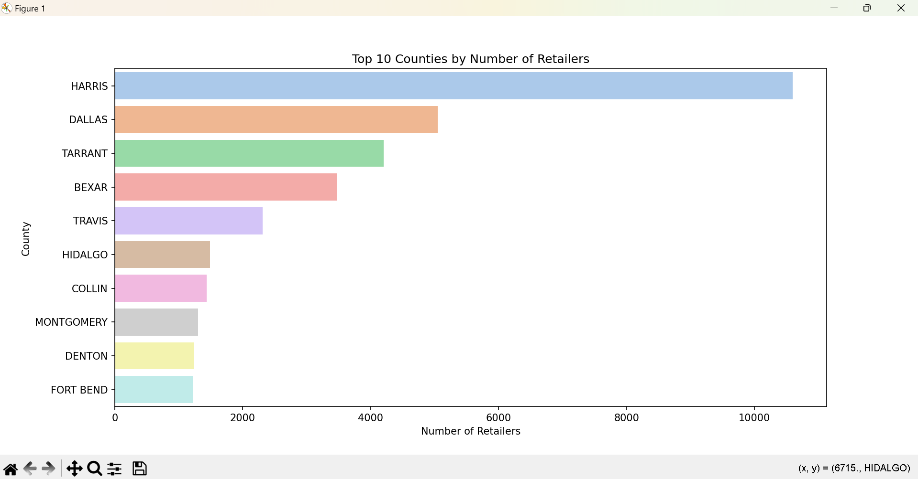
Objective 4: Top 10 Counties by Retailer Count
Goal: Understand geographic concentration at the county level.
Result: Harris, Dallas, Bexar counties lead in permits.
Insight: High correlation with population centers.
Visualization: Bar chart comparing counties.

Slide 8
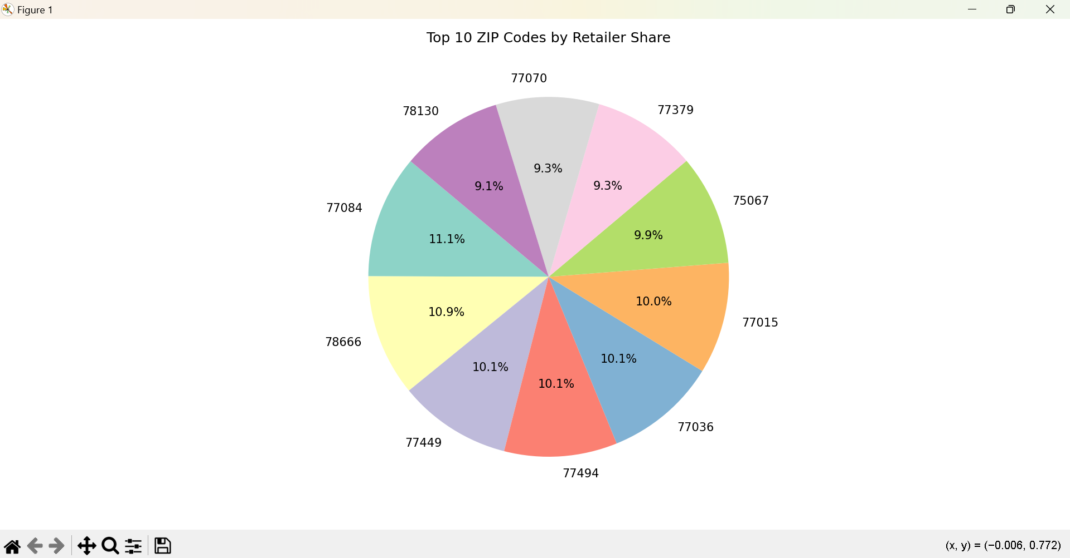
Objective 5: Proportion of Retailers by Permit Type
Goal: Show market share of each permit category.
Method: Used pie chart to visualize proportions.
Result: CIG/TOB RETAILER holds majority share.
Insight: E-CIG permits growing, but still smaller portion.

Slide 9
Key Insights
Traditional tobacco retailers (CIG/TOB) continue to dominate the market, though e-cigarette vendors are growing steadily.
Retailer density is highest in urban areas like Houston, Dallas, and San Antonio, indicating strong ties to population and commercial activity.
Most permits are issued in a few key counties (e.g., Harris, Dallas, Bexar), showing geographic concentration.

Slide 10
Conclusion
Data reveals significant patterns in retail permit activity.
The analysis provided meaningful insights into the distribution and trends of tobacco retail permits in Texas.
Data visualizations (bar charts, pie charts, line plots) helped uncover patterns not easily visible in raw data.

Slide 11
Thank You!

