Slide 1
Pipeline CRM Connector
Participants:
Virat Sagar
Neha Neha

Slide 2
Pipeline CRM
What is webMethods.io connector for Pipeline CRM?
Pipeline CRM
Pipeline CRM is a sales platform that offers easy setup, seamless integrations, and intuitive tools. With Pipeline CRM, you’ll have everything you need to accelerate sales.
Pipeline is the most adopted CRM for small and midsize businesses, empowering sales teams across a breadth of industries to build game changing relationships. Pipeline is built around an easy-to-use and customizable user experience, sales focused features, and leading customer support and service. Today more than 18,000 users in 60 countries use Pipeline to gain visibility into their sales, accelerate opportunities, and close more deals.

Slide 3
Pipeline CRM
Connector Capabilities
The Pipeline CRM connector developed using wmio CLI (using nodejs) gives the users an easy and user-friendly way to integrate their sales flows with Pipeline CRM.
This connector enables the users to register and update new companies (to have delas with), to create new deals and to play with the calendar entries for different customers and deals. We have focussed on the following three areas:
Calendar Entries (Tasks and Events): Calendar Entries are items on a calendar and can be associated to deals, people, or companies.
Companies: Companies are the customers and organizations you sell to. Companies can be associated to People and Deals, have activities and files attached to them, etc.
Deals: Deals are the sales you're working on or have closed. Deals can be associated to People and Companies, have activities and files attached to them, etc.

Slide 4
Connector Actions:
Following are the connector actions created:
Create Calendar Entry
Create Company
Create Deals
Delete Calendar Entry
Delete Company
Delete Deal
List Calendar Entries
List Companies
List Deals

Slide 5
Connector Actions:
Retrieve Calendar Entry
Retrieve Company
Retrieve Deals
Update Calendar Entry
Update Company
Update Deal

Slide 6
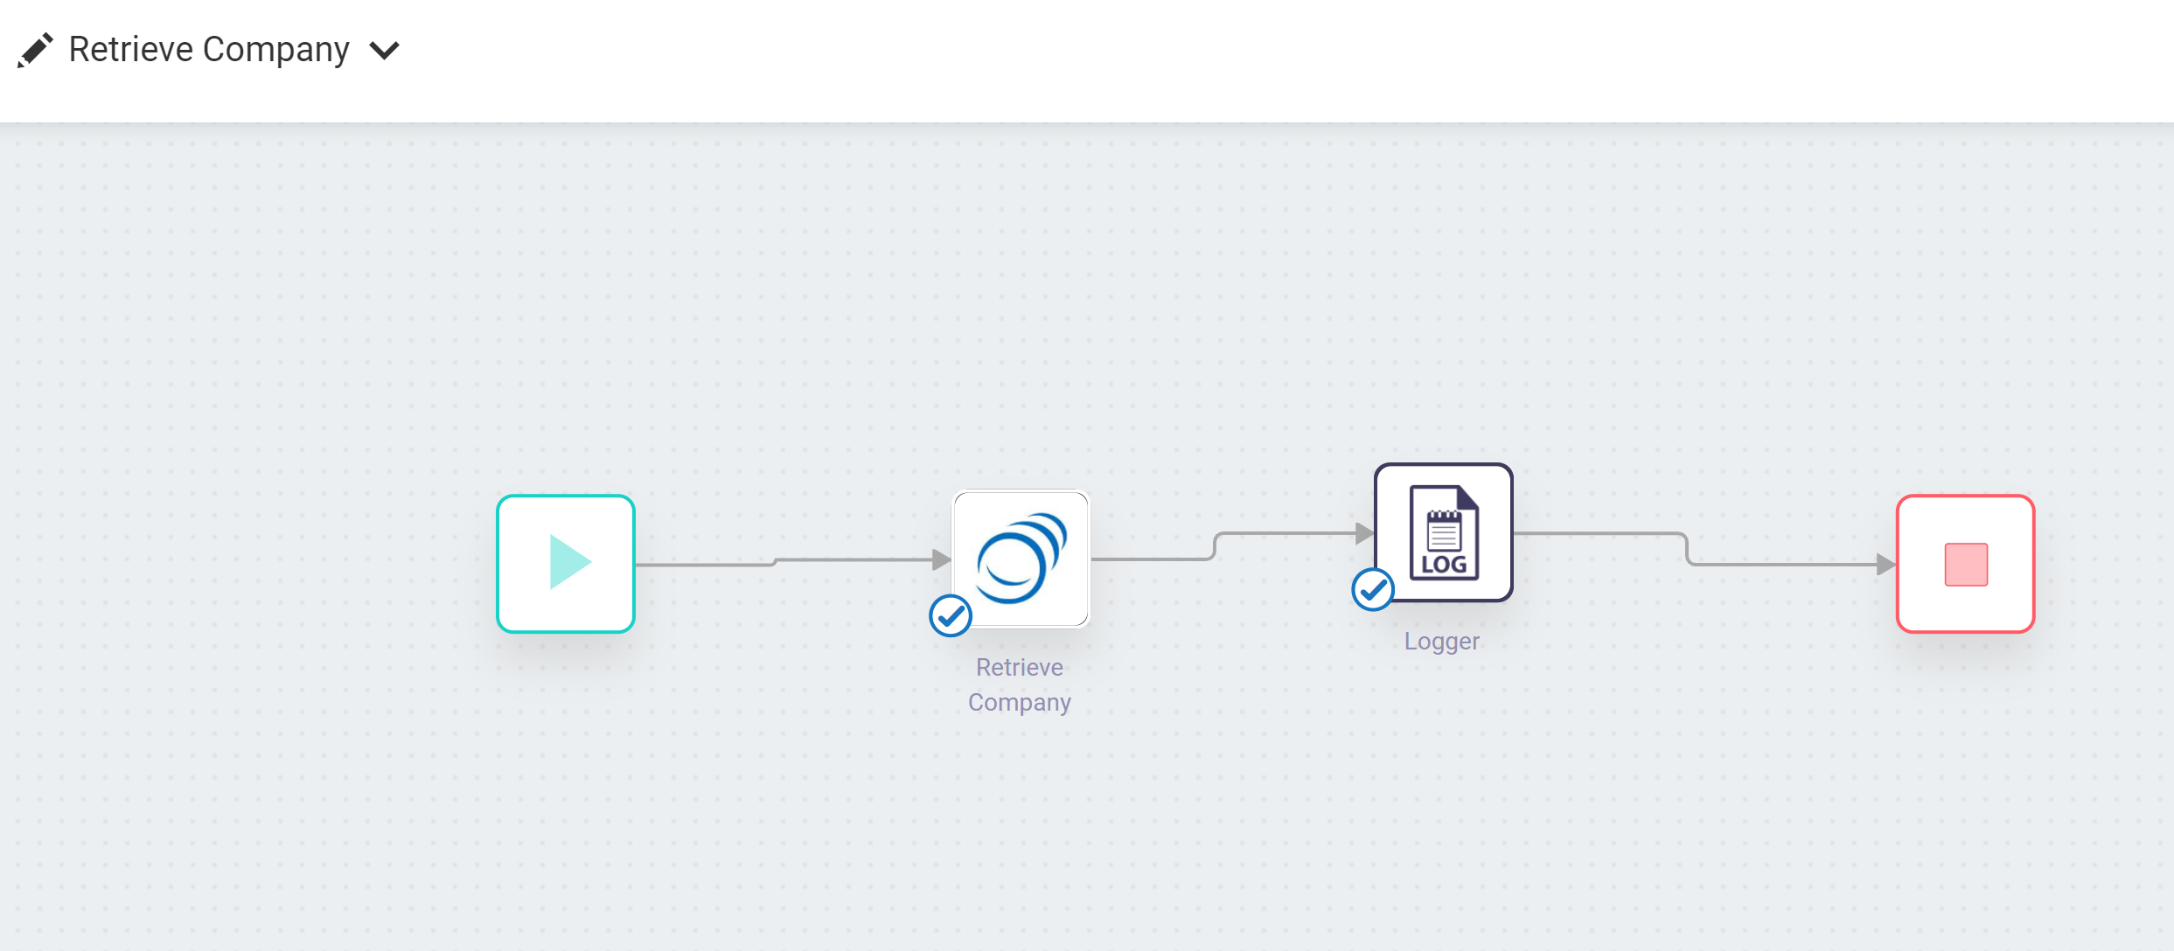
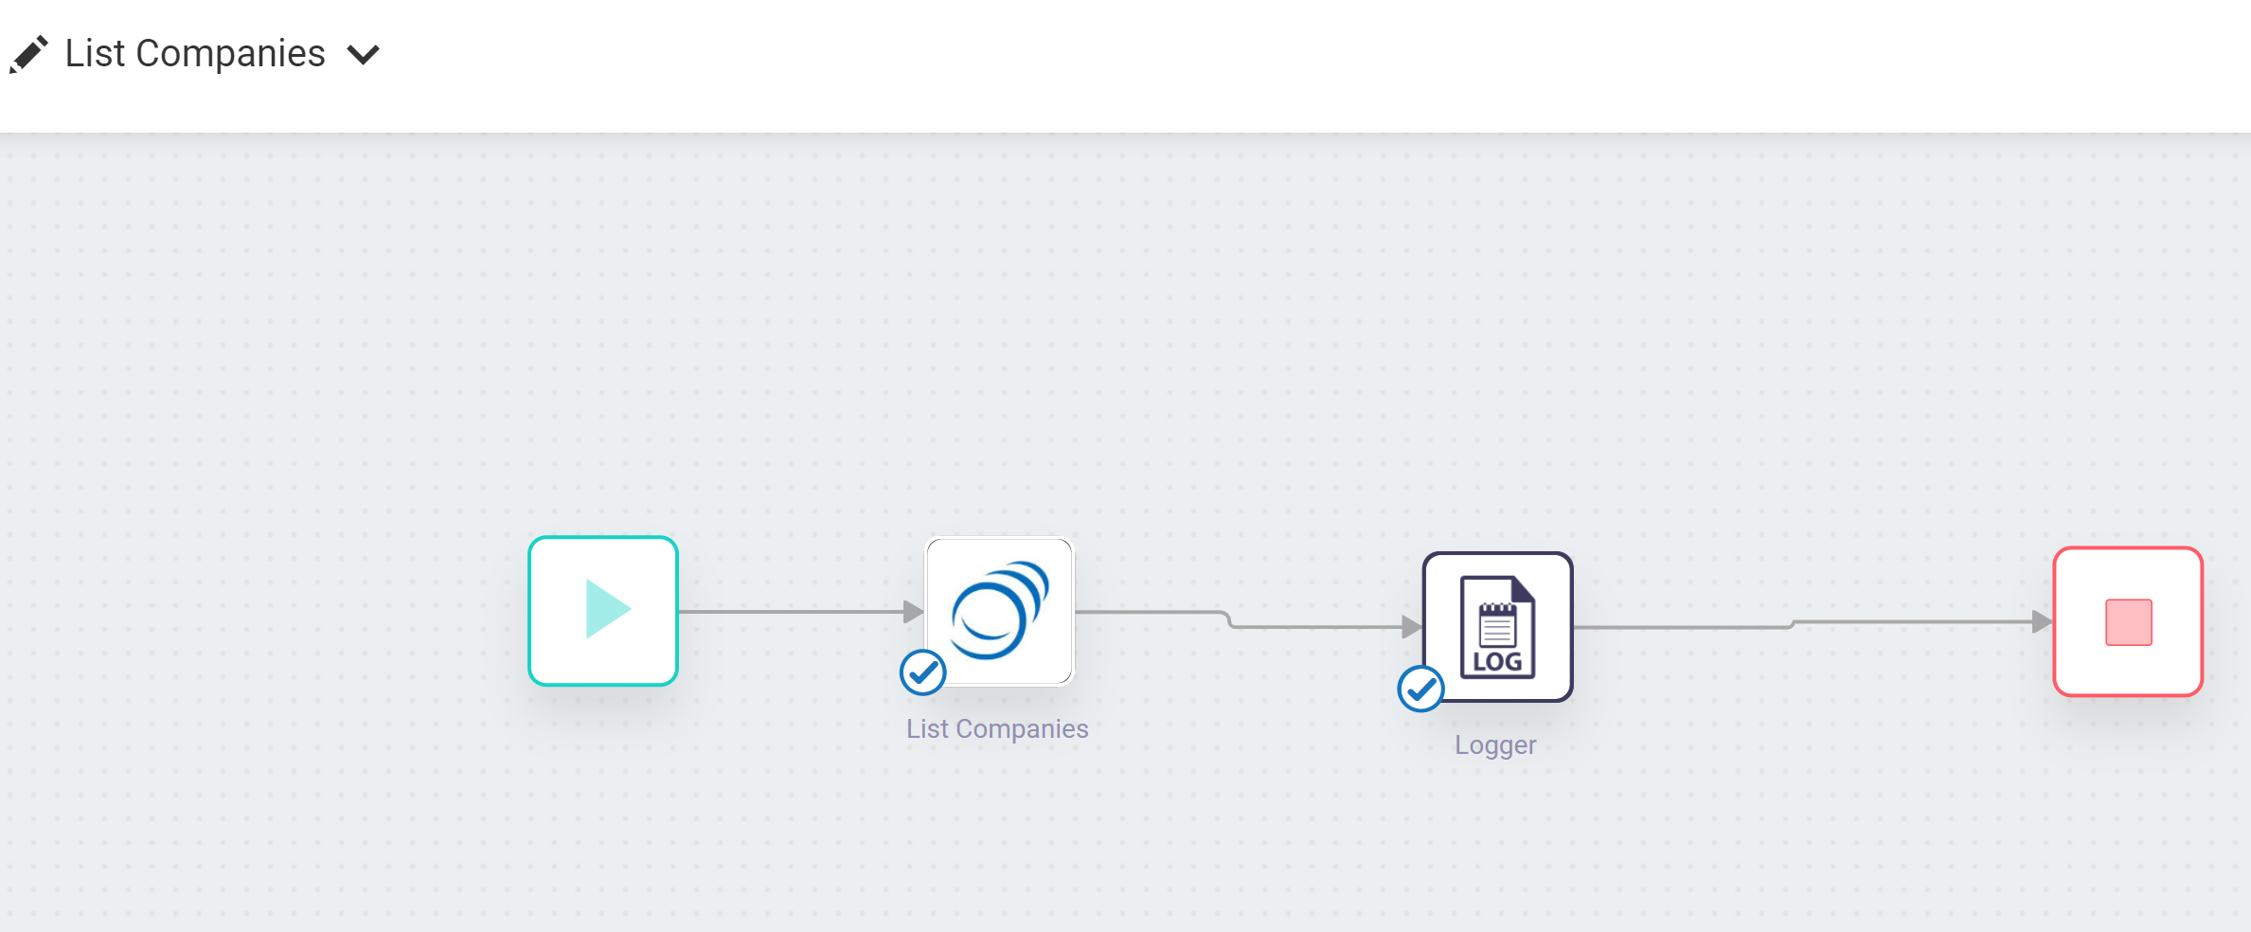
Screenshots for workflow
Retrieve Company and List Companies

