Slide 1


GIT as a DVCS
By Vira Vitanska
July 11, 2018

Slide 2

AGENDA
What is git?
Basic commands of git
Git GUI
Merge conflict
Git in QA practice

Slide 3
WHAT IS GIT?
Git is a software that is used for Version Control.
Version Control is the management of changes to documents, computer programs, large websites and other collection of information.
Benefits of version control system:
A system that keeps records of your changes.
Allows for collaborative development.
Allows you to know who made what changes and when.
Allows you to revert any changes and go back to previous state.

Slide 4
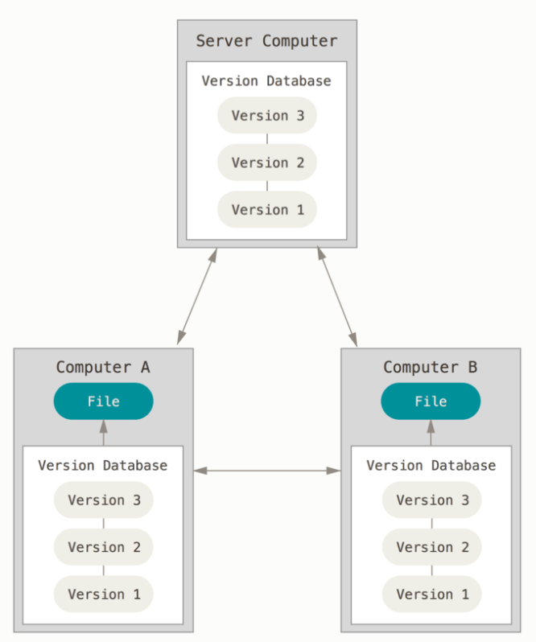
WHAT IS GIT?
There are two types of VCS:
Centralized Version Control System (CVCS)
Distributed Version Control System (DVCS)
Git is a DVCS.

Slide 5


ENOUPH OF THEORY
LETS GET STARTED…

Slide 6
GIT INSTALLATION
Install git:
Linux (Debian)
- Command: sudo apt-get install git
Linux (Fedora)
- Command: sudo yum install git
Mac
- https://git-scm.com/download/mac
Windows
- https://git-scm.com/download/win

Slide 7
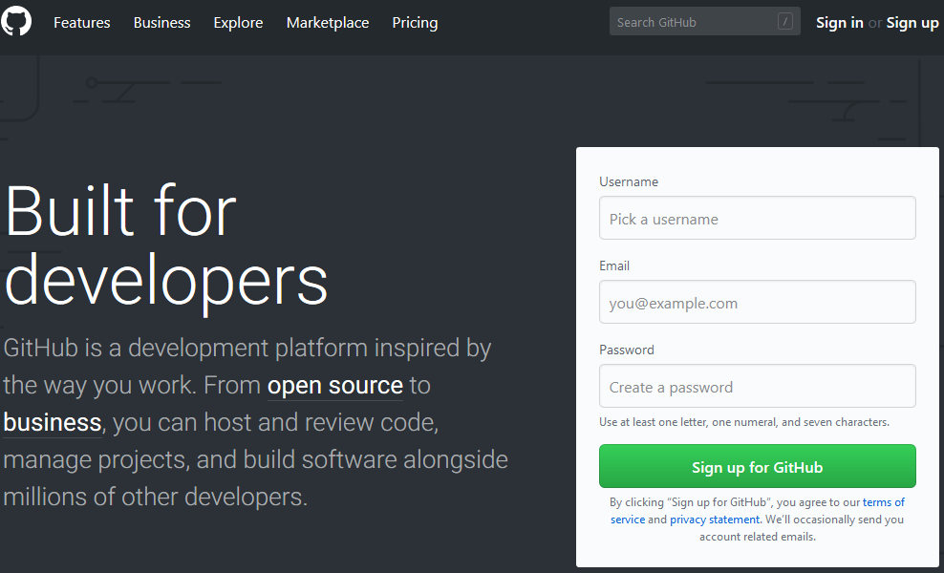
GITHUB ACCOUNT
Create GitHub account:
www.github.com
Free for public repositories

Slide 8
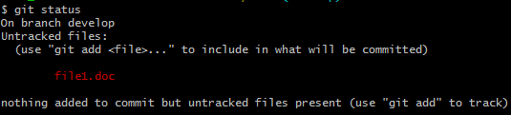
BASIC COMMANDS OF GIT
First-time git setup
Create a repository
Cloning a repository
Create a new branch and switch to it:
When you've made changes to some files or create new one, you can run ‘git status’ to see what will happen on commit. You'll notice a list of modified files, and a message:
Notes:
Connecting to GitHub with SSH
You can connect to GitHub using SSH.
Checking for existing SSH keys
Before you generate an SSH key, you can check to see if you have any existing SSH keys.
Generating a new SSH key and adding it to the ssh-agent
After you've checked for existing SSH keys, you can generate a new SSH key to use for authentication, then add it to the ssh-agent.
Generating a new SSH key
1. Open Git Bash.
2. Paste the text below, substituting in your GitHub email address.
ssh-keygen -t rsa -b 4096 -C "your_email@example.com"
This creates a new ssh key, using the provided email as a label.
Generating public/private rsa key pair.
3. When you're prompted to "Enter a file in which to save the key," press Enter. This accepts the default file location.
Enter a file in which to save the key (/c/Users/you/.ssh/id_rsa):[Press enter]
4. At the prompt, type a secure passphrase. For more informatio.Enter passphrase (empty for no passphrase): [Type a passphrase] Enter same passphrase again: [Type passphrase again]
Adding your SSH key to the ssh-agent
1. Ensure the ssh-agent is running:
If you are using the Git Shell that's installed with GitHub Desktop, the ssh-agent should be running.
If you are using another terminal prompt, such as Git for Windows, you can start it manually:
eval $(ssh-agent -s)
2. Add your SSH private key to the ssh-agent. If you created your key with a different name, or if you are adding an existing key that has a different name, replace id_rsa in the command with the name of your private key file.
ssh-add ~/.ssh/id_rsa
3. Adding a SSH key to your GitHub account
- clip < ~/.ssh/id_rsa.pub
in the upper-right corner of any page, click your profile photo, then click Settings
in the user settings sidebar, click SSH and GPG keys
click New SSH key or Add SSH key
in the "Title" field, add a descriptive label for the new key. For example, if you're using a personal Mac, you might call this key "Personal MacBook Air“
paste your key into the "Key" field
click Add SSH key
if prompted, confirm your GitHub password
Testing your SSH connection
Open Git Bash
Enter the following:
ssh -T git@github.com
3. You may see a warning like this:
The authenticity of host 'github.com (IP ADDRESS)' can't be established. RSA key fingerprint is 16:27:ac:a5:76:28:2d:36:63:1b:56:4d:eb:df:a6:48. Are you sure you want to continue connecting (yes/no)?
or like this:
The authenticity of host 'github.com (IP ADDRESS)' can't be established. RSA key fingerprint is SHA256:nThbg6kXUpJWGl7E1IGOCspRomTxdCARLviKw6E5SY8. Are you sure you want to continue connecting (yes/no)?
Verify that the fingerprint in the message you see matches one of the messages in step 2, then type yes:

Slide 9


BASIC COMMANDS OF GIT
After making changes to the working tree, and before running the commit command, you must use add command to add any new or modified files to the index.
To commit changes use command:
Push. This command transfers commits from your local repository to your remote repository.
Pull. The git pull command fetches changes from a remote repository to a local repository. It merges upstream changes in your local repository, which is a common task in Git based collaborations.

Slide 10
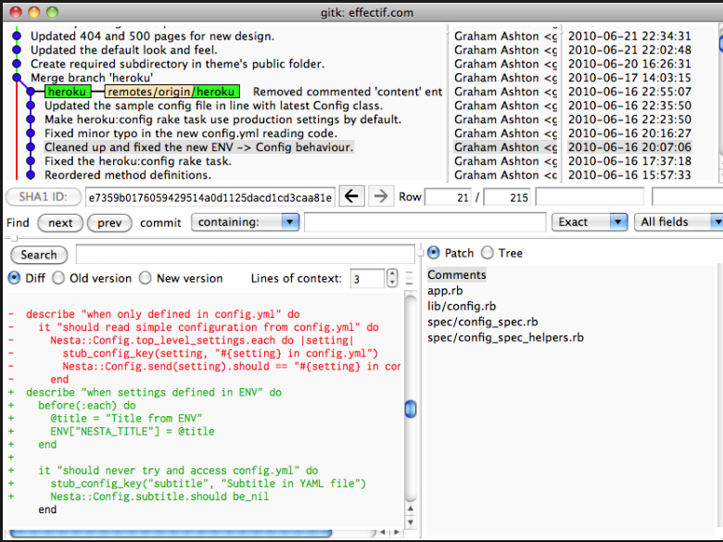
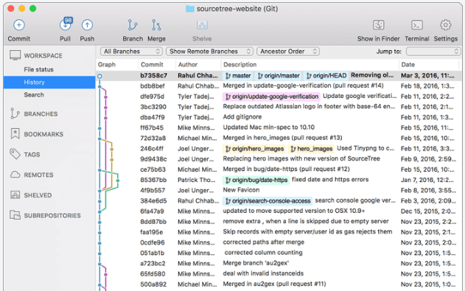
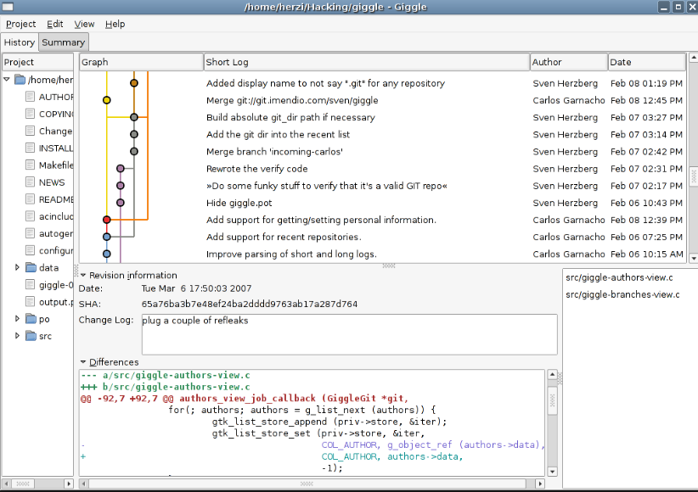
Git GUI
GUI for git:
Gitk
Sourcetree
Giggle
Git-Cola
Qgit
Gitg
TortoiseGit

Slide 11
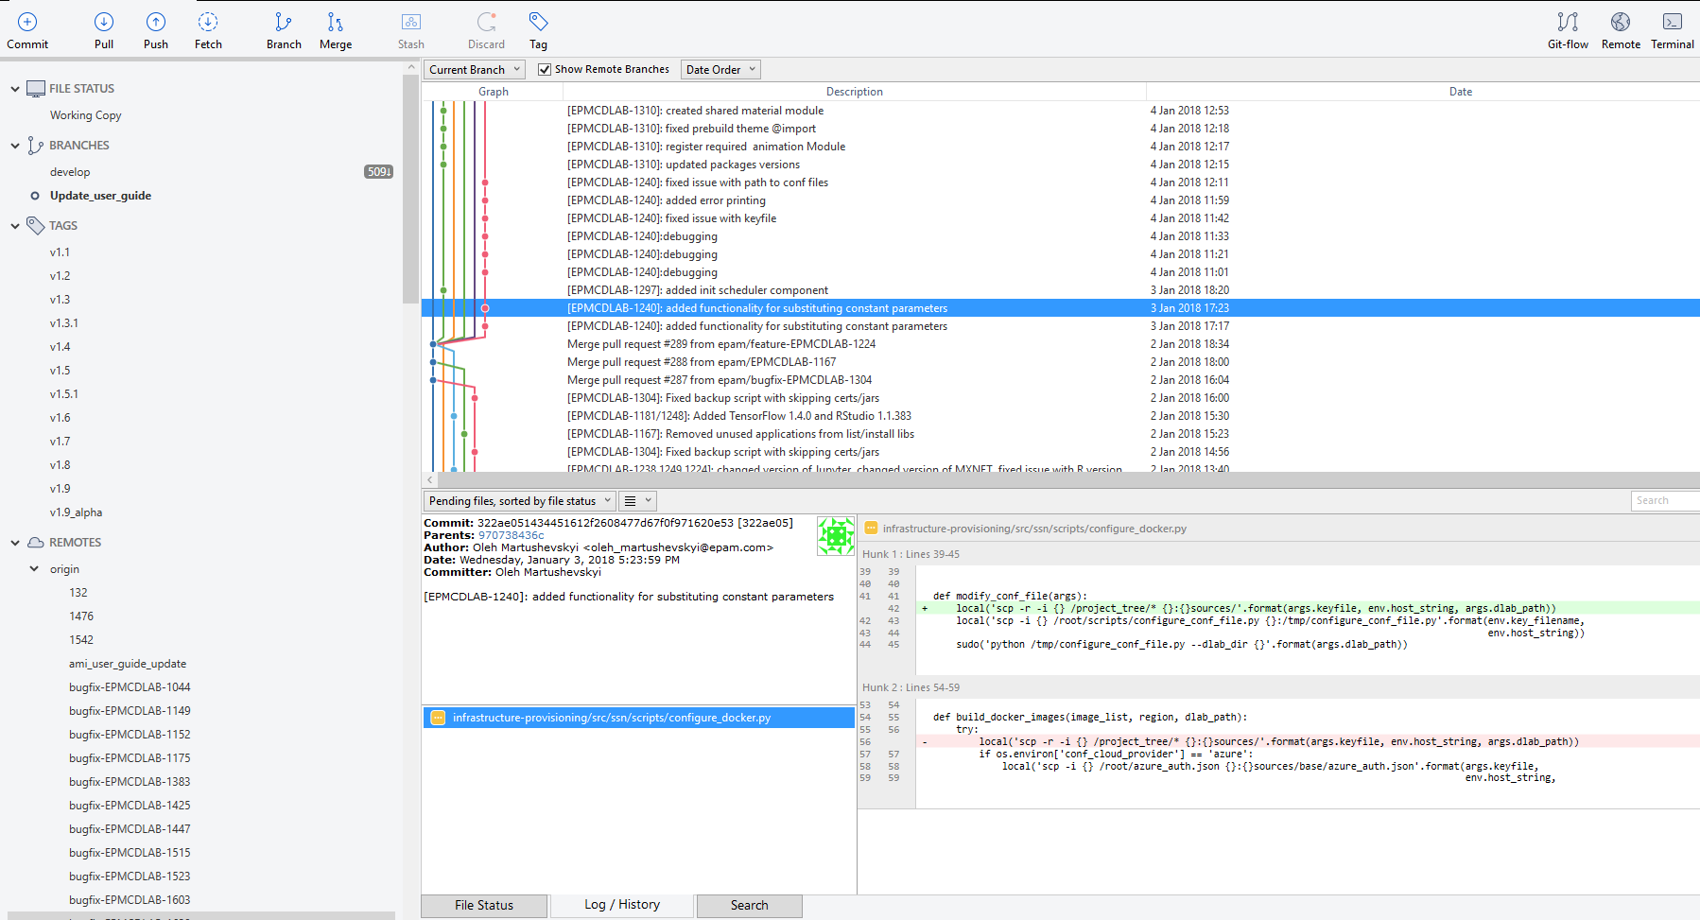
Git GUI

Slide 12
MERGE CONFLICT

Slide 13
GIT IN QA PRACTICE
Usefulness of using git for QA:
1
to do smoke/sanity testing in separate branch
2
to verify if new software version compatibilities with your products
3
to make minor changes by yourself via git if other members of team are busy by urgent tasks
4
increasing your value on labor market

Slide 14
REFERENCES
1
https://try.github.io/
2
https://git-scm.com/book/en/v2
3
https://medium.freecodecamp.org/follow-these-simple-rules-and-youll-become-a-git-and-github-master-e1045057468f
4
https://tutorialzine.com/2016/06/learn-git-in-30-minutes

Slide 15

THANK YOU!

