Slide 1



K. J. Somaiya Institute of Engineering & Information Technology, Mumbai
Department of Computer Engineering
Project Name: Religion in Politics
By
Devansh Agrahari (TY-A32)
Riddhi Aher (TY-A33)
Mahiya Ansari (TY-A34)
Mohammed Saad Ansari (TY-A35)
Shreenath Badwane (TY-A36)
Guide
Dr. Vrushali Deole
11/29/2021
Computer Engineering Department
‹#›

Slide 2

Flow of Presentation
Introduction to Topic
Influence of Religion on Society
Religion in the Modernist Era
Interference of Religion and Politics
Current Situation in India
Why Separate Religion from Politics
Countries with most Religious Freedom
Conclusion
Reference and Further Readings

Slide 3
Introduction
Within religious studies the common methodologies are:
Phenomenology
Functionalism
Lived Religion
Challenges to secular forces in Indian society:
Religion-based politics ideology
Mass mobilization
To capture power:
Religion - Mobilizes religious sensibilities of people
Politics - Uses diplomacy

Slide 4
Introduction
Religions
Often make strong claims on people’s allegiance
Universal Religions
Make these claims on all people, rather than just a particular community
Relation between religion and politics is an important theme in political philosophy.
Democratic theory
An emphasis to reference to all kinds of beliefs, much centered on religious beliefs.

Slide 5
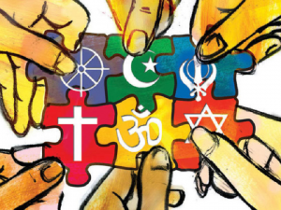
Influence of Religion on Society
The Contingency Theory:
Religion influences people’s -
Perception of the world
Sense of belonging
Values to accept or reject

Slide 6
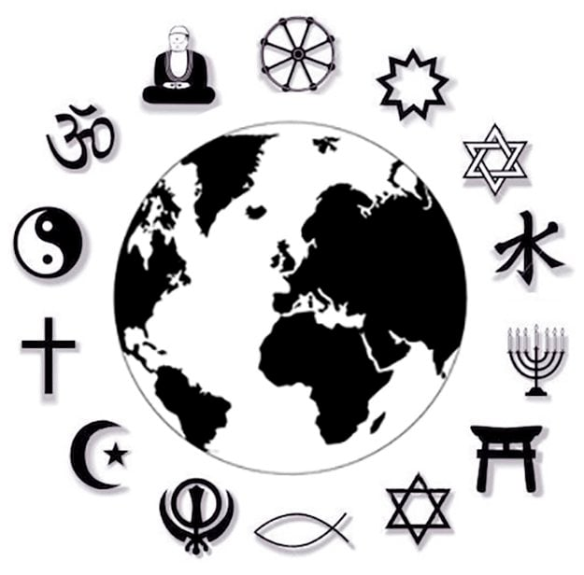
Religion in the Modernist Era
There remain three options for any religion:
Avoid and disapprove any change in its structure.
Adapt itself.
Fail to respond to the challenges and confine its activities to spirituality.

Slide 7
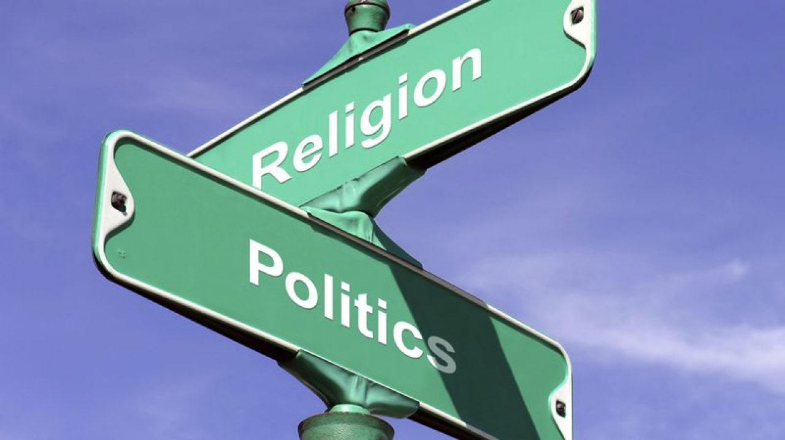
Interference of Religion and Politics
Models:
There are three models -
Integration and sharing
Religion subservient to politics
Rivals, struggle for domination

Slide 8
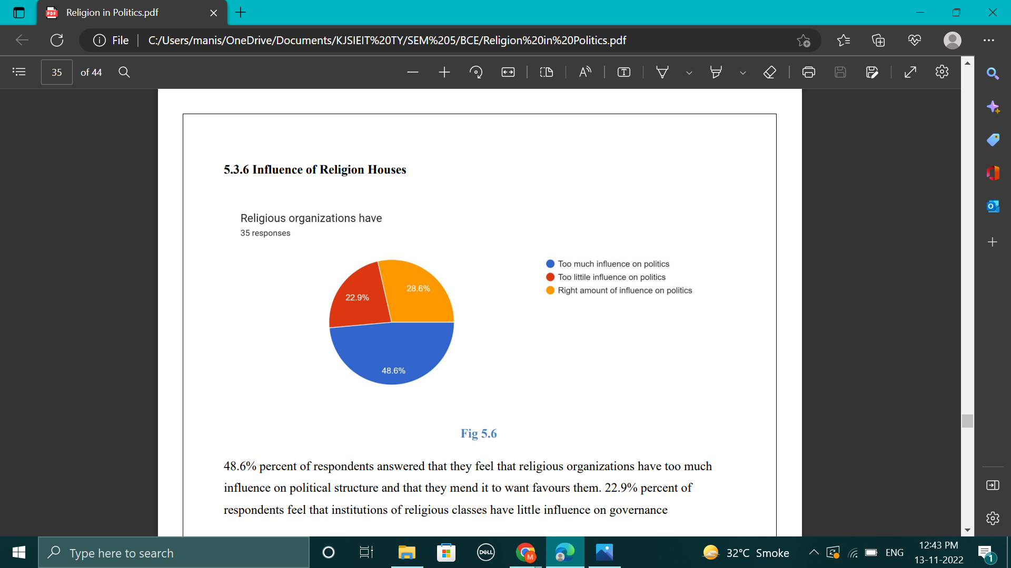
Influence of Religion on Politics - Poll

Slide 9
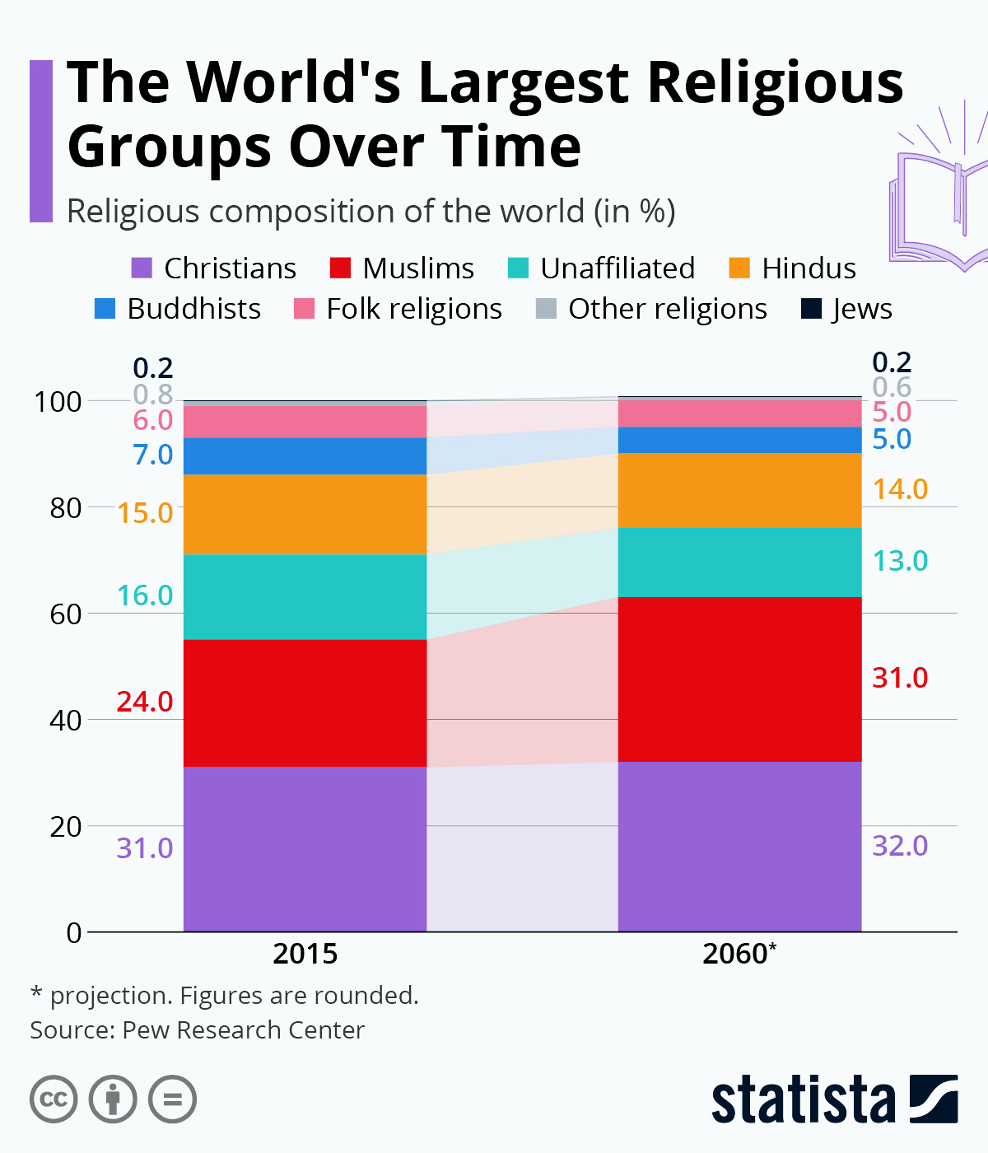
Religious Affiliation Statistics

Slide 10
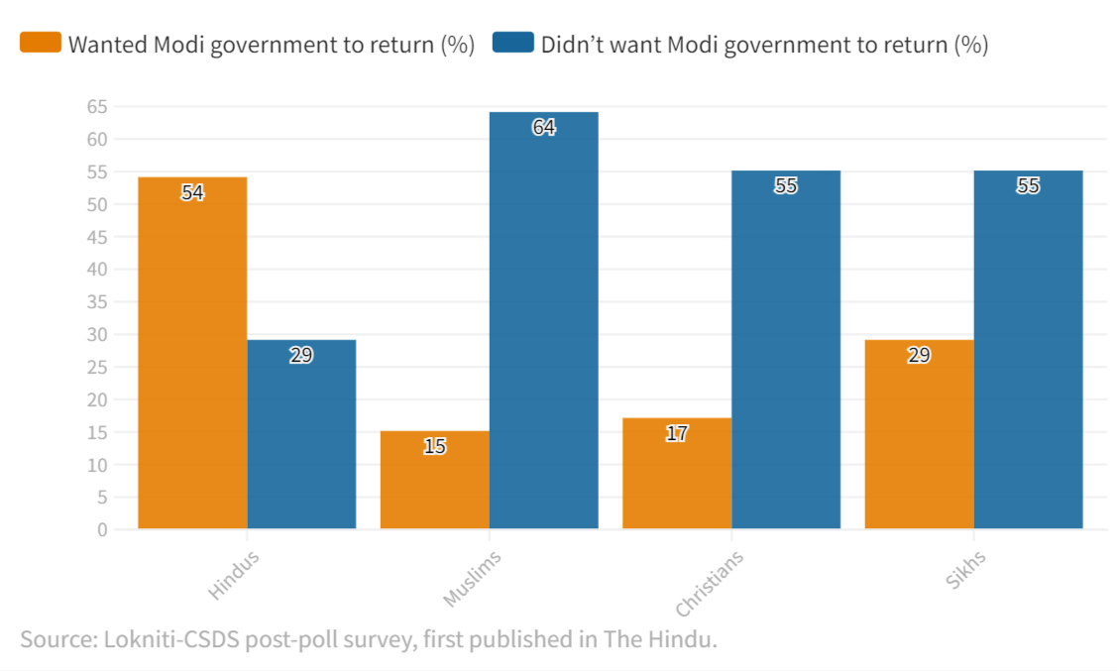
Modi Wave: Has Hindu mind been rigged?
Hindus and Minorities Sharply Divided on Modi's Popularity:
54% Hindus wanted Narendra Modi back as PM but 64% Muslims and 55% Sikhs and Christians did not want him back.

Slide 11
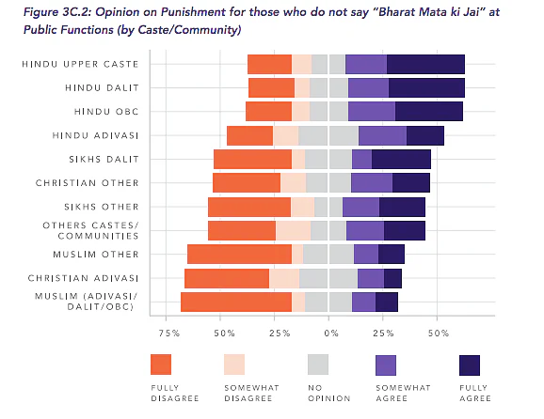
Modi Wave: Has Hindu mind been rigged?
Non-Adivasi Hindus are more likely to agree that people should be punished for not chanting ‘Bharat Mata Ki Jai’. Minorities think otherwise.

Slide 12
Why is BJP a Negative Entity for Muslims?
The 2002 anti-Muslim pogrom during Modi’s chief ministership in Gujarat.
Lynchings by Hindu activists in the name of protecting cows.
Hindu nationalist and anti-Muslim remarks in speeches and interviews.
“Shoot the Traitors”, discrimination against Muslims under India’s New Citizenship Policy
The hate crimes against Muslims in the last 7-8 years

Slide 13
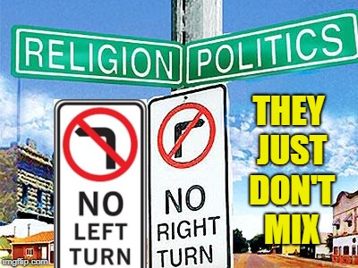
Why separate religion from politics?
To prevent domination of the majority religious group.
To avoid the violation of Fundamental Rights.
To avoid discrimination based on religion.
Every individual has the freedom to embrace other religions.

Slide 14










Countries with most Religious Freedom
Netherlands
Canada
United Kingdom
Australia
Norway
Sweden
Denmark
United States
Finland
New Zealand

Slide 15
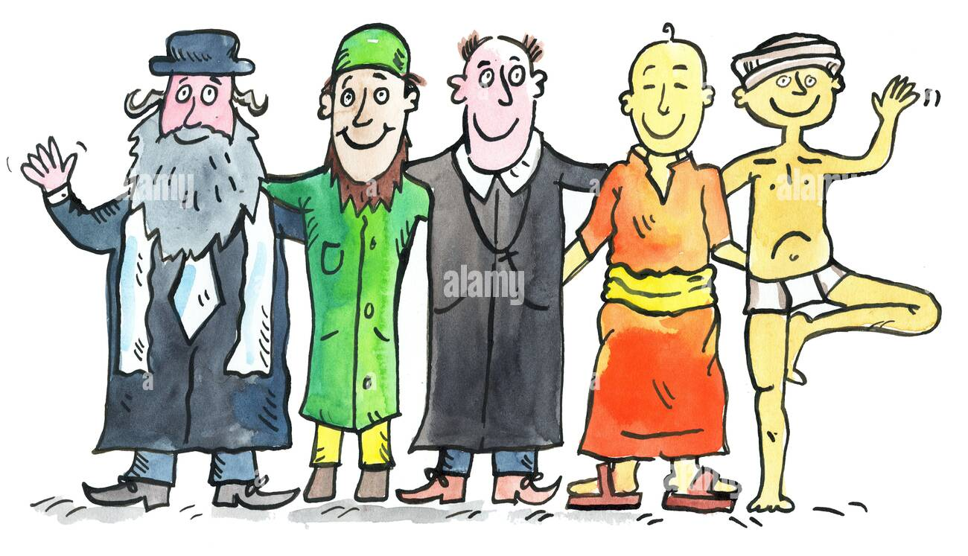
Conclusion
Secularism - Rapid economic development.
Religion - Still an important aspect of human life.
Politics - Faces inevitable interference of religion.

Slide 16
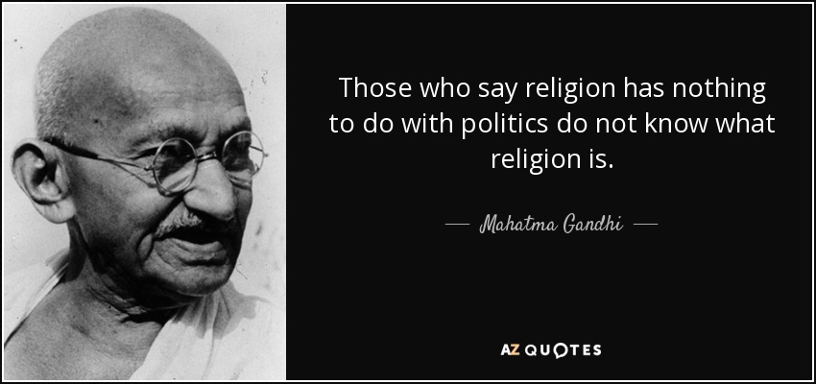
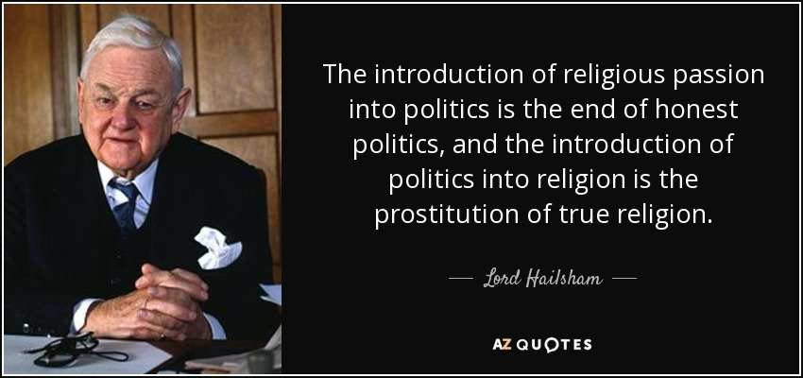
Conclusion

Slide 17
References and Further Readings
Journal and Papers:
More dialogue between approaches: Everyday religion and political religion. (2019). Political Religion, Everyday Religion: Sociological Trends, 55- 66. https://doi.org/10.1163/9789004397965_006
Rossi, E. (2017). Understanding religion, governing religion. Oxford Scholarship Online. https://doi.org/10.1093/oso/9780198794394.003.0005
Assoudeh, E. (2015). Between political religion and politicized religion: Interwar fascism and religion revisited. Religion Compass, 9(1), 13-33. https://doi.org/10.1111/rec3.12141
Newspaper Articles:
Miller, E. C. (2022, October 18). How religion became more conservative and society more secular: An interview with David Hollinger. Religion & Politics. https://religionandpolitics.org/2022/10/18/how-religion-became-more-conservative-and-society-more-secular-an-interview-with-david-hollinger/
Neelakantan, A. (2022, September 30). Mixing religion with politics and invoking ram’s name. Outlook India. https://www.outlookindia.com/national/mixing-religion-with-politics-and-invoking-ram-s-name-magazine-226592
Outlook Bureau. (2022, October 21). Religion always shapes political culture in liberal democracies. Outlook India. https://www.outlookindia.com/national/religion-always-shapes-political-culture-in-liberal-democracies-magazine-231464

Slide 18
Thank You

