Slide 1
Patient Management System for Hospitals
Object Oriented Software Engineering

Slide 2
Before Implementation
All work done by hand
Patient visits & medications recorded on paper
At the end of the day, all the records are sorted
Risk of loss of data due to human error & ignorance or due to accidents

Slide 3
After Implementation
All records are computerised
Regular backups minimise data loss due to failures
Comparatively lower maintenance
Data stored at a central location, allowing the patient to visit hospitals located elsewhere
Reduces stress on hospital staff

Slide 4
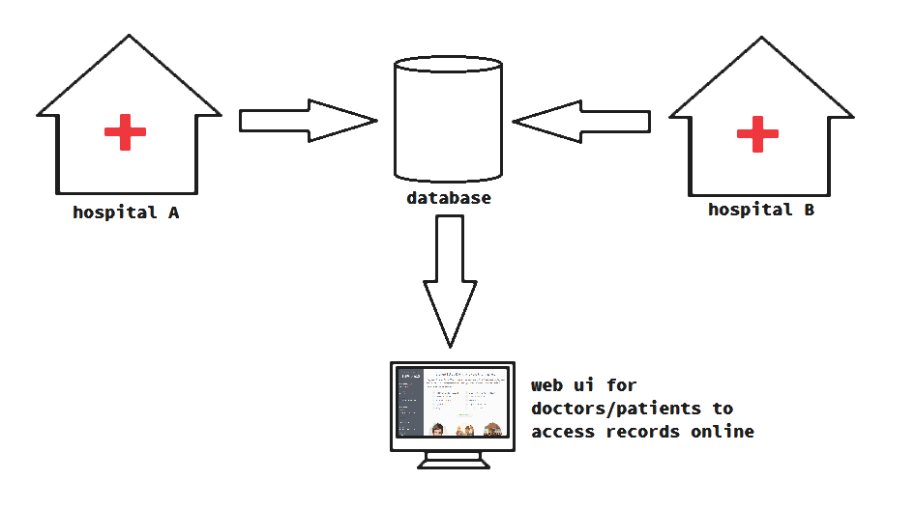

Slide 5
Features
Central database stores consolidated data
Graphical UI for doctors
Smart cards may be provided to the patients to serve as identity

