Slide 1
Patient Management System
For medical dispensaries

Slide 2
ANALysis
Determining what the product is to do

Slide 3
Product is supposed to:
Handle all the patient records
Automate systems so as to reduce manual efforts
Make regular backups
Generate reports and analyse data
Provide reasonable data security, redundancy and privacy

Slide 4
Product is supposed to:
Provide an easy & convenient way for new patients to register
Provide an easy to use User Interface for the staff members to use

Slide 5
Interface
Login
Doctor
Pharmacist
Clerk
Visit history
Current visit
Patient Mgmt.
Patient details
Queue Mgmt.

Slide 6
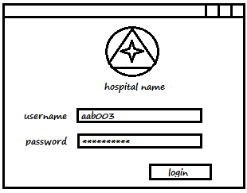
UI Mockups
Login Box

Slide 7
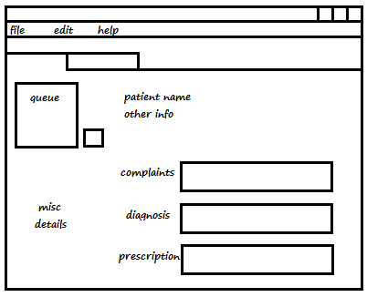
UI Mockups
Doctor Screen

Slide 8
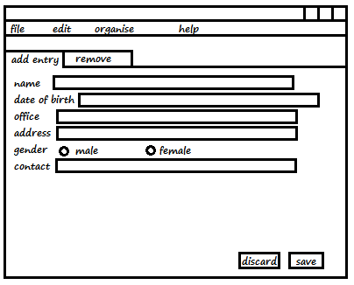
UI Mockups
New Patient Screen

Slide 9
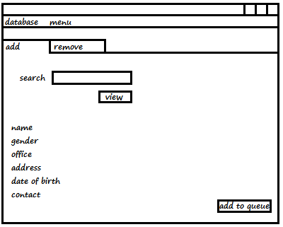
UI Mockups
Patient Details Screen

