Slide 1
Patient Management System
For medical dispensaries

Slide 2
Design phase

Slide 3
Underlying framework
Frontend
MS Visual Basic
MS ODBC driver
Backend
Oracle Database

Slide 4
Data Flow Diagram
query
database
patient identity
patient_queue
clerk
manage patient queue
save
changes,
medicine_info
patient_info,
medical_info
medicine_info
deliver prescribed drugs
add/update/delete patient_info, medical_info
pharmacist
doctor

Slide 5
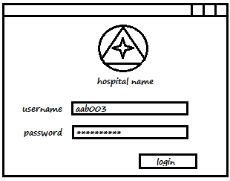
Frontend - UI
Login Screen

Slide 6
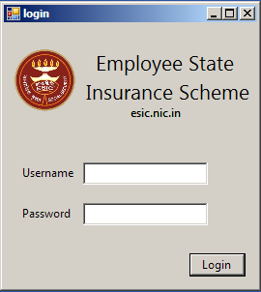
Login Screen

Slide 7
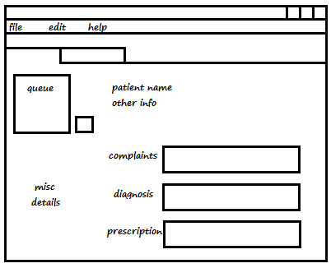
Doctor Screen

Slide 8
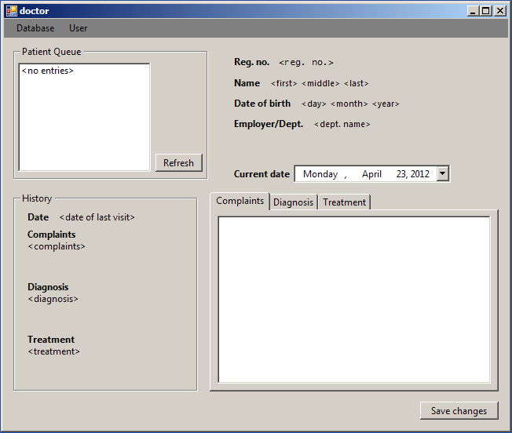
Doctor Screen

Slide 9
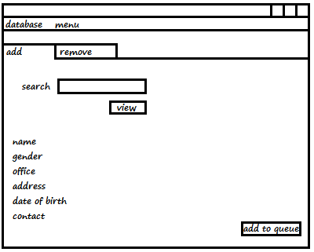
Clerk Screen

Slide 10
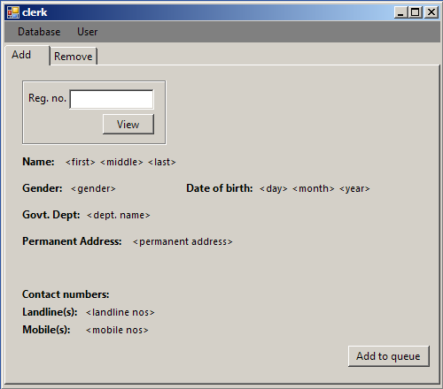
Clerk Screen

Slide 11
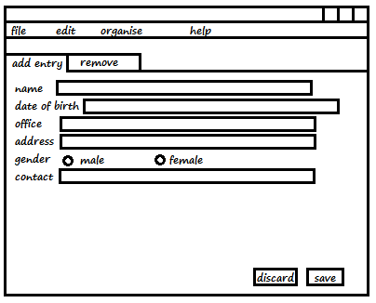
New Record Screen

Slide 12
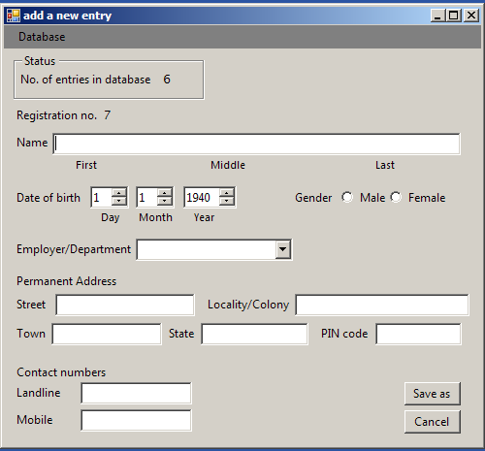
New Record Screen

Slide 13
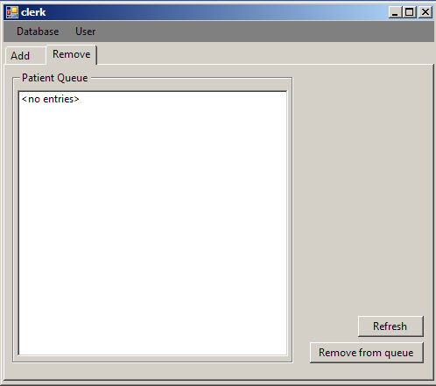
Clerk Screen

Slide 14
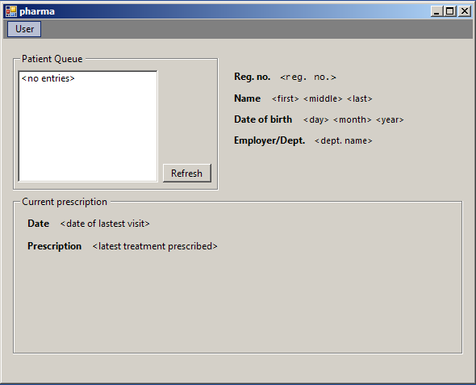
Pharmacist Screen

Slide 15
Backend - Database
login_table
username (char)
password (char)
usertype (int)

Slide 16
user_table
id (int) - street (char)
name (char) - locality (char)
dob (date) - town (char)
dept (char) - state (char)
gender (int) - pincode (int)
landline (int)
mobile (int)

Slide 17
health_table
id (int)
last_visit (date)
complaints (char)
diagnosis (char)
treatment (char)

Slide 18
queue_table
place (char)
id (int)

Slide 19
Software Project Management Plan
Initial Project Proposal 29 January
Requirements 19 Feb
Design 2 April
Implementation
16 April
Analysis 19 March
Deployment -
Postdelivery Maintenance
Retirement
Model followed: Waterfall Model
* under the assumption that requirements do not change

Slide 20
Conclusion
End of Design Phase
Frontend - UI design
Backend – Database design
Software Project Management Plan
Data Flow Diagram

